Slide 1

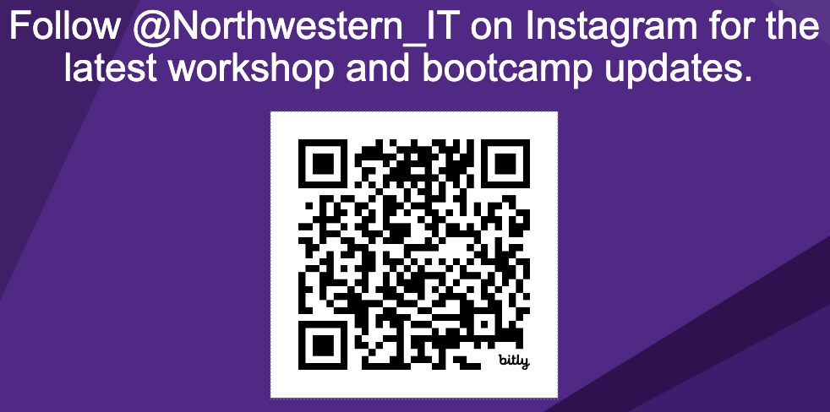
AI for Research
Workshop starts at 09:32
Materials for today:
https://github.com/nuitrcs/fine_tuning_workshop

Slide 2
Fine-Tuning LLMs for Text Analysis
Emilio Lehoucq

Slide 3
This workshop is brought to you by:
Northwestern IT Research Computing and Data Services
Need help?
AI, Machine Learning, Data Science
Statistics
Visualization
Collecting web data (scraping, APIs), text analysis, extracting information from text
Cleaning, transforming, reformatting, and wrangling data
Automating repetitive research tasks
Research reproducibility and replicability
Programming, computing, data management, etc.
R, Python, SQL, MATLAB, Stata, SPSS, SAS, etc.
Request a FREE consultation at bit.ly/rcdsconsult.

Slide 4
Collaborative project support
If you're a faculty (or postdoc, research staff, or graduate student with faculty sponsorship), we can provide longer-term support in your project.
We can help from exploration (is this idea possible?) to concrete outcomes (e.g., data collection, cleaning, analysis or visualization for a publication).
Find more information at bit.ly/collaborative_project_support

Slide 5
Bring Your Own Data (BYOD)
Do you have research data waiting to be collected, cleaned, analyzed or visualized? Come to BYOD.
BYOD is a weekly working group that provides structure, guidance, and accountability to help you make progress on your research project in a supportive and stress-free environment.
Find more information at bit.ly/byod_groups

Slide 6
Logistics
We'll stop for lunch for an hour around noon or 12:15.
We'll take 5-15 minutes breaks more or less every hour, hour and a half.
I'll start with some lecturing, then I'll demo some code, and afterwards it'll be your turn to work in groups. I'll be around to help you.
The instructions for the group work are in the README on GitHub: https://github.com/nuitrcs/fine_tuning_workshop

Slide 7
What’s next?
Tomorrow: Retrieval-Augmented Generation: Enhancing LLM Systems with Research Data

Slide 8
AI has an environmental impact 🌍
Carbon footprint due to energy consumption both during model training and usage.
Fresh water evaporated to cool servers.
E-waste containing hazardous substances generated with the production of hardware.
A query to ChatGPT consumes about 10 times more electricity than a Google search.💡
Generating images is even more energy intensive than generating text... generating just one image can take as much energy as fully charging a smartphone.📱
Notes:
Short overview: https://www.unep.org/news-and-stories/story/ai-has-environmental-problem-heres-what-world-can-do-about
2024 report by the International Energy Agency: https://iea.blob.core.windows.net/assets/6b2fd954-2017-408e-bf08-952fdd62118a/Electricity2024-Analysisandforecastto2026.pdf
MIT Technology Review article: https://www.technologyreview.com/2023/12/01/1084189/making-an-image-with-generative-ai-uses-as-much-energy-as-charging-your-phone/

Slide 9
Warning!
Google Colab sends your data to Google’s servers.
Don’t upload any information you wouldn’t publicly share!
This includes data, code, API keys, people’s names, etc. It is OK to use Google Colab for today’s workshop.

Slide 10
Fine-tuning in a research context

Slide 11
Example research project
Say you are in the school of communications.
You want to study whether newspapers in the United States have tended to cover the economy from a protectionist or anti-protectionist perspective over time and across different states.
Luckily, you got access to a dataset of tens of thousands of articles over the past 25 years.
Now you have to go through each of those tens of thousands of articles, read it, and categorize it. Does it adopt a protectionist or anti-protectionist perspective?
That's a lot to do! How can you do it?

Slide 12
Dictionary approach
One approach would be to create a dictionary with protectionist terms and anti-protectionist terms. You can then tokenize the news articles and count the prevalence of protectionist vs anti-protectionist terms.
This approach could be a reasonable starting place. You don't need to manually label data, it's easy to implement, and you know exactly what it's doing.
However, this approach doesn't account for how words are used (ambiguity, context, negation) and may miss relevant words.
So, what else could you do?

Slide 13
RAs or training a model from scratch
Well, if you have enough money and patience, hire a bunch of research assistants!
Also, if you are familiar with machine learning, you can manually label a lot of news articles (or hire someone else to do it) and train a classifier. This is certainly a possible approach – but you'll likely need a lot of data.
What else could you do?

Slide 14
ChatGPT et al
You can use one of the models like those behind ChatGPT, feed them one article at the time, and ask them to classify it into protectionist vs anti-protectionist.
That's a reasonable approach. And you should probably try it with a sample of articles to see how well it works.
However, while you can ask models like the ones behind ChatGPT to classify news articles, that's not the specific task that they are trained for. You can get a smaller, specialized model to do it more efficiently.
Also, using a model like those behind ChatGPT may cost you money.
Finally, using models like those behind ChatGPT poses issues with reproducibility and replicability.

Slide 15
Fine-tuning to the rescue!
Surprise, surprise, you can also try fine-tuning a model! What does this mean?
There are people with more machine learning expertise and money than you (no offense) that have trained machine learning models from scratch and uploaded them to the internet–for free!
You can take one of those free models from the internet and adapt it for your research project.
Don't get me wrong—you'll still have to manually label some articles, but less than for training a model from scratch.

Slide 16
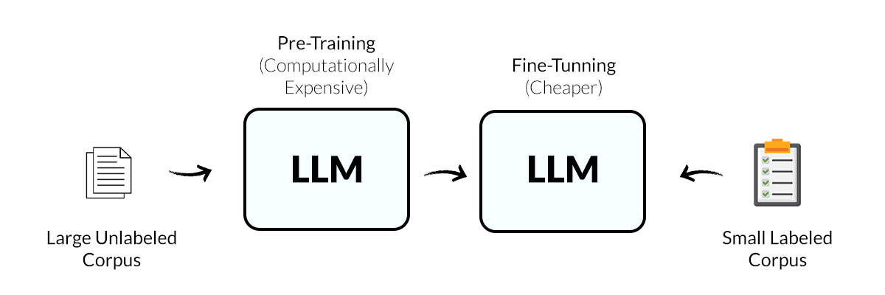
What is fine-tuning (at a high level)
Fine-tuning consists of taking an existing model (a "pretrained model") and adapting it for your task.
Notes:
Image from: https://www.anolytics.ai/blog/fine-tuning-and-its-transformative-impact-on-llms-output/

Slide 17
Disclaimers
Today we're focusing on fine-tuning a specific type of models for text classification.
Even then, this workshop could be a whole course. While we don't have time to cover everything in detail, there are appendix slides with more detail.
This is a practical, not a theoretical workshop.
There are aspects that need to be considered on a case-by-case basis.
Ambiguous [terms] are bracketed and in italics, signaling that there is more detail in the appendix slides.
You're always welcome to submit a free consult request with us at bit.ly/rcdsconsult

Slide 18
Real-life example of fine-tuning in research
Erhard et al (2025) fine-tuned GBERT_{Large} to detect and quantify left-wing and right-wing and anti-elitist and people-centric instances of populist discourse in Germany.
This allows them to analyze the prevalence of populist language in the German Bundestag and its breakdown across political parties.
More generally, the fine-tuned model can help to identify rhetorical patterns, contextual factors, or temporal dynamics underlying populist language and to examine how populists frame their messages and which social, economic, or cultural issues they emphasize.

Slide 19
Summary: why learn about fine-tuning
Adapting a pretrained model for your task requires [less] training data than training a model from scratch.
You can get pretty accurate labels even if you don't have the money to annotate [large amounts] of data or are interested in specific domains in which only small corpora exist.
It's a competitive alternative to [gigantic] models such as the ones behind ChatGPT at a lower cost and with more reliability and reproducibility.

Slide 20
Overview of fine-tuning for research

Slide 21
How does fine-tuning work
Adding a layer to the pretrained model and updating all the parameters.
Predicted class
New classification layer
Pretrained model
Updating
Input text

Slide 22
Checklist for fine-tuning a model
Consider possible approaches for your project and assess whether fine-tuning is [appropriate].
Consider the software and hardware required.
Manually label an [appropriate] number of texts. Divide the data, at least, into a training set and a test set.
Select [appropriate] models to fine-tune.
Consider the [appropriate] performance metrics.
Fine-tune the models, using a [reasonable] range of hyperparameters.
Assess the performance of the fine-tuned models on the test set and compare it against alternative approaches.
Check for biases that could affect your project or cause harm.
Store the selected model for future use.

Slide 23
Key decisions when fine-tuning a model
How much manually labeled data to use and whether to under/oversample.
What model to use.
Whether to use CPUs or GPUs.
What performance metrics to use.
What hyperparameters to explore, particularly the maximum input length, number of epochs, batch size, learning rate, and weight decay.
How to explore hyperparameters (e.g., train/validation/test approach).

Slide 24
How to know if you "correctly" fine-tuned a model
Estimate the performance of the fine-tuned model on a hold-out dataset using [appropriate] metrics.
Check for biases that could affect your project or cause harm. Check whether false classifications correlate with relevant features of the text or task.
Compare the performance of the fine-tuned model with alternative approaches (classical machine learning models trained from scratch and zero-shot and few-shot learning using a decoder-only model).

Slide 25
Fine-tuning for research demo

Slide 26
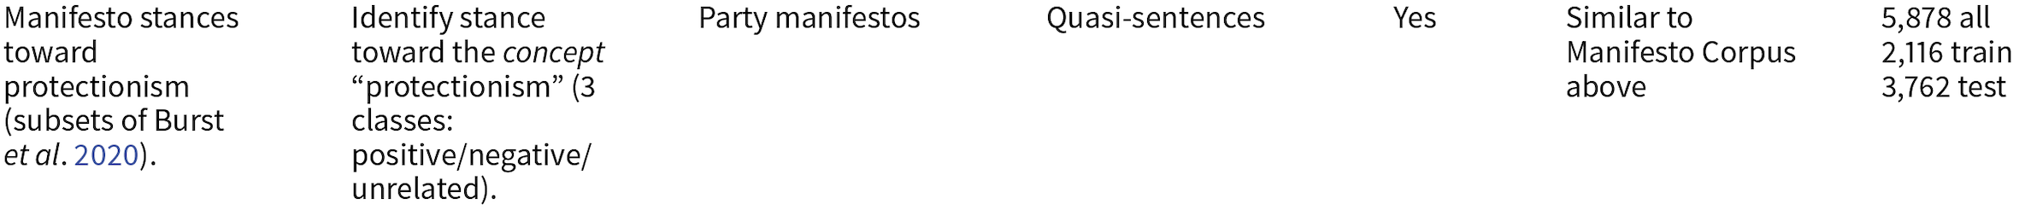
Data and research question
Dataset from Laurer, M., van Atteveldt, W., Casas, A. & Welbers,K. (2024). Less Annotating, More Classifying: Addressing the DataScarcity Issue of Supervised Machine Learning with Deep Transfer Learning and BERT-NLI. Political Analysis, 32, 84 – 100.
https://github.com/MoritzLaurer/less-annotating-with-bert-nli
Research question: in which country is protectionist political speech more prevalent?
Machine learning task: classify documents into protectionist or not.

Slide 27
Hardware
For fine-tuning, it is useful to have access to GPUs, which can more efficiently handle complex mathematical operations in parallel.
For your research, you can use GPUs on Quest: https://services.northwestern.edu/TDClient/30/Portal/KB/ArticleDet?ID=1112
Today we're using Google Colab: https://colab.research.google.com/
In the top bar, click on "Runtime" > click on "Change runtime type" > select "CPU" or "T4 GPU".
It's unclear how much GPU access Google Colab provides. Close your Google Colab tabs when you're done with your work and avoid opting for GPUs when you don't need it.
Notes:
GPUs on Google Colab: https://research.google.com/colaboratory/faq.html
Number of CPUs on Google Colab and parallelizing acros CPUs:
https://saturncloud.io/blog/whats-the-hardware-spec-for-google-colaboratory/
https://colab.research.google.com/drive/1foUVwuP6-6OPz9mjy70gEYqeR7qLWyNS?usp=sharing

Slide 28
Software
Transformers library: https://huggingface.co/docs/transformers/en/index
Models for today:
https://huggingface.co/google-bert/bert-base-uncased
https://huggingface.co/distilbert/distilbert-base-uncased
https://huggingface.co/FacebookAI/roberta-base
https://huggingface.co/distilbert/distilroberta-base

Slide 29
Code
https://github.com/nuitrcs/fine_tuning_workshop/blob/main/fine_tuning_demo.ipynb
https://colab.research.google.com/github/nuitrcs/fine_tuning_workshop/blob/main/fine_tuning_demo.ipynb

Slide 30
Your turn to fine-tune

Slide 31
Logistics for the rest of the day (approximate)
~11:30 (10 mins): Form groups of 3-4 people.
~11:40 (20 mins): Decide on a dataset and a question.
~12:00 (15 mins): Test that you can use the tools for today.
~12:15 (60 mins): Lunch break
~1:15 (60 mins): Fine-tune and answer your question.
~2:15 (60 mins): Present your dataset, question, fine-tuning strategy, results, and any challenges/lessons.
~3:15 (15 mins): Questions, recap, and next steps to continue learning.
We may finish early, but I'll be here until 4pm for questions. We can also go through some of the appendix slides if time permits.

Slide 32
Datasets for you to fine-tune a model
Datasets from Laurer, M., van Atteveldt, W., Casas, A. & Welbers, K. (2024). Less Annotating, More Classifying: Addressing the Data Scarcity Issue of Supervised Machine Learning with Deep Transfer Learning and BERT-NLI. Political Analysis, 32, 84 – 100.
https://github.com/MoritzLaurer/less-annotating-with-bert-nli

Slide 33
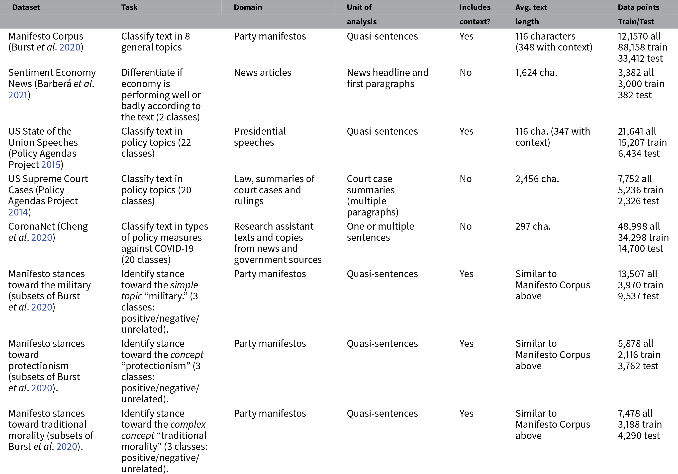

Slide 34
Conclusion

Slide 35
What we covered
What is fine-tuning, how it works, and how it can help your research.
How to fine-tune encoder-only models for text classification, including the steps that you need to go through, the key decisions involved, and how to know if you "correctly" fine-tuned a model.
While today we used Google Colab, you can use Quest (including GPUs) for your research.

Slide 36
Next steps to continue learning
Read the references available in the next slide to learn in more detail how fine-tuning works and find more examples of published research using fine-tuning.
Fine-tune a model for your own project, with your own data.

Slide 37
References
URLs in notes.
Bonikowski, B., Luo, Y. & Stuhler, O. (2022). Politics as Usual? Measuring Populism, Nationalism, and Authoritarianism in U.S. Presidential Campaigns (1952 – 2020) with Neural Language Models. Sociological Methods & Research, 51(4), 1721 – 1787.
Chae, Y. & Davidson, T. (2025). Large Lanugage Models for Text Classification: From Zero-Shot Learning to Fine-Tuning. Sociological Methods & Research.
Do, S., Ollion, E. & Shen, R. (2024). The Augmented Social Scientist: Using Sequential Transfer Learning to Annotate Millions of Texts with Human-Level Accuracy. Sociological Methods & Research, 53(3), 1167 – 1200.
Erhard, L., Hanke, S., Remer, U., Falenska, A. & Heiberger, R.H. (2025). PopBERT. Detecting Populism and Its Host Ideologies in the German Bundestag. Political Analysis, 33, 1 – 17.
Laurer, M., van Atteveldt, W., Casas, A. & Welbers, K. (2024). Less Annotating, More Classifying: Addressing the Data Scarcity Issue of Supervised Machine Learning with Deep Transfer Learning and BERT-NLI. Political Analysis, 32, 84 – 100.
Wang, Y. (2023). Topic Classification for Political Texts with Pretrained Language Models. Political Analysis, 31, 662 – 668.
Wankmüller, S. (2024). Introduction to Neural Transfer Learning With Transformers for Social Science Text Analysis. Sociological Methods & Research, 53(4), 1676 – 1752.

Slide 38
Thanks!
Need help with data?
Request a FREE consultation at bit.ly/rcdsconsult.
emilio@northwestern.edu

Slide 39
Appendix

Slide 40
Machine learning review

Slide 41
Neural networks

Slide 42
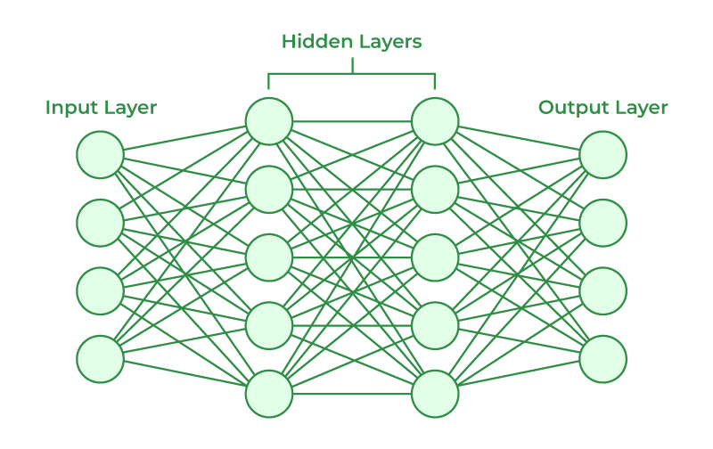
Neural networks
Notes:
https://www.geeksforgeeks.org/artificial-intelligence/artificial-neural-networks-and-its-applications/

Slide 43
Weights and biases
Weights are numerical values assigned to the connections between neurons. They determine how much influence each input has on the final output. Inputs are multiplied by their weights before being passed through the activation function.
Biases are parameters that shift the activation function. They help neurons activate even when the weighted sum of inputs is not enough, making the network more flexible.
Notes:
https://www.geeksforgeeks.org/deep-learning/the-role-of-weights-and-bias-in-neural-networks/

Slide 44
Loss function
A loss function is a function that quantifies the error between a model's prediction and the actual target value.
Notes:
https://www.datacamp.com/tutorial/loss-function-in-machine-learning

Slide 45
Batches and epochs
In deep learning, the training dataset is often divided into smaller subsets known as batches. The model processes each batch sequentially during an epoch, making adjustments to its parameters after each batch.
An epoch represents one complete pass through the entire training dataset. It ensures that every data sample is used to update the model's parameters.
After each epoch, the model's performance is evaluated on a validation dataset to track progress.
Generally, increasing the number of epochs enhances model performance by allowing to capture more intricate patterns in the data. However, too many epochs can lead to overfitting.
The number of batches in an epoch is determined by the batch size.
Notes:
https://www.geeksforgeeks.org/epoch-in-machine-learning/

Slide 46
Backpropagation
Backpropagation is a method used to train neural networks. It works iteratively to adjust weights and biases to minimize the loss function. In each epoch, the model adapts the parameters, reducing the loss. It uses optimization algorithms such as gradient descent or stochastic gradient descent.

Slide 47
Learning rate
Learning rate is a hyperparameter that controls how much to change the model in response to the estimated error each time the model weights are updated.
A well-calibrated learning rate balances convergence speed and solution quality. If set too low, the model converges slowly. If set too high, it can cause the model to overshoot optimal weights.
Notes:
https://www.geeksforgeeks.org/impact-of-learning-rate-on-a-model/
https://www.datacamp.com/tutorial/loss-function-in-machine-learning

Slide 48
Weight decay
Weight decay is a regularization method that penalizes large weights in the model by adding a term to the loss function. It is important to find the right balance between preventing overfitting and optimizing model performance. A small weight decay can let the weights grow large and overfit the data. A large weight decay forces the weight to remain small and can lead to underfitting.
Notes:
https://www.geeksforgeeks.org/dropout-vs-weight-decay/

Slide 49
Performance metrics

Slide 50
Accuracy
Accuracy is the proportion of correct classifications. Its disadvantage is that it overestimates the performance of classifiers overpredicting majority classes and neglecting minority classes.
Balanced accuracy calculates accuracy for each class separately and then takes the average of each per-class accuracy score. It gives equal weight to all classes independently of their size and is a more suitable metric if all classes have similar substantive value. Tends to be higher for classifiers with less false negatives but does not properly account for false positives. Favors classifiers that predict many minority classes well but perform less well on a few majority classes.

Slide 51
Precision, recall, and F1 score
Precision is the proportion of all positive classifications that are actually positive = true positives / (true positives + false positives).
Recall is the proportion of all actual positives that were classified correctly as positives = true positives / (true positives + false negatives).
Precision captures how accurately a classifier detects a particular class, whereas recall measures how many relevant examples were detected.
F1 score is the harmonic mean of precision and recall = 2 * ([precision * recall] / [precision + recall]).
A weighted F1 score can be obtained by taking a weighted average over each class.
Gives equal weight to all classes independently of their size. Its main disadvantage is that it is harder to interpret than accuracy. It's often the most appropriate metric in the social sciences, when data tend to be imbalanced.
Notes:
https://developers.google.com/machine-learning/crash-course/classification/accuracy-precision-recall

Slide 52
Hyperparameter tuning

Slide 53
How to explore hyperparameters
Hyperparameter tuning is the process of selecting the optimal values for a machine learning model's hyperparameters.
Grid search works by fitting the model using all possible combinations of predefined hyperparameter values. This can be slow and computationally intensive.
Random search selects values at random as opposed to the predetermined set of values used in grid search. This can reduce unnecessary computation and explore a wider range of hyperparameters in fewer iterations. Although not exhaustive, it can be more efficient, particularly with a large hyperparameter space.
Bayesian optimization uses a probabilistic model that considers past evaluation results to select the next set of hyperparameters.
Notes:
https://www.geeksforgeeks.org/hyperparameter-tuning/

Slide 54
Train/validation/test split
The train/validation/test split approach is a method to train and evaluate a model so that it generalizes to new data.
The training set is used to fit the parameters of the model (e.g., set the weights and biases using backpropagation).
The validation set is used to evaluate the model during the process of hyperparameter tuning (e.g., deciding the learning rate).
The test set is used to evaluate the final model.
Notes:
https://en.wikipedia.org/wiki/Training,_validation,_and_test_data_sets

Slide 55
K-fold cross-validation
Similarly to the train/validation/test split approach, k-fold cross-validation is a method to train and evaluate a model so that it generalizes to new data.
K-fold cross-validation consists of splitting the data into k folds, training the model on k-1 folds and validating it in the remaining fold. This process is repeated k times and the results from each validation are averaged.
It is still advisable to split the whole data set into a training set and a test set, conducting k-fold cross-validation in the training set and using the test set to evaluate the final model.
Notes:
https://www.geeksforgeeks.org/machine-learning/cross-validation-machine-learning/

Slide 56
NLP

Slide 57
The Transformer
The Transformer is a deep learning architecture that is based on attention mechanisms.
Attention mechanisms learn a token representation by capturing information from other tokens and thereby encode textual dependencies and context-dependent meanings.
The original Transformer included both encoders and decoders.
An encoder transforms input text into a representation and a decoder conducts the reverse operation: it produces text from an encoded representation.

Slide 58
Autoencoding models
In the pretraining task, autoencoding models are presented with input sequences that are altered at some positions. The task is to correctly predict the uncorrupted sequence.
The models' architecture is typically composed of the encoders of the Transformer.
Autoencoding models can access the entire set of input sequence tokens and can learn bidirectional token representations.
Autoencoding models tend to be especially high performing in sequence or token classification target tasks.

Slide 59
BERT
Autoencoding model that consists of a stack of Transformer encoders and comes in two different sizes: BERT_{BASE} and BERT_{LARGE}.
For pretraining, BERT used the BooksCorpus and English Wikipedia.
BERT uses a variant of the traditional language modeling pretraining task called masked language modeling to learn representations that are bidirectional. In addition, BERT is also pretrained on a next sentences prediction task in which the model has to predict whether the second of two text segments it is presented with succeeds the first.
For fine-tuning, the output layer from pretraining is exchanged with an output layer tailored for the target task. However, all parameters of BERT are updated.

Slide 60
Input for BERT
BERT takes as an input a sequence of embedded tokens.
Each sequence of tokens is set to start with the classification token "[CLS]". After fine-tuning, the "[CLS]" token functions as an aggregate representation of the entire sequence and is used as an input for single sequence classification target tasks.
The separation token "[SEP]" is used to separate different segments.
In software implementations, BERT-like models typically require all input sequences to have the same length. Text sequences are truncated if sequences exceed the maximin length and padded with a padding token ("[PAD]") until the desired length is reached. Due to memory restrictions, the maximum sequence length that BERT can process is limited to 512 tokens.

Slide 61
Dealing with long inputs
One approach is to keep the first, e.g., 128 tokens and the last, e.g., 382 tokens and remove the tokens in the middle. Of course, this depends on your data and project.
Models such as the Longformer and ModernBERT can handle longer inputs.

Slide 62
Extensions of BERT
BERT demonstrated the power of fine-tuning. Various extensions of BERT have been developed since its introduction.
RoBERTa makes changes in the pretraining and hyperparameter settings of BERT. For instance, RoBERTa is only pretrained on the masked language modeling and not the next sentence prediction task. Also, RoBERTa is trained on more data and more heterogeneous data (CommonCrawl, OpenWebText).
Longformer introduces a new variant of the attention mechanism that allows for longer texts to be processed, i.e., up to 4,096 tokens.
Other models such as SentenceBERT (SBERT), ModernBERT, and DeBERTa introduce further innovations that may be useful for some cases.
Models such as CamemBERT (French) and GBERT (German) are useful for research in other languages.

Slide 63
Autoregressive models
Autoregressive models (such as GPT and its successors) are pretrained on the classical language modeling task and their architecture is typically based only on the decoders of the Transformer. As a result, they are typically very good at target tasks in which they have to generate text. However, autoregressive models can be fine-tuned to a large variety of downstream tasks.

Slide 64
Sequence-to-sequence models
The architecture of sequence-to-sequence models contains Transformer encoders and decoders.
They tend to be pretrained on sequence-to-sequence tasks such as translation and are especially suited for sequence-to-sequence tasks such as translation or summarization.
Some examples of sequence-to-sequence models include the original Transformer, BART, and the T5.

Slide 65
How to classify text

Slide 66
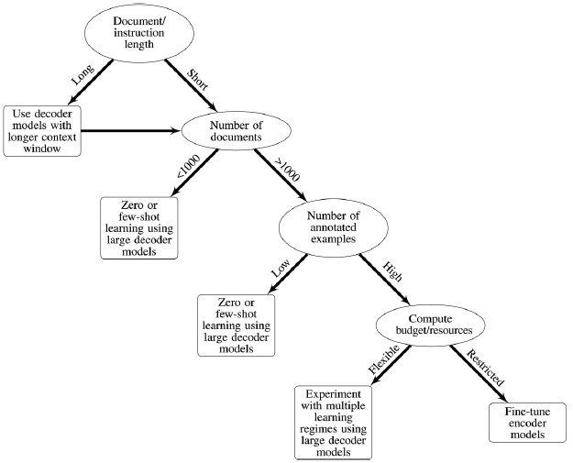
Chae & Davidson (2025)

Slide 67
Fine-tuning

Slide 68
Encoder-only models (focus for this workshop)

Slide 69
Pretraining
Fine-tuning requires a pretrained model.
Language modeling is a common pretraining task. A language model models the probability for a sequence of tokens, which involves predicting the conditional probability of a token given all its preceding tokens (forward) or all its succeeding tokens (backward).
When being trained on a language modeling task in pretraining, a model learns general structures and aspects of language, such as long-range dependencies, compositional structures, semantics, and sentiment, that are relevant for a wide spectrum of possible target tasks.

Slide 70
How does fine-tuning work (in more detail)
Adding a layer known as a classification head to the pretrained model.
The classification head has randomly initialized weights. It consists of a fully connected layer that outputs a logit for each label and a softmax activation function that converts the logits into probabilities that sum to one.
As the training examples are passed through the network, both the existing parameters and those in the classification head are updated through backpropagation to minimize the loss function.
Once trained, the test data are input into the fine-tuned model, which then outputs probabilities for each class.

Slide 71
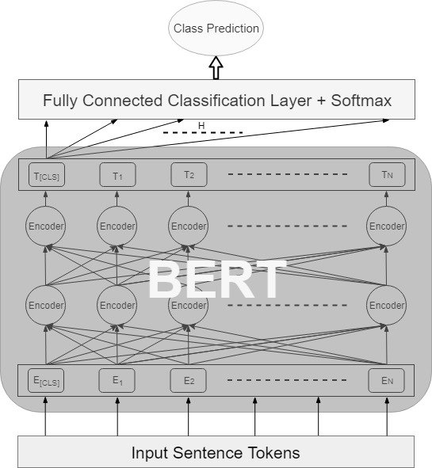
How does fine-tuning work (more detailed figure)
Notes:
Image from: https://www.researchgate.net/figure/BERT-Fine-Tuning-Model-Architecture_fig4_334770935

Slide 72
Text embeddings (ML review for fine-tuning)
Real-valued K-dimensional vector representations of text. Frequently, the embedded entities are unique vocabulary terms. Yet embeddings can also be learned for smaller or larger textual units such as characters, subwords, sentences, or documents.
The positioning of the embedding vectors within the K-dimensional spaces reflects the information that the embeddings encode about the text (e.g., semantics).

Slide 73
Fully connected layer, softmax, and cross-entropy (ML review for fine-tuning)
Fully connected layers (or dense layers) are those where each neuron in one layer is connected to every neuron in the preceding layer.
Softmax is an activation function commonly used in neural networks for classification problems. An activation function is a function that is applied to the output of a neuron to introduce non-linearity. The softmax function converts a vector of logits into probabilities distributed across different classes such that their sum equals to 1.
Cross-entropy loss (or log loss) is a metric used to measure the performance of a classification model. Since each sample can belong to only a particular class, the true probability value would be 1 for that class and 0 for the other(s). Cross entropy measures the difference between the predicted probability and the true probability and thus ranges between 0 and 1.
Notes:
https://www.geeksforgeeks.org/what-is-fully-connected-layer-in-deep-learning/
https://www.geeksforgeeks.org/machine-learning/activation-functions-neural-networks/
https://www.geeksforgeeks.org/the-role-of-softmax-in-neural-networks-detailed-explanation-and-applications/
https://www.geeksforgeeks.org/what-is-cross-entropy-loss-function/

Slide 74
Considerations to select an encoder-only model to fine-tune
Read the literature to find what models are used for your problem and in your field.
Consider how different models perform on benchmarks relevant to your problem.
Read literature about the model(s).
Consider the context window of the model and the length of the input that you want to provide.
Consider what the model was trained for.
Consider the training data for the model and whether it's suitable for your problem (e.g., what type of data, diversity of data, possible biases in the data, time-period of the data, formality of the data, language of the data).
Assess hardware available vs. hardware needed (CPU vs GPU, memory).
Consider the model license and whether it poses issues for your use case.
Consider the creator of the model and whether it's reliable and whether there's an active community.

Slide 75
Beyond encoder-only models

Slide 76
Fine-tuning encoder-decoder and decoder-only models
The language modeling head of the model, the final part of the decoder component that generates output tokens, is replaced by a classification head. As such, fine-tuning curtails the generative capacity of these models as they are adapted for classification.
Due to the larger size of these models, QLoRA helps to fine-tune efficiently. QLoRA enables updating a low-rank approximation of the weight matrix and to store the numeric values in a compressed, quantized format, reducing memory consumption and compute time.

Slide 77
Instruction-tuning
Fine-tuning an encoder-decoder or decoder-only model using large quantities of instruction and output pairs. Can improve performance on zero-shot and few-shot learning tasks and yield better quality text generations.
Classification tasks can be framed as a variant of instruction-tuning where inputs are the texts to be classified, a set of instructions, and the labels.
Allows to incorporate a dynamic label structure rather than specifying the fixed number of labels in advance.
Larger "teacher" models can provide the inputs to tune smaller models.

Slide 78
How much data you need

Slide 79
How much data you need to train a model from scratch
"As of 2016, a rough rule of thumb is that supervised deep learning algorithm will generally achieve acceptable performance with around 5,000 labeled examples per category." Goodfellow, Bengio, and Courville cited in (Wankmüller, 2024, 1678)

Slide 80
How much data you need to fine-tune a model
"[A] few hundred training samples" (Wang, 2023, 666). > 1000-2000 is better.
The fewer training data, the more class labels, and the more imbalanced the distribution over class labels, the more difficult a task is likely to be.
Random undersampling of the majority class or random oversampling of the minority class can help.
Active learning can also help.

Slide 81
Active learning (ML review for how much data question)
Procedure that iteratively improves classifier performance through targeted hand-coding.
Fine-tune model with pre-labeled texts.
Identify the documents where the model is performing the worse and manually label them.
Fine-tune the model again.
Iterate.
Particularly useful for highly skewed class proportions and small training sets.

Slide 82
Hardware

Slide 83
CPUs vs. GPUs
A CPU, or central processing unit, is a hardware component that handles computing tasks.
A GPU, or graphics processing unit, is similar, but can more efficiently handle complex mathematical operations that run in parallel because it can complete simple and repetitive tasks much faster by breaking the task down into smaller components and finishing them in parallel.
A server cannot work without a CPU, while a GPU supports the CPU to perform concurrent calculations.
Notes:
https://aws.amazon.com/compare/the-difference-between-gpus-cpus/

