Slide 1


Git and GitHub
The Northwestern IT Research Computing and Data Services team
June 26th 2024

Slide 2
Outline
By the end of this training, you will understand…
The motivation for Git and Version Control System in General
How Git Works
How to make a commit
How to perform a merge
How to create a Pull Request

Slide 3
UPSTREAM
(NUIT-RCDS)
main

Slide 4
Vocabulary
Upstream: When talking about a branch or a fork, the primary branch on the original repository is often referred to as the "upstream", since that is the main place that other changes will come in from. The branch/fork you are working on is then the "downstream"
Upstream Branch: The default branch that is merged into the branch in question (or the branch in question is rebased onto). If the upstream branch of A is origin/B, we say "A is tracking origin/B."
Main: The default development branch. Whenever you create a Git repository, a branch named main is created, and becomes the active branch.
https://docs.github.com/en/get-started/learning-about-github/github-glossary#fork

Slide 5
And, thusly, I have forked
UPSTREAM
ORIGIN
(NUIT-RCDS)
(YOU)
main
(Scotty)
main

Slide 6
And, thusly, all your collaborators have forked
UPSTREAM
ORIGIN
(NUIT-RCDS)
(YOU)
(Scotty)
main
main
(Julia)
main
(Sophie)
main

Slide 7
Vocabulary
Fork/Forking: A personal copy of another user's repository that lives on your account. Forks allow you to freely make changes to a project without affecting the original upstream repository.
Origin: The default upstream repository. Most projects have at least one upstream project that they track. By default, origin is used for that purpose.
https://docs.github.com/en/get-started/learning-about-github/github-glossary#fork

Slide 8
At this stage, you have not left the GitHub eco-system. All these repositories still leave in GitHub, either in your personal account or in an organizational account.
So how do you get something that lives in GitHub, to exist locally?
UPSTREAM
ORIGIN
(NUIT-RCDS)
(YOU)
(Scotty)
main
main
(Julia)
main
(Sophie)
main

Slide 9
Vocabulary
Repository: The most basic element of GitHub. They're easiest to imagine as a project's folder. A repository contains all of the project files (including documentation), and stores each file's revision history. Repositories can have multiple collaborators and can be either public or private.
https://docs.github.com/en/get-started/learning-about-github/github-glossary#fork

Slide 10
UPSTREAM
ORIGIN
Local
(NUIT-RCDS)
(YOU)
CLONE
(Wherever You Clone)
(Scotty)
main
Laptop
main
main
(Julia)
Quest
main
main
(Sophie)
main

Slide 11
Vocabulary
Clone: A clone is a copy of a repository that lives on your computer (aka local) instead of on a website's server somewhere, or the act of making that copy. When you make a clone, you can edit the files in your preferred editor and use Git to keep track of your changes without having to be online. The repository you cloned is still connected to the remote version so that you can push your local changes to the remote to keep them synced when you're online.
https://docs.github.com/en/get-started/learning-about-github/github-glossary#fork

Slide 12
UPSTREAM
ORIGIN
Local
(NUIT-RCDS)
(YOU)
CLONE
(Wherever You Clone)
(Scotty)
main
Laptop
main
main
(Julia)
Quest
main
main
(Sophie)
Laptop
main
main
Laptop
main

Slide 13
Let’s Talk Connections
UPSTREAM
ORIGIN
Local
(NUIT-RCDS)
(YOU)
(Wherever You Clone)
(Scotty)
main
Laptop
main
main
Every clone will have at least one remote.
The default remote location when you run git clone is always called “origin”.
(Julia)
Quest
main
main
(Sophie)
Laptop
main
main
Laptop
main

Slide 14
Vocabulary
Remote: This is the version of a repository or branch that is hosted on a server, most likely GitHub.com. Remote versions can be connected to local clones so that changes can be synced.
git remote –v: List the current remotes associated with the local repository.
https://docs.github.com/en/get-started/learning-about-github/github-glossary#fork

Slide 15
Example: Clone
$ git clone git@github.com:scottcoughlin2014/github-reu.git
$ cd github-reu
$ git remote -v
origin git@github.com:scottcoughlin2014/github-reu.git (fetch)
origin git@github.com:scottcoughlin2014/github-reu.git (push)

Slide 16
What If I Wanted to Connect My Clone to Upstream?
UPSTREAM
ORIGIN
Local
(NUIT-RCDS)
(YOU)
(Wherever You Clone)
(Scotty)
main
Laptop
main
main
(Julia)
Quest
main
main
(Sophie)
Laptop
main
main
Laptop
main

Slide 17
Example: Remotes
Solution: You can add as many remote locations as you want, including one called upstream.
$ git remote add upstream git@github.com:nuitrcs/github-reu.git
$ git remote -v
origin git@github.com:scottcoughlin2014/github-reu.git (fetch)
origin git@github.com:scottcoughlin2014/github-reu.git (push)
upstream git@github.com:nuitrcs/github-reu.git (fetch)
upstream git@github.com:nuitrcs/github-reu.git (push)

Slide 18
Let’s Talk Branches: Because When Something Looks like a Tree…
UPSTREAM
ORIGIN
Local
(NUIT-RCDS)
(YOU)
(Wherever You Clone)
(Scotty)
main
Laptop
main
main
my-branch
(Julia)
Quest
main
main
(Sophie)
Laptop
main
main
Laptop
main

Slide 19
Vocabulary
Branch: A branch is a parallel version of a repository. It is contained within the repository but does not affect the primary or main branch allowing you to work freely without disrupting the "live" version. When you've made the changes you want to make, you can merge your branch back into the main branch to publish your changes.
checkout: You can use git checkout on the command line to create a new branch, change your current working branch to a different branch, or even to switch to a different version of a file from a different branch with git checkout [branchname] [path to file].
https://docs.github.com/en/get-started/learning-about-github/github-glossary#fork

Slide 20
Example: Branches
Let’s make a new branch called my-branch.
$ git checkout –b my-branch
$ git branch
main
* my-branch
$ git branch -r
origin/HEAD -> origin/main
origin/main
Odd…Anyone know what is going on with this output?

Slide 21
This branch only lives on your laptop, origin has no clue it exists…
UPSTREAM
ORIGIN
Local
(NUIT-RCDS)
(YOU)
(Wherever You Clone)
(Scotty)
main
Laptop
main
??????????
main
my-branch
(Julia)
Quest
main
main
(Sophie)
Laptop
main
main
Laptop
main

Slide 22
Example: Push and Set Upstream
$ git push --set-upstream origin my-branch
Total 0 (delta 0), reused 0 (delta 0), pack-reused 0
remote:
remote: Create a pull request for 'my-branch' on GitHub by visiting:
remote: https://github.com/scottcoughlin2014/github-reu/pull/new/my-branch
remote:
To github.com:scottcoughlin2014/github-reu.git
* [new branch] my-branch -> my-branch
Branch 'my-branch' set up to track remote branch 'my-branch' from 'origin'.

Slide 23
Now my-branch exists in `origin`.
UPSTREAM
ORIGIN
Local
(NUIT-RCDS)
(YOU)
(Wherever You Clone)
(Scotty)
main
git push --set-upstream origin my-branch
Laptop
main
main
my-branch
my-branch
(Julia)
Quest
main
main
(Sophie)
Laptop
main
main
Laptop
main

Slide 24
Example: Make and Push Code Changes
Now let’s change something about the code in my-branch.
$ git diff
diff --git a/README.md b/README.md
index b827d7a..dbccf37 100644
--- a/README.md
+++ b/README.md
@@ -1,4 +1,4 @@
# github-reu
Example repository for REU git workshops
-Scott Coughlin loves the Vikings.
+Scott Coughlin loves the Vikings and Wolves.
$ git add README.md
$ git commit -m "I am adding more teams that I love"
[my-branch 6a7f7a4] I am adding more teams that I love
1 file changed, 1 insertion(+), 1 deletion(-)
$ git push
Determine what files have been changed and what in the file changed.
Stage the file for committing
Commit the change
Push the commit to the remote, i.e. `origin`.

Slide 25
Vocabulary
diff: A diff is the difference in changes between two commits, or saved changes. The diff will visually describe what was added or removed from a file since its last commit
commit: A commit, or "revision", is an individual change to a file (or set of files). When you make a commit to save your work, Git creates a unique ID (the "SHA" or "hash") that allows you to keep record of the specific changes committed along with who made them and when. Commits usually contain a commit message which is a brief description of what changes were made
push: To push means to send your committed changes to a remote repository on GitHub.com. For instance, If you change something locally, you can push those changes so that others may access them.
https://docs.github.com/en/get-started/learning-about-github/github-glossary#fork

Slide 26
Now my-branch exists in `origin`, time to get `my-branch` onto Quest.
UPSTREAM
ORIGIN
Local
(NUIT-RCDS)
(YOU)
(Wherever You Clone)
(Scotty)
main
Laptop
main
main
my-branch
my-branch
(Julia)
??????????
Quest
main
main
There is now a difference between the clone on Quest and origin/laptop clone.
(Sophie)
Laptop
main
main
Laptop
main

Slide 27
Now my-branch exists in `origin`, time to get `my-branch` onto Quest.
UPSTREAM
ORIGIN
Local
(NUIT-RCDS)
(YOU)
(Wherever You Clone)
(Scotty)
main
Laptop
main
main
my-branch
my-branch
(Julia)
Quest
main
main
$ git pull
my-branch
(Sophie)
Laptop
main
main
Laptop
main

Slide 28
Vocabulary
Pull: Pull refers to when you are fetching in changes and merging them. For instance, if someone has edited the remote file you're both working on, you'll want to pull in those changes to your local copy so that it's up to date.
Fetch: When you use git fetch, you're adding changes from the remote repository to your loack working branch without committing them. Unlike git pull, fetching allows you to review changes before committing them to your local branch
https://docs.github.com/en/get-started/learning-about-github/github-glossary#fork

Slide 29
Now I want my super awesome code changes to be accepted into `upstream`
UPSTREAM
ORIGIN
Local
(NUIT-RCDS)
(YOU)
(Wherever You Clone)
(Scotty)
main
Laptop
??????????
main
main
my-branch
my-branch
(Julia)
Quest
main
main
my-branch
(Sophie)
Laptop
main
main
Laptop
main

Slide 30
Now I want my super awesome code changes to be accepted into `upstream`
UPSTREAM
ORIGIN
Local
(NUIT-RCDS)
(YOU)
(Wherever You Clone)
(Scotty)
main
Laptop
main
main
my-branch
my-branch
TIME FOR A PULL REQUEST
(Julia)
Quest
main
main
my-branch
(Sophie)
Laptop
main
main
Laptop
main

Slide 31
Vocabulary
Pull request: Pull requests are proposed changes to a repository submitted by a user and accepted or rejected by a repository's collaborators.
https://docs.github.com/en/get-started/learning-about-github/github-glossary#fork

Slide 32
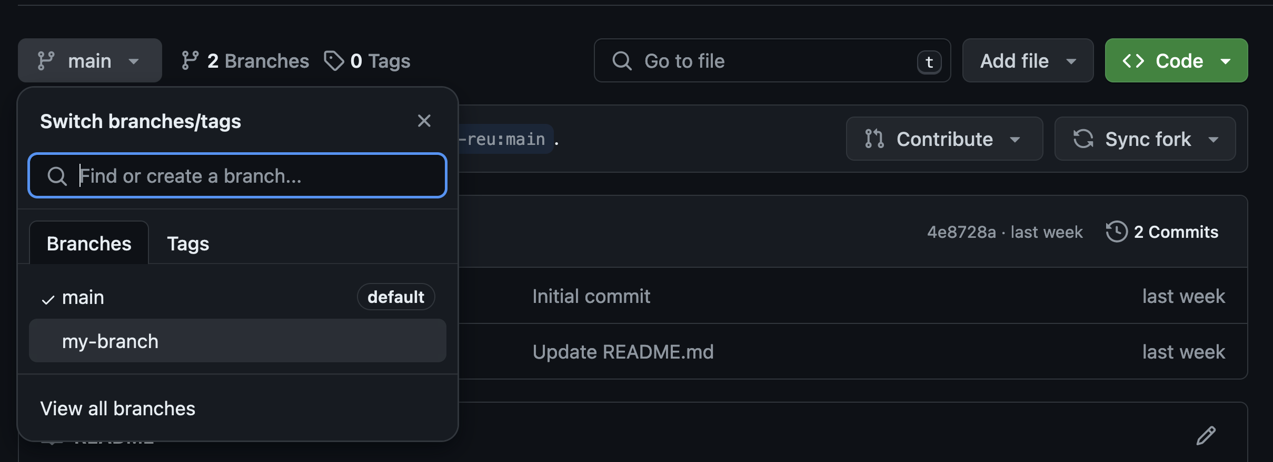
Example: Pull Request (no CLI for this)
On GitHub, navigate to your fork, switch from main to `my-branch`.

Slide 33
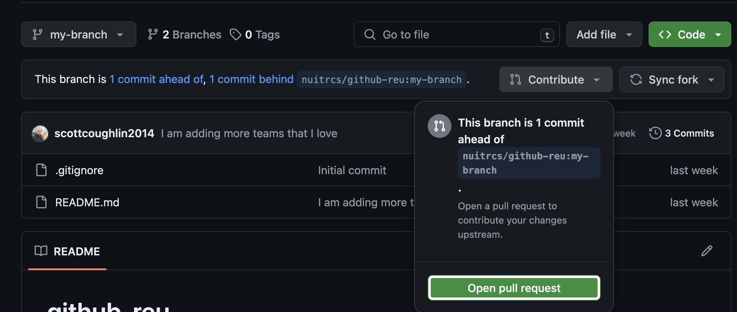
Example: Pull Request (no CLI for this)
Select “Contribute” ➔ Open Pull Request

Slide 34
Now I want one of my collaborators super awesome code…
UPSTREAM
ORIGIN
Local
(NUIT-RCDS)
(YOU)
(Wherever You Clone)
(Scotty)
main
Laptop
main
main
my-branch
my-branch
(Julia)
How Do I Get Matthew’s Super Cool Code?!?
Quest
main
main
my-branch
??????????
(Matthew)
Laptop
main
main
my-branch
Laptop
main

Slide 35
Example: Remotes…Again!!
Solution: You can add as many remote locations to a cloned repo as you want, including one called matthew.
$ git remote add matthew https://github.com/HamWham/github-reu.git
$ git remote -v
matthew https://github.com/HamWham/github-reu.git (fetch)
matthew https://github.com/HamWham/github-reu.git (push)
origin git@github.com:scottcoughlin2014/github-reu.git (fetch)
origin git@github.com:scottcoughlin2014/github-reu.git (push)
upstream git@github.com:nuitrcs/github-reu.git (fetch)
upstream git@github.com:nuitrcs/github-reu.git (push)

Slide 36
Example: Make fetch Happen
Solution: Now that I am “hooked in” to Matthew’s fork, I can fetch all his cool code locally
$ git fetch matthew
remote: Enumerating objects: 5, done.
remote: Counting objects: 100% (5/5), done.
remote: Compressing objects: 100% (3/3), done.
remote: Total 3 (delta 0), reused 0 (delta 0), pack-reused 0
Unpacking objects: 100% (3/3), 1.03 KiB | 175.00 KiB/s, done.
From https://github.com/HamWham/github-reu
* [new branch] main -> matthew/main
* [new branch] my-branch -> matthew/my-branch

Slide 37
Now I want one of my collaborators super awesome code…
UPSTREAM
ORIGIN
Local
(NUIT-RCDS)
(YOU)
(Wherever You Clone)
(Scotty)
main
Laptop
main
main
(Matthew)
my-branch
my-branch
main
$ git remote add matthew https://github.com/HamWham/github-reu.git
my-branch
(Julia)
Quest
main
main
my-branch
$ git fetch matthew
(Matthew)
Laptop
main
main
my-branch
Laptop
main

Slide 38
Example: How do I keep these branches straight?
ORIGIN
Local
$ git branch
main
* my-branch
$ git branch -r
matthew/main
matthew/my-branch
origin/HEAD -> origin/main
origin/main
origin/my-branch
(YOU)
(Wherever You Clone)
(Scotty)
Laptop
main
(Matthew)
main
my-branch
my-branch
main
my-branch

Slide 39
Now I want to merge `matthew/my-branch` into my local `my-branch`
UPSTREAM
ORIGIN
Local
(NUIT-RCDS)
(YOU)
(Wherever You Clone)
(Scotty)
main
Laptop
main
main
my-branch
my-branch
(Matthew)
main
my-branch
(Julia)
Quest
main
main
my-branch
(Matthew)
Laptop
main
main
my-branch
Laptop
main

Slide 40
Example: How do I get the code in `matthew/my-branch` into `my-branch` ➔ git merge
Local
(Wherever You Clone)
$ git merge matthew/my-branch
Auto-merging README.md
CONFLICT (content): Merge conflict in README.md
Automatic merge failed; fix conflicts and then commit the result.
Laptop
(Matthew)
main
my-branch
main
my-branch
MERGE CONFLICT

Slide 41
Vocabulary
Merge: Merging takes the changes from one branch (in the same repository or from a fork), and applies them into another. This often happens as a "pull request" (which can be thought of as a request to merge), or via the command line. A merge can be done through a pull request via the command line.
Merge conflict: A difference that occurs between merged branches. Merge conflicts happen when people make different changes to the same line of the same file, or when one person edits a file and another person deletes the same file. The merge conflict must be resolved before you can merge branches
https://docs.github.com/en/get-started/learning-about-github/github-glossary#fork

Slide 42
Example: How do resolve this conflict?
Solution: Use git status to determine which file failed to `merge` automatically between `matthew/my-branch and `my-branch`.
$ git status
On branch my-branch
Your branch is up to date with 'origin/my-branch'.
You have unmerged paths.
(fix conflicts and run "git commit")
(use "git merge --abort" to abort the merge)
Unmerged paths:
(use "git add <file>..." to mark resolution)
both modified: README.md
no changes added to commit (use "git add" and/or "git commit -a")

Slide 43
Example: How do resolve this conflict?
Solution: Use git diff to determine the specific lines of code that could not be merged automatically.
$ git diff
diff --cc README.md
index dbccf37,a5cde5a..0000000
--- a/README.md
+++ b/README.md
@@@ -1,4 -1,4 +1,8 @@@
# github-reu
Example repository for REU git workshops
++<<<<<<< HEAD
+Scott Coughlin loves the Vikings and Wolves.
++=======
+ Matthew Gorby loved the Portland Trail Blazers until the front office ruined the team.
++>>>>>>> matthew/my-branch

Slide 44
Example: How do resolve this conflict?
Solution: At this point you decide what you want to do with this information. Here I decide to keep both lines.
$ git diff
diff --cc README.md
index dbccf37,a5cde5a..0000000
--- a/README.md
+++ b/README.md
@@@ -1,4 -1,4 +1,5 @@@
# github-reu
Example repository for REU git workshops
+Scott Coughlin loves the Vikings and Wolves.
+ Matthew Gorby loved the Portland Trail Blazers until the front office ruined the team.

Slide 45
Example: How do resolve this conflict?
Solution: Now we repeat the regular “add”, “commit”, “push” steps from earlier.
$ git add README.md
$ git commit -m "Resolving the merge conflict between matthew/my-branch and my-branch"
[my-branch 7728888] Resolving the merge conflict between matthew/my-branch and my-branch
$ git push

Slide 46
Example: How do resolve this conflict?
Local
(Wherever You Clone)
Laptop
(Matthew)
main
my-branch
main
my-branch
MERGE CONFLICT RESOLVE!

Slide 47
Demo

Slide 48
Questions?

