Slide 1


Slide 2

Goals - scaling up for high throughput
modify individual submission scripts to work across samples
use variables to remove hard-coding and increase generalizability
use job arrays to launch multiple jobs with one script
set up dependent jobs

Slide 3

Start by opening up a script to modify...
log onto Quest
move into our allocation directory
make a personal folder if you don’t already have one
copy /projects/e32559/data/bwa.sh to your personal folder
open your copy of bwa.sh with your editor of choice

Slide 4
#!/bin/bash
#SBATCH --account=e32559
#SBATCH --partition=normal
#SBATCH --job-name=bwa_align
#SBATCH --time=10:00:00
#SBATCH --mem=10G
#SBATCH --ntasks=8
#SBATCH --nodes=1
module load bwa/0.7.17
bwa mem -t 8 \
/projects/e32559/example_data/oenotheraHarringtonii.softmasked.fasta \
/projects/e32559/example_data/TRIN_5690_11_S31_L001_R1_001.fastq.gz \
/projects/e32559/example_data/TRIN_5690_11_S31_L001_R2_001.fastq.gz \
> TRIN_5690_11_S31_L001_aln-pe.sam
Requesting resources from the scheduler
Using specific bwa module

Slide 5
#!/bin/bash
#SBATCH --account=e32559
#SBATCH --partition=normal
#SBATCH --job-name=bwa_align
#SBATCH --time=10:00:00
#SBATCH --mem=10G
#SBATCH --ntasks=8
#SBATCH --nodes=1
module load bwa/0.7.17
bwa mem -t 8 \
/projects/e32559/example_data/oenotheraHarringtonii.softmasked.fasta \
/projects/e32559/example_data/TRIN_5690_11_S31_L001_R1_001.fastq.gz \
/projects/e32559/example_data/TRIN_5690_11_S31_L001_R2_001.fastq.gz \
> TRIN_5690_11_S31_L001_aln-pe.sam
The bwa mem command takes 5 arguments:
threads
genome
fastq files (1+2)
output file
What is hard-coded?

Slide 6
#!/bin/bash
#SBATCH --account=e32559
#SBATCH --partition=normal
#SBATCH --job-name=bwa_align
#SBATCH --time=10:00:00
#SBATCH --mem=10G
#SBATCH --ntasks=8
#SBATCH --nodes=1
module load bwa/0.7.17
bwa mem -t 8 \
/projects/e32559/example_data/oenotheraHarringtonii.softmasked.fasta \
/projects/e32559/example_data/TRIN_5690_11_S31_L001_R1_001.fastq.gz \
/projects/e32559/example_data/TRIN_5690_11_S31_L001_R2_001.fastq.gz \
> TRIN_5690_11_S31_L001_aln-pe.sam
The bwa mem command takes 5 arguments:
threads
genome
fastq files (1+2)
output file
Where is there repetition?

Slide 7
#!/bin/bash
#SBATCH --account=e32559
#SBATCH --partition=normal
#SBATCH --job-name=bwa_align
#SBATCH --time=10:00:00
#SBATCH --mem=10G
#SBATCH --ntasks=8
#SBATCH --nodes=1
module load bwa/0.7.17
bwa mem -t 8 \
/projects/e32559/example_data/oenotheraHarringtonii.softmasked.fasta \
/projects/e32559/example_data/TRIN_5690_11_S31_L001_R1_001.fastq.gz \
/projects/e32559/example_data/TRIN_5690_11_S31_L001_R2_001.fastq.gz \
> TRIN_5690_11_S31_L001_aln-pe.sam
The bwa mem command takes 5 arguments:
threads
genome
fastq files (1+2)
output file
Where is there repetition?

Slide 8
#!/bin/bash
#SBATCH --account=e32559
#SBATCH --partition=normal
#SBATCH --job-name=bwa_align
#SBATCH --time=10:00:00
#SBATCH --mem=10G
#SBATCH --ntasks=8
#SBATCH --nodes=1
module load bwa/0.7.17
bwa mem -t 8 \
/projects/e32559/example_data/oenotheraHarringtonii.softmasked.fasta \
/projects/e32559/example_data/TRIN_5690_11_S31_L001_R1_001.fastq.gz \
/projects/e32559/example_data/TRIN_5690_11_S31_L001_R2_001.fastq.gz \
> TRIN_5690_11_S31_L001_aln-pe.sam
The bwa mem command takes 5 arguments:
threads
genome
fastq files (1+2)
output file
Where is there repetition?

Slide 9
#!/bin/bash
#SBATCH --account=e32559
#SBATCH --partition=normal
#SBATCH --job-name=bwa_align
#SBATCH --time=10:00:00
#SBATCH --mem=10G
#SBATCH --ntasks=8
#SBATCH --nodes=1
module load bwa/0.7.17
bwa mem -t 8 \
/projects/e32559/example_data/oenotheraHarringtonii.softmasked.fasta \
/projects/e32559/example_data/TRIN_5690_11_S31_L001_R1_001.fastq.gz \
/projects/e32559/example_data/TRIN_5690_11_S31_L001_R2_001.fastq.gz \
> TRIN_5690_11_S31_L001_aln-pe.sam
The bwa mem command takes 5 arguments:
threads
genome
fastq files (1+2)
output file
Where is there repetition?

Slide 10

Replace hard-coding with variables

Slide 11
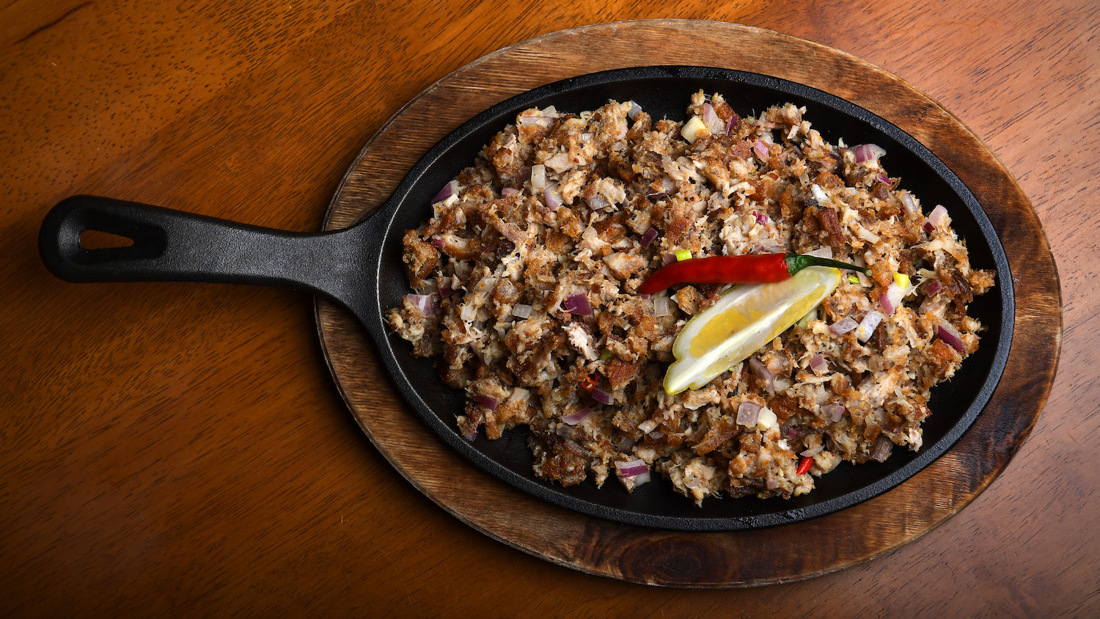
bash variables
set with =
referenced with $
FAVORITE_FOOD=“sisig”
echo $FAVORITE_FOOD

Slide 12
#!/bin/bash
#SBATCH --account=e32559
#SBATCH --partition=normal
#SBATCH --job-name=bwa_align
#SBATCH --time=10:00:00
#SBATCH --mem=10G
#SBATCH --ntasks=8
#SBATCH --nodes=1
module load bwa/0.7.17
bwa mem -t 8 \
/projects/e32559/example_data/oenotheraHarringtonii.softmasked.fasta \
/projects/e32559/example_data/TRIN_5690_11_S31_L001_R1_001.fastq.gz \
/projects/e32559/example_data/TRIN_5690_11_S31_L001_R2_001.fastq.gz \
> TRIN_5690_11_S31_L001_aln-pe.sam
What do we want to call this variable?

Slide 13
#!/bin/bash
#SBATCH --account=e32559
#SBATCH --partition=normal
#SBATCH --job-name=bwa_align
#SBATCH --time=10:00:00
#SBATCH --mem=10G
#SBATCH --ntasks=8
#SBATCH --nodes=1
module load bwa/0.7.17
SAMPLE_DIR=/projects/e32559/example_data
bwa mem -t 8 \
$SAMPLE_DIR/oenotheraHarringtonii.softmasked.fasta \
$SAMPLE_DIR/TRIN_5690_11_S31_L001_R1_001.fastq.gz \
$SAMPLE_DIR/TRIN_5690_11_S31_L001_R2_001.fastq.gz \
> TRIN_5690_11_S31_L001_aln-pe.sam

Slide 14
#!/bin/bash
#SBATCH --account=e32559
#SBATCH --partition=normal
#SBATCH --job-name=bwa_align
#SBATCH --time=10:00:00
#SBATCH --mem=10G
#SBATCH --ntasks=8
#SBATCH --nodes=1
module load bwa/0.7.17
SAMPLE_DIR=/projects/e32559/example_data
bwa mem -t 8 \
$SAMPLE_DIR/oenotheraHarringtonii.softmasked.fasta \
$SAMPLE_DIR/TRIN_5690_11_S31_L001_R1_001.fastq.gz \
$SAMPLE_DIR/TRIN_5690_11_S31_L001_R2_001.fastq.gz \
> TRIN_5690_11_S31_L001_aln-pe.sam
This can use a SLURM variable built into the scheduling software.

Slide 15
#!/bin/bash
#SBATCH --account=e32559
#SBATCH --partition=normal
#SBATCH --job-name=bwa_align
#SBATCH --time=10:00:00
#SBATCH --mem=10G
#SBATCH --ntasks=8
#SBATCH --nodes=1
module load bwa/0.7.17
SAMPLE_DIR=/projects/e32559/example_data
bwa mem -t $SLURM_NPROCS \
$SAMPLE_DIR/oenotheraHarringtonii.softmasked.fasta \
$SAMPLE_DIR/TRIN_5690_11_S31_L001_R1_001.fastq.gz \
$SAMPLE_DIR/TRIN_5690_11_S31_L001_R2_001.fastq.gz \
> TRIN_5690_11_S31_L001_aln-pe.sam

Slide 16
#!/bin/bash
#SBATCH --account=e32559
#SBATCH --partition=normal
#SBATCH --job-name=bwa_align
#SBATCH --time=10:00:00
#SBATCH --mem=10G
#SBATCH --ntasks=8
#SBATCH --nodes=1
module load bwa/0.7.17
SAMPLE_DIR=/projects/e32559/example_data
bwa mem -t $SLURM_NPROCS \
$SAMPLE_DIR/oenotheraHarringtonii.softmasked.fasta \
$SAMPLE_DIR/TRIN_5690_11_S31_L001_R1_001.fastq.gz \
$SAMPLE_DIR/TRIN_5690_11_S31_L001_R2_001.fastq.gz \
> TRIN_5690_11_S31_L001_aln-pe.sam
What is still hard-coded?

Slide 17
#!/bin/bash
#SBATCH --account=e32559
#SBATCH --partition=normal
#SBATCH --job-name=bwa_align
#SBATCH --time=10:00:00
#SBATCH --mem=10G
#SBATCH --ntasks=8
#SBATCH --nodes=1
module load bwa/0.7.17
SAMPLE_DIR=/projects/e32559/example_data
bwa mem -t $SLURM_NPROCS \
$SAMPLE_DIR/oenotheraHarringtonii.softmasked.fasta \
$SAMPLE_DIR/TRIN_5690_11_S31_L001_R1_001.fastq.gz \
$SAMPLE_DIR/TRIN_5690_11_S31_L001_R2_001.fastq.gz \
> TRIN_5690_11_S31_L001_aln-pe.sam
What is still hard-coded?
One time input, set as variable
Refers to specific samples
What we want to “loop” through

Slide 18



Job arrays are preferred over loops
could write a for loop in bash that would work through your list of samples
job arrays are an alternative built into SLURM
easier on the scheduling system because they take up less room in the queue while pending

Slide 19
#!/bin/bash
#SBATCH --account=e32559
#SBATCH --partition=normal
#SBATCH --job-name=bwa_align
#SBATCH --time=10:00:00
#SBATCH --mem=10G
#SBATCH --ntasks=8
#SBATCH --nodes=1
#SBATCH --array=0-66
module load bwa/0.7.17
SAMPLE_DIR=/projects/e32559/example_data
REF_GENOME=oenotheraHarringtonii.softmasked.fasta
# read in list of samples
IFS=$'\n' read -d '' -r -a lines < $SAMPLE_DIR/list_of_samples.txt
bwa mem -t $SLURM_PROCS $SAMPLE_DIR/$REF_GENOME \
$SAMPLE_DIR/${lines[$SLURM_ARRAY_TASK_ID]}_R1_001.fastq.gz \
$SAMPLE_DIR/${lines[$SLURM_ARRAY_TASK_ID]}_R2_001.fastq.gz > ${lines[$SLURM_ARRAY_TASK_ID]}_aln-pe.sam

Slide 20
# read in list of samples
IFS=$'\n' read -d '' -r -a lines < $SAMPLE_DIR/list_of_samples.txt
bwa mem -t $SLURM_PROCS $SAMPLE_DIR/$REF_GENOME \
$SAMPLE_DIR/${lines[$SLURM_ARRAY_TASK_ID]}_R1_001.fastq.gz \
$SAMPLE_DIR/${lines[$SLURM_ARRAY_TASK_ID]}_R2_001.fastq.gz > ${lines[$SLURM_ARRAY_TASK_ID]}_aln-pe.sam
1. take a list of samples

Slide 21
# read in list of samples
IFS=$'\n' read -d '' -r -a lines < $SAMPLE_DIR/list_of_samples.txt
bwa mem -t $SLURM_PROCS $SAMPLE_DIR/$REF_GENOME \
$SAMPLE_DIR/${lines[$SLURM_ARRAY_TASK_ID]}_R1_001.fastq.gz \
$SAMPLE_DIR/${lines[$SLURM_ARRAY_TASK_ID]}_R2_001.fastq.gz > ${lines[$SLURM_ARRAY_TASK_ID]}_aln-pe.sam
1. take a list of samples
2. read it line by line into a variable called ‘lines’

Slide 22
# read in list of samples
IFS=$'\n' read -d '' -r -a lines < $SAMPLE_DIR/list_of_samples.txt
bwa mem -t $SLURM_PROCS $SAMPLE_DIR/$REF_GENOME \
$SAMPLE_DIR/${lines[$SLURM_ARRAY_TASK_ID]}_R1_001.fastq.gz \
$SAMPLE_DIR/${lines[$SLURM_ARRAY_TASK_ID]}_R2_001.fastq.gz > ${lines[$SLURM_ARRAY_TASK_ID]}_aln-pe.sam
1. take a list of samples
2. read it line by line into a variable called ‘lines’
Replace sample ID with line from list
Indexing by iteration in the array

Slide 23
#!/bin/bash
#SBATCH --account=e32559
#SBATCH --partition=normal
#SBATCH --job-name=bwa_align
#SBATCH --time=10:00:00
#SBATCH --mem=10G
#SBATCH --ntasks=8
#SBATCH --nodes=1
#SBATCH --array=0-66
module load bwa/0.7.17
SAMPLE_DIR=/projects/e32559/example_data
REF_GENOME=oenotheraHarringtonii.softmasked.fasta
# read in list of samples
IFS=$'\n' read -d '' -r -a lines < $SAMPLE_DIR/list_of_samples.txt
bwa mem -t $SLURM_PROCS $SAMPLE_DIR/$REF_GENOME \
$SAMPLE_DIR/${lines[$SLURM_ARRAY_TASK_ID]}_R1_001.fastq.gz \
$SAMPLE_DIR/${lines[$SLURM_ARRAY_TASK_ID]}_R2_001.fastq.gz > ${lines[$SLURM_ARRAY_TASK_ID]}_aln-pe.sam
Define an array with the number of samples you have to go through

Slide 24
Let’s practice!
Recursively copy /projects/e32680/04_highthroughput to a folder within your folder called scripts:
cp -R /projects/e32680/04_highthroughput ./scripts/
Which of these scripts make sense as arrays?

Slide 25
Script | Function | Array? | Other files needed:
star1.sh | index genome for STAR aligner
star2.sh | align reads to ref. genome
MACS2_1.sh | call peaks with MACS2
fasterq.sh | download data from NCBI short read archive

Slide 26
Generating lists of files or samples
ls -1 | sed -e 's/\_..fastq.gz$//' | uniq > samples.txt
naming schemes and wildcards *
ls
grep or sed
> to pipe output to a file

