Slide 1
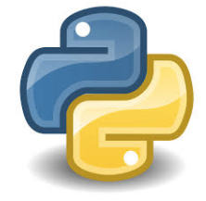
Research Computing Services
Northwestern Postdocs Association
SPIE
Introduction to Python
for non-programmers
http://bit.ly/2tbm12e
Janna Nugent: janna.nugent@northwestern.edu
Alper Kinaci: akinaci@northwestern.edu
Christina Maimone: christina.maimone@northwestern.edu

Slide 2
https://github.com/nuitrcs/pythonworkshops/Part_3
Introduction to Python
for non-programmers
or
http://bit.ly/2tbm12e

Slide 3
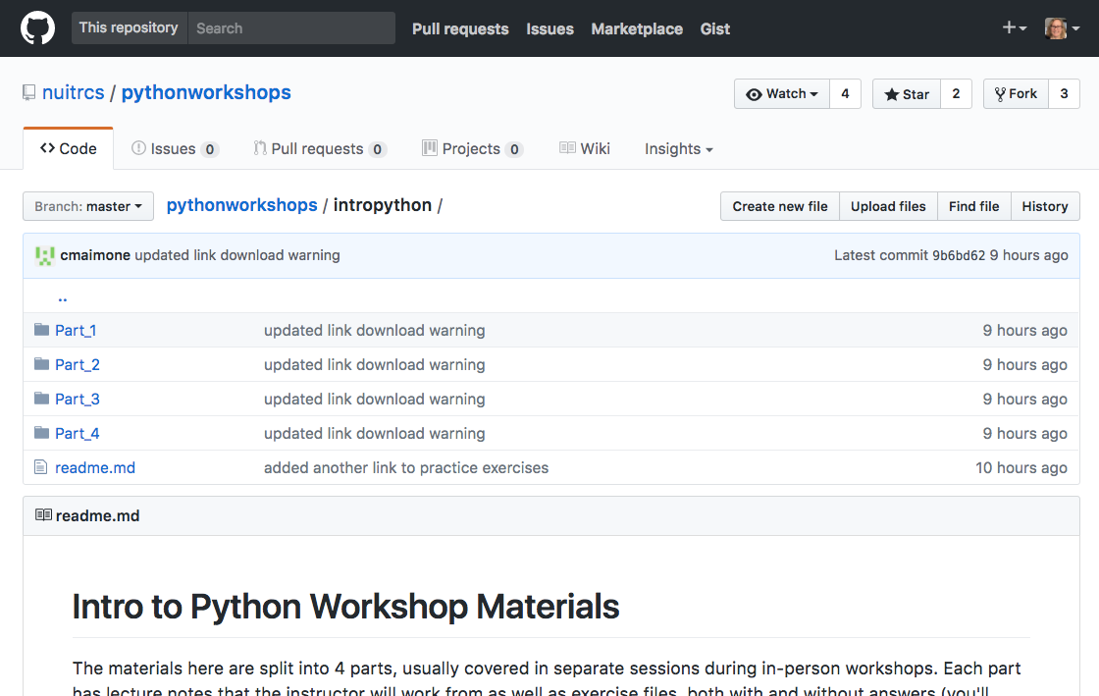
https://github.com/nuitrcs/pythonworkshops/tree/master/intropython

Slide 4

What we’ve covered so far:
First Session
Python versions
Jupyter notebooks
Math
Print
Comments
Variables
Int, float, strings, booleans
Lists, Tuples
Second Session
Indexing and subsetting lists, slice syntax
Replacing and deleting elements in a list
PyCharm
Dicts
Using existing, built-in basic functions
If statements
Loops

Slide 5
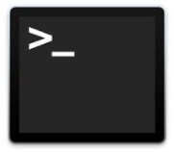
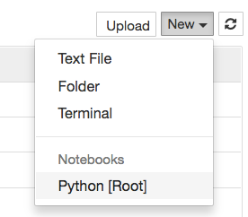

Let’s get started: Jupyter (mac)
Open Terminal
type “jupyter notebook”
New -> Python [Root]
quit: Use Control-C to stop this server and shut down all kernels (twice to skip confirmation).

Slide 6
Let’s get started: Jupyter (PC)
Open: Installed as a program - click on the icon
New -> Python [Root]

Slide 7

Functions (aka “subprograms”)
A function is a block of organized, reusable code that is used to perform a single, related action.
Each subprogram has a single entry point
The calling program is suspended during execution of the called subprogram
Control always returns to the caller when the called subprogram’s execution terminates
Functions you’ve already used:
print()
len()
type()

Slide 8
Functions: Namespaces
“Namespaces are one honking great
idea -- let's do more of those!”
-Tim Peters, The Zen of Python

Slide 9
Functions
All parameters (arguments) in the Python language are passed by reference.
Pass the parameter by sending the memory address it’s located at in RAM
Pass a copy of the parameter
Java, C
If you change the value of a parameter from within the function, that change persists after the function returns.

Slide 10
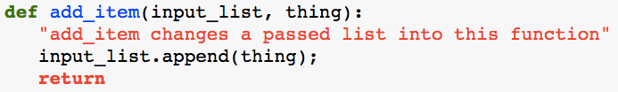

Writing Functions
“Behold, this is a function definition: from here on out when you see this name, it means do this function”
Parameters passed in to the function
do
End of function definition. May include value to return.
Documentation for your function, access via add_item?? or help(add_item)
Must be indented 4 spaces

Slide 11
Functions: Namespaces
“Any time you see varname =, you're creating a new name binding within the function's scope. Whatever value varname was bound to before is lost within this scope.
Any time you see varname.foo() you're calling a method on varname. The method may alter varname (e.g. list.append). varname (or, rather, the object that varname names) may exist in more than one scope, and since it's the same object, any changes will be visible in all scopes.” -John Fouhey

Slide 12
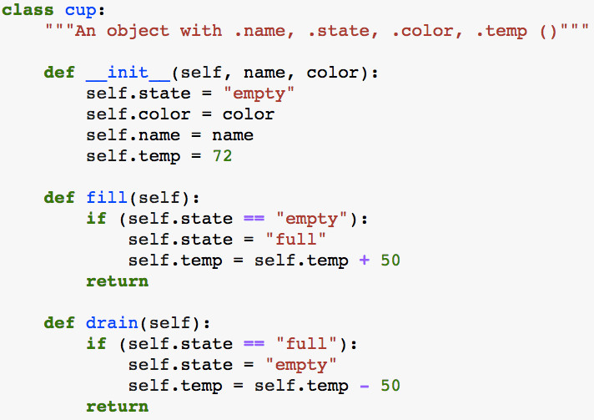
Object attributes and methods
“nouns”
“verbs”
attributes
methods

Slide 13

Importing Packages

Slide 14
Many Data Science libraries are available for Python, and they are easy to install (using pip):
DataFrame- Pandas
Machine Learning- scikitlearn
Statistics- Scipy
Arrays- Numpy
Plots- matplotlib
Science- anaconda distribution
DataScrapping- BeautifulSoup
FetchUrldetails- urllib

Slide 15
Installing Packages
Use “pip”:
In Jupiter notebooks:
!pip install <package_name>
on the command line:
pip install <package_name>

Slide 16
Package Documentation
help(<package_name>)
or
<package_name>??
also
google <package_name>

Slide 17
Solving Problems
Some approaches aren’t good ideas
my_list=[1,2,3…n]
for number in my_list:
n times
2
for number on my_list:
n times
for number on my_list:
3
n times
for number on my_list:
4
n times
for number on my_list:
5
n = 20,000
n times
n = 400,000,000
2
3
n = 8,000,000,000,000
4
n = 160,000,000,000,000,000
5
n = 3,200,000,000,000,000,000,000,000

Slide 18
Solving Problems
“The most common mistake I see when conducting interviews or watching someone try to solve a programming problem is they try to start writing code as soon as possible.
You must resist this urge.
You really want to make sure you take enough time to understand the problem completely before attempting to solve it.”
-Matt Sonmez
https://simpleprogrammer.com/2011/01/08/solving-problems-breaking-it-down/

Slide 19
Data Camp:
Next Steps
http://www.it.northwestern.edu/research/campus-events/data-camp.html

