Slide 1
Machine Learning with scikit-learn
GitHub Link
https://github.com/nuitrcs/machine-learning-2026
Please sign in using the sign-in sheet by the entrance and grab the red & blue post it notes.
Workshop starts at 09:03AM

Slide 2
Machine Learning with Scikit-Learn
Instructor: efrén cruz cortés
TA: Yangyang Li

Slide 3
Logistics

Slide 4
This workshop is brought to you by:
Northwestern IT Research Computing and Data Services
Need help?
AI
Machine Learning
Data Science
Statistics
Visualization
Collecting online data, text analysis, simulations, etc.
R, Python, SQL, MATLAB, Stata, SPSS, SAS, etc.
Request a FREE consultation at bit.ly/rcdsconsult.

Slide 5
Collaborative project support
We also provide longer-term support in your project!
Exploration
Modeling
Data collection, analysis, visualization, etc.
(Available for faculty or researchers with strong faculty support/involvement)
Find more information at bit.ly/collaborative_project_support

Slide 6
Bring Your Own Data (BYOD)
Weekly working group for mutual accountability and advice from our staff and other BYOD participants.
Great stress-free environment to progress on your research project!
Find more information at bit.ly/byod_groups

Slide 7
Logistics
Post-it notes 🟥 🟦
Questions or need help? → 🟥
Completed an exercise? → 🟦
Don’t be afraid to ask questions!

Slide 8
What’s next?
AI for Research (Sep 2 – Sep 5)
https://www.it.northwestern.edu/departments/it-services-support/research/training-and-consultation/research-code-academy.html

Slide 9
AI’s Impact
AI relies on extensive human labor, sometimes under exploitative conditions
Mining for minerals
Training, content moderation, etc.
AI relies on environmental resources
AI may impact people disproportionally and in undesirable ways

Slide 10
Warning!
Google Colab sends your data to Google’s servers.
Don’t upload any information you wouldn’t publicly share!
This includes data, code, API keys, people’s names, etc.
It is OK to use Google Colab for today’s workshop.

Slide 11
Introduction

Slide 12
Teams and ice-breaking activity
Let me explain the team structure and dynamics.
Note: Tomorrow you can sit somewhere else and meet new people!
2. If you are comfortable with it, take two minutes to introduce yourself to your team and to those next to you (both sides).
(If you don't feel comfortable talking today, you can tell them "today I prefer not to talk" or provide a similar indication. It's fine.).
3. Now let's do a round of names and get used to asking questions!

Slide 13
Machine Learning

Slide 14
What do we want to learn in ML?
Task
I think of ML through a task centered framework:
There is a task we want the machine to do.
To perform this task, the machine must learn an underlying concept.
We’ll try to learn this concept by searching over a space of models.
Think of these as the why, what, and how of learning.
Concept
Space of models

Slide 15
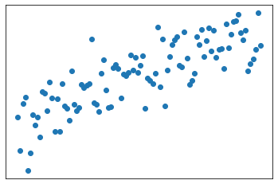
Example 1. Learning a linear relationship
Imagine we observe the variation of one variable with respect to another. We presume the relationship is linear:
Response, target, dependent variable, etc...
Predictive Observation

Slide 16
Learning a linear relationship
Imagine we observe the variation of one variable with respect to another. We presume the relationship is linear:
Task: Understand numerical relationship between predictor and response
Concept: Overall pattern of relationship
Model Space: Set of all straight lines

Slide 17
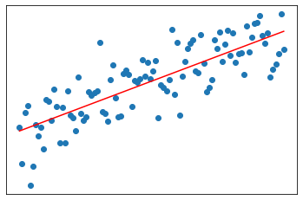
Learning a linear relationship
Our model space is the set of all straight lines:
Option 1
Option 2
Best Option
Option 3
Option 4

Slide 18
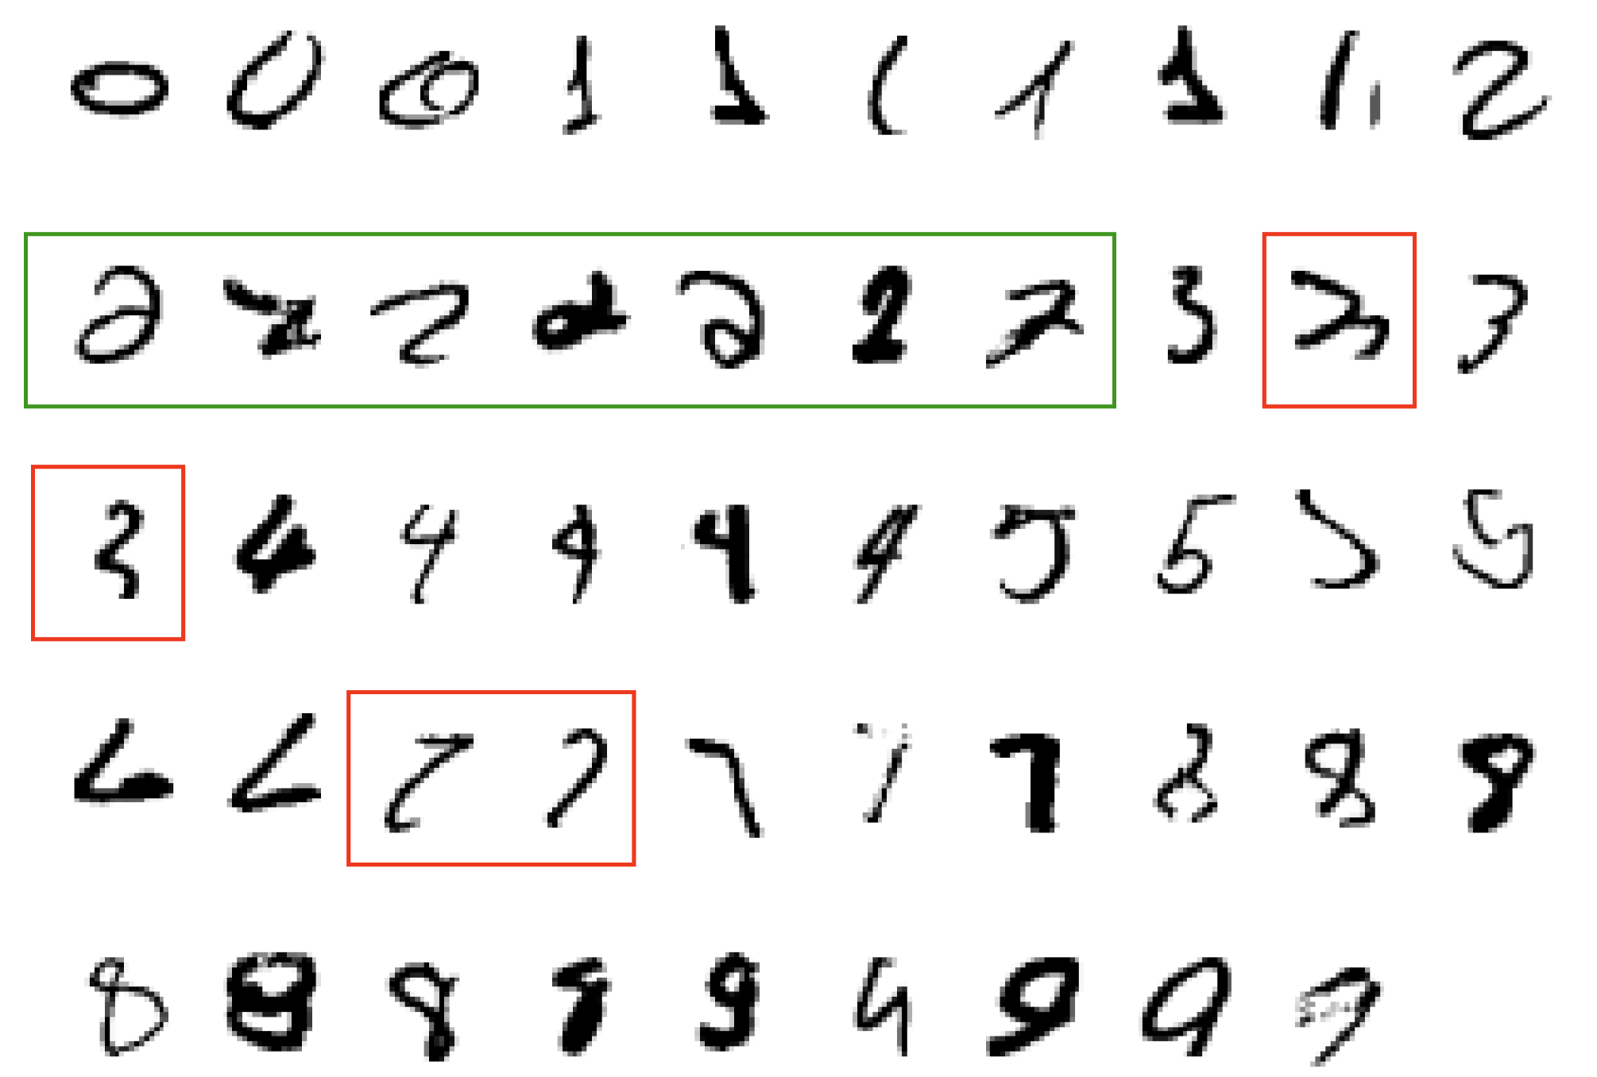
Example 2. Classifying hand-written digits
What makes a 2?

Slide 19
Classifying hand-written digits
Task: Identify a number based on an image
Concept: A “digit”, represented visually
Model Space: Set of all mappings from 64x64 pixels to {0, 1, ..., 9} (see next slide)

Slide 20

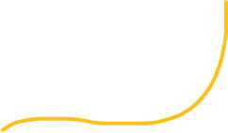
Classifying hand-written digits
Yellow region → 0
Green region → 2
Red region → 4
Purple region → 1
...

Slide 21
Example 3. Clustering documents by topic
Task: Identify groups of documents by topic
Concept: Latent topics among all docs
Model Space: Possible groupings of documents

Slide 22
Clustering documents by topic

Slide 23
Clustering documents by topic

Slide 24
Clustering documents by topic

Slide 25
Clustering documents by topic

Slide 26
Clustering documents by topic

Slide 27
ML Tasks
Supervised Learning (we have labels!)
Regression
Classification
Unsupervised Learning (no labels!)
Clustering
Dimensionality Reduction

Slide 28
Examples
Task | Concept | Model
Recognize pedestrians | Pedestrian (image of) | Subset in image space
Generate images from prompt | Entities in the prompt | Function from words to images
Identify a cancer | Cancer types | Subsets of genetic signatures
Allocate resources | Communities in need | Function from income and infrastructure to allocation amount
Identify topics in text | Topics | Groupings of texts into cohesive clusters
* In practice take the form of functions: classifiers, regressors, generative models, etc.

Slide 29
When Do We Use Machine Learning?
ML is used when:
Human expertise does not exist (navigating on Mars)
Humans can’t explain their expertise (speech recognition)
Models must be customized (personalized medicine)
Models are based on huge amounts of data (genomics)
When you should not use ML:
Task can be done with classical stats or field-specific knowledge.
When it is unethical!
*Thanks to Ritika Giri for this slide

Slide 30
More examples of ML tasks
Recognizing patterns:
Facial identities or facial expressions
Handwritten or spoken words
Medical images
Generating patterns:
Generating images or motion sequences
Generating text, as with Chat GPT
Recognizing anomalies:
Unusual credit card transactions
Unusual patterns of sensor readings in a nuclear power plant
Prediction:
Future stock prices or currency exchange rates

Slide 31
Activity
Talk to your neighbor:
What do you want to use Machine Learning for?
Does it fit the task-concept-model framework?
If not, what are some new complexities?

Slide 32
Conceptual Intermezzo - Regression

Slide 33
Learning a linear relationship
Imagine we observe the variation of one variable with respect to another.

Slide 34
Learning a linear relationship
We presume the relationship is linear. Meaning, we expect some sort of line to explain the overall pattern:

Slide 35
Learning a linear relationship
Fitting the model means finding the best straight lines among all possible candidates:
Option 1
Option 2
Best Option
Option 3
Option 4

Slide 36
Conceptual Intermezzo - Generalization

Slide 37
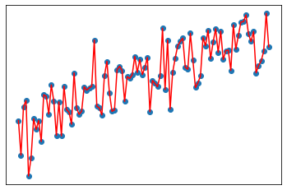
Should we perfectly fit our observations?
We run the risk of overfitting!!
While the line minimizes the error...
It is unlikely it will match any new observation.
*Thanks to Ritika Giri for this slide

Slide 38
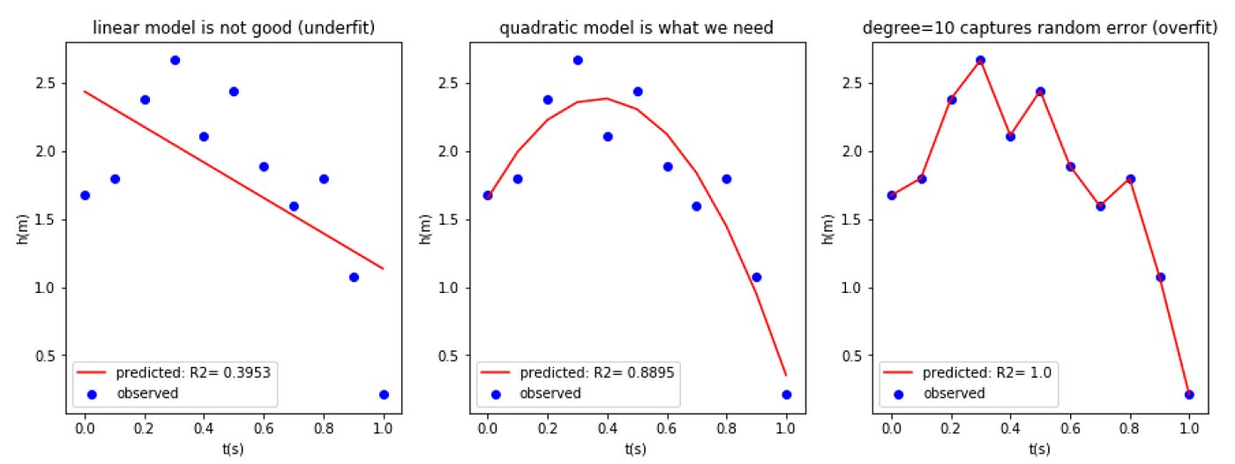
Example
A straight line is too simple of a hypothesis. Error is large.
A complicated line relies too much on specific data, will fail with new data. Error is zero.
A quadratic line is the perfect middle ground: it gives space for new observations while keeping the error small.
*Thanks to Ritika Giri for this slide

Slide 39
Generalization
The problem of finding the middle ground between underfitting and overfitting is called the bias-variance trade-off.
(Should it be called the Goldilocks principle?)
A simple model will be biased towards a specific form, and it will vary little with observations (like a hard-headed person).
A complicated model will have low bias, but vary widely with observations (like someone who keeps modifying their theories just to be right).
A good balanced hypothesis will have the power of generalization: it will, with some small error, generalize to new observations.

Slide 40
Bias-Variance trade-off
Underfitting
Overfitting
Bias:​
Systematic prejudice in the model​
Simple model = High bias
Variance:​
Change in the model’s prediction, when the dataset is changed a little bit​
Complex model = High variance
High Bias
Low Variance
Low Bias
High Variance
*Thanks to Ritika Giri for this slide

Slide 41
How to find a generalizable hypothesis?
Instead of minimizing the error on our observations:
Save a portion of the data and keep it secret, unobserved.
Formulate the model.
Test the model on the secret data.
This procedure helps us build models with good generalization properties.
Training data: observed data, used to formulate our model.
Testing data: held out, secret data, used to test the model.

Slide 42
Conceptual Intermezzo - Classification

Slide 43
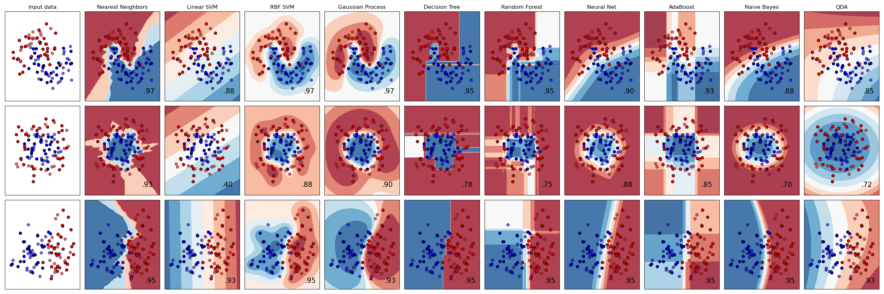
Labeled data
Assume we have a collection of data points, each of which belonging to one of two classes.
In this case, the classes are blue and red.
Each data point is “labeled” according to its class.
*Images taken from scikit-learn website.

Slide 44
Classification: find class regions
The main classification task is to create regions in the data space that will determine if a point is blue or red.
*Images taken from scikit-learn website.

Slide 45
Example
*Images taken from scikit-learn website.

Slide 46
Example
*Images taken from scikit-learn website.

Slide 47
Then what?
We can predict the class of any newly observed point!
*Images taken from scikit-learn website.

Slide 48
Conceptual Intermezzo – Confusion Matrix

Slide 49
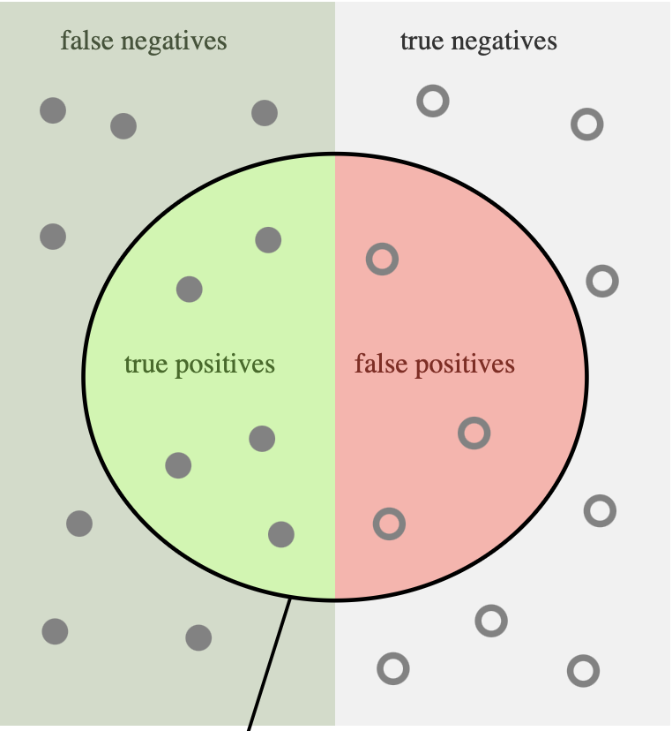
True and False Positives and Negatives
Terminology
Positive and negative are sometimes used in binary classification
This is historical use: think about diagnosing a disease or detecting an incoming airplane
In general, such association does not exist (cats vs dogs, for example)
But for binary, it’s useful to have a reference class
*image from https://en.wikipedia.org/wiki/Precision_and_recall

Slide 50
True and False Positives and Negatives
Truth
Left is positive
Right is negative
Prediction
Inside circle is Positive
Outside circle is negative
*image from https://en.wikipedia.org/wiki/Precision_and_recall

Slide 51
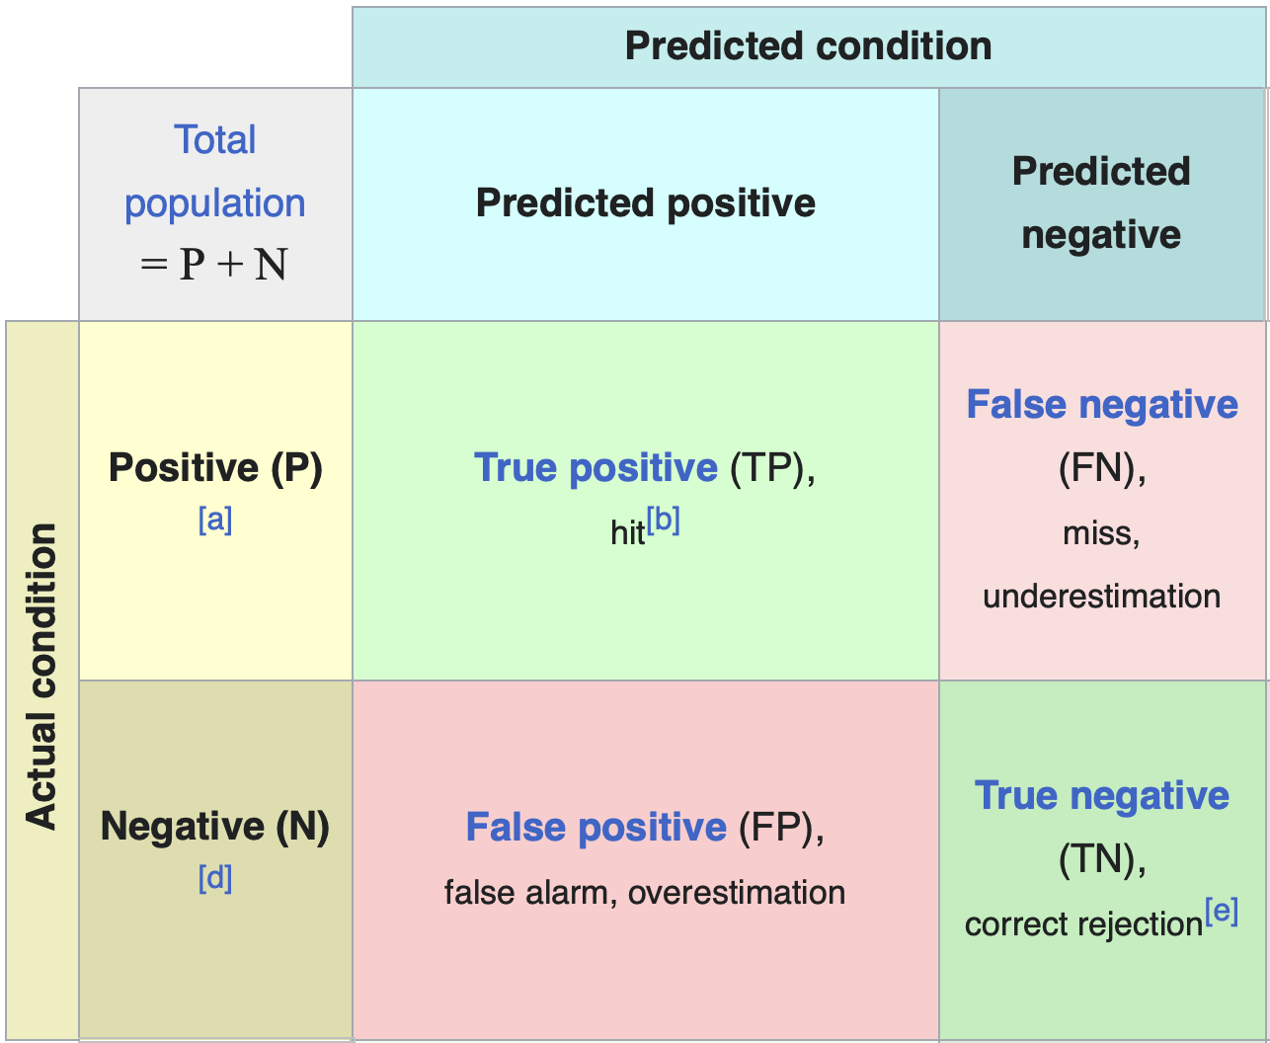
The confusion matrix for classification
*image from https://en.wikipedia.org/wiki/Confusion_matrix

Slide 52
The confusion matrix for classification
*image from https://en.wikipedia.org/wiki/Confusion_matrix
**image from scikit-learn website.

Slide 53
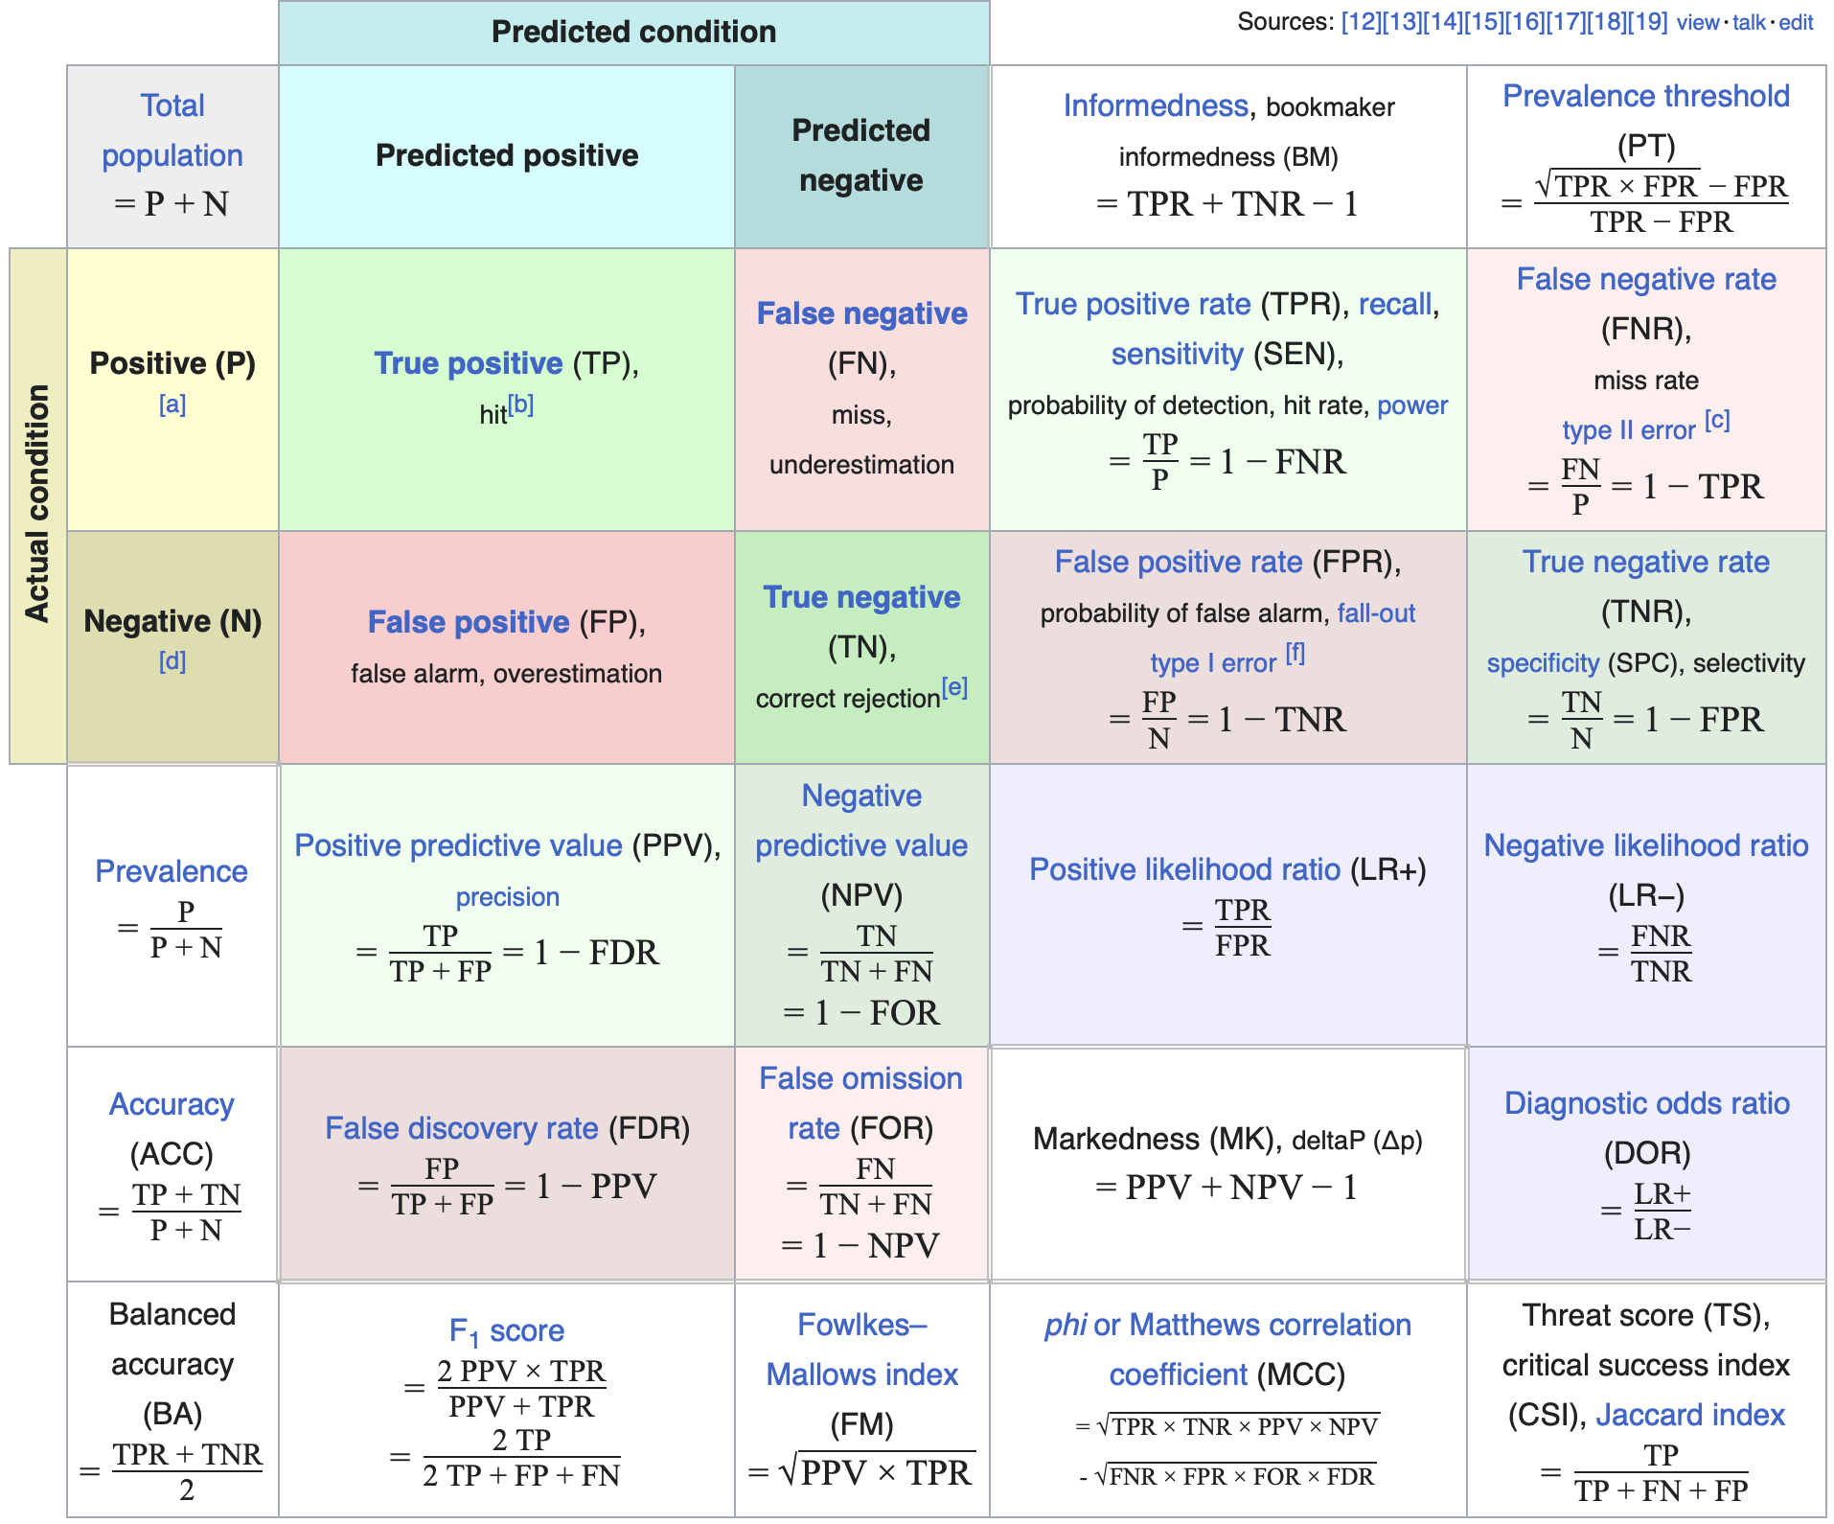
Metrics from the confusion matrix
*image from https://en.wikipedia.org/wiki/Confusion_matrix

Slide 54
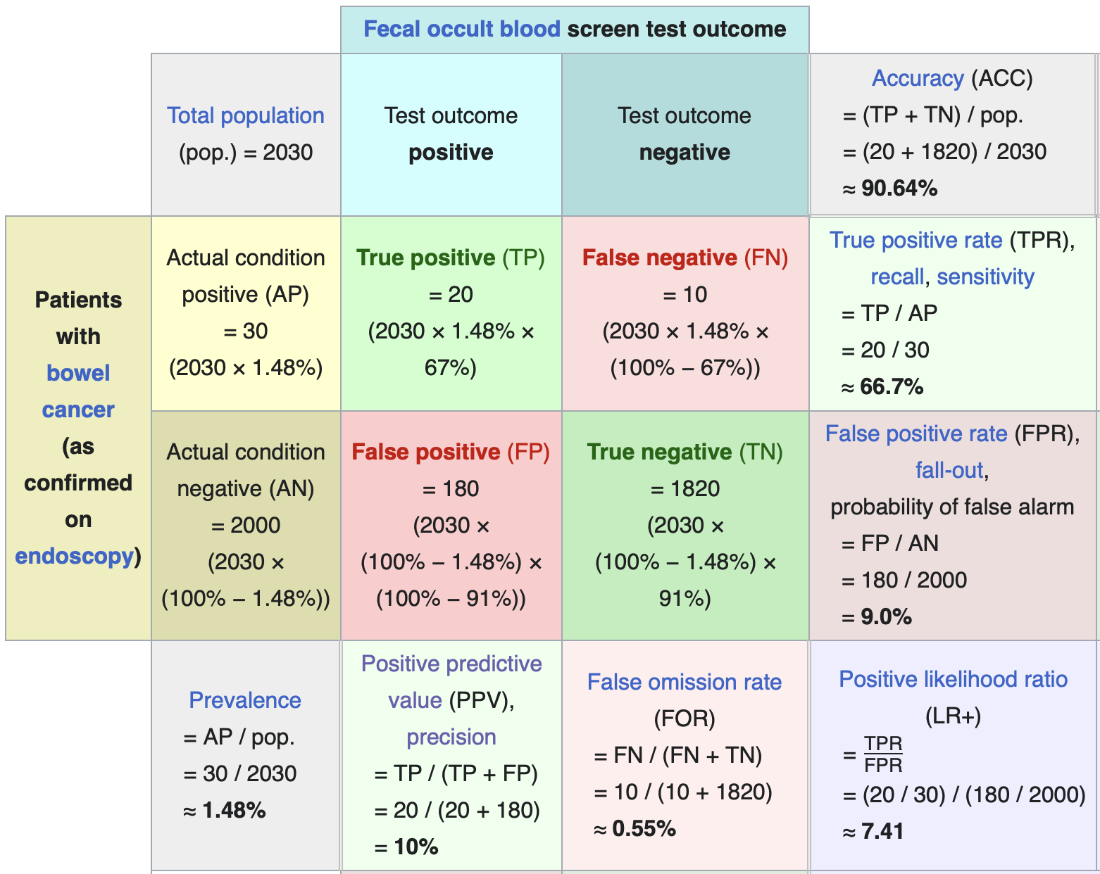
Example
Let’s say we have a population of 2030, and we want to diagnose bowel cancer.
*image from https://en.wikipedia.org/wiki/Positive_and_negative_predictive_values

Slide 55
Conceptual Intermezzo - Cross-Validation

Slide 56
Cross-validation
Cross-validation takes us back to our generalization concept.
We may want to assess how well our model generalizes without touching the test data.
So we further subdivide the training data into k “folds”, each with its own mini validation set. We then tune hyperparameters and other aspects of the model by averaging over the validation partitions.

Slide 57

k-fold cross-validation
Performance 1
Performance 2
Performance 3
Overall generalization performance of a given model and a given set of hyperparameters
Performance 4
Performance 5
*Images taken from scikit-learn website.

Slide 58
k-fold cross-validation
*Images taken from scikit-learn website.

Slide 59
Conceptual Intermezzo - Clustering

Slide 60
Clustering
Assign to each data point a category, or cluster, without knowing in advance what these clusters are.
Contrary to classification or regression, we have no access to ground truth!
Unsupervised Learning Assumption
Anything that can be learned from the data is present in the structure of the data itself.
Clustering Assumption
Different clusters are assumed to be distinguishable from each other purely from the data.

Slide 61
Clustering documents by topic

Slide 62
Clustering documents by topic

Slide 63
Clustering documents by topic

Slide 64
Conceptual Intermezzo - Dimensionality Reduction

Slide 65
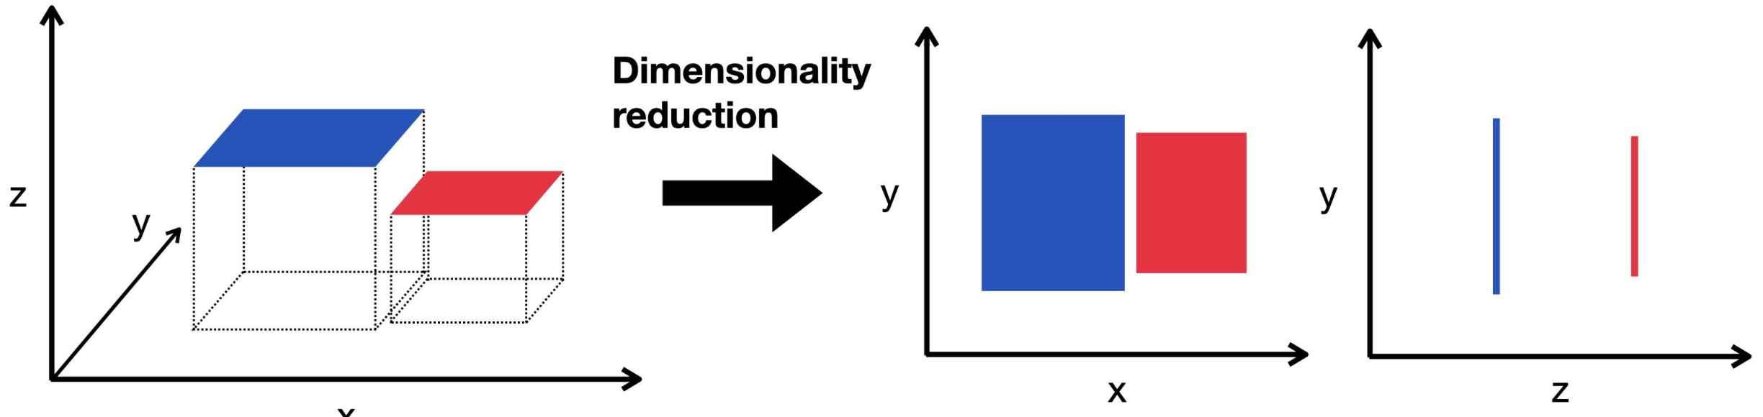
Dimensionality Reduction
The objective is to map high-dimensional data to a visualizable or otherwise manageable low-dimensional space
*Image from Single-cell Best Practices

Slide 66
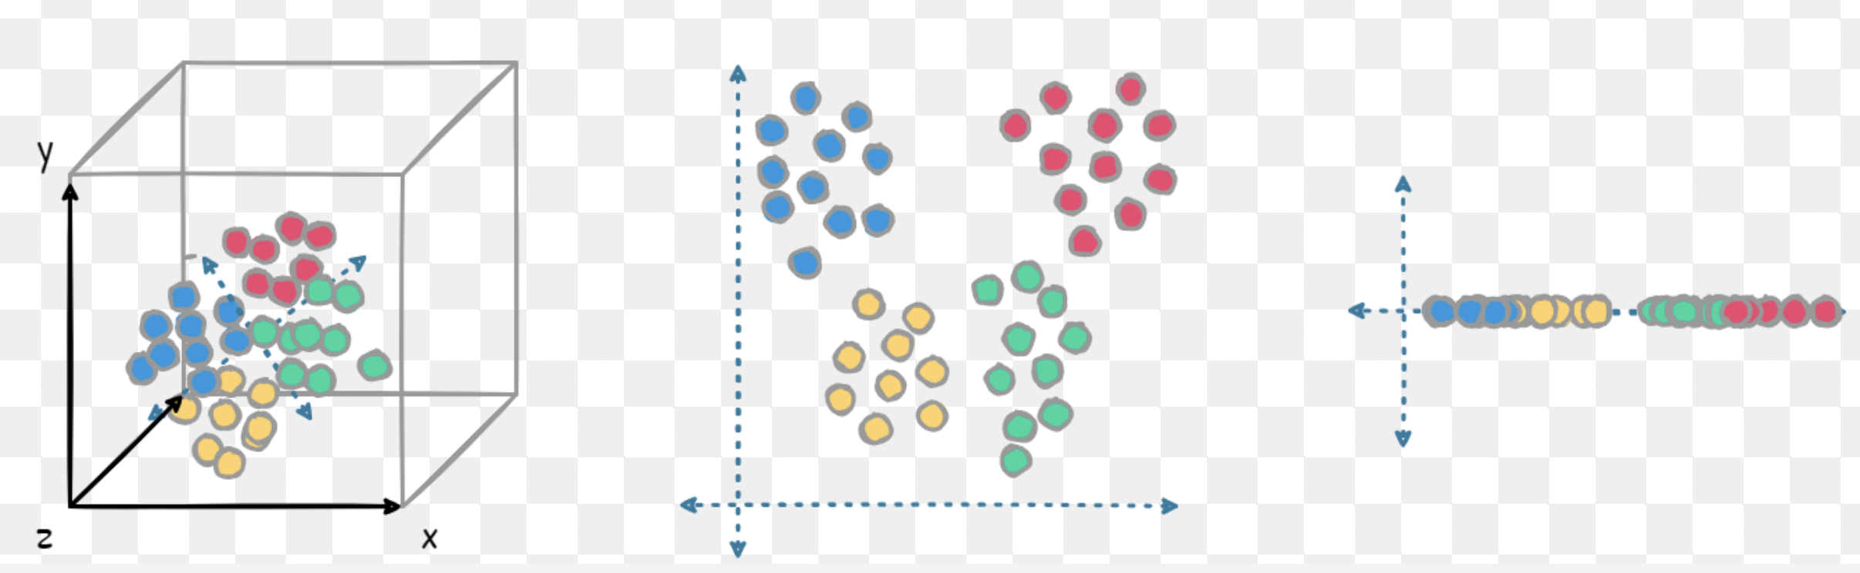
Dimensionality Reduction – Blob Data
This is a more realistic example, with blob-like data
*Image from Roboflow Blog

Slide 67
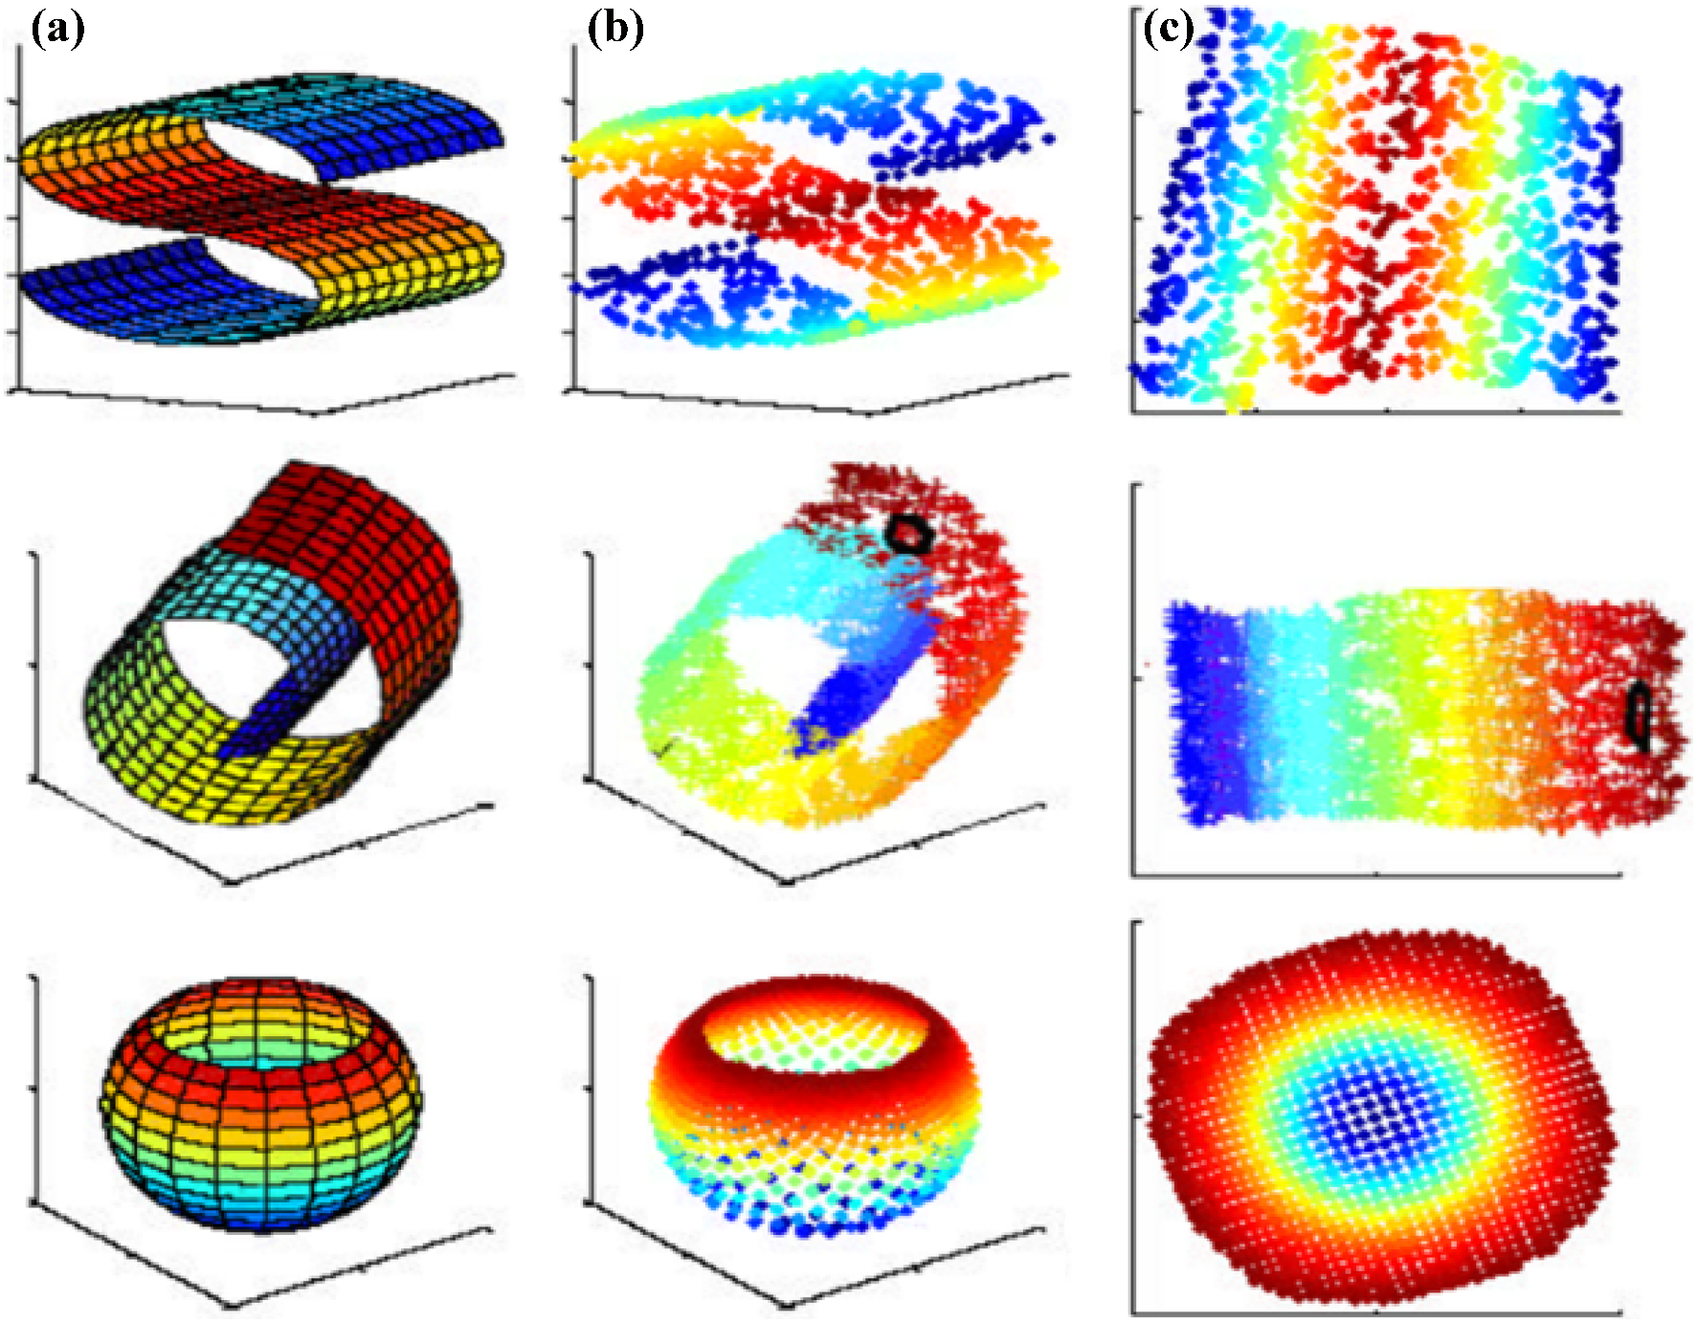
Dimensionality Reduction – Complex Structure
This is a more realistic example, with highly structured, non-linear data.
*Image from Jia et al., “Feature dimensionality reduction: a review”, Complex and Intelligent Systems 2022.

