Slide 1

The Researcher’s Guide to Multiple Statistical Comparisons
Instructor: Jillian Whitton
TA: TBD

Slide 2
This workshop is brought to you by:
Northwestern IT Research Computing and Data Services
Need help?
AI, Machine Learning, Data Science
Statistics
Visualization
Collecting web data (scraping, APIs), text analysis, extracting information from text
Cleaning, transforming, reformatting, and wrangling data
Automating repetitive research tasks
Research reproducibility and replicability
Programming, computing, data management, etc.
R, Python, SQL, MATLAB, Stata, SPSS, SAS, etc.
Request a FREE consultation at bit.ly/rcdsconsult.

Slide 3
Logistics
Ask Questions [in the zoom chat].
If you know the answer, feel free to respond (we may politely clarify if needed).
Our TA (name tbd) is also available to respond to any questions or comments.
If my internet goes out.
Take a 5 minute break, and we will meet back in the same zoom room.

Slide 4
Introduction and Goals

Slide 5
Statistical analysis is sometimes very straightforward. But sometimes it isn’t. We can find ourselves constructing more than one statistical model and performing more than one statistical test.
Classical statistical approaches are based on the probability of our results occurring by chance (p=0.05 for example), and basing “statistical significance” on this probability. A p-value of 0.05 means the results would only happen by chance 5% of the time.
But if we are doing more than one test, this can cause problems! We may need to make adjustments to our probability to correct for multiple testing.
Better still, we should plan our analysis – if we can – to reduce the likelihood of this happening in the first place.

Slide 6
Goals of the workshop
Explain basic concepts of hypothesis testing
Understand the effect of multiple testing on our ability to draw inferences from our data
Understand the importance of strategies to avoid or reduce multiple comparisons
Introduce some approaches to correct for multiple comparisons in our estimates
This shouldn’t be heavy on math – and there’ll be no coding

Slide 7
Hypothesis testing
We have a hypothesis we want to test, using our data (already existing, or collected for the purpose).
Typically: is there a relationship between an outcome and other observed data (for example, is there a relationship between car engine size and fuel consumption?)
We have a hypothesis we want to test, using our data (already existing, or collected for the purpose).
How likely are the results we are seeing, if the null hypothesis is true?

Slide 8
We’re testing to see if our data support the null hypothesis H₀. There are four possibilities.
 |  |  | Null hypothesis (H₀)
 |  |  | True | False
 |  |  | In reality
Decision about null hypothesis (H₀) | Accept | Based on our data | Correct inference | Type II error
 |  |  | True negative | False negative
 |  |  | Probability = 1 - α | Probability = ϐ
 | Reject |  | Type I error | Correct inference
 |  |  | False positive | True positive
 |  |  | Probability = α | Probability = 1 - ϐ
Our data will provide evidence for acceptance or rejection of the null hypothesis. They will give us a probability that it’s true*. And this means there’s a probability that we’ll get it wrong.

Slide 9
The p-value
Most often, we use a p-value: the probability of the association happening by chance, given that our assumptions and our model are both correct.
It’s the probability of a false positive: α or the Type I error rate.
In many fields, the usual criterion for “significance” is p=0.05 - but this is arbitrary and used by convention.

Slide 10
Multiple tests
What if we have more than one outcome? Or more than one relationship between outcome and dependent variables?
If we use our “usual” p=0.05 criterion:
Two tests: 5% from the first test, plus 5% of the remaining 95% from the second test. So our overall false-positive rate is now
5% of 100% (first test) + 5% of 95% (second test)
= 9.8%

Slide 11
Multiple tests can blow up rapidly!

Slide 12
So what can we do?
Two approaches:
The “standard” approach - make adjustments to our significance criteria.
A more “holistic” way of addressing the issue; plan our study carefully to avoid or reduce the problem.
These are not separate options – we can use both approaches!

Slide 13
Statistical corrections
As we’ve seen, we can’t just use our “usual” p=0.05 calculations criterion if we’re making multiple comparisons – this no longer corresponds to a 5% false positive rate. If we’re doing ten tests, it’s 40%.
We can adjust our criterion to correct for this. There are a lot of options, with different pros and cons, and applicable to different types of data.
A brief overview of the most common approaches follows – but talk to a statistician about your specific needs!

Slide 14
Family-wise error rate
How many comparisons are we making? It’s not as trivial as it sounds.
FWER = the probability of making at least one type I error when making a specified group (“family”) of related tests.
We can think of it as all the tests we might test within our hypothesis and its associated model.

Slide 15
Bonferroni correction
Reduce the effective false-positive rate (family-wise error rate).
If we’d normally use a false-positive rate of α, and we’re performing n tests, our new rate is α/n
So: if we have five tests and we’d use 0.05 for one test -> use 0.01
Easy to calculate
Quite conservative – it’s more likely to exclude a “positive” result than include a “negative” one. This is often what we want, but not always

Slide 16
Holm-Bonferroni correction
Another approach to the false-positive rate
We get n p-values from our data: sort the list in highest-to lowest order
If our first p-value is less than or equal to is α/n, it’s “significant” and so are all the subsequent ones. Otherwise, it isn’t - move to the next one.
If the next p-value is less than or equal to is α/(n-1), it’s “significant” and so are all the subsequent ones. Otherwise, it isn’t - move to the next one.
And so on. If p_{m} ≤ α/(n-(m-1)), accept it and all the remaining ones.
This test is less conservative than Bonferroni.

Slide 17
Exercise
We performed five tests and got the following p-values:
0.012, 0.042, 0.006, 0.023, 0.002
With a significance level of p = 0.05, which tests do we accept as significant using:
- Bonferroni (p ≤ α/n)?
- Holm-Bonferroni (sort in descending order, p_{m} ≤ α/(n-(m-1))?

Slide 18
Exercise
For clarity, let’s sort the results:
P-values | 0.042 | 0.023 | 0.012 | 0.006 | 0.002
Significance level (Bonferroni) | 0.01 | 0.01 | 0.01 | 0.01 | 0.01
Significant |  |  |  | * | *
Order | 1 | 2 | 3 | 4 | 5
Significance level (Holm-Bonferroni) | 0.01 | 0.0125 | 0.0167 | - | -
Significant |  |  | * | * | *

Slide 19
Exercise
What are the advantages and disadvantages of being:
more conservative (Bonferroni)?
less conservative (Holm-Bonferroni)?
Think about what you’re trying to do with your analysis. When might we prefer one over the other?
Put your thoughts in the chat!

Slide 20
Tukey’s range test
We have multiple estimates of group means (income levels by age group, for example)
Is the largest difference among means statistically significant?
The Tukey test statistic is q = |Y_{a} – Y_{b}| / SE
Compare q to the q_{α} value from the Studentized range distribution for the specified Type I error rate α. If q > q_{α}, we can say that the two means are significantly different.
Considers all pairwise comparisons.
Group sample sizes must be equal (this has been extended as the Tukey-Kramer test).

Slide 21
Example
Four sets of observations:
 |  |  |  |  |  | Total | Mean (μ)
Group 1 | 6.9 | 5.4 | 5.8 | 4.6 | 4.0 | 26.7 | 5.34
Group 2 | 8.3 | 6.8 | 7.8 | 9.2 | 6.5 | 38.6 | 7.72
Group 3 | 8.0 | 10.5 | 8.1 | 6.9 | 9.3 | 42.8 | 8.56
Group 4 | 5.8 | 3.8 | 6.1 | 5.6 | 6.2 | 27.5 | 5.50
 |  |  |  |  |  | 135.6 | 6.78
Four means: μ1 μ2, μ3, μ4. Six comparisons of means (all the permutations): μ2−μ1, μ3−μ1, μ1−μ4, μ2−μ3, μ2−μ4, μ3−μ4
95% confidence interval with 20 observations and 4 groups -> the required percentile of the Studentized range distribution is q_{0.05;4,16} (we look this up or get it from statistical software)
Applying this yields:
0.29 ≤ μ2−μ1 ≤ 4.47 1.13 ≤ μ3−μ1 ≤ 5.31 −2.25 ≤ μ1−μ4 ≤ 1.93
−2.93 ≤ μ2−μ3 ≤ 1.25 0.13 ≤ μ2−μ4 ≤ 4.31 0.97 ≤ μ3−μ4 ≤ 5.15
Four comparisons are significant.

Slide 22
Dunnett’s test
Similar to Tukey’s test, but used in a situation where we are comparing multiple means to a single control group
Compute a t-statistic for each group against the common control group.
The t-statistics are all derived from the same estimate of the pooled error across all treatment and control groups.
We then test the largest of these statistics against a suitably chosen one- or two-sided Dunnett's test critical value.
Note: both Tukey’s and Dunnett’s tests (and all the others we’re covering) can be done in R, SAS and other statistical packages

Slide 23
What if we have a LOT of tests?
The approaches we’ve discussed so far work well if we have a relative handful of comparisons
In many situations (such as genome or cell-biology studies) we have thousands of them.
All of the “standard” approaches will blow up if we apply them to such a large number.
So what can we do?

Slide 24
False discovery rate
We have an exploratory analysis including a large number of tests.
How many of them are naively “significant”?
Of our statistically significant results, how many do we expect to be false positives (false discoveries)?
False discovery rate (FDR): the expected rate of false discoveries (i.e. type I errors) as a proportion of all statistical positives:
FDR = E|V/(V+S)|
where V is the number of false positives and S is the number of true positives.

Slide 25
Controlling the FDR
Benjamini-Hochberg procedure: control the FDR for m tests at level α as follows.
Find the largest k such that P_{(k)} ≤ αk/m
Reject the null hypothesis (i.e. consider as true positive) for all hypotheses H_{(i)} for i = 1, …, k)
We can visualize this as a straight-line plot with slope α/m, with all points below the line, on the left, considered discoveries.
Conceptually similar to Holm-Bonferroni

Slide 26
An example, with 25 observations

Slide 27
It’s important to remember that and FDR-based approach is exploratory – we’re using it to identify promising associations for further study.
Its less conservative than FWER approaches like Bonferroni. That’s what we want from an exploratory analysis!

Slide 28
Bayesian approaches
Is the null hypothesis (that there is zero difference between groups) ever really true? Do we ever really believe it’s true?
An alternative: a multilevel model in which all the comparisons take account of information from the other comparisons.
Fit this partially-pooled framework to determine posterior probabilities, using Bayesian-specific techniques.
Simple models can be fitted using R or SAS.
It all rests on our prior probabilities – in practice, this can be a problem.

Slide 29
Other methods
This is just an overview of some of the most common adjustment techniques.
Talk to your statistician!
If you don’t have one, we can help: bit.ly/rcdsconsult

Slide 30
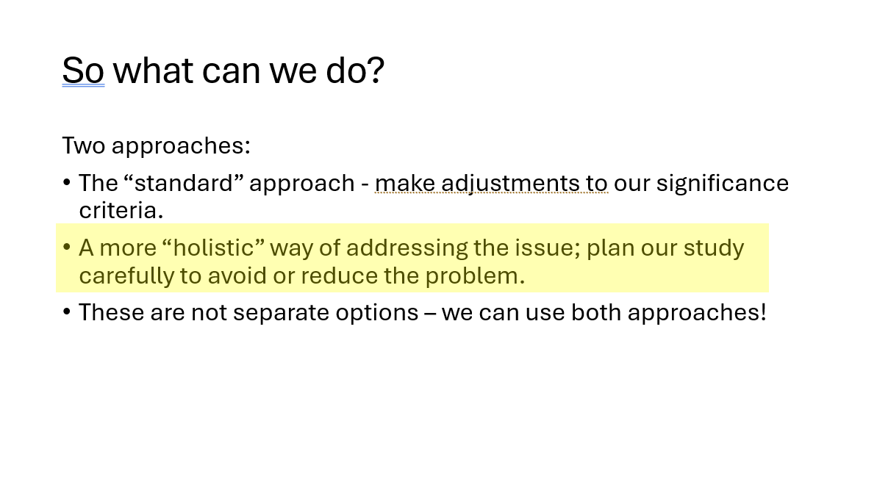
Going back to an earlier slide…

Slide 31
Important things to think about
Every time we have to make multiple comparisons, we’re reducing the effectiveness of our analysis – if we’re using a Bonferroni correction for five comparisons, and we’d usually use p = 0.05, we have to use p = 0.01.
Sometimes it’s unavoidable – but there are things we can do to avoid or reduce having to do it.
More statistical power, maybe lower cost.

Slide 32
Plan, plan, plan…
What’s the hypothesis? How specific can we be?
What’s the outcome?
What does the outcome depend on?
Do we need to control for anything?
How exploratory do we want to be?
Fishing for significance is tempting – especially when we’re confident there’s a “real” effect somewhere. “Let’s try this and see if we can get the p-value down”

Slide 33
Exploratory analysis vs. hypothesis testing
We need to think about what we are doing, and plan accordingly.
Exploratory analysis, where we have no preconceived ideas about what we are going to find, is perfectly valid…

Slide 34
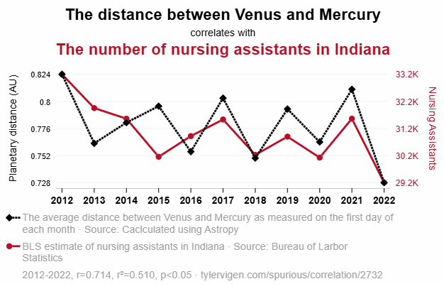
… but it’s dangerous!

Slide 35
Don’t let this happen to you! Think about the mechanisms, not just the statistics.
In exploratory analysis, use the false discovery rate to control p-values.
Remember your results are preliminary.
Extraordinary claims require extraordinary evidence!

Slide 36
In a hypothesis-driven analysis, make a plan before you start!
Drafting a “Table 1” is REALLY helpful. It can be empty at this point, but it helps you think about potential associations. What do you want to include in your tests? What might influence your outcome?
Covariate | Level | Mean annual temperature
Year | 1980-89
 | 1990-99
 | 2000-09
 | 2010-19
Latitude (degrees) | 0-20
 | 20-40
 | 40-60
Climate type | Wet
 | Medium
 | Dry

Slide 37
Refining/building your model during analysis is generally considered OK (although this isn’t completely cut and dried) – but don’t throw in new covariates you haven’t considered before – unless you adjust for multiple comparisons.
If you’re working with continuous variables (such as temperature) and you want to divide it into categories, use what you know about the science to do so – or use commonly-accepted divisions such as age over/under 18.
Avoid percentiles– it’s hard to replicate or generalize these.
And absolutely DON’T derive the divisions based on generating the “best” p-value.
And beware of convincing yourself to stretch the limits!

Slide 38
Exercise
Here are two study proposals.
What are the multiple-comparisons issues?
Can they be alleviated, and if so, how?
Put your thoughts/suggestions in the chat. (No right or wrong answers here!)

Slide 39
1. We are monitoring the health of patients after cardiac surgery, and would like to know if there’s a relationship between requiring a second procedure, demographic factors, and other health measures.
2. We are evaluating a pilot survey questionnaire of 25 questions. We would like to know which questions have a non-response rate of more than 10%.

Slide 40
Wrapping up
This is a complicated issue – and we can often justify several different approaches.
It’s more important to be able to recognize that there might be a multiple-comparisons issue than it is to know which approach to take – that will emerge and evolve as you formulate your plan.
If in doubt, talk to a statistician!
RCDS free consultation service: bit.ly/rcdsconsult
Any questions or feedback: jillian.whitton@northwestern.edu

