Slide 1


Slide 2
Setup...
slides are at https://github.com/nuitrcs/nextflow_nfcore_intro
log onto Quest via terminal (or Quest OnDemand)
ssh <netid>@quest.northwestern.edu # enter your netid password
move to our classroom folder
cd /projects/e32559
make your own subfolder if you haven’t already
mkdir <folder_name>

Slide 3
Nextflow: a DSL for parallel and scalable computational pipelines
Data-driven computational pipelines
Nextflow enables scalable and reproducible scientific workflows using software containers. It allows the adaptation of pipelines written in the most common scripting languages.
Its fluent DSL simplifies the implementation and the deployment of complex parallel and reactive workflows on clouds and clusters.
https://www.nextflow.io/

Slide 4
Let's break that down...
DSL = domain specific language
Parallel = tasks that are not dependent can run at the same time
Scalable = can be run on one or many samples with the same format
Nextflow is a programming language, specifically for building computational pipelines. If you'd like to build your own pipelines, you will have to learn their syntax. But, there are many prebuilt pipelines!
The benefits of Nextflow pipelines are their scalability, and their reproducibility.

Slide 5
Pipelines are series of tasks with dependent inputs and outputs
Raw sequencing data
Quality control
Trim adaptors
Remove contaminants
Align to reference genome
Quantification

Slide 6
Pipelines are series of tasks with dependent inputs and outputs
Raw sequencing data
Quality control
Trim adaptors
Remove contaminants
Align to reference genome
Quantification
You could work through this step by step, sample by sample.
You could work through each step with all samples with a job array.
You could work through all steps with all samples with dependent job arrays.

Slide 7
Pipelines are series of tasks with dependent inputs and outputs
Raw sequencing data
Quality control
Trim adaptors
Remove contaminants
Align to reference genome
Quantification
So why nextflow?
some pipelines are pre-developed, less time troubleshooting your own scripts
containerized software for reproducibility and portability
many people using the same pipelines and working on their development

Slide 8
Pipelines are series of tasks with dependent inputs and outputs
Raw sequencing data
Quality control
Trim adaptors
Remove contaminants
Align to reference genome
Quantification
But there are cons!!
blackbox - little understanding of what’s happening under the hood
hard to troubleshoot when you do encounter errors
working in a high-throughput might not notice issues with individual samples
can remove tailoring parameters to best fit your own particular data

Slide 9
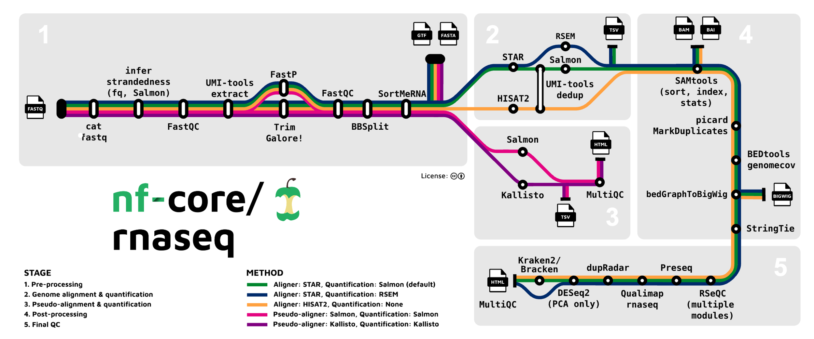
Pipelines are series of tasks with dependent inputs and outputs

Slide 10
nf-core: A global community effort to collect a curated set of open‑source analysis pipelines built using Nextflow.
https://nf-co.re/ - Website with documentation, pipelines, other information.
https://nf-co.re/docs/ - Direct link to documentation pages
https://www.youtube.com/@nf-core - Youtube videos provided by nf-core
Currently 68 released pipelines, 37 under development, and 13 archived.
ampliseq, detaxizer, crisprseq, demultiplex, mag, methylseq, rnaseq, demo, smrnaseq, pairgenomealign, chipseq, scnanoseq, multiplesequencealign, taxprofiler, raredisease, fastquorum, isoseq, funcscan, sarek, nanostring, oncanalyser, scrnaseq, denovotranscript, pixelator, proteinfold, reportho, eager, bacass, mhcquant, airrflow, callingcards, epitopeprediction, rnasplice, differentialabundance, bamtofastq
https://nf-co.re/pipelines/

Slide 11
https://nf-co.re/rnaseq/3.17.0/

Slide 12
Nextflow command
cat /projects/e32559/nextflow_example/script.sh
nextflow run nf-core/rnaseq \
--input /projects/e32559/nextflow_example/samples.csv \
--outdir /projects/e32559/<folder>/nextflow_output \
--gtf /projects/e32559/example_data/braker.gtf \
--fasta /projects/e32559/example_data/oenotheraHarringtonii.softmasked.fasta \
-profile nu_genomics \
-with-report \
-with-trace

Slide 13
Nextflow command
cat /projects/e32559/nextflow_example/script.sh
nextflow run nf-core/rnaseq \
--input /projects/e32559/nextflow_example/samples.csv \
--outdir /projects/e32559/<folder>/nextflow_output \
--gtf /projects/e32559/example_data/braker.gtf \
--fasta /projects/e32559/example_data/oenotheraHarringtonii.softmasked.fasta \
-c /projects/e32559/nextflow_example/nextflow.config \
-with-report \
-with-trace

Slide 14
Copy the nextflow script to your folder
pwd # this should be /projects/e32559/<your folder>, otherwise
cd /projects/e32559/<your folder>
# then
cp /projects/e32559/nextflow_example/script.sh .
nano script.sh
# change the --outdir to your folder, then control+O to save, followed by enter
# and control+X to exit nano
sbatch script.sh
squeue -u <netid>

Slide 15
Look at a completed run
sacct -X -S 111924 # this will show all jobs from November 19th, 2024
7133232 script.sh normal e32559 1 COMPLETED 0:0
7133237 nf-NFCORE+ normal e32559 1 COMPLETED 0:0
7133238 nf-NFCORE+ normal e32559 1 COMPLETED 0:0
7133266 nf-NFCORE+ normal e32559 2 COMPLETED 0:0
7133267 nf-NFCORE+ normal e32559 12 COMPLETED 0:0
7133274 nf-NFCORE+ normal e32559 6 COMPLETED 0:0
7133275 nf-NFCORE+ normal e32559 12 COMPLETED 0:0
7133283 nf-NFCORE+ normal e32559 12 COMPLETED 0:0
7133716 nf-NFCORE+ normal e32559 1 COMPLETED 0:0
7133721 nf-NFCORE+ normal e32559 6 COMPLETED 0:0
7133875 nf-NFCORE+ normal e32559 6 COMPLETED 0:0
7133880 nf-NFCORE+ normal e32559 12 COMPLETED 0:0
7134482 nf-NFCORE+ normal e32559 6 COMPLETED 0:0
7134483 nf-NFCORE+ normal e32559 6 COMPLETED 0:0
7134490 nf-NFCORE+ normal e32559 2 COMPLETED 0:0
7134491 nf-NFCORE+ normal e32559 2 COMPLETED 0:0
7134509 nf-NFCORE+ normal e32559 1 COMPLETED 0:0
7134510 nf-NFCORE+ normal e32559 1 COMPLETED 0:0
7134511 nf-NFCORE+ normal e32559 1 COMPLETED 0:0
7134553 nf-NFCORE+ normal e32559 6 COMPLETED 0:0
7134554 nf-NFCORE+ normal e32559 6 COMPLETED 0:0
7134577 nf-NFCORE+ normal e32559 6 COMPLETED 0:0
7134636 nf-NFCORE+ normal e32559 6 COMPLETED 0:0
7134679 nf-NFCORE+ normal e32559 6 COMPLETED 0:0
7134680 nf-NFCORE+ normal e32559 6 COMPLETED 0:0
Parent job
Subsequent jobs launched by nextflow pipeline

Slide 16
Pipeline output - what to expect when it works
nextflow_output
fastqc - QC reports for samples
multiqc - QC reports for processed samples
star_salmon - bulk of output from alignment and annotation steps
trimgalore - output of sample processing with Trimgalore, and QC after trimming

Slide 17
Output and log files - to help troubleshoot
nextflow will create the following in your working directory
.nextflow hidden folder (ls -a needed to see this)
.nextflow.log hidden log file (ls -a needed to see this)
work folder
nextflow_output folder (which we named in the submission script)
because we added --with-report and --with-trace this will include a pipeline folder with
execution_report_2024-11-19_09-53-12.html
execution_timeline_2024-11-19_09-53-12.html
execution_trace_2024-11-19_09-53-12.txt
slurm will create the following in your working directory
slurm-<jobID>.out log file from slurm

Slide 18
Broken script example 1
Demo:
sbatch /projects/e32559/nextflow_example/broken_script1.sh
squeue -u hsc945
sacct -X
ls -alh
cat slurm-7192720.out
Error:
--input: the file or directory '/projects/e32559/nextflow_example/sampls.csv' does not exist.

Slide 19
Broken script example 2
Demo:
sbatch /projects/e32559/nextflow_example/broken_script2.sh
squeue -u hsc945
sacct -X
ls -alh
cat slurm-7195215.out
Error:
-- Entry 1: Missing required value: strandedness

Slide 20
Broken script example 3
Demo:
sbatch /projects/e32559/nextflow_example/broken_script3.sh
squeue -u hsc945
sacct -X
ls -alh
cat slurm-7196307.out
Error:
/var/spool/slurmd/job7196307/slurm_script: line 12: nextflow: command not found

Slide 21
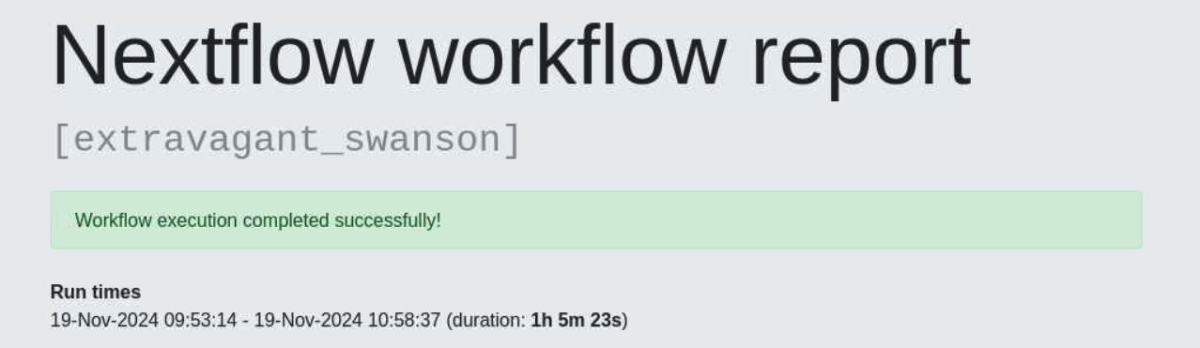
Execution trace/report/timeline files can help show what step failed, if internal job fails
Demo:
qondemand.ci.northwestern.edu
launch Gnome Desktop job
open execution report file from completed run

Slide 22

Questions?
Open a ticket with us - quest-help@northwestern.edu
Reach me in particular - haley.carter@northwestern.edu
Visit our website - https://www.it.northwestern.edu/departments/it-services-support/research/
Our team does consultations as well as workshops, let us know if you’d like to chat about your research, troubleshoot something together, or even have us come to a lab meeting!

