Slide 1


R Fundamentals
You should have R & RStudio installed
Download the materials from GitHub
https://github.com/nuitrcs/r-reu-workshop

Slide 2
Research Computing and Data Services
Instructors:
Ritika Giri
Northwestern IT

Slide 3
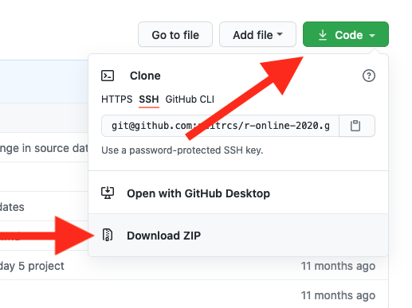
Download materials from github
Step 1: Download as a zip file
Step 2: Unzip the downloaded file
Click on Code
Click on Download Zip
MacOS
Go to “Downloads”
Double-click the file to unzip
Move unzipped folder to desired place (like Documents or Desktop)
Windows
Go to “Downloads”
Right click on the file, then select “Extract All”
Select the desired destination to extract to in the pop-up dialog box
See also: https://www.lifewire.com/unzip-files-windows-11-8425832
Instructions: https://sites.northwestern.edu/researchcomputing/resources/downloading-from-github/

Slide 4
Sticky Notes
I'm done/
doing OK
I need help/
I'm stuck

Slide 5
What are we doing today?
Getting to know R and RStudio
1
Practicing the concepts and commands that you need for data analysis with R
2

Slide 6

Who are you?
Done any coding before?
Majoring in?
Love cats?
Feeling apprehensive?
Feeling confident?
Used R before?

Slide 7
Double click on the .RProj file to open the project in RStudio
Let’s start !

Slide 8
Welcome to RStudio!

Slide 9

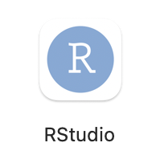
R vs RStuDio
R is a programming language
Runs code, produces output
RStudio is a feature-rich interface that runs on top of R
Makes it easier to write code

Slide 10
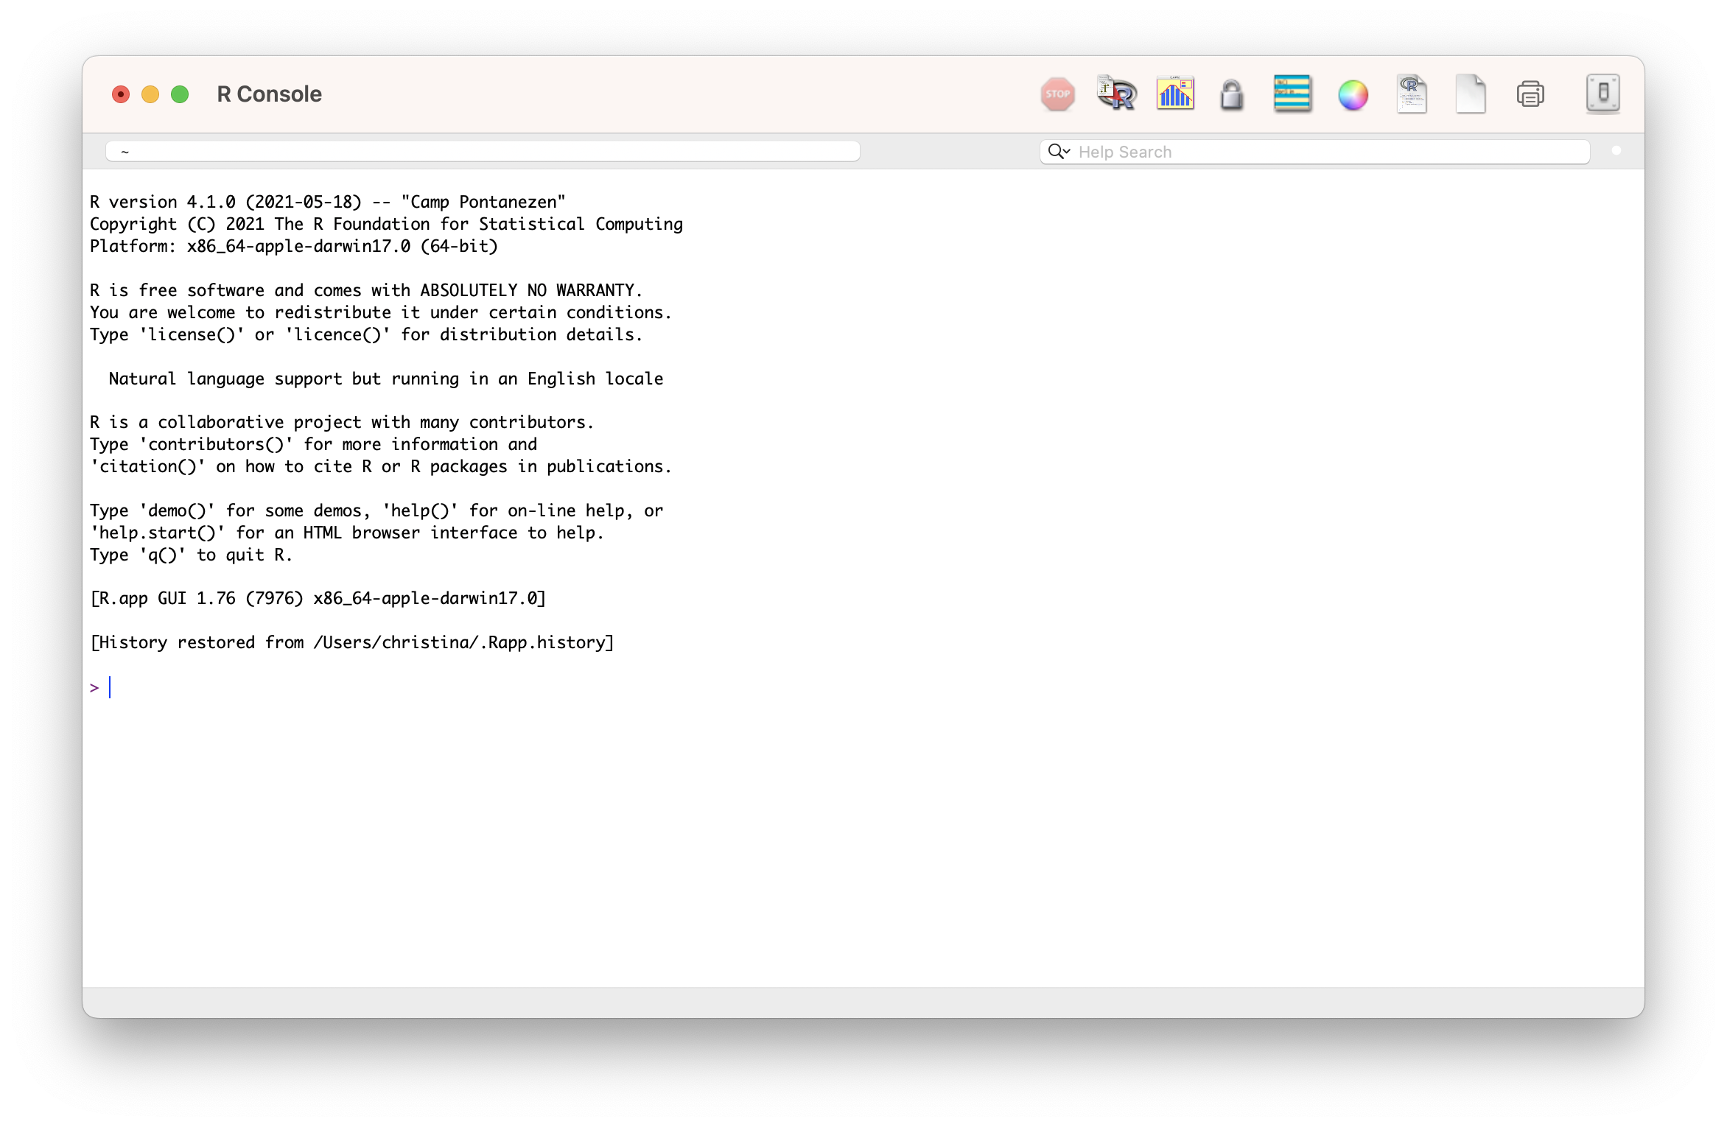
R vs RStuDio

Slide 11
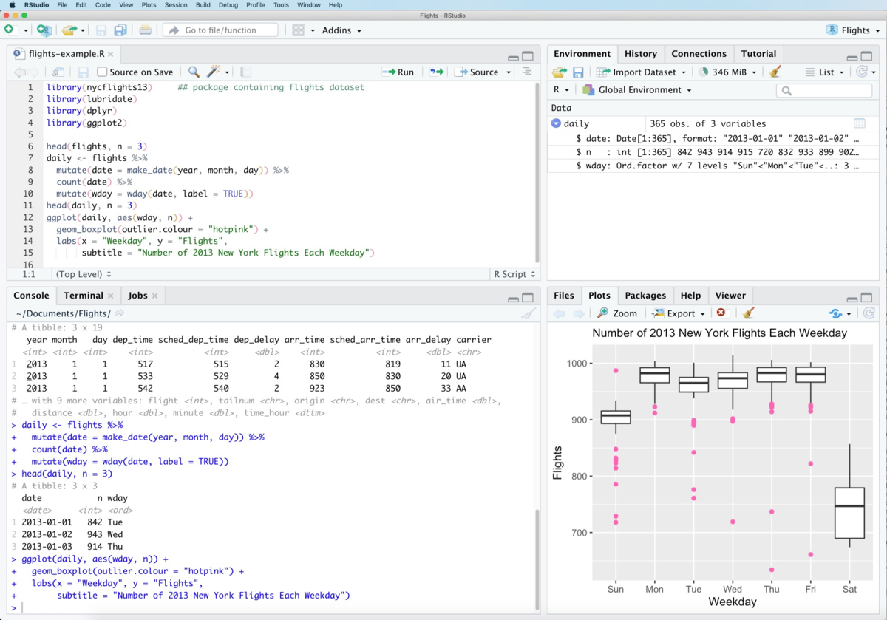
R vs RStuDio

Slide 12
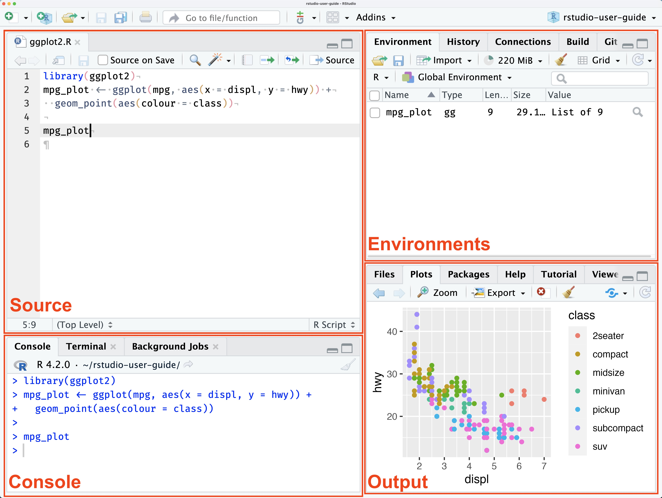
Rstudio pane layout
SOURCE
This is where you write your code!
Your code won’t be evaluated until you “Run” them to the console.
ENVIRONMENT
Here you can see what objects are in your working space
FILES / PACKAGES /PLOTS
Here you can see what file directories, view plots, see your packages, and access R Help
CONSOLE
This is where your code from Source is evaluated by R.
You can also use the console for quick calculations that you don’t need to save.

Slide 13
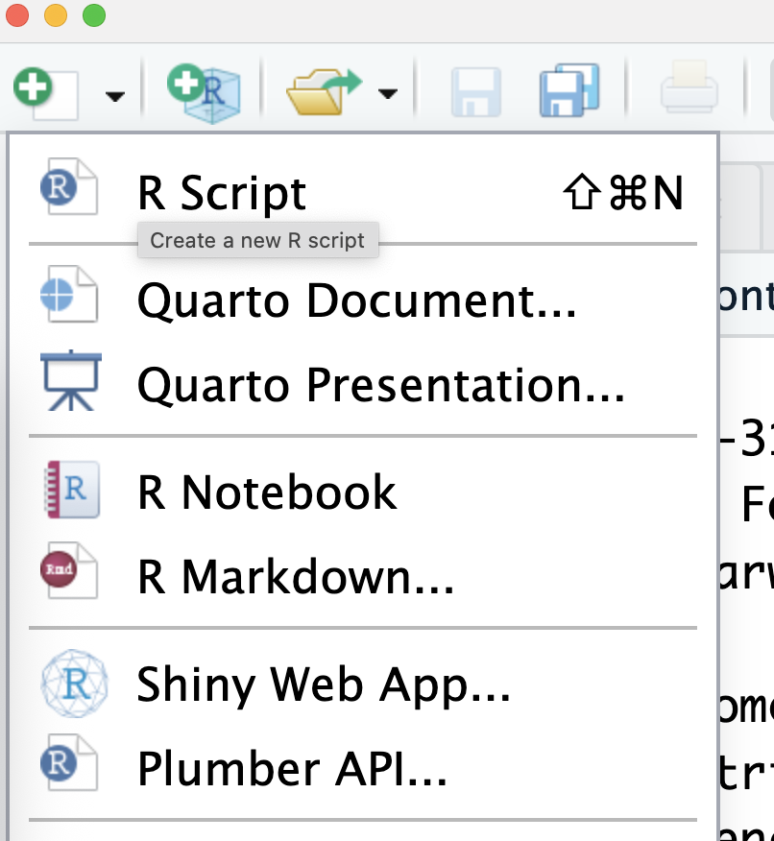
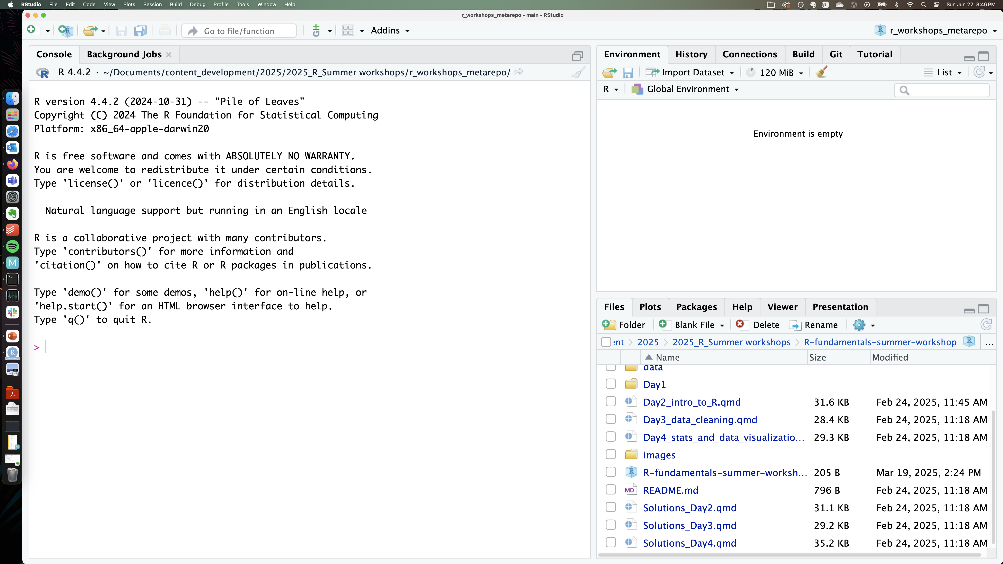
Rstudio pane layout
No SOURCE pane?
If no files are open to write code in, the source tab is minimized.
To see the source pane, open any new file!

Slide 14

TRY IT ..
exercise
Type some math operations in the console and get answers.
Explore the file structure and click on the buttons in the File pane to see what they do!
Warning – deleting files IN r is permanent
The Delete function in the Files pane in RStudio uses the system "Delete" command rather than using the Trash Can/Recycle bin of the system.
We recommend only using the Delete function to remove files or directories that you are sure you want to delete permanently.

Slide 15
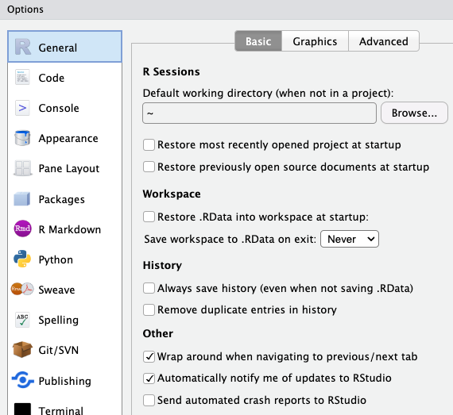
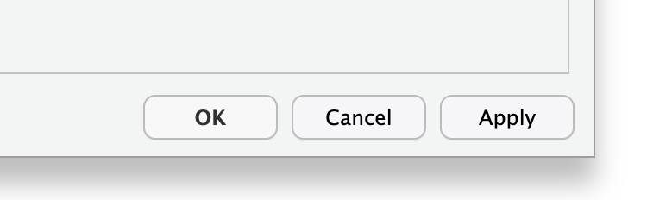
Suggested settings for rstudio
Where:
Tools > Global Options >
General > Basic (tab)
6
Why:
We don’t want to create anything that cannot be reproduced from the R script alone
i.e. no saving history or workspace
Optional
change to a convenient location for you!
1
2
5
3
4
Remember!
Click on “Apply” to apply the new settings

Slide 16
Writing code in R files

Slide 17
Commonly used code-files in rstudio
Popular file formats used by researchers and R coders:
R script (.R)
R Markdown (.Rmd)
Quarto Markdown (.qmd)

Slide 18
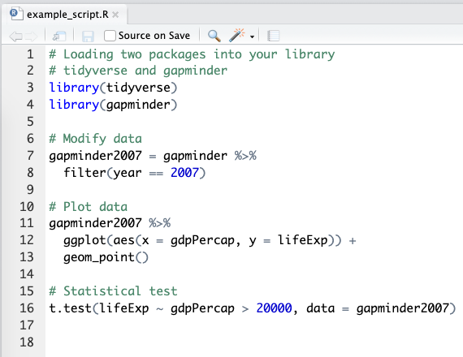
R script file
What:
A script is a list of instructions.
It is a text file. No special software is required to view one.
Notice the file extension – example_script.R
# this is a code comment
Some parts of the script read like normal English. These lines start with a # - they are called “comments”. These are notes of what we are doing, for others and our future selves!
Code lines
Lines that don’t start with # are R code. When the R script is executed by the console, only R code lines will be evaluated and run.

Slide 19
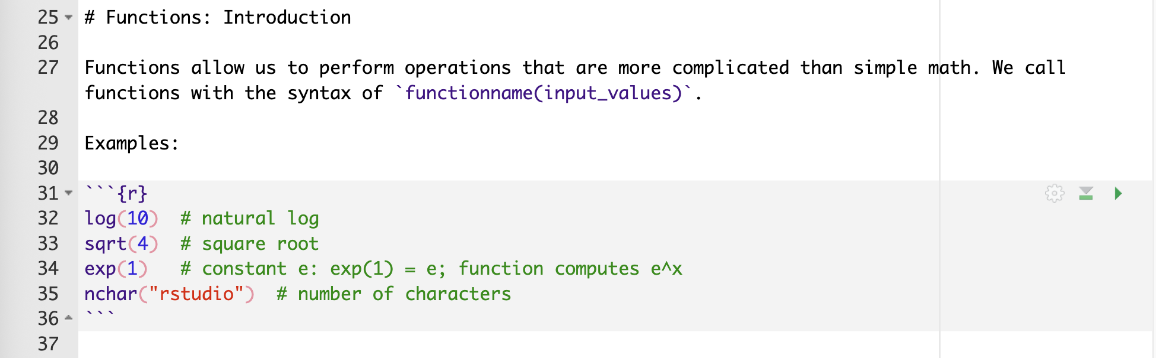
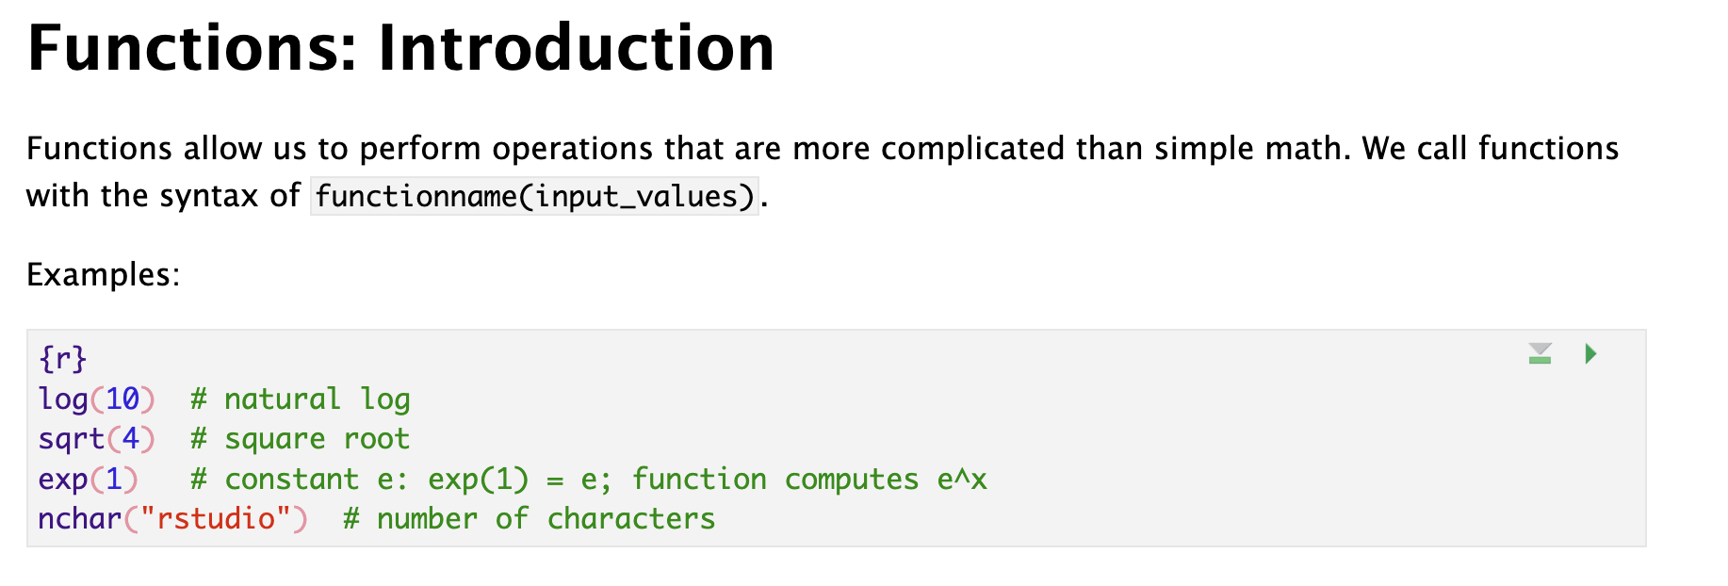
R / Quarto MARKDOWN file
What:
R Markdown is a file format for making dynamic or interactive documents with R.
.Rmd - R Markdown file extension
.qmd – Quarto Markdown file extension
It contains both plain text and code chunks.
R Markdown file in plain text format
Markdown
A markup language for creating formatted text using a plain-text editor.
R Markdown file after rendering
Plain markup text
Write in English (or any language). Use special symbols to indicate formatting, (note how # creates a heading in the example)
Code chunk
```{r}
2 + 2 # code for addition
```
Triple backticks in the format above indicate a code chunk that can be executed through the R console.

Slide 20
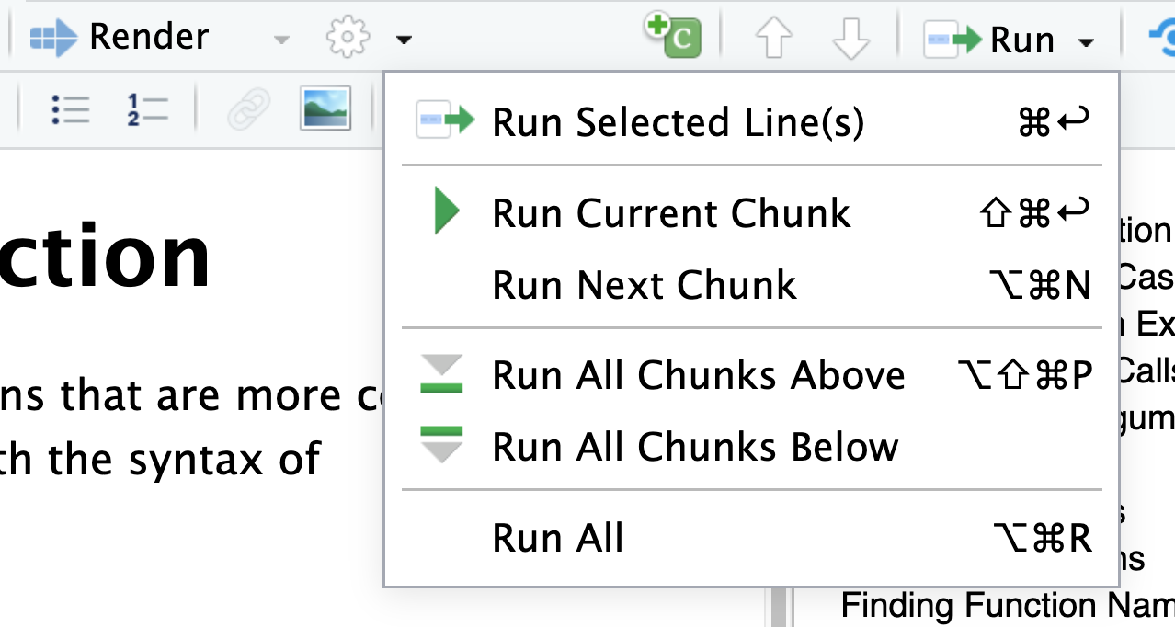
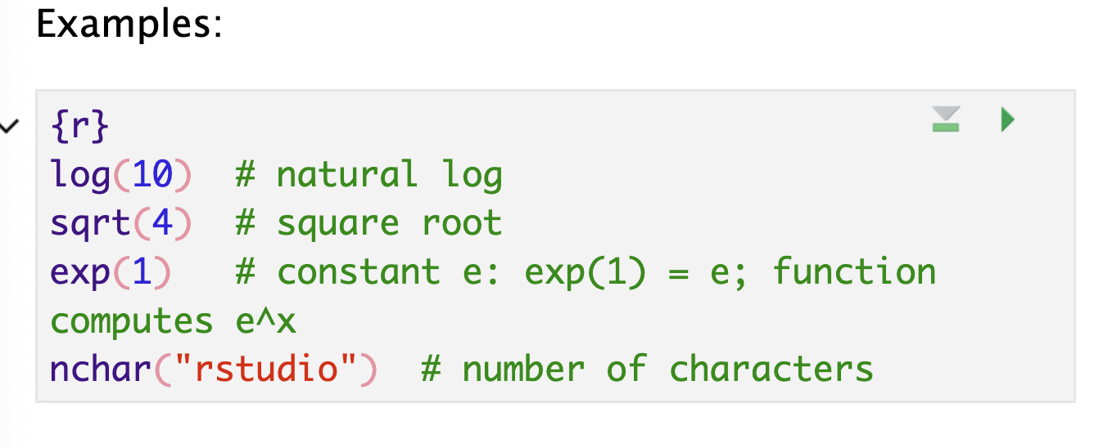
R / Quarto MARKDOWN file – helpful menu buttons
Inserting a code chunk
keyboard shortcut Ctrl + Alt + I (OS X: Cmd + Option + I)
Add chunk menu button in the editor toolbar
Executing code
Executing a single line
To execute the line of source code where the cursor currently resides press the Ctrl+Enter keys (or use the Run toolbar button). This works for both .R scripts and .Rmd/.qmd files.
Executing multiple lines
Select the lines to run, and press Ctrl+Enter
Select one of the options in the Run Menu drop-down
Some shortcuts are present in the top-right for each chunk:

Slide 21
TRY IT ..
exercise
Open the file welcome.R
Can you spot code lines and comment lines?
Open any .qmd file –
Insert a code chunk in this file

Slide 22
R Packages

Slide 23
R packages
What:
R packages are extensions to the R programming language
Contain code, data, and documentation in a standardized format that can installed by other R users
Examples of useful packages:
haven (Enables R to read and write data from SAS, SPSS, and Stata)
ggplot2 (R's famous package for making beautiful graphics)
survival (Tools for survival analysis)
Why:
Enable re-use of code within the R ecosystem in a reproducible manner
Using a package:
Packages need to be installed on your computer and then loaded into your R session before you can use them. Packages are stored in a directory on your computer called a library.
Finding a package:
You can search for packages on CRAN or by using “task views”, which organize packages by specific areas of application. (CRAN - https://cran.r-project.org/web/packages/)

Slide 24
using R packages
Installing a package
# run this command to install a desired package
install.packages(“package-name”)
Loading a package
# run this command to use the package
library(package-name)
# notice - no quotes for package-name
What R does when you install
package-name will be found on a repository (eg. CRAN), downloaded to your local machine, and stored in the library folder
What R does when you load
package-name will be found in the library folder of your computer, and loaded into RAM (memory) for easy access in your current R session
You only install once!
Once package-name is installed on your machine it lives on your hard drive and doesn’t need to be installed again (except for package updates, where the updated version is downloaded fresh from the repo).
You load every *RAM* time!
Every fresh R session will require loading package-name into RAM for use during that session. When you close out R, the RAM for that session is refreshed and all loaded packages are lost.

Slide 25

TRY IT ..
exercise
Install the following packages on your computer
tidyverse
janitor
Now, use the library command to load them into your R session
Installing a package
install.packages(“package-name”)
Loading a package
library(package-name)

Slide 26
Functions

Slide 27
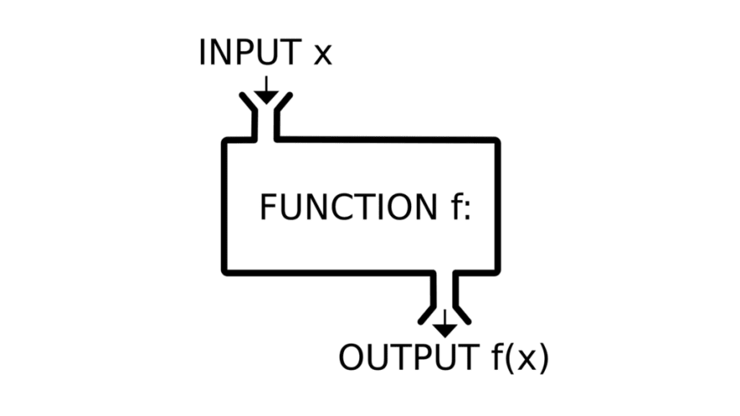
Functions in programming ~ similar to math functions
f(x) = y
Takes input values, also called parameters or arguments
Returns an output value, also called a return value
R functions usually don't alter their input values (but they sometimes do!)

Slide 28
Why should you use functions?
Pieces of code designed to perform specific tasks
You can re-use them multiple times without re-writing the same code
They help you organize your code into manageable chunks
You can use them just knowing their input and output
→ They help you write code that is clearer and less error prone. They also help you conserve your valuable brain power

Slide 29
Data Frames

Slide 30
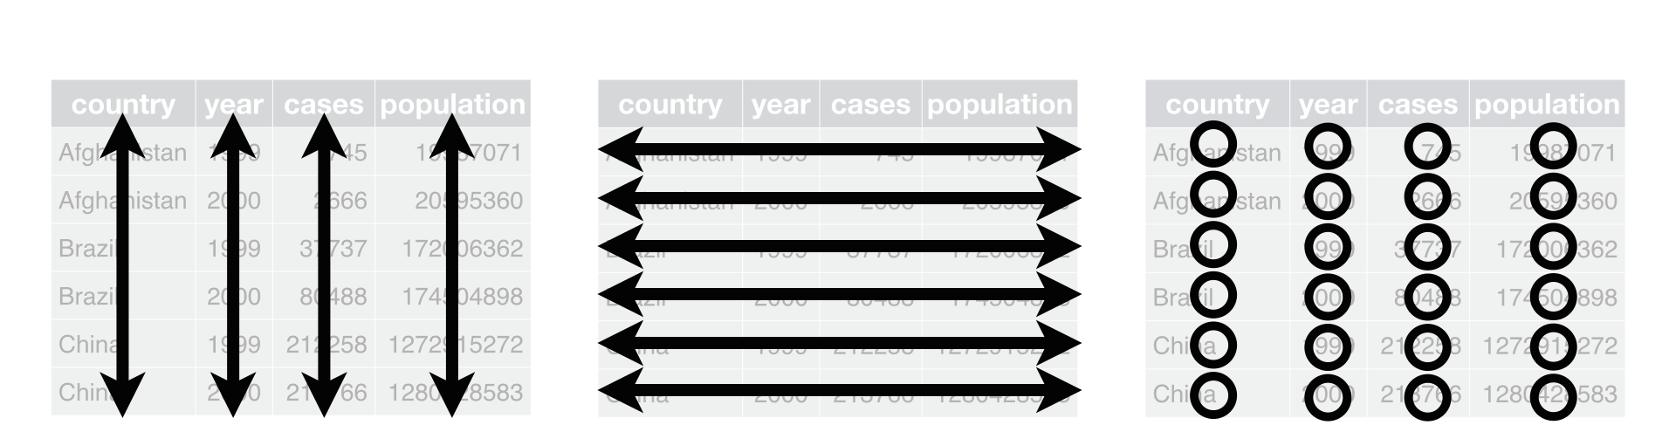
Data Frames: Rectangles of Data
View(data)
variables/
features
observations
values

Slide 31
Rows: Observations
nrow(data)
Person (or mouse, worm, etc.)
Country
Year
Run/trial of an experiment
Chemical
Sample

Slide 32
Columns: Variables
ncol(data)
Measurements
Grouping/identification variables:
> trial/sample
> condition
> label for the observation (country name)
Each ID variable in its own column

Slide 33
{ CODE SESSION }

Slide 34
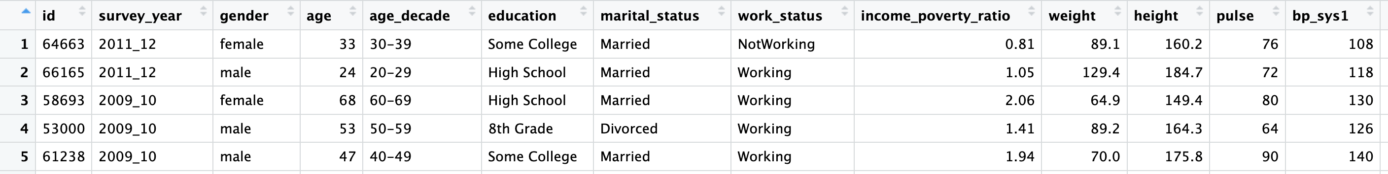
Data Frames – the NHANES data set
View(data)

Slide 35
Data Frames: The $ operator
Access columns by names as:
data$column
Example
healthdata$age

Slide 36
Data Frames: Indexing
Access rows or columns by indexing as:
data [ rows , columns ]
Example
healthdata[1:5 , 3:10 ]

Slide 37
Boolean Operations

Slide 38
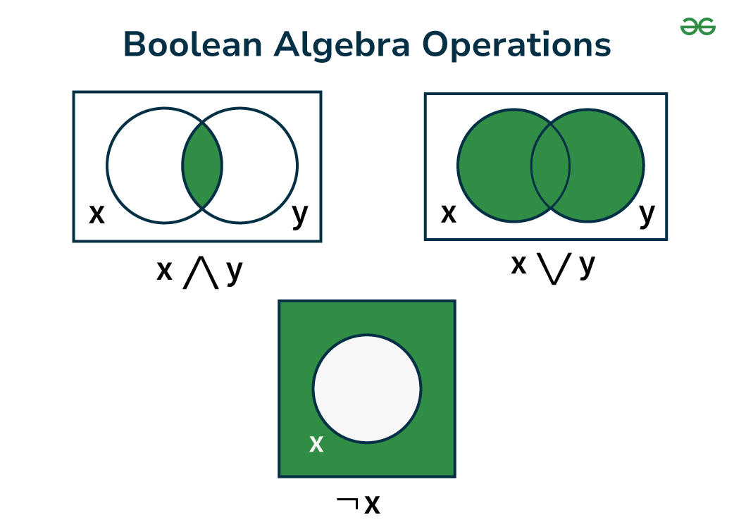
Boolean / Logical operators:
What:
Logical operators are used to compare the output of two comparisons.
There are three types of logical operators in R
AND ( & )
OR ( | )
NOT ( ! )
Output
1 , TRUE
0 , FALSE
NA (missing)
AND
OR
NOT
x & y
x | y
!x

Slide 39
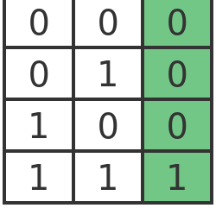
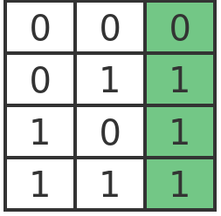
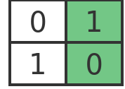
Boolean / Logical operators
both conditions must be TRUE
at least 1 condition must be TRUE
condition must be NOT TRUE
= condition must be FALSE
X
Y
X
Y
X
!X
AND
OR
NOT
x & y
x | y
!x

Slide 40
TRY IT ..
exercise
# evaluate the following in the R console (or predict)
TRUE & FALSE
TRUE | TRUE
FALSE | TRUE
!TRUE & !TRUE
FALSE | !TRUE
!FALSE & TRUE
FALSE | !FALSE | TRUE
Work out the individual expressions to TRUE or FALSE first,
then compute the answer according to the Boolean logic tables

