Slide 1
Introduction to r programming
Research Computing and Data Services
Instructor:
Artur Baranov
Emilio Lehoucq
Northwestern IT
GitHub Repo: https://github.com/nuitrcs/r_ibis

Slide 2
This workshop is brought to you by:
Northwestern IT
Research Computing and Data Services
Need help?
AI, Machine Learning, Data Science
Statistics
Visualization
Collecting web data (scraping, APIs), text analysis, extracting information from text
Cleaning, transforming, reformatting, and wrangling data
Automating repetitive research tasks
Research reproducibility and replicability
Programming, computing, data management, etc.
R, Python, SQL, MATLAB, Stata, SPSS, SAS, etc.
Request a FREE consultation at bit.ly/rcdsconsult.

Slide 3
Collaborative project support
If you're a faculty (or postdoc, research staff, or graduate student with faculty sponsorship), we can provide longer-term support in your project.
We can help from exploration (is this idea possible?) to concrete outcomes (e.g., data collection, cleaning, analysis or visualization for a publication).
Find more information at bit.ly/collaborative_project_support

Slide 4
Bring Your Own Data (BYOD)
Do you have research data waiting to be collected, cleaned, analyzed or visualized?
Come to BYOD.
BYOD is a weekly working group that provides structure, guidance, and accountability to help you make progress on your research project in a supportive and stress-free environment.
Find more information at bit.ly/byod_groups

Slide 5
Sticky Notes
I'm done/
doing OK
I need help/
I'm stuck

Slide 6
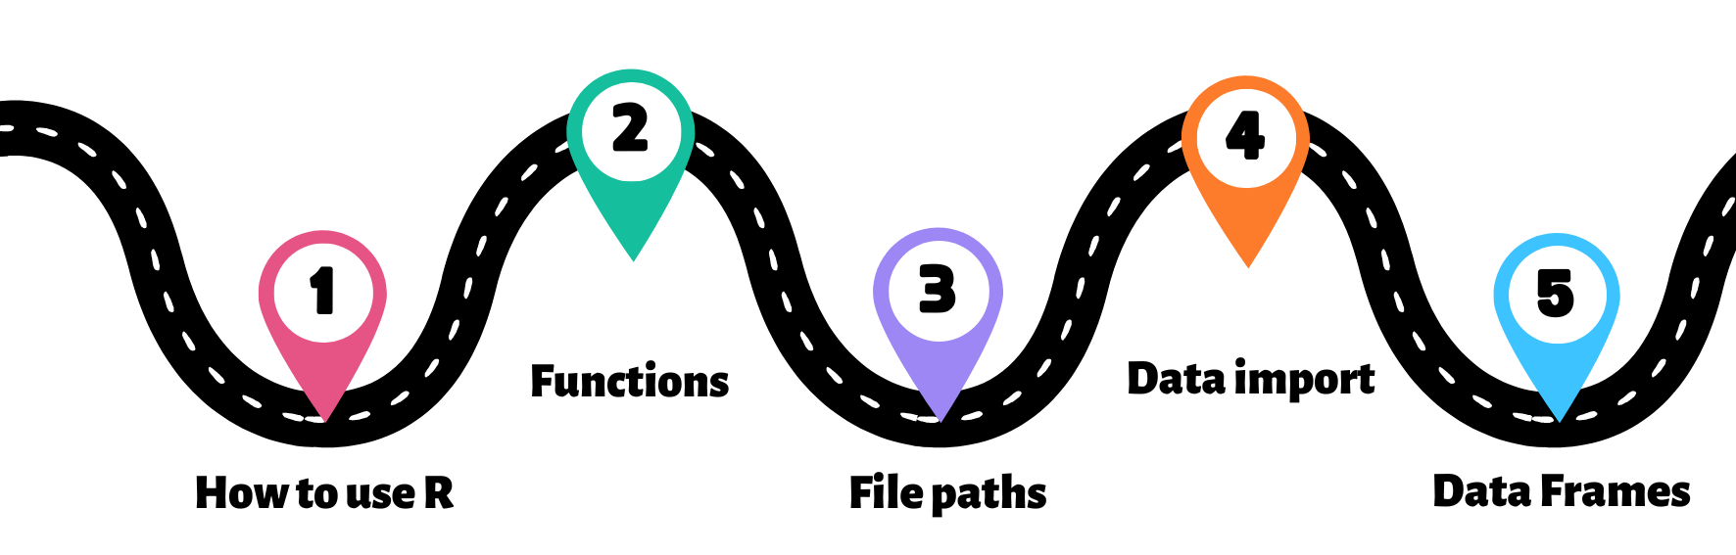
ROADMAP
You are here!
Destination
START
Import a dataset and analyze it with R!

Slide 7
Double click on the .RProj file to open the project in RStudio
Let’s start !

Slide 8
Welcome to RStudio!

Slide 9

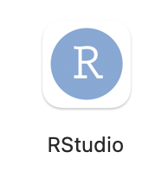
R vs RStuDio
R is a programming language
Runs code, produces output
RStudio is a feature-rich interface that runs on top of R
Makes it easier to write code

Slide 10
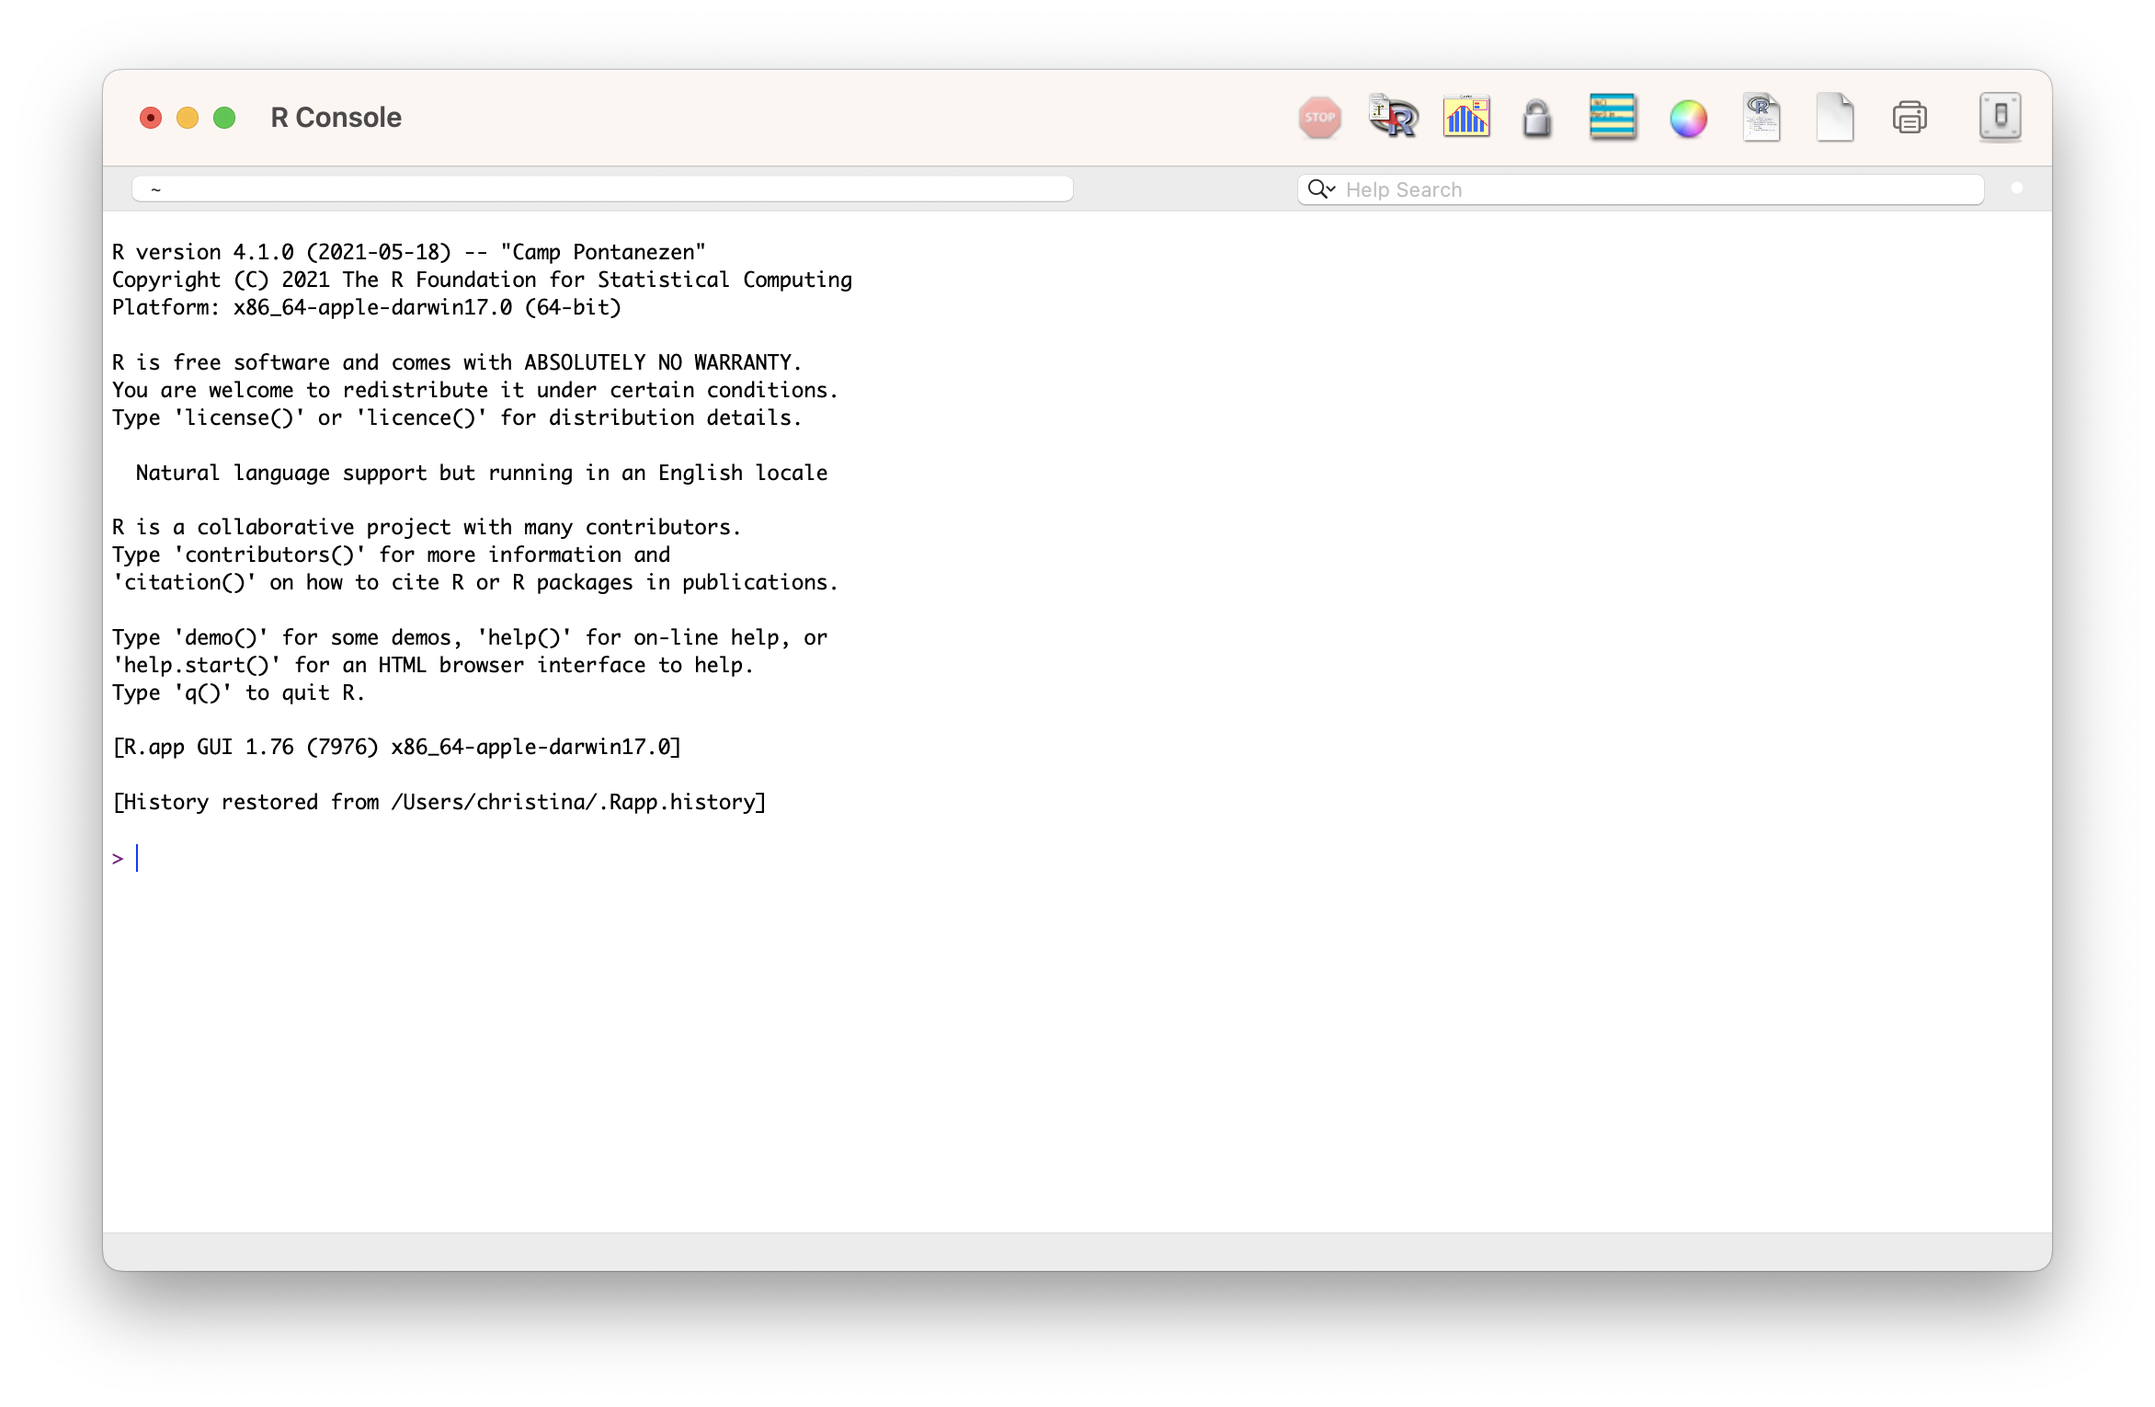

R vs RStuDio

Slide 11
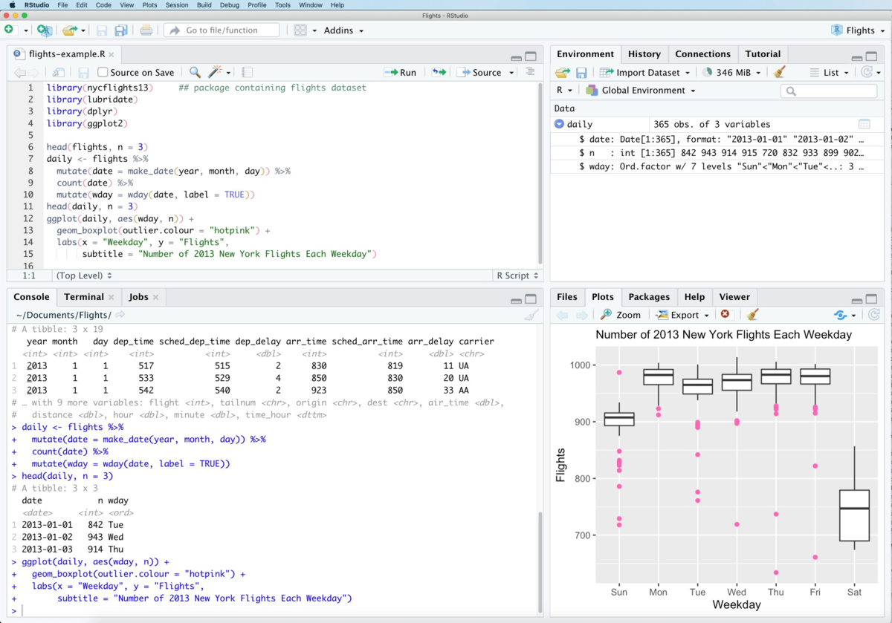

R vs RStuDio

Slide 12
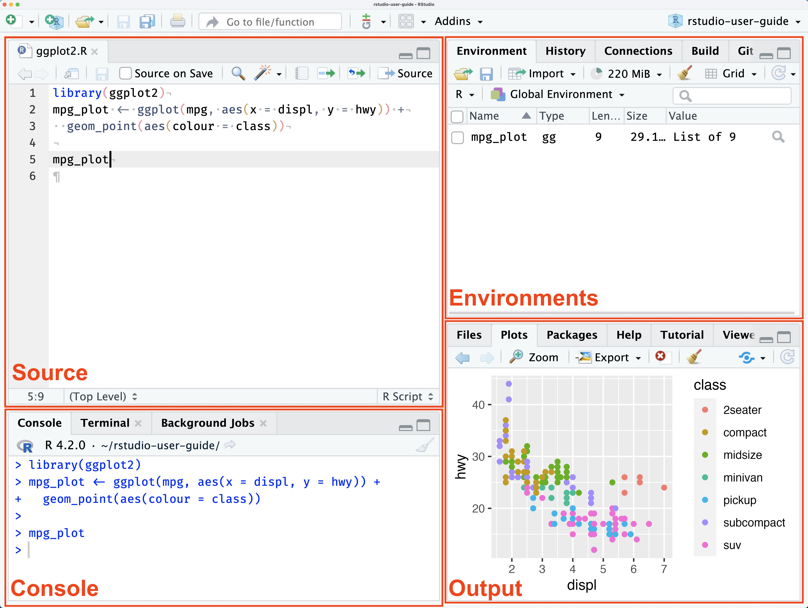
Rstudio pane layout
SOURCE
This is where you write your code!
Your code won’t be evaluated until you “Run” them to the console.
ENVIRONMENT
Here you can see what objects are in your working space
FILES / PACKAGES /PLOTS
Here you can see what file directories, view plots, see your packages, and access R Help
CONSOLE
This is where your code from Source is evaluated by R.
You can also use the console for quick calculations that you don’t need to save.

Slide 13
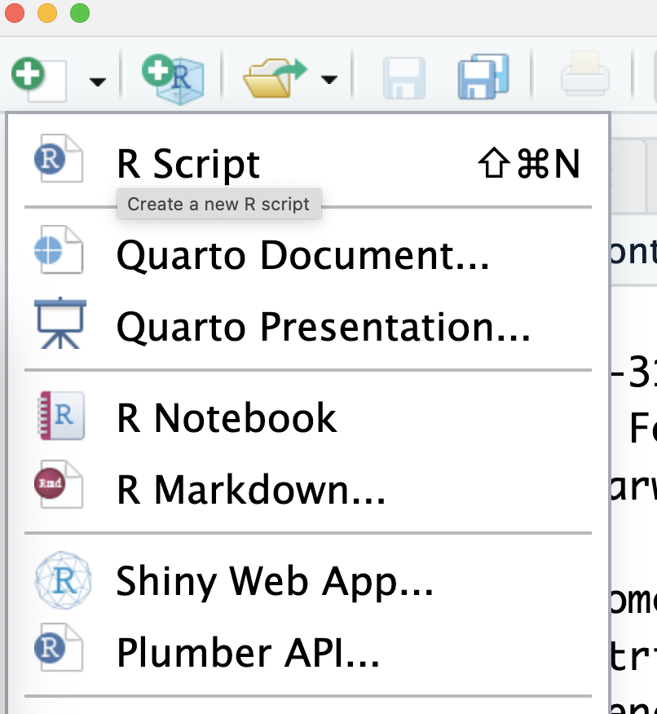
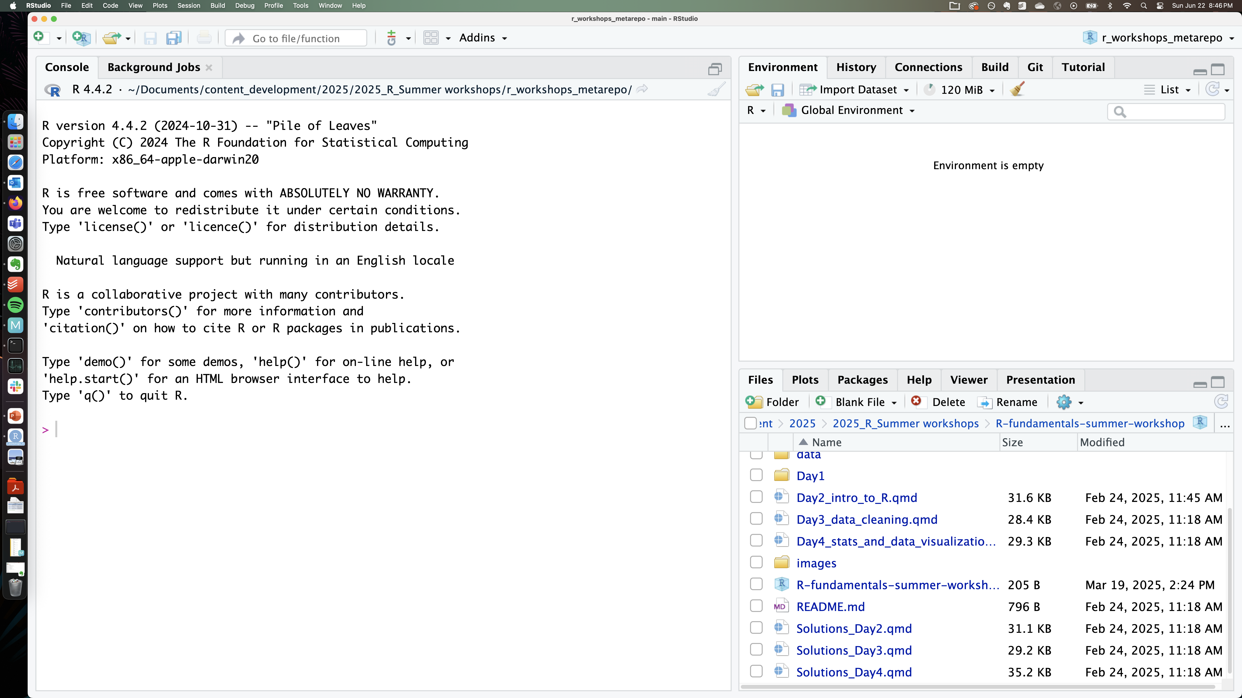
Rstudio pane layout
No SOURCE pane?
If no files are open to write code in, the source tab is minimized.
To see the source pane, open any new file!

Slide 14

TRY IT ..
exercise
Type some math operations in the console and get answers.
Explore the file structure and click on the buttons in the File pane to see what they do!
Warning – deleting files IN r is permanent
The Delete function in the Files pane in RStudio uses the system "Delete" command rather than using the Trash Can/Recycle bin of the system.
We recommend only using the Delete function to remove files or directories that you are sure you want to delete permanently.

Slide 15
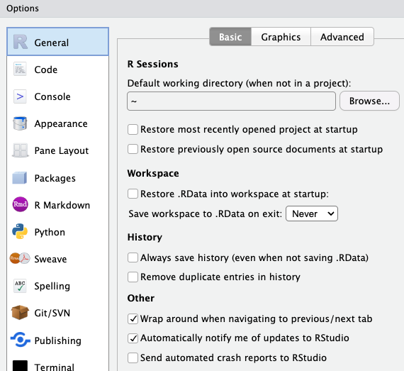
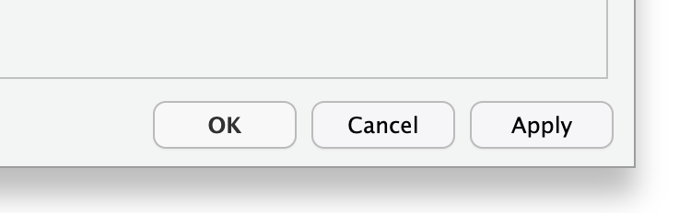
Suggested settings for rstudio
Where:
Tools > Global Options >
General > Basic (tab)
6
Why:
We don’t want to create anything that cannot be reproduced from the R script alone
i.e. no saving history or workspace
Optional
change to a convenient location for you!
1
2
5
3
4
Remember!
Click on “Apply” to apply the new settings

Slide 16
Writing code in R files

Slide 17
Commonly used code-files in rstudio
Popular file formats used by researchers and R coders:
R script (.R)
R Markdown (.Rmd)
Quarto Markdown (.qmd)

Slide 18
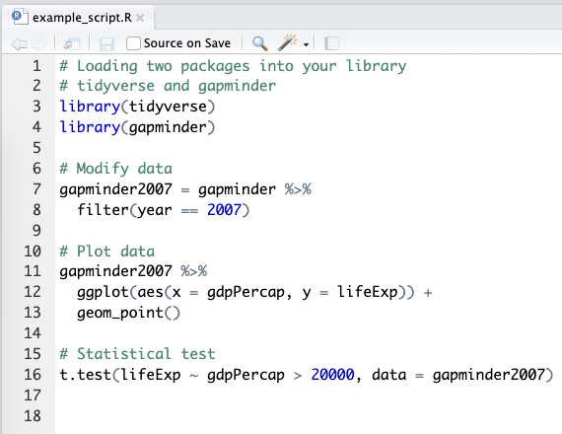
R script file
What:
A script is a list of instructions.
It is a text file. No special software is required to view one.
Notice the file extension – example_script.R
# this is a code comment
Some parts of the script read like normal English. These lines start with a # - they are called “comments”. These are notes of what we are doing, for others and our future selves!
Code lines
Lines that don’t start with # are R code. When the R script is executed by the console, only R code lines will be evaluated and run.

Slide 19
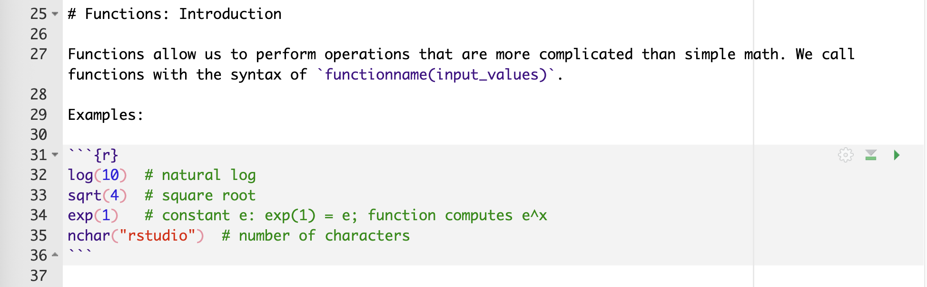
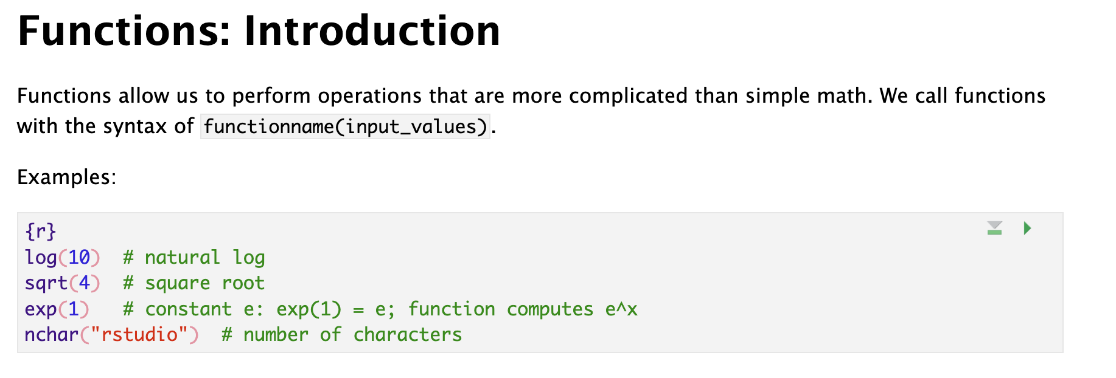
R / Quarto MARKDOWN file
What:
R Markdown is a file format for making dynamic or interactive documents with R.
.Rmd - R Markdown file extension
.qmd – Quarto Markdown file extension
It contains both plain text and code chunks.
R Markdown file in plain text format
Markdown
A markup language for creating formatted text using a plain-text editor.
R Markdown file after rendering
Plain markup text
Write in English (or any language). Use special symbols to indicate formatting, (note how # creates a heading in the example)
Code chunk
```{r}
2 + 2 # code for addition
```
Triple backticks in the format above indicate a code chunk that can be executed through the R console.

Slide 20
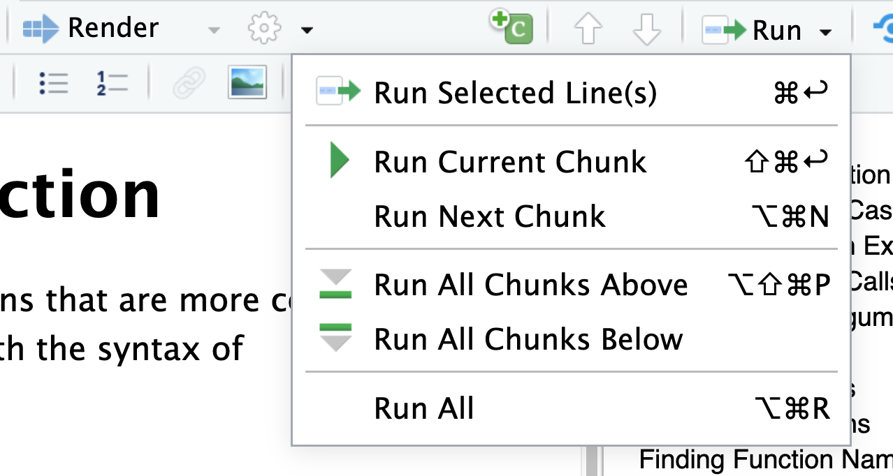
R / Quarto MARKDOWN file – helpful menu buttons
Inserting a code chunk
keyboard shortcut Ctrl + Alt + I (OS X: Cmd + Option + I)
Add chunk menu button in the editor toolbar

Slide 21
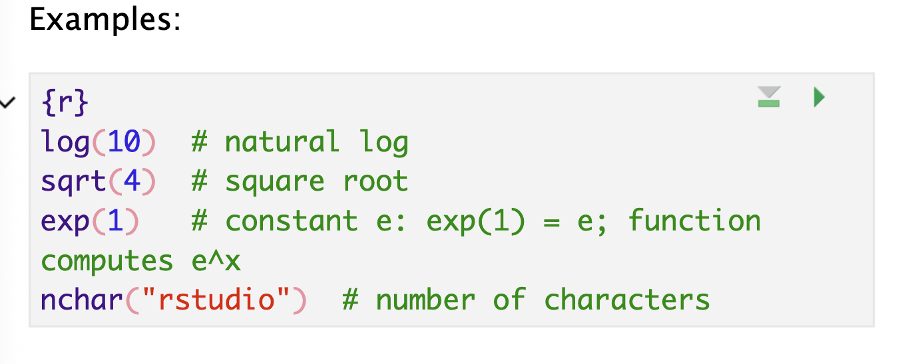
R / Quarto MARKDOWN file – helpful menu buttons
Executing code
Executing a single line
  To execute the line of source code where the cursor currently resides press the Ctrl+Enter keys (or use the Run toolbar button). This works for both .R scripts and .Rmd/.qmd files.
Executing multiple lines
  Select the lines to run, and press Ctrl+Enter
  Select one of the options in the Run Menu drop-down
  Some shortcuts are present in the top-right for each chunk:

Slide 22
TRY IT ..
exercise
Open the file welcome.R
Can you spot code lines and comment lines?
Open the file 01_basic_functions.qmd –
Insert a code chunk in this file

Slide 23
Functions

Slide 24
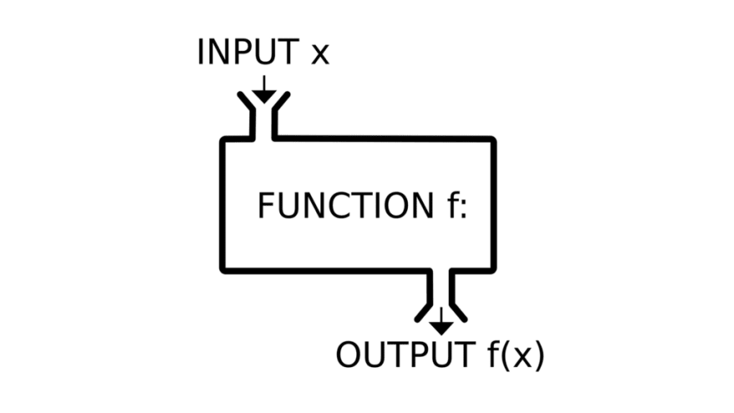
Functions in programming ~ similar to math functions
f(x) = y
Takes input values, also called parameters or arguments
Returns an output value, also called a return value
R functions usually don't alter their input values (but they sometimes do!)

Slide 25
Why should you use functions?
Pieces of code designed to perform specific tasks
  You can re-use them multiple times without re-writing the same code
  They help you organize your code into manageable chunks
  You can use them just knowing their input and output
  → They help you write code that is clearer and less error prone. They also help you conserve your valuable brain power

Slide 26

Let’s look at a useful function..
read.csv(file, header = TRUE, sep = ",", quote = "\"",
dec = ".", fill = TRUE, comment.char = "", ...)
What:
This is the function definition for the function named “read.csv”
It contains the function name, and the inputs it takes inside parentheses
Where:
Type read.csv in the R console to see this definition printed to console.
Type ?read.csv in the R console to see the more details for each input argument in the R Help tab on the File pane of RStudio.
Tip!
You can check the definition of any function with ?function_name

Slide 27
Defining functions
Functions have names
read.csv(file, header = TRUE, sep = ",", quote = "\"",
dec = ".", fill = TRUE, comment.char = "", ...)

Slide 28
Defining functions
Functions can be called with their names using ( )
read.csv(file, header = TRUE, sep = ",", quote = "\"",
dec = ".", fill = TRUE, comment.char = "", ...)

Slide 29
Defining functions
Functions take input parameters or arguments inside ( )
read.csv(file, header = TRUE, sep = ",", quote = "\"",
dec = ".", fill = TRUE, comment.char = "", ...)

Slide 30
Defining functions
Function parameters also have names (parameter names)
read.csv(file, header = TRUE, sep = ",", quote = "\"",
dec = ".", fill = TRUE, comment.char = "", ...)

Slide 31
Defining functions
Some function parameters have default values
read.csv(file, header = TRUE, sep = ",", quote = "\"",
dec = ".", fill = TRUE, comment.char = "", ...)
These are the values the function parameter will take if no values are provided for it by the user

Slide 32
Defining functions
However, some parameters are required parameters!
read.csv(file, header = TRUE, sep = ",", quote = "\"",
dec = ".", fill = TRUE, comment.char = "", ...)
These parameter values need to be provided by the user

Slide 33
Defining functions
Some functions also have additional undefined parameters
read.csv(file, header = TRUE, sep = ",", quote = "\"",
dec = ".", fill = TRUE, comment.char = "", ...)
These are additional values that can be taken by this function but are not explicitly listed in the function definition.
We will see some examples later.

Slide 34
Defining functions
Putting it all together
read.csv(file, header = TRUE, sep = ",", quote = "\"",
dec = ".", fill = TRUE, comment.char = "", ...)
Functions have names, they can be called with ().
Functions take input parameters, which also have parameter names.
Some parameters are required, some have default values, and some others are additional (hidden) parameters.

Slide 35
Calling functions
Functions are called as: function_name(input parameters/args)

Slide 36

Calling functions
Functions are called as: function_name(input parameters/args)
How does R know which value to assign to which input parameter??

Slide 37

Calling functions
Functions are called as: function_name(input parameters/args)
How does R know which value to assign to which input parameter??
by name
by position
by name and position

Slide 38
Calling functions
Defining parameter values by Name
read.csv(file, header = TRUE, sep = ",", quote = "\"",
dec = ".", fill = TRUE, comment.char = "", ...)
read.csv(file=“results.txt”,
header=TRUE,
sep=“\t”)

Slide 39
Calling functions
Defining parameter values by Name
read.csv(file, header = TRUE, sep = ",", quote = "\"",
dec = ".", fill = TRUE, comment.char = "", ...)
read.csv( sep=“\t”,
file=“results.txt”,
header=TRUE)

Slide 40
Calling functions
Defining parameter values by Position
read.csv(file, header = TRUE, sep = ",", quote = "\"",
dec = ".", fill = TRUE, comment.char = "", ...)
read.csv(“results.txt”, TRUE, “\t”)

Slide 41
Calling functions
Defining parameter values by Position
read.csv(file, header = TRUE, sep = ",", quote = "\"",
dec = ".", fill = TRUE, comment.char = "", ...)
1, 2, 3
read.csv(“results.txt”, TRUE, “\t”)

Slide 42
Calling functions
Defining parameter values by Position & Name
read.csv(file, header = TRUE, sep = ",", quote = "\"",
dec = ".", fill = TRUE, comment.char = "", ...)
read.csv(file=“results.txt”, TRUE, “\t”)

Slide 43
Calling functions
Defining parameter values by Position & Name
read.csv(file, header = TRUE, sep = ",", quote = "\"",
dec = ".", fill = TRUE, comment.char = "", ...)
read.csv(file=“results.txt”, TRUE, “\t”)
Match all named arguments first,

Slide 44
Calling functions
Defining parameter values by Position & Name
read.csv(file, header = TRUE, sep = ",", quote = "\"",
dec = ".", fill = TRUE, comment.char = "", ...)
read.csv(file=“results.txt”, TRUE, “\t”)
Match all named arguments first,
Match positions in order – 1

Slide 45
Calling functions
Defining parameter values by Position & Name
read.csv(file, header = TRUE, sep = ",", quote = "\"",
dec = ".", fill = TRUE, comment.char = "", ...)
read.csv(file=“results.txt”, TRUE, “\t”)
Match all named arguments first,
Match positions in order – 1
Match positions in order – 2

Slide 46
Calling functions
Defining parameter values by Position & Name
read.csv(file, header = TRUE, sep = ",", quote = "\"",
dec = ".", fill = TRUE, comment.char = "", ...)
read.csv(header=TRUE, “results.txt”, “\t”)
Let’s try another example..

Slide 47
Calling functions
Defining parameter values by Position & Name
read.csv(file, header = TRUE, sep = ",", quote = "\"",
dec = ".", fill = TRUE, comment.char = "", ...)
read.csv(header=TRUE, “results.txt”, “\t”)
Named arguments matched!

Slide 48
Calling functions
Defining parameter values by Position & Name
read.csv(file, header = TRUE, sep = ",", quote = "\"",
dec = ".", fill = TRUE, comment.char = "", ...)
read.csv(header=TRUE, “results.txt”, “\t”)
Named arguments matched!
Position 1 matched to first leftover argument

Slide 49
Calling functions
Defining parameter values by Position & Name
read.csv(file, header = TRUE, sep = ",", quote = "\"",
dec = ".", fill = TRUE, comment.char = "", ...)
read.csv(header=TRUE, “results.txt”, “\t”)
Named arguments matched!
Position 1 matched to first leftover argument
Position 2 matched to second leftover argument

Slide 50
Quiz Time!
Will this function call work?
read.csv(file, header = TRUE, sep = ",", quote = "\"",
dec = ".", fill = TRUE, comment.char = "", ...)
read.csv("results.txt", sep="\t")
read.csv("results.txt", "\t")
read.csv("results.txt", TRUE, "\t")

Slide 51
Quiz Time!
Will this function call work?
read.csv(file, header = TRUE, sep = ",", quote = "\"",
dec = ".", fill = TRUE, comment.char = "", ...)
read.csv("results.txt", sep="\t")

Slide 52

Quiz Time!
Will this function call work?
read.csv(file, header = TRUE, sep = ",", quote = "\"",
dec = ".", fill = TRUE, comment.char = "", ...)
read.csv("results.txt", sep="\t")
Named argument sep is matched with value “\t”
First value “results.txt” is matched to first argument file

Slide 53
Quiz Time!
Will this function call work?
read.csv(file, header = TRUE, sep = ",", quote = "\"",
dec = ".", fill = TRUE, comment.char = "", ...)
read.csv("results.txt", "\t")

Slide 54

Quiz Time!
Will this function call work?
read.csv(file, header = TRUE, sep = ",", quote = "\"",
dec = ".", fill = TRUE, comment.char = "", ...)
read.csv("results.txt", "\t")
There are no named arguments
First value “results.txt” is matched to first argument file
Second value “\t” is matched to second argument header

Slide 55
Quiz Time!
Will this function call work?
read.csv(file, header = TRUE, sep = ",", quote = "\"",
dec = ".", fill = TRUE, comment.char = "", ...)
read.csv("results.txt", TRUE, "\t")

Slide 56
Quiz Time!
Will this function call work?
read.csv(file, header = TRUE, sep = ",", quote = "\"",
dec = ".", fill = TRUE, comment.char = "", ...)
read.csv("results.txt", TRUE, "\t")
There are no named arguments
First value “results.txt” is matched to first argument file
Second value TRUE is matched to second argument header
Third value “\t” is matched to third argument sep

Slide 57
Returning values
The output of a function is its return value
Function call
Return value
abs(-3)
3
But this output value is not saved!
How do we save this value??
We can save it by assigning the return value to a variable!
x <- abs(-3)

Slide 58
Half-way there!
You are here!
Destination
START
Import a dataset and analyze it with R!

Slide 59
File Paths

Slide 60
File paths
How do we tell R where our files are without using point and click interfaces?
Every file has an absolute path, which starts with the root
An absolute path makes no assumptions about your current location. It starts from the start of your hard drive and describes every step to get to a file. The root is that start—it's the starting point to organize all files on your computer

Slide 61
EXAMPLE OF AN ABSOLUTE PATH
Earth → North America → United States → Illinois → Evanston → Tech Drive → 2233 Mudd → My office!

Slide 62
PC (Windows)
c:

Slide 63

C:\
PC (Windows)
c:
Program Files
Users
System

Slide 64
C:\Users\
PC (Windows)
c:
Program Files
Users
System
ritika
guest

Slide 65
C:\Users\ritika\
PC (Windows)
c:
Program Files
Users
System
ritika
guest
Documents
Desktop
Music
Photos

Slide 66
C:\Users\ritika\Documents\
PC (Windows)
c:
Program Files
Users
System
ritika
guest
Documents
Desktop
Music
Photos
dissertation
my_project

Slide 67

C:\Users\ritika\Documents\my_project
PC (Windows)
c:
Program Files
Users
System
ritika
guest
Documents
Desktop
Music
Photos
dissertation
my_project
data.csv
process.py
DRAFT.docx

Slide 68
C:\Users\ritika\Documents\my_project\data.csv
PC (Windows)
c:
Program Files
Users
System
ritika
guest
Documents
Desktop
Music
Photos
dissertation
my_project
data.csv
process.py
DRAFT.docx

Slide 69
/Users/ritika/Documents/my_project/data.csv
MacOS
/
Applications
Users
System
ritika
guest
Documents
Desktop
Music
Photos
dissertation
my_project
data.csv
process.py
DRAFT.docx

Slide 70
Absolute Paths
C:\Users\ritika\Documents\my_project\data.csv
/Users/ritika/Documents/my_project/data.csv
R is not able to understand normal Windows paths correctly because the "\" has special meaning - it is used as escape character to give following characters special meaning (\n for newline, \t for tab, etc.)
For windows:
Replace the "\" with "/" , or
Replace the "\" with "\\" , - an additional escape character escapes the special meaning

Slide 71
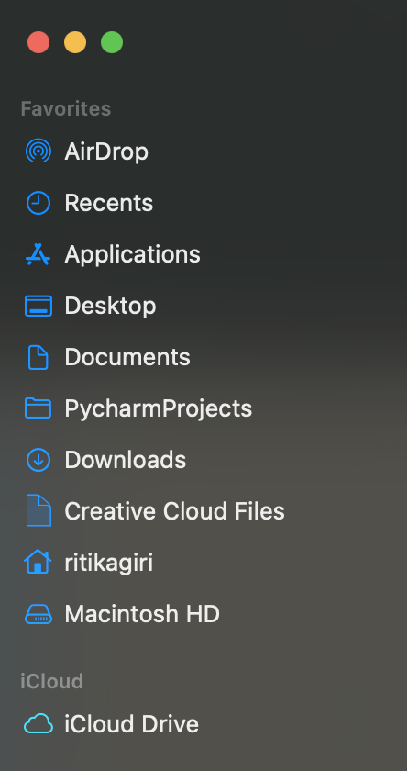
Home Directory
The home directory is a personal directory assigned to a user.
The root directory is the starting point of the whole computer, while the home directory is specific to a user.

Slide 72
Home Directory: C:\Users\ritika = ~
c:
Program Files
~
Users
System
ritika
guest
Documents
Desktop
Music
Photos
dissertation
my_project
data.csv
process.py
DRAFT.docx

Slide 73
~/Documents/my_project/data.csv
c:
Program Files
Users
System
ritika
guest
Documents
Desktop
Music
Photos
dissertation
my_project
data.csv
process.py
DRAFT.docx

Slide 74
Working Directory
A directory in the file system associated with a running process or program (aka "where you're working from")
>> Where R starts when looking for files
>> Uses Relative File Paths

Slide 75
EXAMPLE OF A RELATIVE PATH
Remember our absolute path: Earth → North America → United States → Illinois → Evanston → Tech Drive → 2233
The relative path (relative to Illinois) would be: Evanston → Tech Drive → 2233

Slide 76
Relative Path from Documents: my_project/data.csv
c:
Program Files
Users
System
ritika
guest
Documents
Desktop
Music
Photos
dissertation
my_project
data.csv
process.py
DRAFT.docx

Slide 77
From ritika:
c:
Program Files
Users
System
ritika
guest
Documents
Desktop
Music
Photos
dissertation
my_project
data.csv
process.py
DRAFT.docx
Notes:
Documents/my_project/data.csv

Slide 78
From ritika: Documents/my_project/data.csv
c:
Program Files
Users
System
ritika
guest
Documents
Desktop
Music
Photos
dissertation
my_project
data.csv
process.py
DRAFT.docx
Notes:
Documents/my_project/data.csv

Slide 79
.. means go up a level

Slide 80
From Desktop: ../Documents/my_project/data.csv
c:
Program Files
Users
System
ritika
guest
Documents
Desktop
Music
Photos
dissertation
my_project
data.csv
process.py
DRAFT.docx
Notes:
Documents/my_project/data.csv

Slide 81
From dissertation: ../my_project/data.csv
c:
Program Files
Users
System
ritika
guest
Documents
Desktop
Music
Photos
dissertation
my_project
data.csv
process.py
DRAFT.docx
Notes:
Documents/my_project/data.csv

Slide 82
How to find paths in your computer?
Mac:
  Right click on a file > Get info ("Where")
Windows:
  Right click on a file > Properties ("Location")
  Or clicking in the box that contains the file name (above the list of files inside the folder)

Slide 83
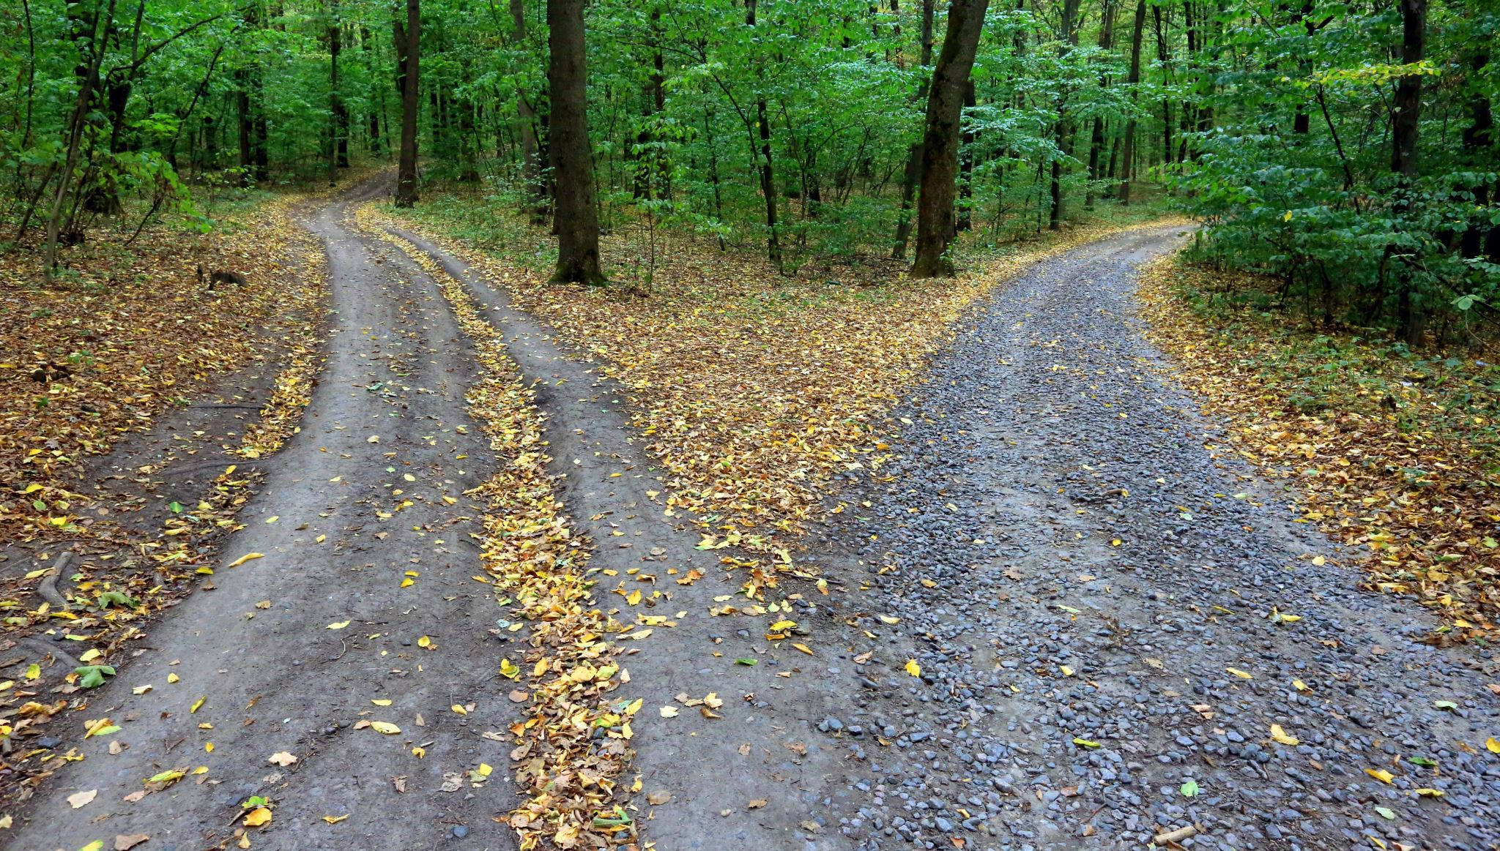
Why not just use absolute paths?

Slide 84
Store Project Files Together
project_directory
code
  process_data.r
  make_graphs.r
  estimate_model.r
data
  people.csv
  exam1.csv
output
  impact_plot.pdf
reports
  chapter1.docx
working directory

Slide 85
But what is the Working Directory for R?
Default: home directory of the user (~)
RStudio Projects: the folder you associate with the project
>> You can set or change the working directory
getwd()
Ask R to tell you where the working directory is now
setwd(“your-desired-path”)
Tell R to set working directory to your-desired-path

Slide 86
RStudio Projects

Slide 87
RStudio Projects
RStudio projects make it straightforward to divide your work into multiple contexts, each with their own working directory, workspace, history, and source documents.
You can create an RStudio project:
In a brand-new directory
In an existing directory which has R code and/or data
By cloning a version control (eg: Git) repository

Slide 88
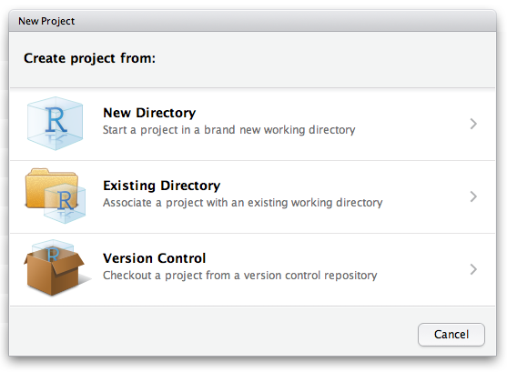
RStudio Projects
RStudio projects make it straightforward to divide your work into multiple contexts, each with their own working directory, workspace, history, and source documents.
To create a new project in the RStudio IDE, use the Create Project command (available on the Projects menu and on the global toolbar)

Slide 89
GETTING THERE!!
Destination
You are here!
START
Import a dataset and analyze it with R!

Slide 90

R Packages

Slide 91
R packages
What:
R packages are extensions to the R programming language
Contain code, data, and documentation in a standardized format that can installed by other R users
Examples of useful packages:
haven (Enables R to read and write data from SAS, SPSS, and Stata)
ggplot2 (R's famous package for making beautiful graphics)
survival (Tools for survival analysis)
Why:
Enable re-use of code within the R ecosystem in a reproducible manner
Using a package:
Packages need to be installed on your computer and then loaded into your R session before you can use them. Packages are stored in a directory on your computer called a library.
Finding a package:
You can search for packages on CRAN or by using “task views”, which organize packages by specific areas of application. (CRAN - https://cran.r-project.org/web/packages/)

Slide 92
using R packages
Installing a package
# run this command to install a desired package
install.packages(“package-name”)
Loading a package
# run this command to use the package
library(package-name)
# notice - no quotes for package-name
What R does when you install
package-name will be found on a repository (eg. CRAN), downloaded to your local machine, and stored in the library folder
What R does when you load
package-name will be found in the library folder of your computer, and loaded into RAM (memory) for easy access in your current R session
You only install once!
Once package-name is installed on your machine it lives on your hard drive and doesn’t need to be installed again (except for package updates, where the updated version is downloaded fresh from the repo).
You load every *RAM* time!
Every fresh R session will require loading package-name into RAM for use during that session. When you close out R, the RAM for that session is refreshed and all loaded packages are lost.

Slide 93

TRY IT ..
exercise
Install the following packages on your computer
  tidyverse
  janitor
Now, use the library command to load them into your R session
Installing a package
install.packages(“package-name”)
Loading a package
library(package-name)

Slide 94
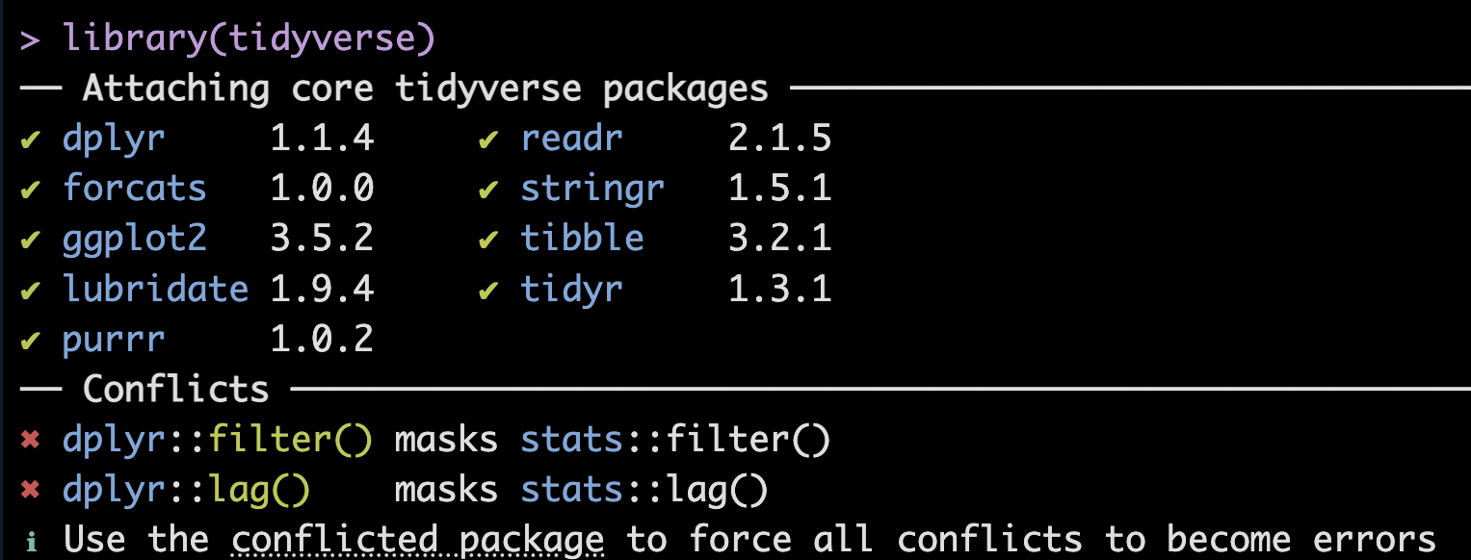
using R packages
In R, multiple packages can have functions with the same name. When you load such packages, R uses the most recently loaded version of the function.
A namespace conflict means:
"Two packages define the same function name, and R has to choose which one to use."
In this instance,
base R stats package has functions named filter, and lag
dplyr also has functions named filter, and lag
So the console message is telling you that dplyr::filter() and dplyr::lag() will be called if filter and lag functions are called without specifying which package to use.

Slide 95
Data Frames

Slide 96
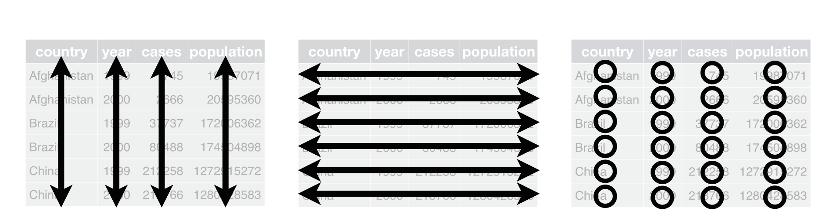
Data Frames: Rectangles of Data
View(data)
variables/
features
observations
values

Slide 97
Rows: Observations
nrow(data)
Person (or mouse, worm, etc.)
Country
Year
Run/trial of an experiment
Chemical
Sample

Slide 98
Columns: Variables
ncol(data)
Measurements
Grouping/identification variables:
> trial/sample
> condition
> label for the observation (country name)
Each ID variable in its own column

Slide 99
THERE!!
Destination
You are here!
START
Import a dataset and analyze it with R!

Slide 100
Open the file 02_importing_data.qmd
{ CODE SESSION }

Slide 101
{ Quick Review }

Slide 102
Variables
Assigning values to variables
x = 3
x <- 3
Variable name
"Left hand side"
Value
"Right hand side"
Assignment
operator

Slide 103
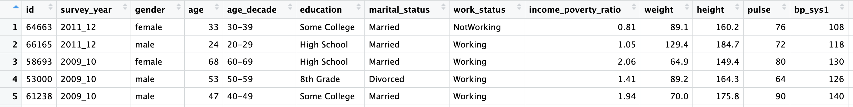
Data Frames – the NHANES data set
View(data)

Slide 104
Data Frames: The $ operator
Access columns by names as:
data$column
Example
healthdata$age

Slide 105
Data Frames: Indexing
Access rows or columns by indexing as:
data [ rows , columns ]
Example
healthdata[1:5 , 3:10 ]

Slide 106
Indexing Values in a Vector
Retrieving single elements from a vector
Indexing –giving a unique number to each element based on its position in the list
Indices in R start from 1
Position/Index: 1 2 3 4
x <- c(2, 4, 7, 8)

Slide 107
Selecting elements from a vector
elements of a vector can be selected using [ ]
The position/index goes inside [ ]
x <- c(2, 4, 7, 8)
x[1] stores 2
x[2] stores 4
Note that ( ) usually denotes a function call, while [ ] denotes index/subset in R

Slide 108
Boolean Operations

Slide 109
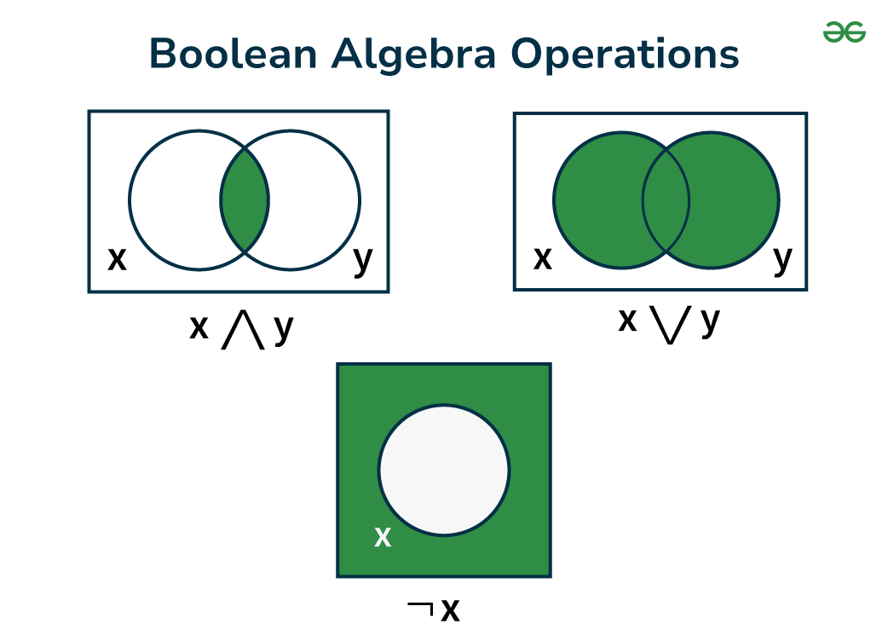
Boolean / Logical operators:
What:
Logical operators are used to compare the output of two comparisons.
There are three types of logical operators in R
AND ( & )
OR ( | )
NOT ( ! )
Output
  1 , TRUE
  0 , FALSE
  NA (missing)
AND
OR
NOT
x & y
x | y
!x

Slide 110
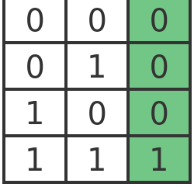
Boolean operator: AND
both conditions must be TRUE
X
Y
AND
OR
NOT
x & y
x | y
!x

Slide 111
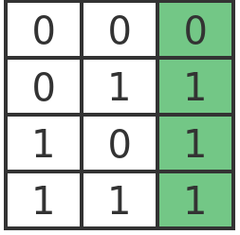
Boolean operator: OR
at least 1 condition must be TRUE
X
Y
AND
OR
NOT
x & y
x | y
!x

Slide 112
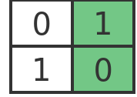
Boolean operator: NOT
condition must be NOT TRUE
= condition must be FALSE
X
!X
AND
OR
NOT
x & y
x | y
!x

Slide 113
TRY IT ..
exercise
# evaluate the following in the R console (or predict)
TRUE & FALSE
TRUE | TRUE
FALSE | TRUE
!TRUE & !TRUE
FALSE | !TRUE
!FALSE & TRUE
FALSE | !FALSE | TRUE
Work out the individual expressions to TRUE or FALSE first,
then compute the answer according to the Boolean logic tables

