Slide 1

R Statistics
Dave Nichols
Jillian Whitton
RCDS
Northwestern University IT
We start at 9:30
Notes:
Quick intro of myself and Dave

Slide 2
This workshop is brought to you by:
Northwestern IT Research Computing and Data Services
Need help?
AI, Machine Learning, Data Science
Statistics
Visualization
Collecting web data (scraping, APIs), text analysis, extracting information from text
Cleaning, transforming, reformatting, and wrangling data
Automating repetitive research tasks
Research reproducibility and replicability
Programming, computing, data management, etc.
R, Python, SQL, MATLAB, Stata, SPSS, SAS, etc.
Get 1-1 help from us! – bit.ly/rcdsconsult
Bring Your Own Data (BYOD) working groups – bit.ly/byod_groups
Collaborative Project Support – bit.ly/collaborative_project_support
Notes:
Go through this a line at a time

Slide 3
Logistics
You should already have R and Rstudio installed on your laptop
If you need either, instructions are at https://rcdsdocs.it.northwestern.edu/tutorials/r/r-installation.html
Let us know if you’re having issues
We’ll be breaking for lunch for an hour around noon
There’ll be 10-15 minute breaks mid-morning and mid-afternoon

Slide 4
Sticky Notes
I'm done/
doing OK
I need help/
I'm stuck

Slide 5
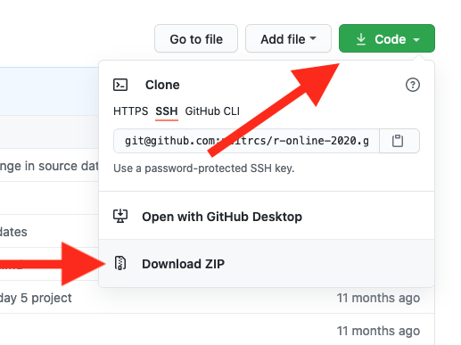
Download materials from github: https://github.com/nuitrcs/r_statistics
Step 1: Download as a zip file
Step 2: Unzip the downloaded file
Click on Code
Click on Download Zip
MacOS
Go to “Downloads”
Double-click the file to unzip
Move unzipped folder to desired place (like Documents or Desktop)
Windows
Go to “Downloads”
Right click on the file, then select “Extract All”
Select the desired destination to extract to in the pop-up dialog box
See also: https://www.lifewire.com/unzip-files-windows-11-8425832

Slide 6
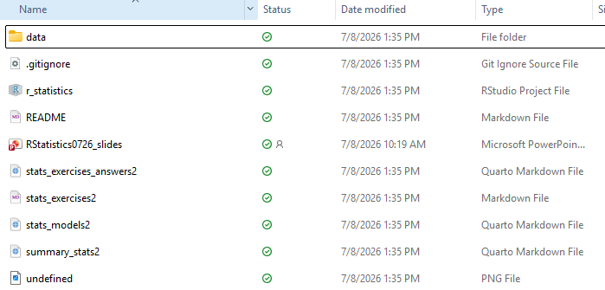

Go to the downloaded folder, open the r_statistics folder, click on the r_statistics R project, and we’ll get started…

Slide 7



All by Andrew Shiva / Wikipedia

Slide 8
Thanks for attending!
You can contact us at david.nichols@northwestern.edu and jillian.whitton@northwestern.edu
Get 1-1 help from us! – bit.ly/rcdsconsult
Bring Your Own Data (BYOD) working groups – bit.ly/byod_groups
Collaborative Project Support – bit.ly/collaborative_project_support

