Slide 1
The Researcher’s Guide to Code Organization
Workshop starts at 12:03
by efrén cruz cortés
TA: Yangyang Li
https://github.com/nuitrcs/researchers_guide_to_code_organization

Slide 2
This workshop is brought to you by:
Northwestern IT Research Computing and Data Services
Need help?
AI, Machine Learning, Data Science
Statistics
Visualization
Scraping, text analysis, modeling, computing, reproducibility, etc.
R, Python, SQL, MATLAB, Stata, SPSS, SAS, etc.
Request a FREE consultation at bit.ly/rcdsconsult.

Slide 3
Logistics
Ask questions!
If I use terminology and forgot to define, please ask!
Feel free to interrupt and ask whatever for clarification

Slide 4
Downloading the materials
https://github.com/nuitrcs/researchers_guide_to_code_organization

Slide 5
What to expect
A lay of the land
won’t be able to go into details
Everything you always wanted to know about programming for research but were afraid to ask
Hands on exercises (mostly Day 2)

Slide 6
Overview
Day 1 will focus on overall project organization principles and tools.
Day 2 dives into organizing principles within a script.

Slide 7
Day 1 Introduction

Slide 8
Does this sound familiar?
I can’t find my script!
My script worked last week but now it’s broken.
My script works perfectly in my computer but not when I share it with my colleague.
What does this file do? I’ll just delete it...

Slide 9
Motivation
A code-based research project is composed of many elements outside internal code logic, and yet, these are not taught in classes!
We need a place to understand how all these elements come together, why they are necessary, and the principles behind them.
Proper organization will facilitate collaboration, reproducibility, and other important elements of research.
A bit of effort now will save you sweat and tears in the future!!

Slide 10
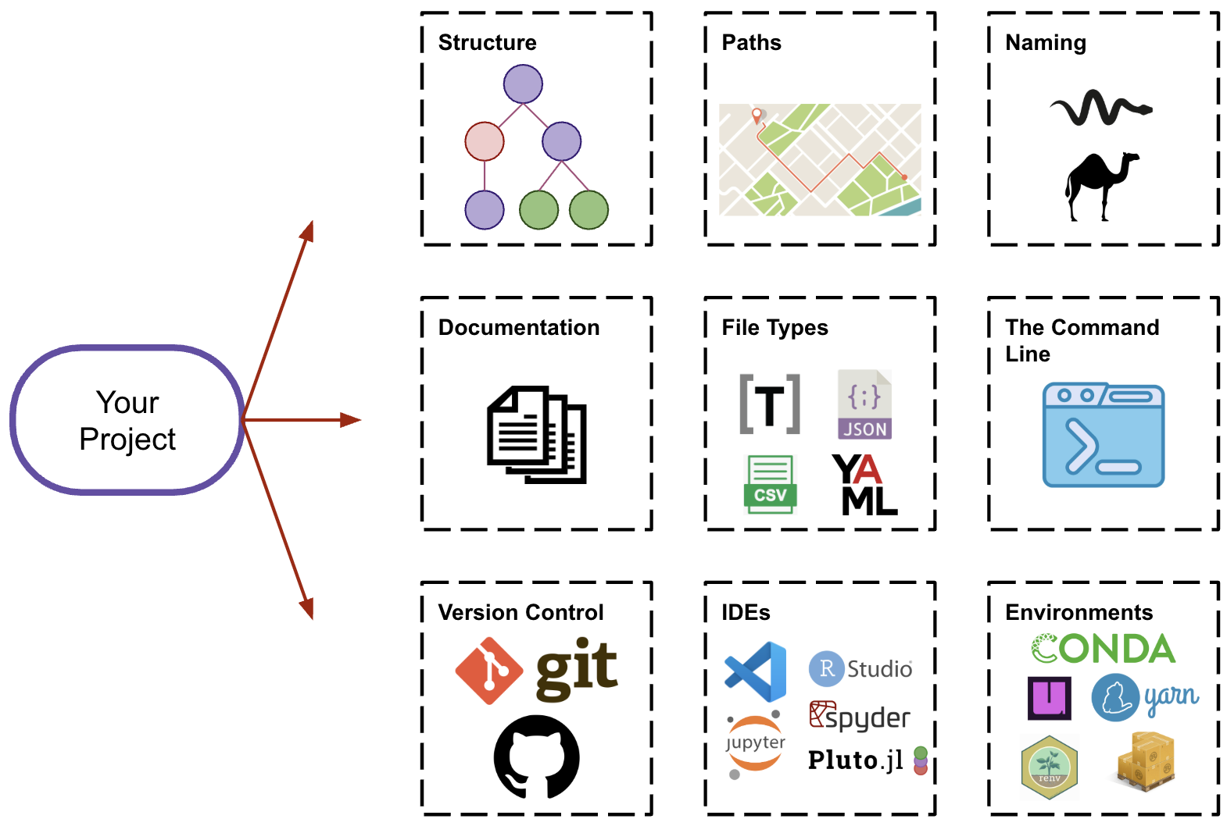
Day 1- Overview

Slide 11
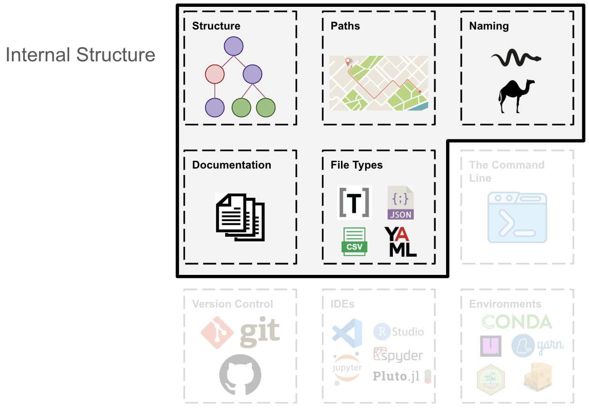

Slide 12
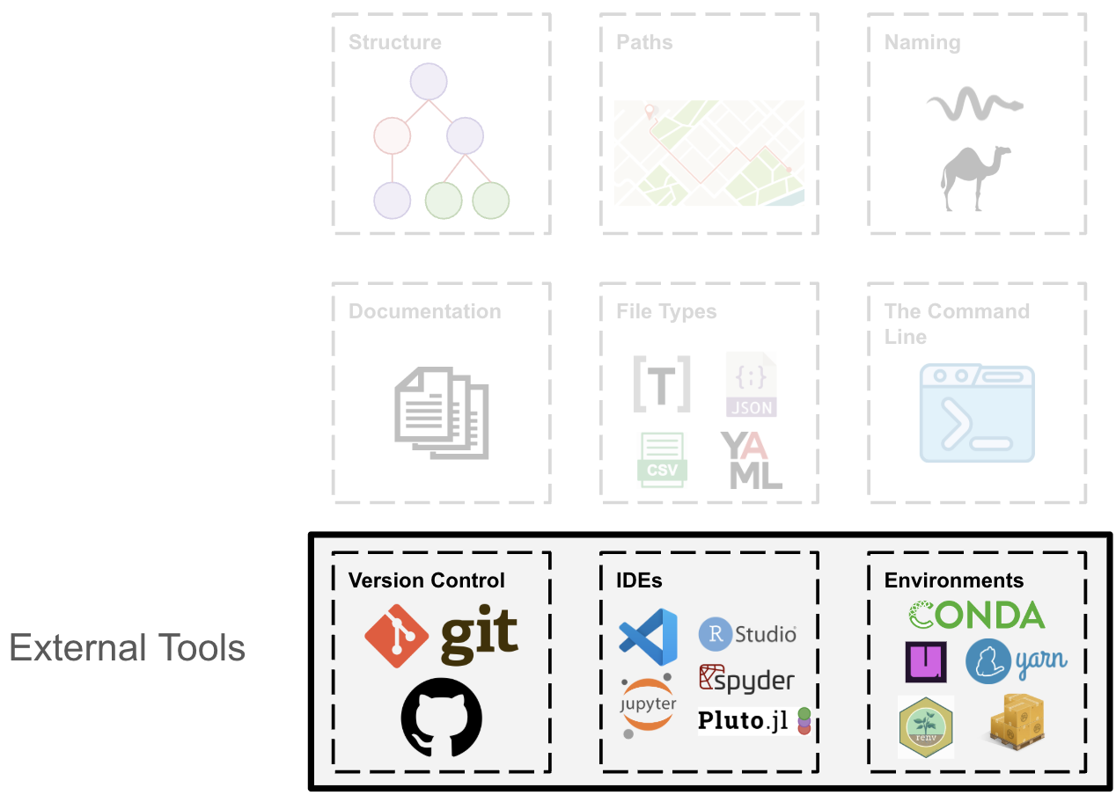

Slide 13
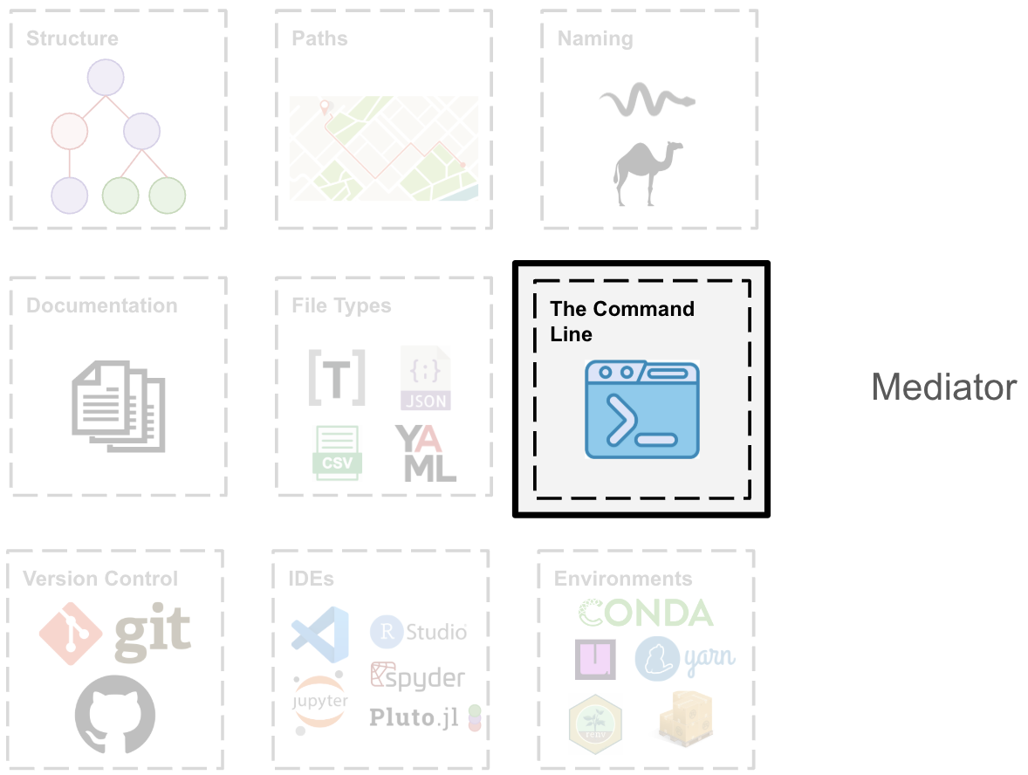

Slide 14
General Principles
Organization
Separation of Concerns
Modularity
Containment
Hierarchy
Robustness
Usability
Portability
Automation
Scalability
Reliability
Collaboration
Documentation
Transparency
Reproducibility
Version Control
Notes:
We will talk about these in more detail in day 2

Slide 15
General Principles
Organization
Separation of Concerns
Modularity
Containment
Hierarchy
Robustness
Usability
Portability
Automation
Scalability
Reliability
Collaboration
Documentation
Transparency
Reproducibility
Version Control
Architecture
Performance
Continuity
Notes:
We will talk about these in more detail in day 2

Slide 16
Quick Survey
What is your primary programming language?
Do you use an integrated development environment (IDE)?
(e.g., RStudio, Jupyter Lab, VS Code, ...)

Slide 17
Project Structure

Slide 18
Identify your project structure
Does your project use data?
If so, at which stage?
At the beginning (training, preprocessing, ...)
At the end (calibration, validation, ...)
Throughout (sensors, inference, ...)
Is your project iterative in nature?
Does your project branch into possible models / analyses?

Slide 19
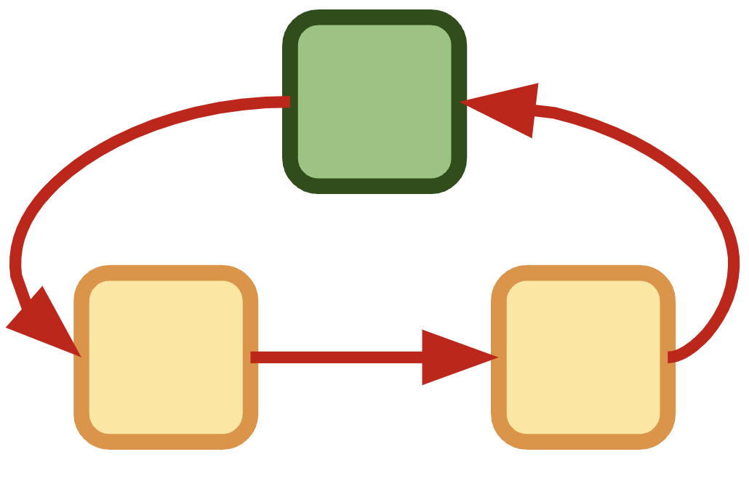
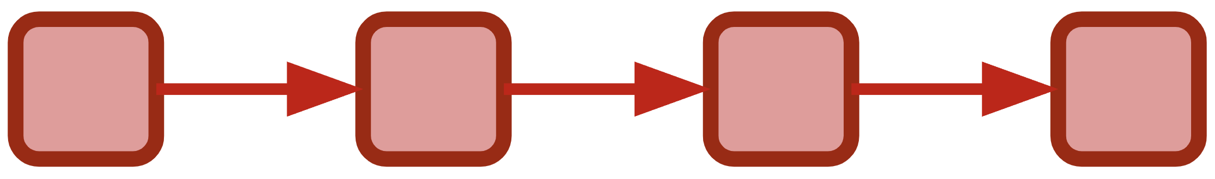
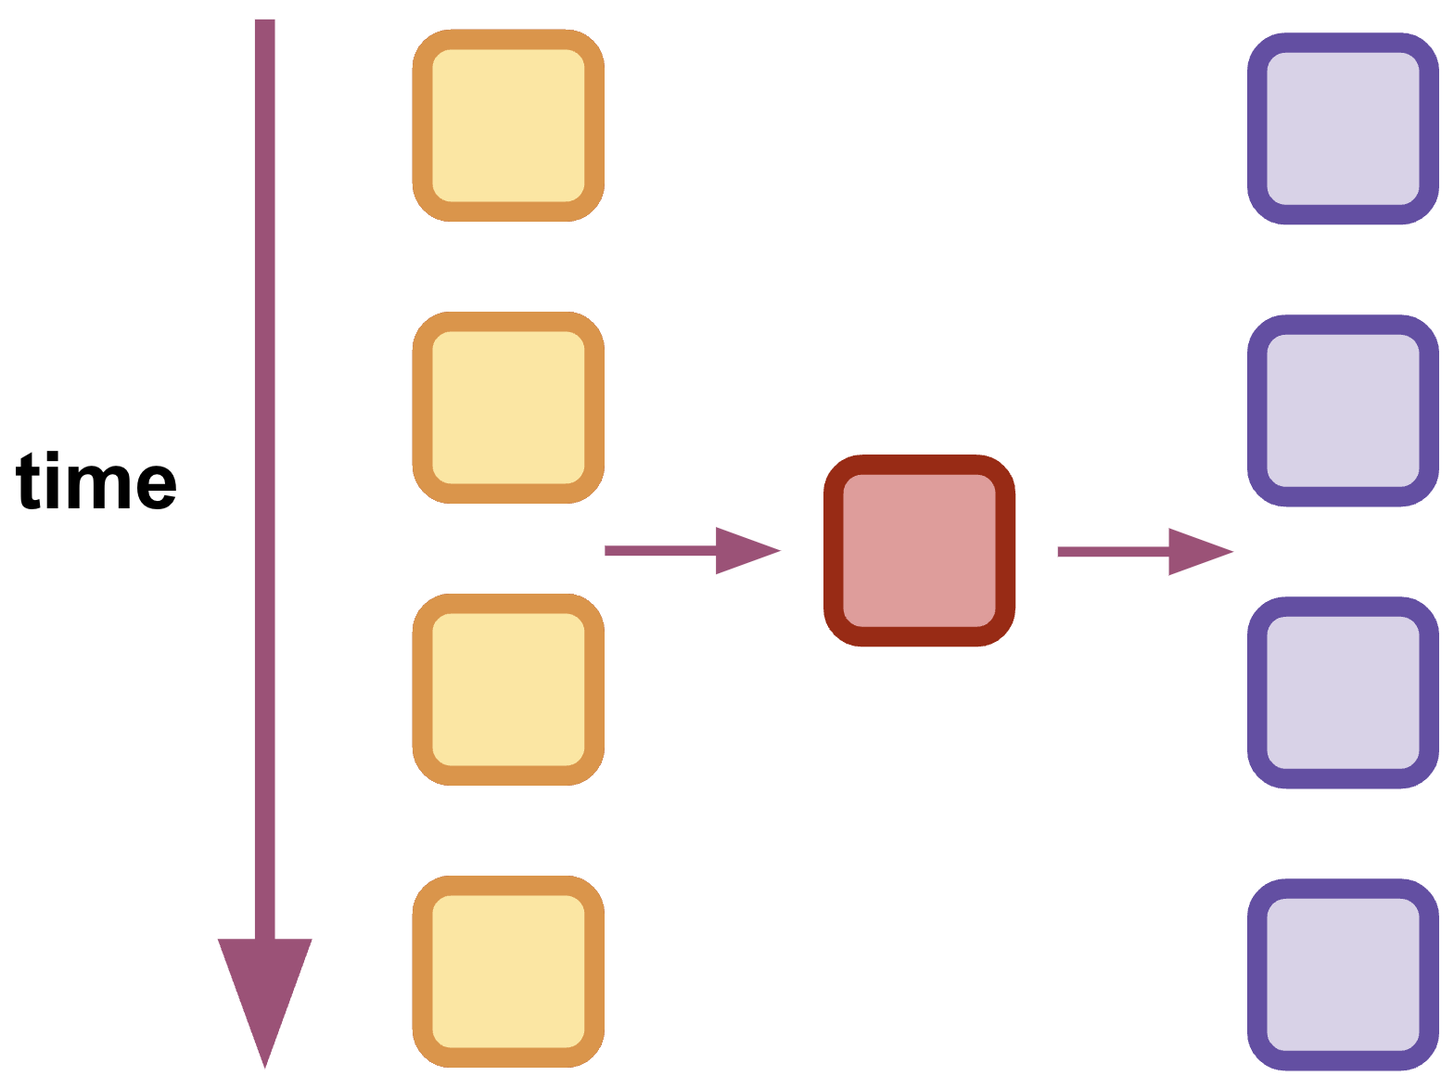
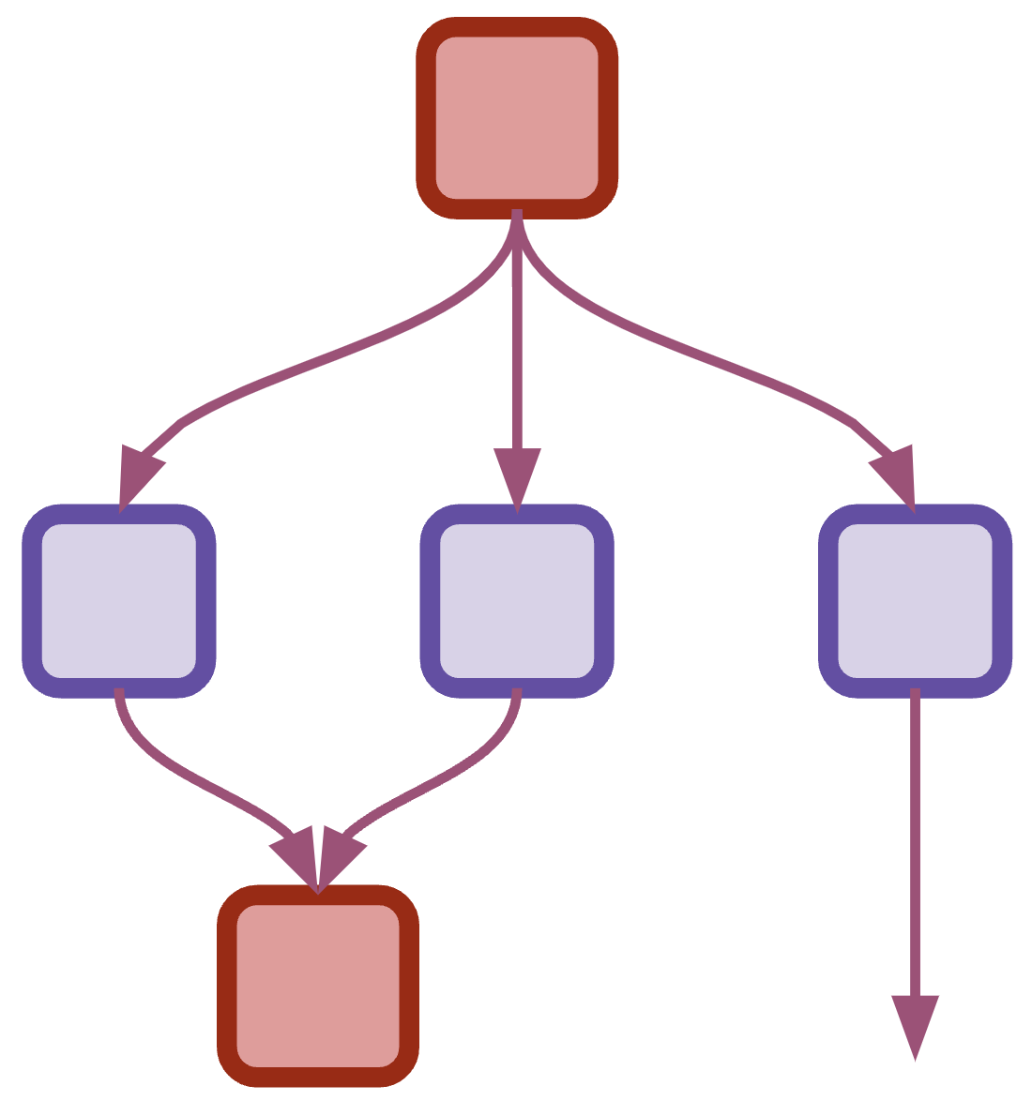
A simple project taxonomy*
Linear
Iterative
Recurrent
Branching
*I couldn’t find an official taxonomy / framework for research project structures, so these examples are limited to my own experience. -ecc

Slide 20
Examples
In reality, most projects are iterative in nature as we improve our own understanding and as we calibrate with data.
These are generic possibilities, but of course research is more complex:
Linear: batch learning, descriptive statistics
Recurrent: online learning, sensor data
Iterative: physics simulation, agent-based models
Branching: model selection, by-case analysis

Slide 21
Exercise
Grab a piece of paper and sketch the structure of your project.
It’s OK if it isn’t perfect, if it doesn’t fit the shapes above, or if it is a strange mix.
Show it to your neighbor and talk about it!

Slide 22
Directory Structure

Slide 23
Question
What is the first thing you do when you start a project?
When you create a new script, where do you save it?

Slide 24
Keep the project contained
By default, all materials for your project should go inside one project directory.
(Imagine the chaos of saving all your .doc files in a single folder)
Plan your project directory based on your project structure.

Slide 25
Bad!
See example folder Example-Bad
user
.spyder
Desktop
Documents
whose_is_this.R
where_am_i.py
what_is_this.R
MATLAB
yolo.m

Slide 26


Bad IDEs!
IDEs by default tend to save your files in predetermined folders (often hidden) they create during installation.
You should NOT save your files in your IDE’s default, but within your project directory.

Slide 27
Remember
Create a project directory, and keep your files contained within it.

Slide 28
Separation of Concerns
Separation of concerns is the general principle in which pieces of a project should be separated according to their distinct form and function.
For example, data is separated from “code” files.
Within a research pipeline, preprocessing is separate from analysis, which is separate from visualization.

Slide 29
Good! Common organization paradigm
Project
Data
Documentation
Results
Exploration
Scripts
High-level files
Raw
Processed
Images
Reports

Slide 30
Example
See example folder Example_Desktop/Project_1

Slide 31
No size fits all
The previous organizational paradigm is common and a good starting point, but your project may ask for a different structure.
Just make sure you abide by general principles of containment and organization.

Slide 32
Tree structures
Note that you won’t always be able to visualize a tree as above. Sometimes the tree structure is written out using tabs and/or lines:
Project
| - Data
| - Raw
| - Processed
| - Scripts
| - Results
| - Figures
| - Reports
| - high_level_file

Slide 33
Exercise
Grab a piece of paper and create a draft of your directory structure based on the first exercise.
Think about where you will save files by function and by type.
You can draw a tree diagram or write it out in linear format as above.
Then, create the respective directories in your computer!

Slide 34
Note on literature
You may be tempted to add supporting literature (research papers, etc.) to your project directory. However, you will often use overlapping literature for different projects.
Instead, I recommend you organize literature elsewhere and use a reference management tool like Zotero.

Slide 35
General Principles
Containment
Separation of concerns
Modularity
Hierarchy
Efficiency

Slide 36
Intermezzo 1 - Paths

Slide 37
The current working directory
A directory is a location in your computer (a folder in the desktop, for example)
When running a script, the current working directory (cwd) is the location from where the script is run (set by IDE or terminal)
Not all scripts are at the same location as the cwd, but we should aim for them to be “close by” (see next slide).

Slide 38
Absolute vs relative paths
The absolute path of a file is the “address” from the root directory of your computer.
/Users/efren/Desktop/Example/some_file.txt
A relative path is the address as viewed from a different starting point. For example, if I’m on the Desktop already:
Example/some_file.txt

Slide 39
Where’s your Desktop?
Note:
On some new laptops, your Desktop folder may be automatically in either iCloud or OneDrive.
This means your files are not saved in your computer but in the cloud!
Just make sure you know where everything is, and are intentionally using one option or the other.

Slide 40
Project’s Root
The top level directory of your project
From there, all subdirectories branch off, as in a tree
Tomorrow we’ll talk more about the project root
Don’t mistake “project root” for just “root”, which usually refers to the top level directory of your whole computer.

Slide 41
Use relative paths!
Common relative path indicators:
Single dot ( . ) indicates current directory
Double dots ( .. ) indicate parent directory
‘A/B’ indicates B is a sub-directory of A
Data/Raw (Mac)
Data\Raw (Windows)
Lone slash ‘/’ for mac, or ‘C:’ for windows at the beginning mean computer’s root directory
/Users/Alice/Desktop/Project_1 (Mac)
C:\Users\Alice\Desktop\Project_1 (Windows)
Assume I’m on the desktop:
./Project_1/Data
../Downloads

Slide 42
Path Standardization
Paths are written differently for different operating systems (forward and backward slashes being the main culprits)
Many languages have a tool to help you standardize paths.
In python, for example, pathlib does that for you.

Slide 43
Example
See jupyter notebook inside folder Example_Paths/Project_Root

Slide 44
General Principles
Portability
You can move your folder around and it won’t break.
Collaboration
You can share your project with other people!

Slide 45
Exercise
Assume you are situated in “Project_1”. Change the following absolute paths to relative:
/Users/you/Desktop/Project_1/data/your_data.csv
/Users/you/Desktop/Project_1/auxiliary_file.py
/Users/you/Desktop/Project_2/
/Users/you/Downloads
If you are stuck talk to your neighbor!

Slide 46
Naming

Slide 47
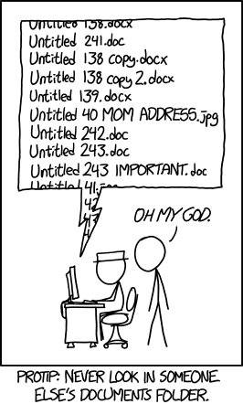

Slide 48
Conventions
Be specific and be descriptive
Be consistent
Name according to specific function, stage, date, etc.
Avoid generic names like data.csv, function.py, etc.

Slide 49
Conventions – versioning
Avoid file names with version suffixes like:
my_file_final.R
my_file_final_final.R
my_file_final_final_FOR_REALZ_THIS_TIME.R
Try to avoid manual versioning (we’ll talk version control soon)
my_file_v1.m
my_file_v2.m
For data, dating is better (see next slide)

Slide 50
Conventions - dating
Use the standard date format
YYYY-MM-DD
YYYY_MM_DD
Most languages have a function to obtain current date/time.
Get in the habit of appending date to data files names as either prefix or suffix.
When necessary, also append time of simulation (hour, minute, second).

Slide 51
Conventions – casing for legibility
Recommended:
snake_case: my_file.py
camelCase: myFile.js
mixed: heartData_Evanston_2025_02_24.csv
Acceptable:
hyphenated-case (usually for folders): project-1
Avoid:
spaced names: project report.pdf
dotted*: heat.data.evanston.csv
* Some authors recommend dotted naming. I discourage it as it is quite confusing and unacceptable under some language conventions.

Slide 52
A Note on Data, Dates, and Names
Occasionally, I generate a lot of data files within a single simulation. In this case, instead of naming:
YYYY_MM_DD_hh_mm_ss_simulation_001.mat
YYYY_MM_DD_hh_mm_ss_simulation_002.mat
YYYY_MM_DD_hh_mm_ss_simulation_003.mat
I make a folder per run inside my results folder, and save only the generated data of that run in there:
YYYY_MM_DD_hh_mm_ss/
simulation_001.mat
simulation_002.mat
simulation_003.mat
simulation_info.txt

Slide 53
General Principles
Usability
Portability
Automation
Collaboration

Slide 54
Documentation

Slide 55
Where to document
A README file for the whole project.
Specific observations / thoughts, etc. (appropriately placed in directory tree structure).
Inside your script.

Slide 56
README file
Overall description of the project
General requirements
Other general information (structure, explanations, semantics, conventions)
Example usage

Slide 57
Example
See example Example_Desktop/Project_2

Slide 58
General Principles
Reproducibility
Collaboration

Slide 59
txt vs md
My README file had a weird suffix: .md
What is this about? Well...

Slide 60
Intermezzo 2 – File Types

Slide 61
What should README be?
You may have seen README files as:
README.txt
README.md
The latter one is a markdown file
This just means it has extra marks for nice formatting, used often in the web.

Slide 62
Different data types
Do not be afraid of different file types, you will encounter and work with many, and it’s fine.
Learn what each does and how it interacts with others in your project

Slide 63
Data: language specific vs agnostic
You may be used to saving your data in language-specific formats:
.pickle, .pkl, .mat, .rds, .rdata, etc.
These formats are fast and convenient (often binary), but are not portable and easily shareable.
If your data is huge, you may be forced to use them.
If you want to share data, aim for language-agnostic formats, at least for finalized data:
.csv, .json
If you don’t know what a file type is, look it up!

Slide 64
Auxiliary files
You will encounter, and use, a variety of auxiliary files:
To store directory information, configuration parameters, “secrets” (API keys, e.g.), requirements, version control info, etc.
As metadata: to help you read other data files.

Slide 65
Example
EEG Data (BrainVision format)
.eeg → raw, binary data of voltage measurements
.vhdr → header file, metadata like sampling rate
.vmrk → records specific times of triggers or events
Your data is not always in one single file!

Slide 66
Common Project files
We’ll talk about these more in Day 2, but pay attention:
.env (usually for secrets and other environment variables)
.yaml, .toml (usually for configuration parameters, requirements)
.gitignore (which files to ignore by Git, more on this later)

Slide 67
Seeing hidden files
Invisible files start with a single dot “.”
.gitignore
.env
You can see them in your computer, while on your file explorer:
Mac: command + shift + .
Windows: File Explorer -> View -> Hidden items

Slide 68
Creating files
You will need the command line or and IDE to create and edit those files.
More on IDEs later.

Slide 69
Exercise
Experiment with the IDE you are used to (Jupyter Lab, RStudio, etc.) and see what type of files you can create and edit.
Make a mock README.md file in your project directory.

Slide 70
General Principles
Portability
Reproducibility
Collaboration

Slide 71
The Command Line

Slide 72
The command line interface (CLI)
Text based interface to communicate with your operating system
Terminal
Console
Prompt
You will certainly need it for your projects, but don’t be afraid, you don’t need to learn everything about it.

Slide 73
Analogy
When working on a powerpoint presentation, there are “add-ons” or “plug-ins” that help you achieve X, but are not default implementations of powerpoint.
Similarly, programming projects often rely on external tools for specific purposes (downloading packages, version control, connecting to remote servers, etc.)
These tools don’t come with a nice graphical interface (too much work!), but you can run them on the command line!
their use can be automated
commands are precise and reproducible

Slide 74
Who’s afraid of the CLI?
Many tools will require you to run commands from the CLI, if anything just for installation.
Usually, these tools have clear instructions on how to use it and what to run.
You don’t need to learn everything now. Important steps:
Get comfortable with opening and closing it
Learn how to change directories

Slide 75
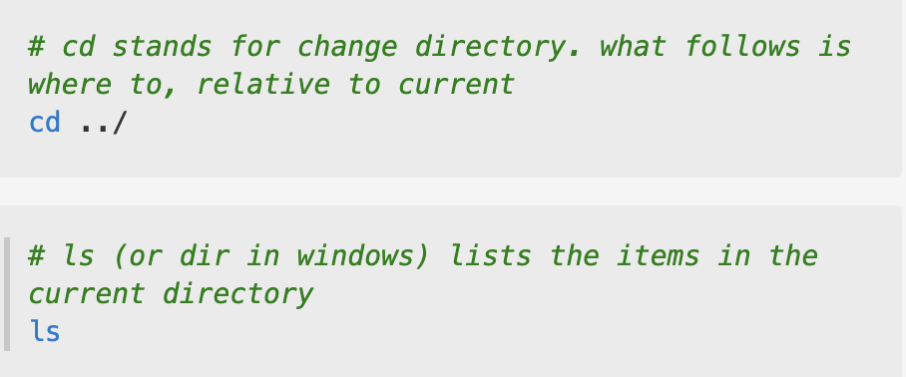
Example
Changing directories
Listing directories
See live example

Slide 76
Exercise
Open your:
PowerShell if on Windows
Terminal if on Mac
Look up the commands to change directory and to list files online
Play around for a bit!

Slide 77
Version Control

Slide 78
What and why?
Version control is any protocol used to keep track of versions of your code (or other materials) as you develop it.
A version control system is any specific software that helps you achieve the above.
Helps you avoid manual version control: file_v1, file_v2, etc.
The most common vcs is Git
Using a version control tool is indispensable for efficient and robust collaboration!

Slide 79
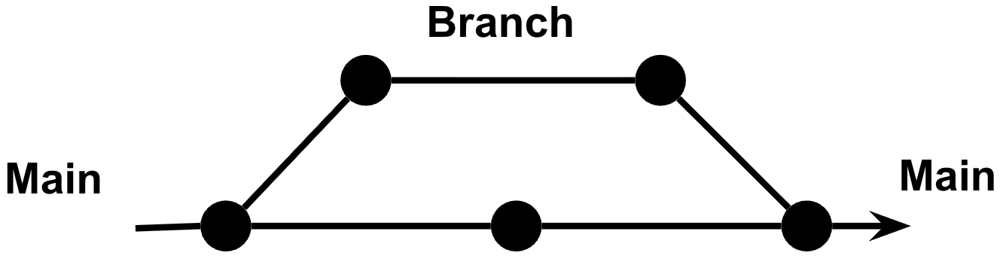
Example
Each point is a new version of your code. You can keep track of these on the central line.
You may want to experiment with changing some aspects of your code, so you branch off, and later “merge” with the main line.
Alternatively, you may share with a collaborator, who will make changes, and then merge.

Slide 80
Git
We don’t have time to help you install and learn git, but we have materials here.
It’s easy to use, and to get started you need to learn 5 words:
init, status, add, commit –m
(Live demonstration)

Slide 81
GitHub
GitHub is a website that allows you to:
Host Git repositories online
Perform Git actions through a graphical interface
You can sync your local project with GitHub in several ways:
Through a command line interface (terminal, etc.)
Through an IDE
Through the GitHub Desktop App
I recommend starting with the terminal, may take a bit of searching and learning but the payoff is worth it

Slide 82

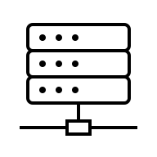


Example
Quest
Quest
solver_alice
solver_bob
lab computer
solver_alice
solver_bob
solver
Laptop
Laptop

Slide 83

Example
GitHub
solver

Slide 84
.gitignore
VERY IMPORTANT
The .gitignore file tells Git which files to ignore. This is a very important file if you use GitHub or another public repository to avoid sharing secret information (for example API keys) online.
You can find .gitignore templates for your favorite programming language here.
Never upload secret or sensitive information to GitHub!!

Slide 85
General Principles
Collaboration
Version Control
Reproducibility

Slide 86
Integrated Development Environment

Slide 87
IDEs
Integrated Development Environments (IDEs) have many advantages besides editing scripts
Enhance productivity
Facilitate project management and Organization
Help with version control
Help with debugging

Slide 88
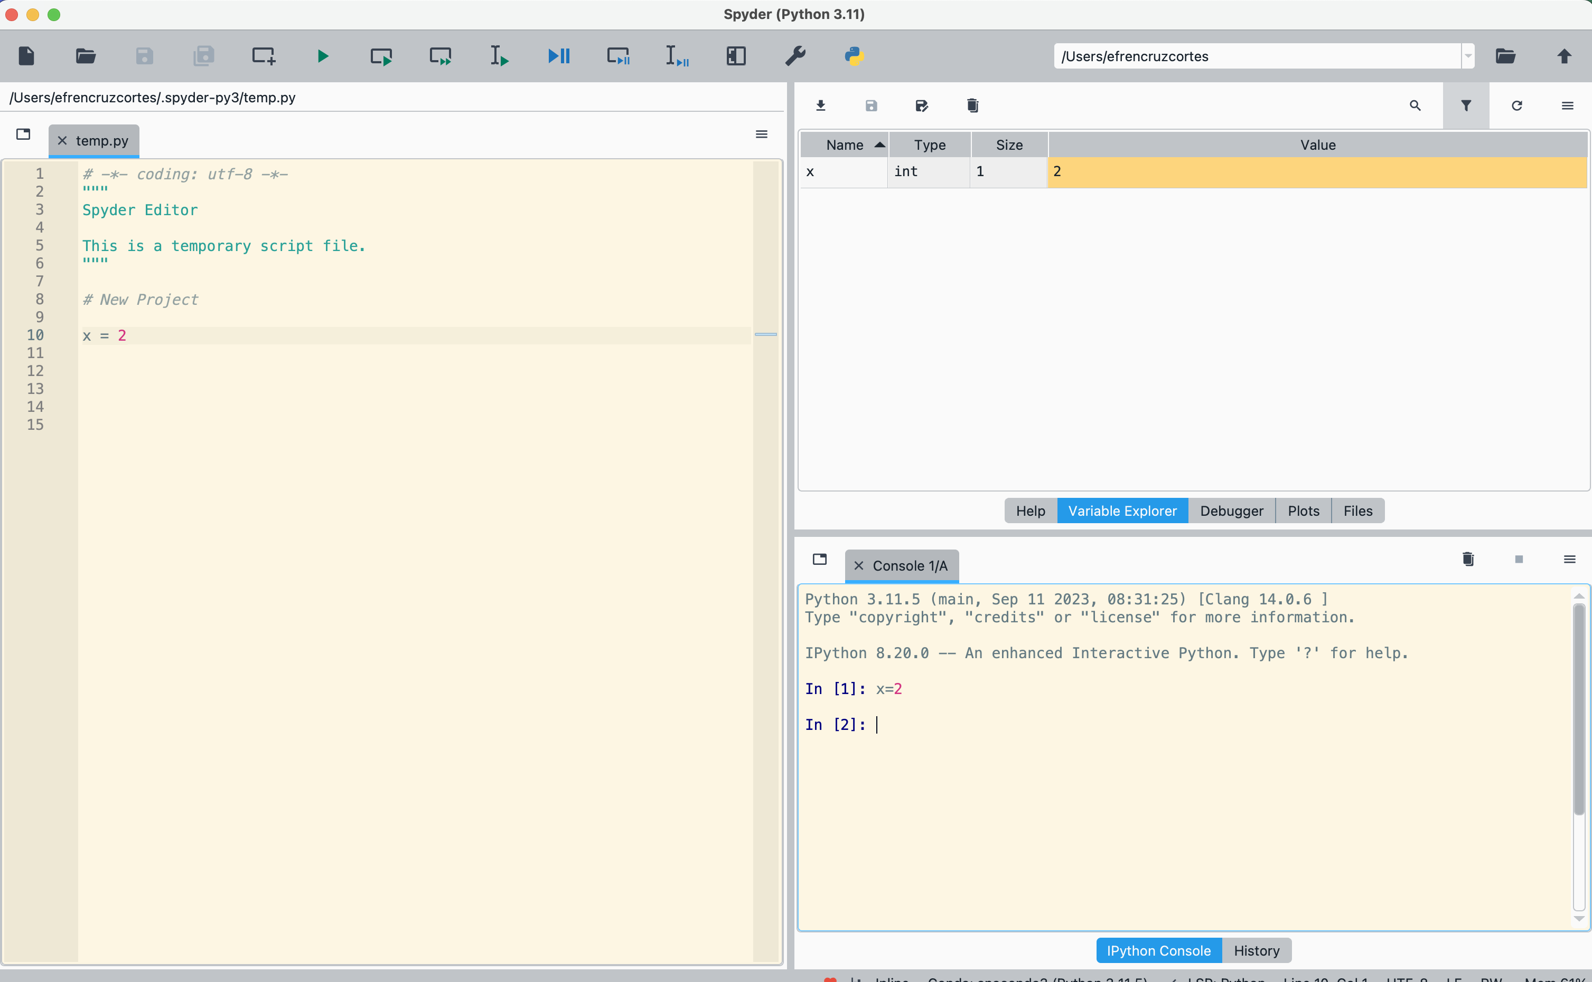
IDEs
IDEs have tools to help you manage projects. For example path management, “projects” (R and Spyder), etc.

Slide 89
Examples
Visual Studio Code
Most versatile
Supports many languages
Supports many file formats
Takes a bit of extra time to get used to
Jupyter Lab
Ju-py-(te)r: supports Julia, Python, R
RStudio
R - Best for R and de-facto.
Others:
Spyder – For Python. Similar GUI to RStudio.
Pluto – For Julia. Interactive like Jupyter, but nicer.
Matlab’s own.

Slide 90
Choose your own adventure – but choose well!
If your language is proprietary (like MATLAB), you don’t have a choice.
If you are only working in R → RStudio
New-ish to python:
Spyder if using .py scripts, want to explore variables, variable structure, easily peak into class methods and properties, etc. Spyder “projects”
Jupyter if using .ipynb notebooks, are doing exploration, or following/preparing educational materials.
More experienced, multi-language, and a bit of patience:
Visual Studio Code.
I’m a convert to VS Code. It is fast, helps you easily create auxiliary files of all types, supports many languages, etc.

Slide 91
Aside note on Jupyter notebooks
Jupyter notebooks are popular because of their pedagogical value: it is easy to present step by step procedures.
If you use them, use them for pedagogical reasons or for exploration and experimentation.
Make sure you add a folder akin to “exploration notebooks” to your directory tree!
But, you should aim to have full .py scripts as your final result.
Containment.
Consistency
Reproducibility.
Automation.

Slide 92
Environments

Slide 93
Environments
An environment is an isolated space, generally self-contained, containing dependencies necessary to run a project.
Dependencies include libraries, packages, and modules.
These are just pre-written pieces of code
Environments contain specific versions of the project’s dependencies.
They avoid conflict among different dependencies and their versions.

Slide 94
Dependency hell
You can’t build everything from scratch. You will inevitably depend on libraries built by others.
These are built mostly independently, so they can conflict with each other.
When dependencies are in conflict with each other, your project may encounter unexpected errors and become impossible to run.
X package (v1)
Y package
Your Project
X package (v2)
Z package

Slide 95
The proprietary paradise
If you are a MATLAB user (or use another proprietary language) you may not be used to this concept, since most packages are designed by the company and kept consistent to avoid these conflicts.

Slide 96
Environments and package managers
Each language will have a tool to create environments, as well as to manage packages within an environment.
These packages are often downloaded from a repository.
Packages, repositories, and managers have varying degrees of security and security checks, so be careful when installing.

Slide 97
Environment cheat sheet*
Language | Terminology | Environment Creation Tool | Package Repository | Package Manager | Requirements Files
Python | Virtual environments Conda environments | venv conda | PyPI Conda | pip conda, mamba | requirements.txt environment.yaml
R | Project environments | renv (.RProj) | CRAN | renv install.packages() | renv.lock
JavaScript | node_modules | npm yarn | npm registry | npm yarn | node_modules .pnp.cjs
Julia | Project environments | Pkg | Julia general registry | Pkg | Project.toml Manifest.toml
Rust | Cargo projects | cargo | crates.io | cargo | Cargo.toml Cargo.lock
MATLAB | N/A | Path management Add-on manager | MATLAB central file exchange | Add-on Manager | N/A
* I’d love to improve on this cheat sheet, if you have suggestions let me know! -efrén

Slide 98
Environments
You should not be afraid of creating environments!
I like to create one per project
Approaches
One environment you can use from anywhere
conda, mamba, etc.
One environment per project
uv, renv, etc.

Slide 99
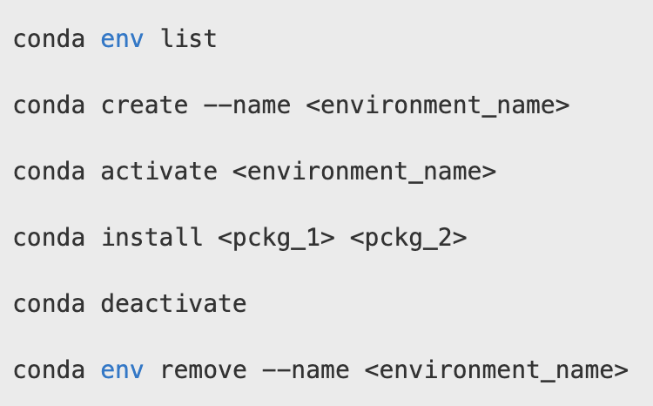
Example - Conda

Slide 100
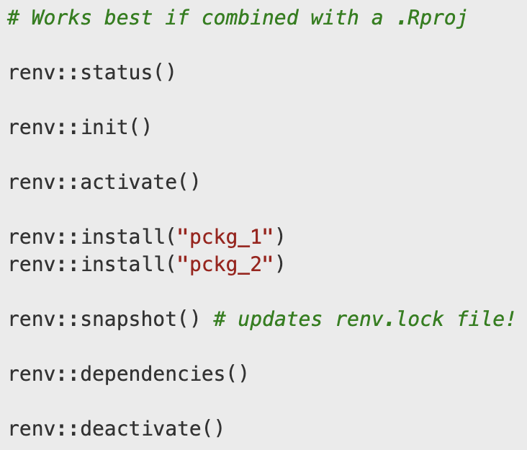
Example - renv

Slide 101
Note
While we’re mentioning environments at the end...
You should set yours up early on! Even before writing any script.

Slide 102
General principles
Reproducibility
Consistency
Collaboration

Slide 103
Final Exercise

Slide 104
Exercise
Take a few minutes to study the structure of one of your current projects.
Write some notes on how you would like to re-organize it based on what we learned today
DO NOT MAKE CHANGES
Talk to your neighbor about it (as long as it’s not a secret project).

Slide 105
Chaos
Go to the Chaos folder, reorganize it and rename files based on the principles we learned today.
All files in this example folder pertain to the same project.
The mock files are empty, they are there just for practice.
If there are folders or files that you think must be added, feel free to do so!

Slide 106
Recap

Slide 107
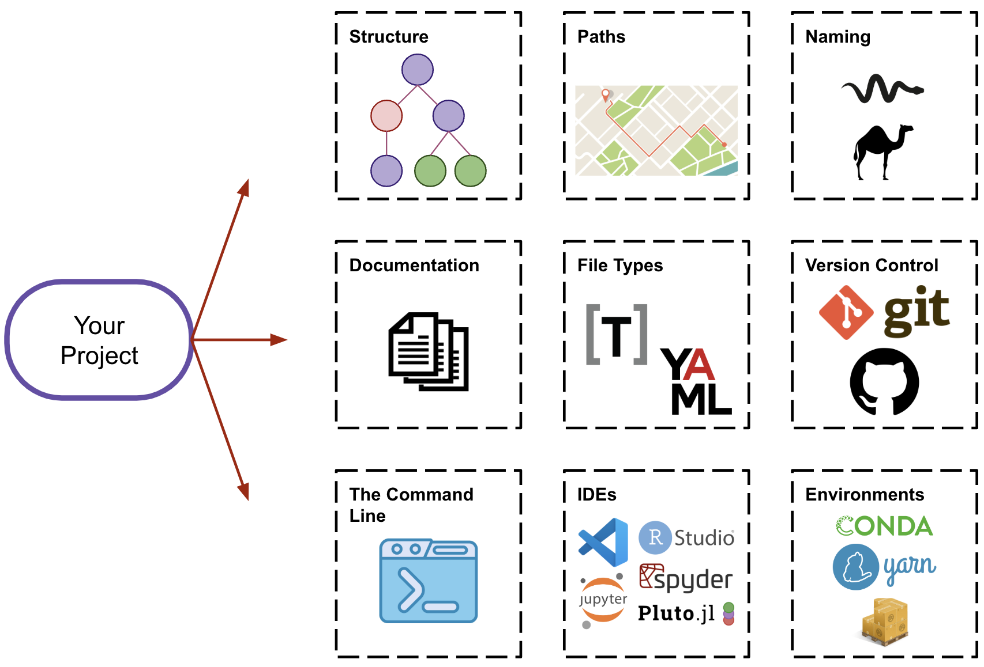
Day 1- Overview

Slide 108
Checklist
Draft the structure of your project
Create the initial directories
Setup version control (git, GitHub)
Setup an environment (renv, conda, etc.)
Setup a README file
Create and update configuration files in tandem to your coding
Start coding!

Slide 109
Questions?

Slide 110
Other resources
This cool post on file structure:
https://mitcommlab.mit.edu/broad/commkit/file-structure/
This workshop by our very own data management team:
Tobin_Magle_Data_Management_Slides
Related workshops by our data science team:
The command line
Conda environments
Git and GitHub

