Slide 1
The Researcher’s Guide to Code Organization
by efrén cruz cortés
TA: Yangyang Li

Slide 2
Day 2 Introduction

Slide 3
Does this sound familiar?
‘I wrote this a year ago, and I can’t remember what it does.’
‘These parameters worked for me, feel free to change them in the script.’
‘My friend Alice sent me a script, but it says the data is in /Home/Users/Alice/Desktop/Data?’
‘Yeah, somewhere around line 2000 you should find the value I used for C’

Slide 4
Motivation
Using proper principles when programming will:
Allow you to easily debug
Allow you to share your code and make it easy for others to run and contribute
Avoid errors due to untracked and inconsistent parameters
Allow you to easily change full sections of your code
etc.

Slide 5
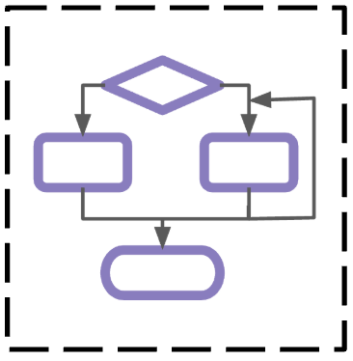




Day 2 Overview
How should code...
be structured?
be written?
be managed?
work properly?
stay healthy?
Continuous Improvement
Architecture
Code Quality
Configuration
Reliability

Slide 6
General Principles
Organization
Separation of Concerns
Modularity
Containment
Hierarchy
Robustness
Usability
Portability
Automation
Scalability
Reliability
Collaboration
Documentation
Transparency
Reproducibility
Version Control
Notes:
We will talk about these in more detail in day 2

Slide 7
Separation of Concerns and Modularity

Slide 8
Separation of Concerns
Organize your code into units such that:
each unit addresses only one concern
applies to all levels: sections within a script, functions, classes, scripts, collections of scripts, etc.
Single Responsibility Principle:
Separation of concerns at the smallest level (function / class)
Only one reason why it should change
Do one thing and do it well

Slide 9
Modularity
Units, or modules, should be able to cohere with the whole:
Encapsulation
Mostly self-contained
Control inputs and outputs
Exchangeability
swap modules without breaking the whole
e.g., change a regression model within a pipeline
Hierarchy
exchange flat long structures for hierarchically organized structures

Slide 10
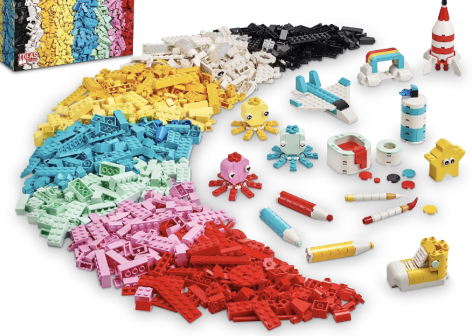
Analogy - LEGO
You can organize LEGO pieces by function, color, part of the whole, etc.
this is akin to separation of concerns
Each LEGO piece has the capacity to be exchanged by another.
this is akin to modularity

Slide 11
Code reuse
Your code may perform similar tasks but with slightly different parameters:
Same analysis for different patients
Same type of graphs for different datasets
Same processing steps for different parameters
→ Don’t repeat yourself!

Slide 12
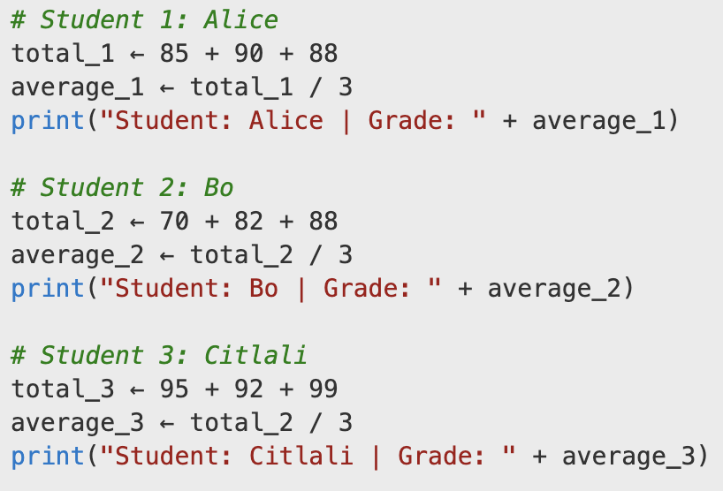
Example
What can go wrong with this code?

Slide 13
Example
What can go wrong with this code?
Some possibilities
Note the mistake in average_3
What if we had 50 students?
What if we decide to curve, or add extra points?

Slide 14
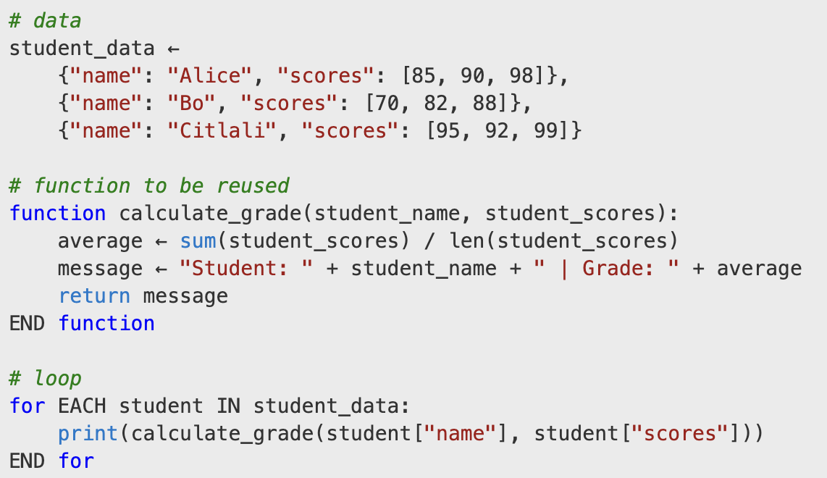
Example
No reuse
Reuse

Slide 15
Hierarchy
Group functions / classes with similar objectives or which are part of a procedural stage
Manage them at a higher abstraction level
Analogy
It would be hard to study the human body as a flat collection of atoms. So we cluster at different levels according to our needs:
Kinesiology: legs, torso, arms...
Physiology: respiratory system, endocrine system, nervous system...
Classical hierarchy: atoms → molecules → cells → tissue → organs ...
etc...

Slide 16
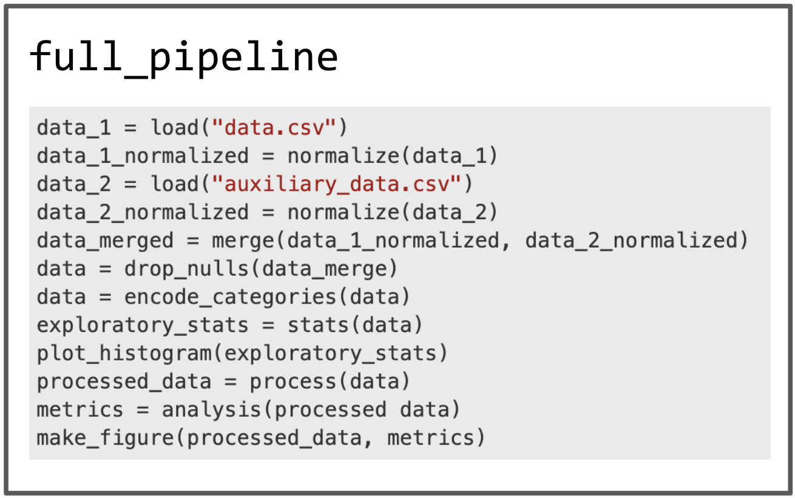
Example – flat script
Long script:
Flat structure
Many responsibilities
Hard to debug
Hard to re-use

Slide 17
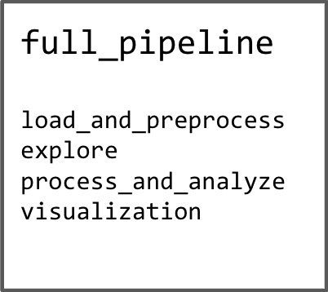
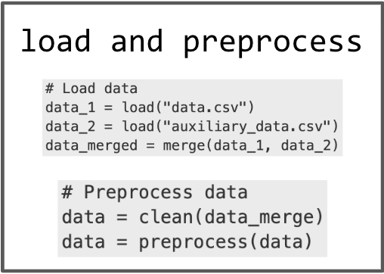
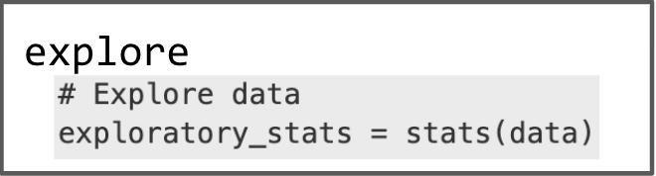
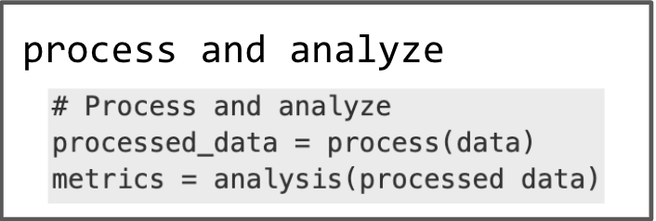
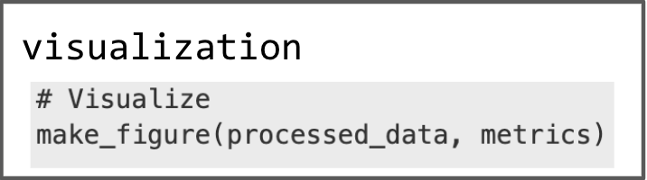
Example – modular script
Divide into smaller modules
Each sub-module may have multiple scripts within

Slide 18
Exercise
You’re building an epidemiological model to simulate a recent outbreak. Your project must handle:
Population Agents: Different behavior for introverts (stay home) and extroverts (go out to parties).
Environments: Different social networks, a dense “urban” one, and a sparse “rural” one.
Pipeline: Uses raw historical data to start simulation, plots dynamics, compares statistics, validates with current data.
Which modules would you need, and how do you organize your project accordingly?
Talk to your neighbor about it!

Slide 19
Code Quality

Slide 20
Naming Conventions
Similar to the folder/file case
snake_case: my_variable_name
camelCase: MyClassName
Different programming languages use different conventions.
consult the conventions of your community
pay particular attention to:
variables
constants
functions
classes

Slide 21
Code Annotations
Comment your code!
Description. At the top of your script / function. Provide a high level overview of what it does, inputs and outputs.
Line comments. These work for more specific guidance, to separate sections, justify decisions, etc.
Type hints. Some languages also provide a way to indicate the variable type (number, text, list, etc.)

Slide 22
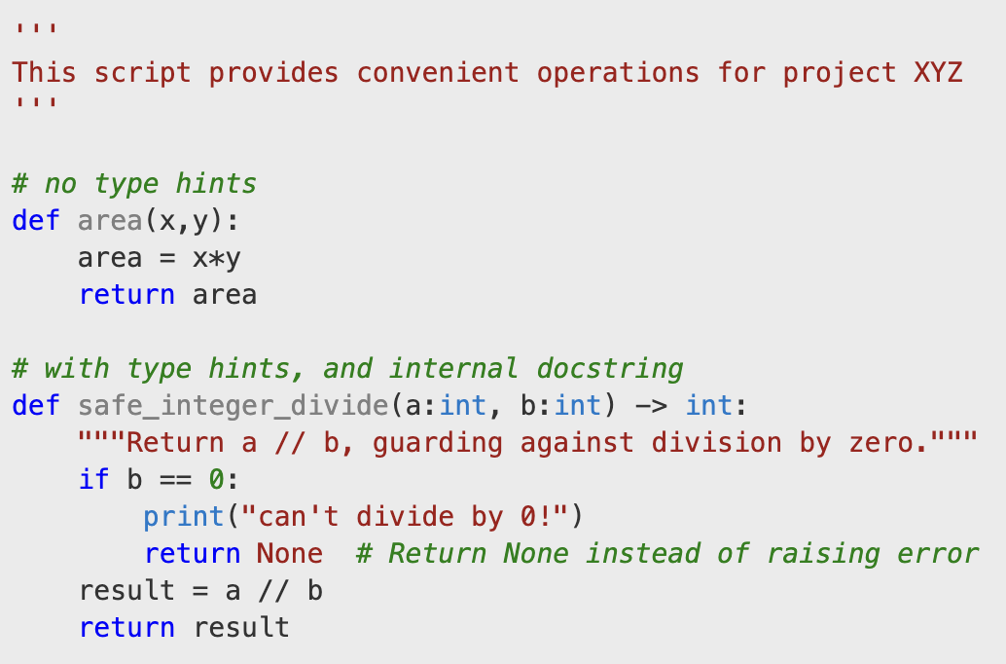
Example

Slide 23
Magic Numbers and Constants
Magic numbers are hard-coded numbers sprinkled throughout your code
If possible, all numerical values used in the code should be kept in a different configuration file
If you will set values within the code, place them at the top of the script
Same principle goes for constants

Slide 24
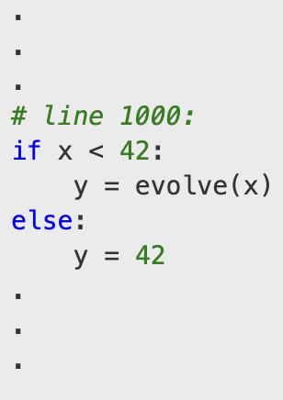
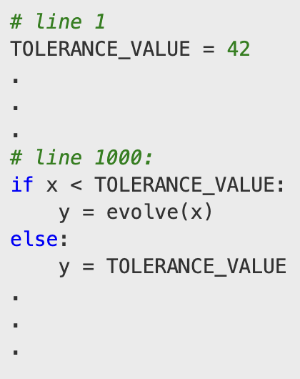
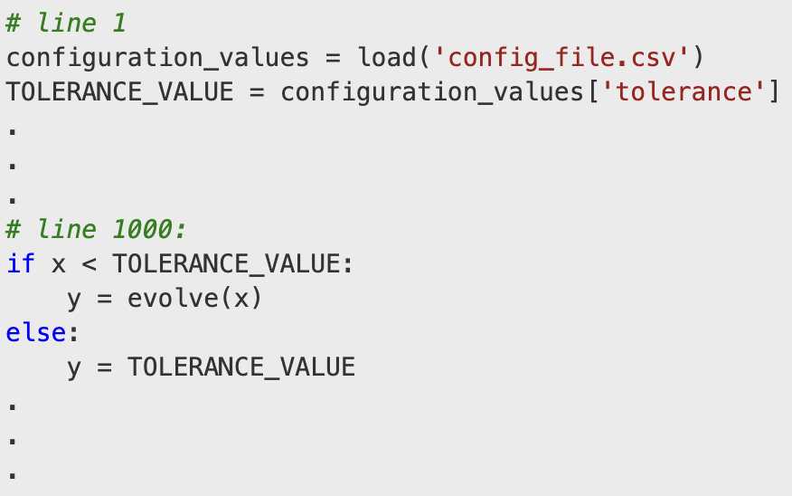
Example
Bad
Better
Best

Slide 25
Scope
Broadly speaking, a scope is a defined region (conceptual) of the code where variables or functions can be accessed.
Global scope. If a variable is defined globally, then it can be accessed everywhere in the code
Local scope. If a variable is defined locally, (for example, inside a function), then that variable is only available while inside the function, not outside.

Slide 26
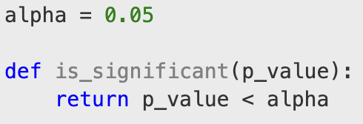

Scope
When you build functions, try to avoid global dependency.
Works, but hard to debug
Best practice

Slide 27
Exercise
In your exercise folder create a new file with a function computing the volume of a cylinder. Requirements:
File-level and function-level documentation
If you need to use constants, place them at the top of the file
Besides constants, the function should not depend on global variables

Slide 28
Environment Management and Configuration

Slide 29
Configuration Files
Configuration files are auxiliary files with information about your script:
parameters
file directories
models
other settings and variables
Common types:
config.toml
config.yaml
config.json

Slide 30
Configuration Files
All you have to do is “load” the configuration at the beginning of your script.
There are packages that help you with specific files.

Slide 31
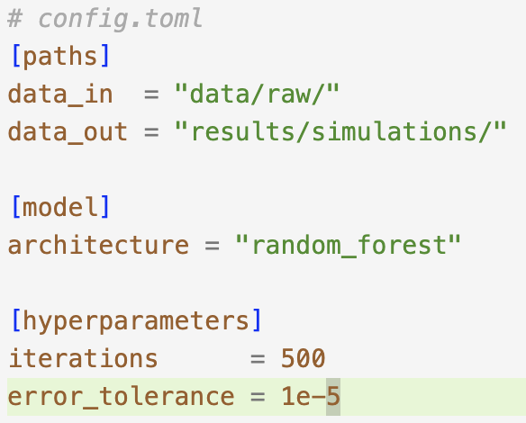
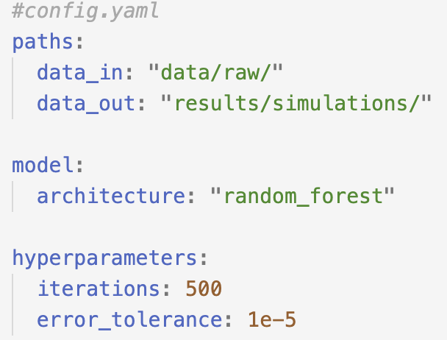
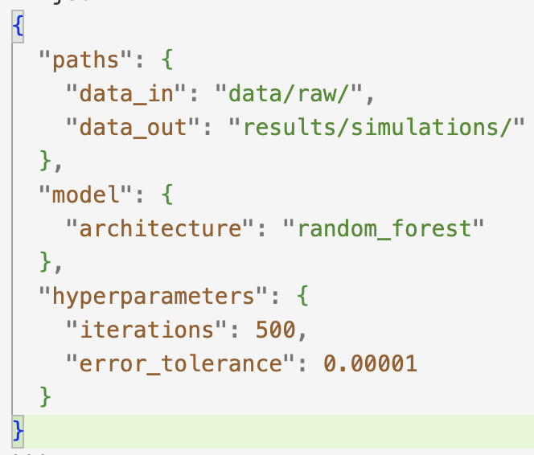
Example
config.toml
config.yaml
config.json

Slide 32
Secrets
Sometimes your script may need private or sensitive information
For example: if using a cloud service or accessing a database, you’ll need username, password, API keys, etc.
DON’T write them directly on your script
Place in a different file (usually .env, and make sure that file is listed in your .gitignore)

Slide 33
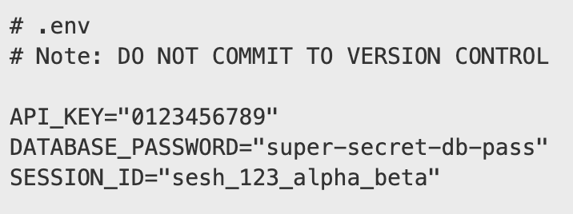
Example

Slide 34
Secrets - Collaboration
You may want to provide a template for collaborators for the .env file:
template.env
.env.example
in the readme file

Slide 35
Path Management
Don’t hardcode!
Save relative paths (relative from project’s “root”) in config files
Make sure script is run from project’s root
provide info on how to do it in readme file if necessary

Slide 36
Running Scripts
When you run a script, it will do so from the “current working directory” (cwd)
Your relative paths work based on the cwd
The “play” button in your IDEs usually runs from cwd
Strive to always run things from root
this may not always be possible: e.g., jupyter notebooks, when testing, etc.
I personally like to run my scripts directly from the terminal, where I can control everything
Live example

Slide 37
Exercise
Take a few minutes to think about one of your current projects, and the parameters, settings, etc. that it depends on.
Think about how you would pull these out from the script and place them in a configuration file
Don’t worry about specific syntax of your config file. Focus on how you would organize these params, and how they are likely to change for different runs / use cases.

Slide 38
Reliability

Slide 39
Debugging Strategies
Debugging Tools in your IDEs
checkpoints
Printing
while debugging, usually variable values and types
Logging
for a full simulation run, record important milestones of the process
Tracing
full execution summary, usually through some package
Rubber ducking
Explain the process to a person (or a rubber duck)
Comment pieces of code to isolate the problem

Slide 40
Errors
Common failure patterns:
syntax
won’t run at all
e.g., forgot comma
runtime
variable type
e.g., string instead of integer
variable conflict
unfinished function calls my_function vs my_function()
logic
runs but results are wrong!
e.g., loops (are objects deleted, created, and iterated over correctly?)

Slide 41
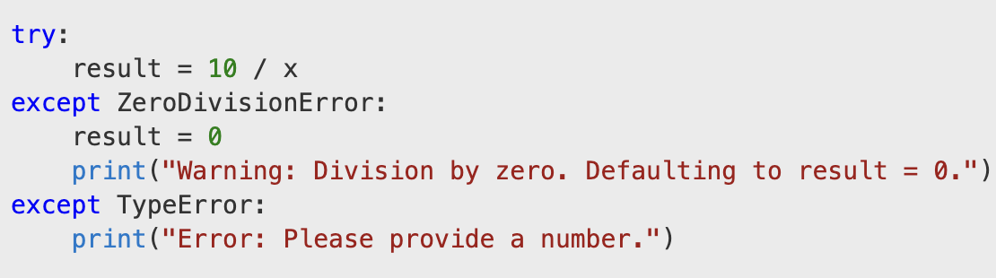
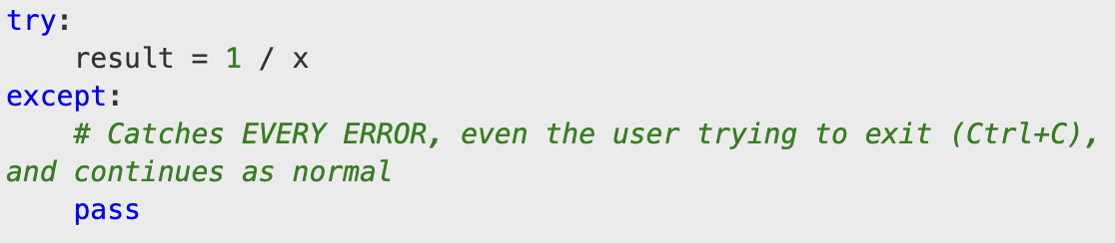
Error Handling
“catch” expected errors and control them
e.g., if number not in allowed range, print useful message and exit
don’t catch everything!
it may hide certain bugs in other sections of your pipeline
Good
Bad

Slide 42
Testing
Unit testing
Test individual functions and sections of the code (“units”)
Consider extreme (“edge”) cases for inputs to your functions
numbers: very small, very large, negative
collections: empty
wrong type: string to a math function
Have a dedicated folder for testing scripts and results

Slide 43
Testing
Most languages have dedicated packages / libraries for testing.
These packages streamline the testing procedure, and provide a specific framework for creating these tests
ex: creating individual functions for each test, all in one script
Different packages have different testing frameworks. You’ll need to do a bit of research on how it’s done in yours.

Slide 44
Example
If my function computes the area of a rectangle. We should build these tests:
area(1,1) = 1
area(-1,1) should tell me the value is not allowed
area(-1,-1) should NOT give “1” as a result

Slide 45
Exercise
Discuss with your neighbor.
Pick one or two of the functions below, what sort of unit tests would you do for such function? Feel free to interpret what they do according to your field.
standardize_participant_name()
clean_signal()
validate_survey()
merge_trials_with_metadata()
align_signals()
detect_outliers()
run_preprocessing()
visualize_results()

Slide 46
Continuous Improvement

Slide 47
Technical Debt
If you take shortcuts while programming, you will inevitably have to go back and fix them
All the labor you will put into fixing things later because of today’s shortcuts is your technical debt
While impossible to fully avoid (deadlines, project evolution, lessons learned, etc.), strive to minimize it.
Stay debt-free!

Slide 48
Refactoring
Changing the project or script structure to enhance readability and maintainability
BUT, without changing what your code actually does.
Don’t wait until the end. Set healthy checkpoints throughout and refactor often. Example:
After you’re done with a large stage (data exploration, model creation, etc.)
When adding new features
When fixing bugs

Slide 49
Code “smells”
They don’t break your code, but make it unreadable, or suggest bad design:
Long functions and scripts
efrén’s rule of thumb: two window scrolls max
Repeated code
Hard to trace a pipeline

Slide 50
Final Exercise
Find a neighbor and take a minute to explain to each other a project you’re working on. Then:
Discuss what structure better fits the project.
Discuss path dependencies, settings, parameters, constants, etc. and where in the project that information would go.
What common errors have you encountered, or do you anticipate could encounter? (unallowed values, variable types, etc.)
What sort of systematic tests would you create to make sure individual aspects of your code are running smoothly?
Feel free to reveal any “smelly” code practices you’ve already committed in your code.
Discuss tools that you’re planning to use and why they will be particularly helpful to you.

Slide 51
Recap

Slide 52
Day 2 Overview
How should code...
be structured?
be written?
be managed?
work properly?
stay healthy?
Continuous Improvement
Architecture
Code Quality
Configuration
Reliability

Slide 53
Checklist
Draft the logical structure of your code.
Group by stages, tasks, etc.
Make sure there are no magic numbers!
Follow standard conventions in your language / field regarding naming variables, files, etc.
If your code is longer than 2-3 scrolls, you likely need to refactor into smaller modules
Use configuration files!
Externalize any variables outside the logical flow of your process.
Add unit tests

Slide 54
Questions?

