Slide 1
Organization Takes time up front Saves time and frustration later Based on material from https://kbroman.org/

Slide 2
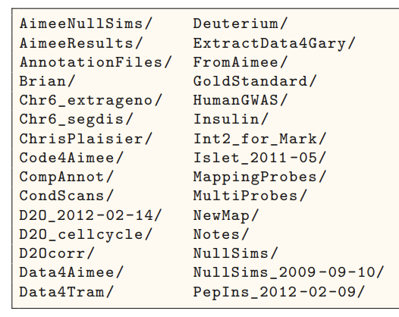
Good Organization Practices
Goal: Avoid Chaos​
Put everything for a project in one folder
Create a subfolder for each file type
Use descriptive names (more on this later)
Make a README (more later)
https://kbroman.org/Tools4RR/assets/lectures/06_org_eda_withnotes.pdf

Slide 3
Example Basic Project
my_project/
code/
data/
raw_data/
processed_data/
Main project folder
Files by type
Subfolders
output/

Slide 4
Example Paper Project
my_paper/
data/
raw_data/
processed_data/
Main project folder
Files by type
Subfolders
tables/
code/
output/
figs/

Slide 5
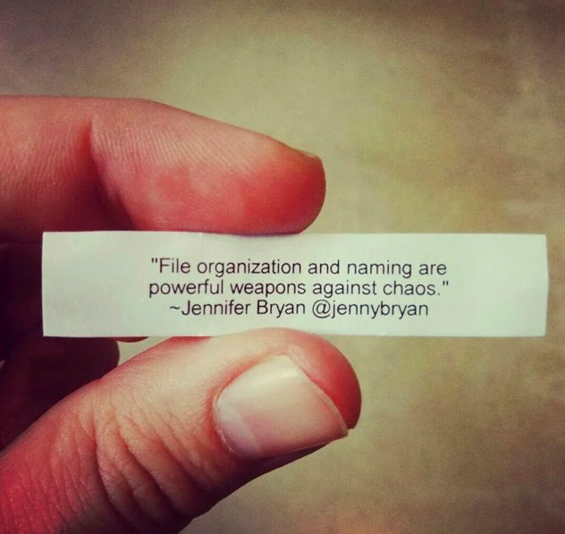
Project Organization Advice
There's no one right answer
Make a system that works for you
Be consistent!
Stick to it
Examples in R, python and bash
https://github.com/moldach/project-directory

Slide 6





Topics
Choosing Storage
Organizing your project
Human vs machine readability
Making it reusable

Slide 7
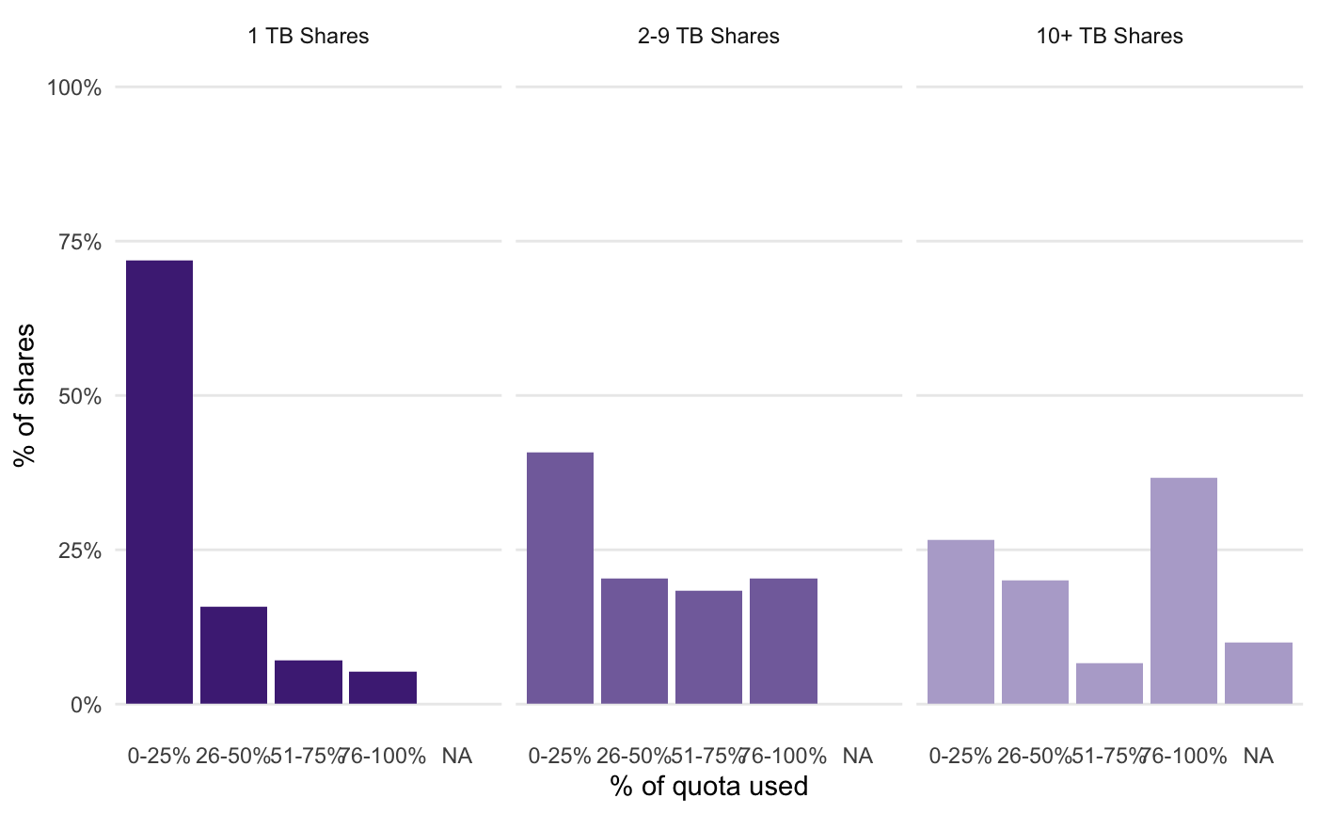
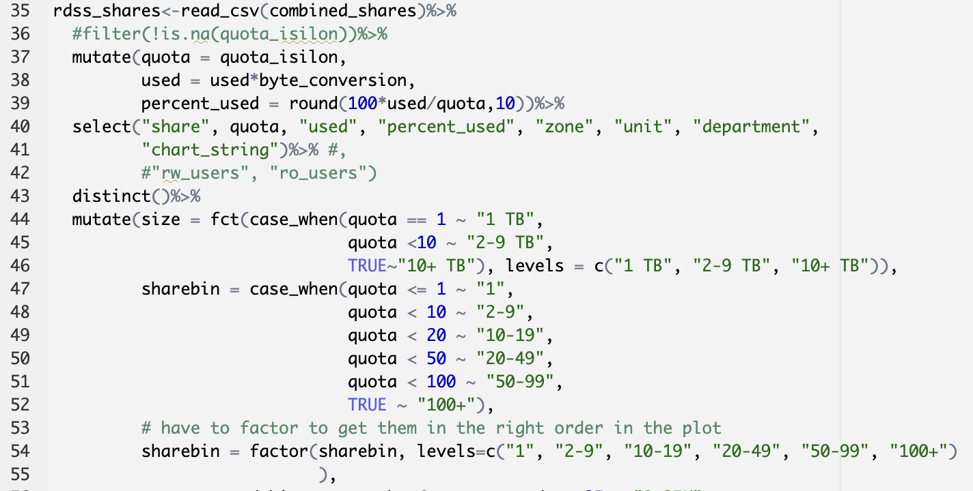
Human vs. Machine readability
Machine readable
Human Readable

Slide 8
Goal: Make your project...
Color coding
Pretty pictures
Full sentences
human readable
AND
machine readable
Good file names
Tidy data
Binary code
Tabular data

Slide 9
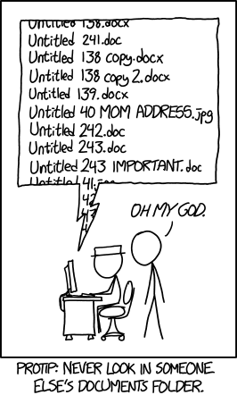
File naming
Programs do not produce good default names
Bad file names can waste time
Create a file naming convention that works for you and stick to it

Slide 10
Good file naming practices
Use descriptive names
No spaces in file names
Limit special characters in file names
Be consistent
Use existing standards
Use sort to your advantage

Slide 11
Use descriptive names
Not specific
script.R
document 1.txt
script.txt
notes.md
Specific
clean-the-data.R
references.txt
outlier-analysis.py
README.md
Names should tell you what's in the file
Non-specific names don't help you or the computer
Use appropriate file extensions
Make sure to include information that differentiates files

Slide 12
Spaces in file names
$ ls
file 1.txt file2.txt
$ ls file 1.txt
ls: 1.txt: No such file or directory
ls: file: No such file or directory
$ ls file2.txt
file2.txt
$
Human readable, but..
Computers use spaces as a delimiter
Replace with _ or -

Slide 13
Limit special characters
Characters have special meanings to operating systems use
Don't confuse your OS
Ex: bash
Underscore (_) and dash (-) are ok
Character | Meaning
# | Comment
$ | Variable expression
& | Background job
* | Wildcard
( ) | Groups commands
; | Separates commands
' or " | Quotes phrases
/ | Pathname directory separator
? | Single-character wildcard
! | Pipeline logical NOT
https://www.oreilly.com/library/view/learning-the-bash/

Slide 14
Be consistent
Make it easy to find the information you need
Things to check for consistency: dates, capital letters, order, abbreviations
Use existing standards
Inconsistent
2023-07-05-geo-Chicago.csv
Chicago-June2023-Geospatial.csv
July22-23-Austin-geo.csv
Austin-July-2023-income.csv
Consistent
07-23-Chicago-geospatial.csv
06-23-Chicago-geospatial.csv
07-23-Austin-geospatial.csv
07-23-Austin-income.csv

Slide 15
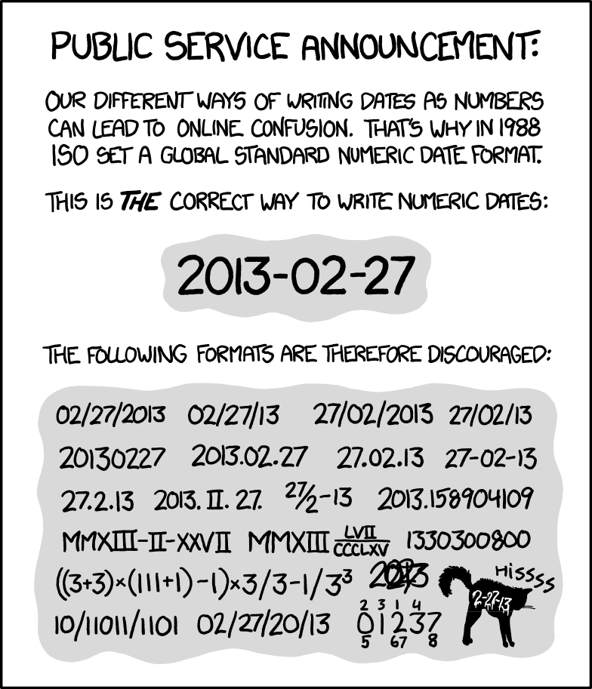
Use existing standards
Dates!
What do other people in your research group do?
What do people in your field do?
https://xkcd.com/1179/

Slide 16
Use sort to your advantage
Your computer is good at sorting
Name your files so it sorts them in a useful way
General to specific
Not useful
06-23-Chicago-geospatial.csv
07-23-Austin-Geospatial.csv
07-23-Austin-income.csv
07-23-Chicago-geospatial.csv
Useful
2023-06-geospatial-Chicago.csv
2023-07-geospatial-Chicago.csv
2023-07-geospatial-Austin.csv
2023-07-income-Austin.csv

Slide 17
File naming advice
Name your files so you know what it is before you open it
Don't use spaces and special characters
Pick a convention and stick to it

