Slide 1
Reusability You mostly collaborate with yourself, and me-from-two-months-ago never responds to email.
- @mtholder

Slide 2
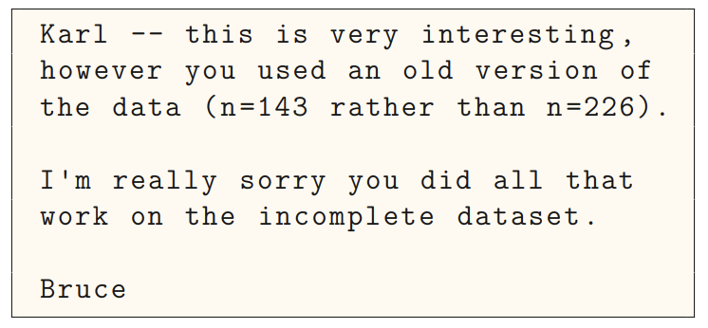
The results in Table 1 don’t seem to correspond to those in Figure 2.
“Your script is now giving an error.”
How did I make that figure?
In what order do I run these scripts?
Where did we get this data file?
“The attached is similar to the code we used.”​​​
Which image goes with
which experiment?​​​
Why did I omit those samples?
Adapted from https://www.biostat.wisc.edu/~kbroman/presentations/steps2rr.pdf

Slide 3
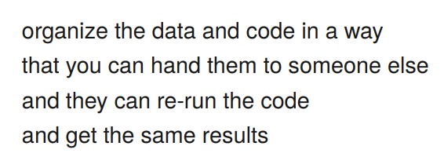
Basic: Make it reproducible
Automation
Keep the raw data raw
Documentation
README / code books
Portability
File paths
Version control
- @kbroman

Slide 4
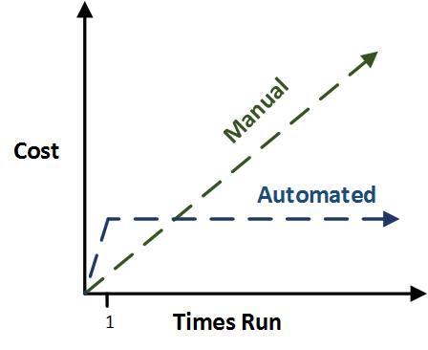
Automate everything
(even the things that take longer to code than if you did it by hand)
It's really hard to document things you do by hand
Don't touch the raw data – mark as read only
Write code that cleans the data and makes any output you need
Then you have a pipeline for when you get another similar file

Slide 5
What goes in a README file?
Tell you-from-6-months-ago how to use the project
Context: How the data was produced
Data inventory: list of files and folders and what they contain
Codebook: Describe the contents of data files
Instructions: how to use the code and data together

Slide 6
What goes in a Codebook?
Describe the contents of data files
What variables measure
What type is it?
Units and any other format (dates, geographic coordinates)
Define valid data range and missing values

Slide 7
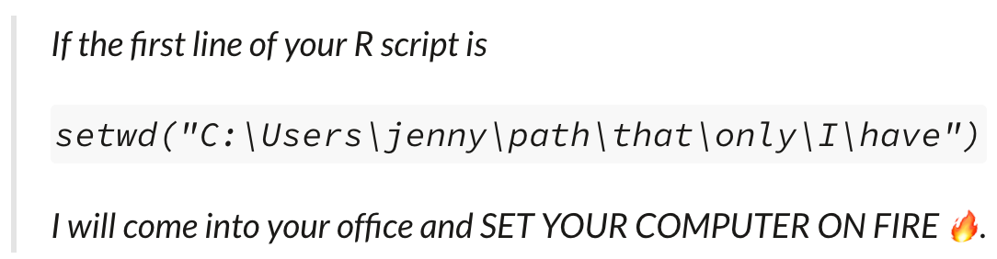
Portability
Will your code work for someone else?
Do you use file paths only you have?
Are all the components you need to run the code in one folder?
https://www.tidyverse.org/blog/2017/12/workflow-vs-script/

Slide 8
Version control
Show how you got from A to B
By hand: Save As
file naming
V1,V2 etc
Dates
Never "Final"
Takes precision
Creates so many files
Formal: Version control system (Git)
Unlimited undo
Creates an ID for each "commit"
Good for collaboration (who did what when)
Steep learning curve
Versions hidden behind latest

Slide 9
Reusability Advice
A little bit reusable is better than nothing
Keep the raw data raw – read only
Document what is there
Use self-contained projects
Use version control

