Slide 1
The Researcher’s Guide to Code Organization
efrén cruz cortés
TA: Yangyang Li

Slide 2
Introduction

Slide 3
Does this sound familiar?
I can’t find my script!
My script worked last week but now it’s broken. I didn’t touch it.
My script works perfectly in my computer but not when I share it with my colleague.
I wrote this a year ago, and I can’t remember what it does.
These parameters worked for me, feel free to change them in the script.
What does this file do? I’ll just delete it...

Slide 4
Motivation
A code-based research project is composed of many elements outside internal code logic, and yet, these are not taught in classes!
We need a place to understand how all these elements come together, why they are necessary, and the principles behind them.
Proper organization will facilitate collaboration, reproducibility, and other important elements of research.
A bit of effort now will save you sweat and tears in the future!!

Slide 5
Overview
Day 1 will focus on overall project organization principles and tools.
Day 2 dives into organizing principles within a script.

Slide 6
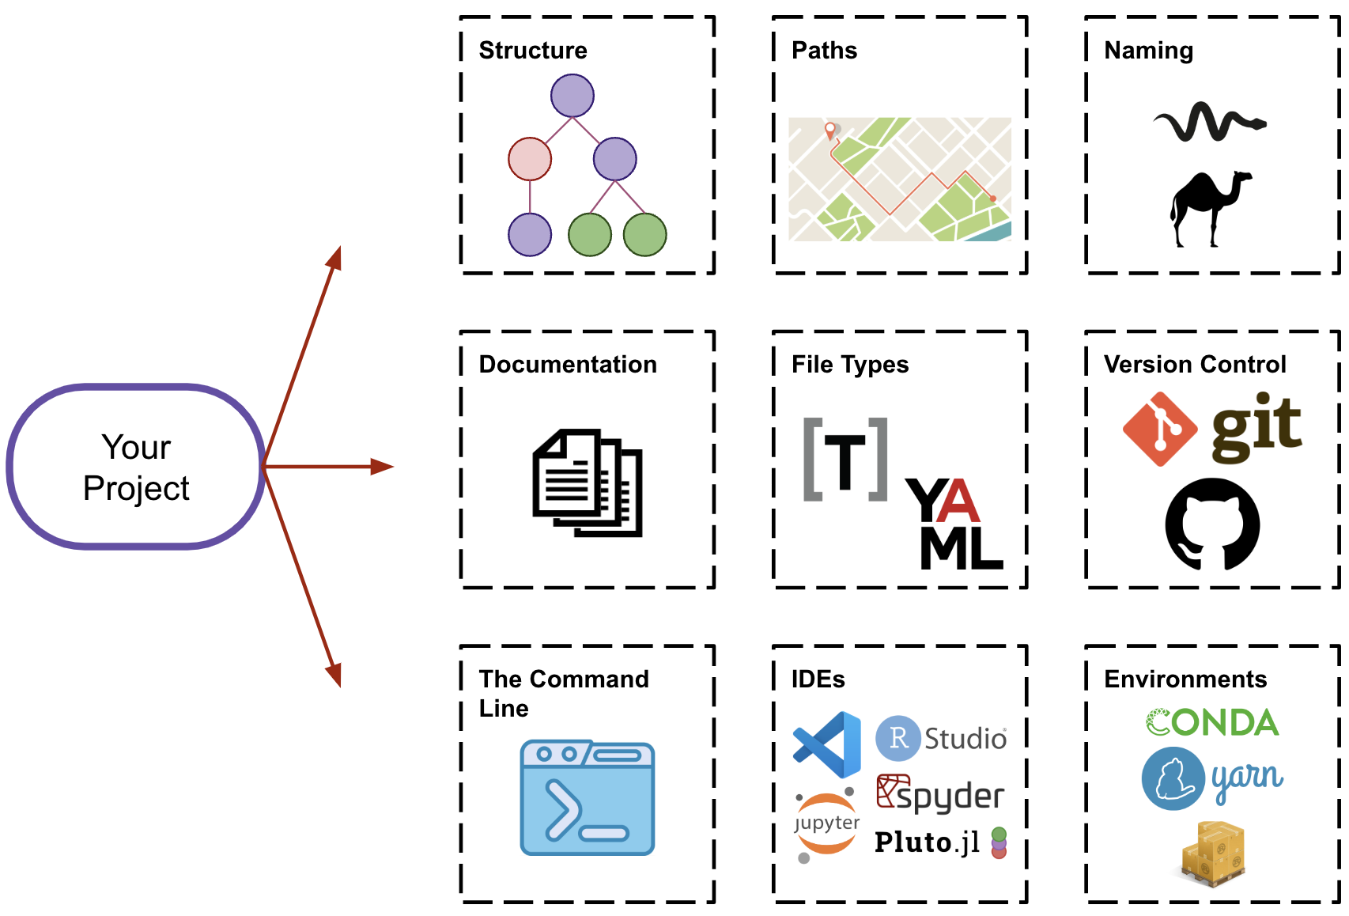
Day 1- Overview

Slide 7
General Principles
Organization
Separation of Concerns
Modularity
Hierarchy
Containment
Efficiency
Usability
Portability
Automation
Scalability
Collaboration
Transparency
Reproducibility
Version Control

Slide 8
Project Structure

Slide 9
Identify your project structure
Does your project use data?
If so, at which stage?
At the beginning (training, preprocessing, ...)
At the end (calibration, validation, ...)
Throughout (sensors, inference, ...)
Is your project iterative in nature?
Does your project branch into possible models / analyses?

Slide 10
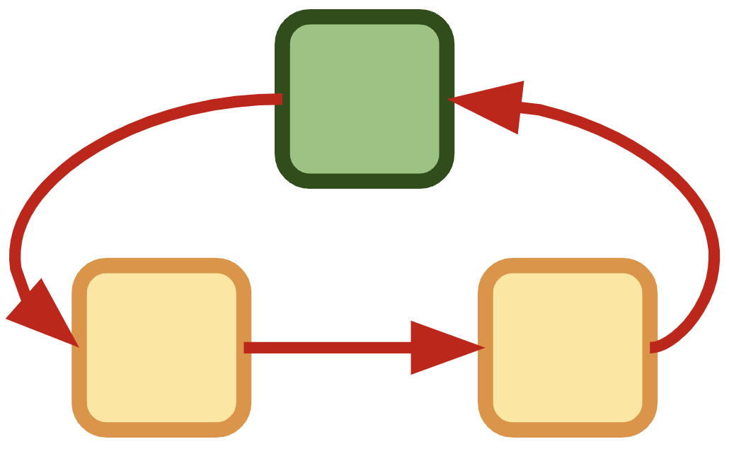
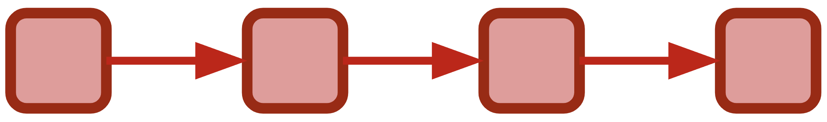
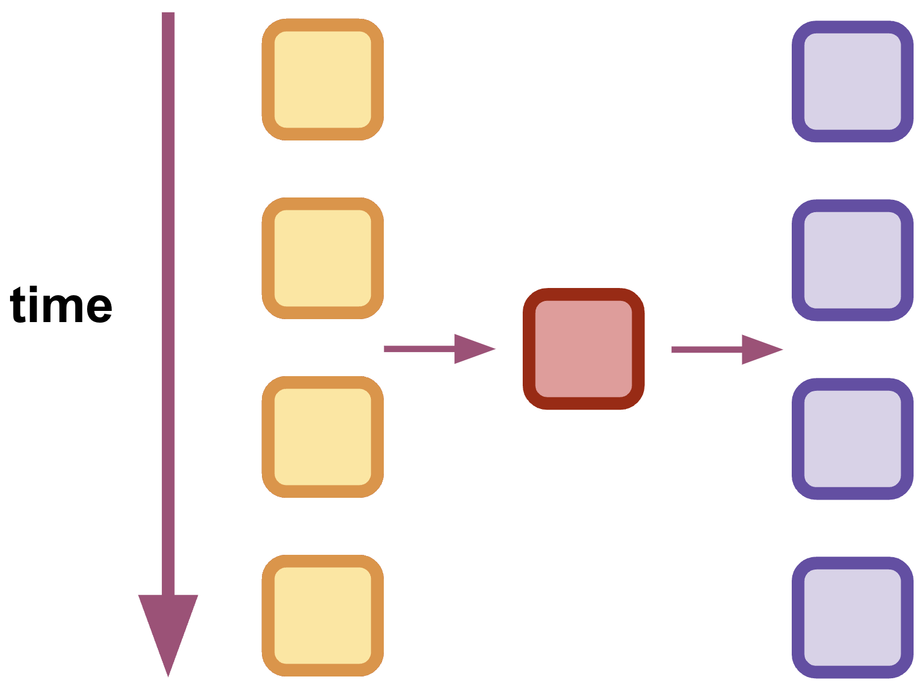
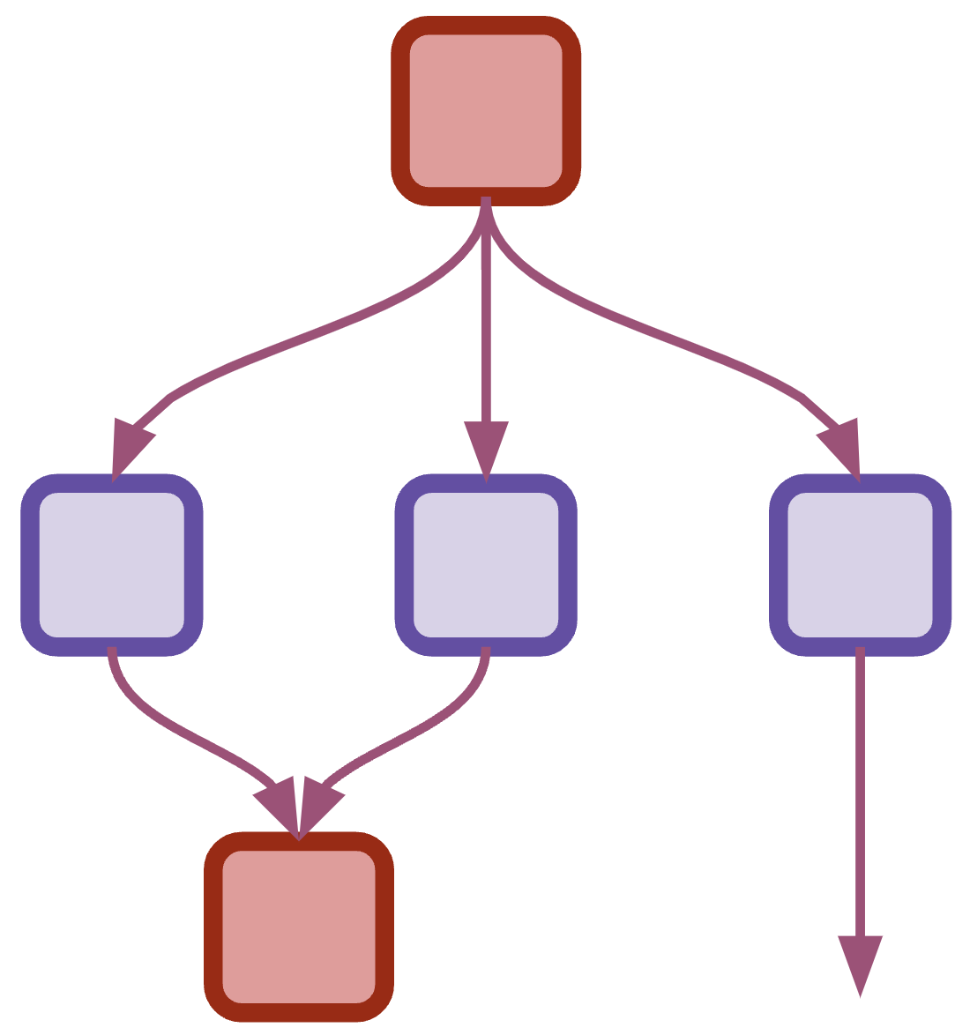
A simple project taxonomy*
Linear
Iterative
Recurrent
Branching
*I couldn’t find an official taxonomy / framework for research project structures, so these examples are limited to my own experience. -ecc

Slide 11
Examples
In reality, most projects are iterative in nature as we improve our own understanding and as we calibrate with data.
These are generic possibilities, but of course research is more complex:
Linear: batch learning, descriptive statistics
Recurrent: online learning, sensor data
Iterative: physics simulation, agent-based models
Branching: model selection, by-case analysis

Slide 12
Exercise
Grab a piece of paper and sketch the structure of your project.
It’s OK if it isn’t perfect, if it doesn’t fit the shapes above, or it is a strange mix.

Slide 13
Directory Structure

Slide 14
Keep the project contained
By default, all materials for your project should go inside one project directory.
(Imagine the chaos of saving all your .doc files in the Desktop)
Plan your project directory based on your project structure.

Slide 15
Bad!
See example folder Example-Bad
user
.spyder
Desktop
Documents
whose_is_this.R
where_am_i.py
what_is_this.R
MATLAB
yolo.m

Slide 16
Separation of Concerns
Separation of concerns is the general principle in which pieces of a project should be separated according to their distinct form and function.
For example, data is separated from “code” files.
Within coding, preprocessing is separate from analysis, which is separate from visualization.

Slide 17
Good! Common organization paradigm
Project
Data
Documentation
Results
Exploration
Scripts
High-level files
Raw
Processed
Images
Reports

Slide 18
Example
See example folder Project_1

Slide 19
No size fits all
The previous organizational paradigm is common and a good starting point, but your project may ask for a different structure.
General Principles to follow:
Containment
Hierarchy
Separation of Concerns

Slide 20
Tree structures
Note that you won’t always be able to visualize a tree as above. Sometimes the tree structure is written out using tabs and/or lines:
Project
| - Data
| - Raw
| - Processed
| - Scripts
| - Results
| - Figures
| - Reports
| - high_level_file

Slide 21
Exercise
Grab a piece of paper and create a draft of your directory structure based on the first exercise.
Think about where you will save files by function and by type.
You can draw a tree diagram or write it out in linear format as above.
Then, create the respective directories in your computer!

Slide 22
Note on literature
You may be tempted to add supporting literature (research papers, etc.) to your project directory. However, you will often use overlapping literature for different projects.
Instead, I recommend you organize literature elsewhere and use a reference management tool like Zotero.

Slide 23
General Principles
Containment
Separation of concerns
Modularity
Hierarchy
Efficiency

Slide 24
Intermezzo 1 - Paths

Slide 25
The current working directory
A directory is a location in your computer (a folder in the desktop, for example)
When running a script, the current working directory (cwd) is the location from where the script is run (set by IDE or terminal)
Not all scripts are at the same location as the cwd, but we should aim for them to be “close by” (see next slide).

Slide 26
Absolute vs relative paths
The absolute path of a file is the “address” from the root directory of your computer.
/Users/efren/Desktop/Example/some_file.txt
A relative path is the address as viewed from a different starting point.
If I’m on the Desktop already:
/Example/some_file.txt

Slide 27
Where’s your Desktop?
Note:
On some new laptops, your Desktop folder may be automatically in either iCloud or OneDrive.
This means your files are not saved in your computer but in the cloud!
Just make sure you know where everything is, and are intentionally using one option or the other.

Slide 28
Use relative paths!
Common relative path indicators:
“.” indicates current directory
“..” indicates parent directory
“A/B” indicates A is a sub-directory of B
“\” for Windows
“/” at the begining means “root directory”
“C:” for Windows
Assume I’m on the desktop:
./Project_1/Data
../Downloads

Slide 29
Path Standardization
Paths are written differently for different operating systems (forward / backward slash being the main culprit)
Many languages have a tool to help you standardize paths.
In python, for example, pathlib does that for you.

Slide 30
Example
See folder Example_Paths

Slide 31
General Principles
Portability
You can move your folder around and it won’t break.
Collaboration
You can share your project with other people!

Slide 32
Exercise
Assume you are situated in “Project_1”. Change the following absolute paths to relative:
/Users/you/Desktop/Project_1/data/your_data.csv
/Users/you/Desktop/Project_1/auxiliary_file.py
/Users/you/Desktop/Project_2/
/Users/you/Downloads

Slide 33
Naming

Slide 34
Conventions
Be specific and be descriptive
Be consistent
Name according to specific function, stage, date, etc.
Avoid generic names like data.csv, function.py, main.py.

Slide 35
Conventions – versioning
Avoid file names with version suffixes like:
my_file_final.R
my_file_final_final.R
my_file_final_final_FOR_REALZ_THIS_TIME.R
Try to avoid manual versioning (we’ll talk version control soon)
my_file_v1.m
my_file_v2.m
For data, dating is better (see next slide)

Slide 36
Conventions - dating
Use the standard date format
YYYY-MM-DD
YYYY_MM_DD
Most languages have a function to obtain current date/time.
Get in the habit of appending date to data files names as either prefix or suffix.

Slide 37
Conventions – casing for legibility
Recommended:
snake_case: my_file.py
camelCase: myFile.js
mixed: heartData_Evanston_2025_02_24.csv
Acceptable:
hyphenated-case (usually for folders): project-1
Avoid:
spaced names: project report.pdf
dotted*: heat.data.evanston.csv
* Some authors recommend dotted naming. I discourage it as it is quite confusing and unacceptable under some language conventions.

Slide 38
General Principles
Usability
Portability
Automation
Collaboration

Slide 39
Documentation

Slide 40
Where to document
A README file for the whole project.
Specific observations / thoughts, etc. (appropriately placed in directory tree structure).
Inside your script.

Slide 41
README file
Overall description of the project
General requirements
Other general information (structure, explanations, semantics, conventions)
Example usage

Slide 42
Example
See example Project_2

Slide 43
General Principles
Reproducibility
Collaboration

Slide 44
Intermezzo 2 – File Types

Slide 45
What should README be?
You may have seen README files as:
README.txt
README.md
The latter one is a markdown file (nicely formatted, used often in the web).

Slide 46
Different data types
Do not be afraid of different file types, you will encounter and work with many, and it’s fine.
Learn what each does and how it interacts with others in your project

Slide 47
Data: language specific vs agnostic
You may be used to saving your data in language-specific formats:
.pickle, .pkl, .mat, .rds, .rdata, etc.
These formats are fast and convenient, but are not portable and easily shareable.
If you want to share data, aim for language-agnostic formats, at least for finalized data:
.csv, .json
If you don’t know what a file is, look it up!

Slide 48
Auxiliary files
You will encounter, and use, a variety of auxiliary files
To store directory information, configuration parameters, “secrets” (API keys, e.g.), requirements, version control info, etc.
We’ll talk about these more in Day 2, but pay attention:
.env (usually for secrets and other environment variables)
.yaml, .toml (usually for configuration parameters, requirements)
.gitignore (which files to ignore by Git, more on this later)

Slide 49
Seeing hidden files
Invisible files start with a “.”.
.gitignore
.env
You can see them in your computer, while on your file explorer:
Mac: command + shift + .
Windows: File Explorer -> View -> Hidden items

Slide 50
Creating files
You will need an editor to create and edit those files.
IDEs help you with this. More on them later.

Slide 51
Exercise
Experiment with the IDE you are used to (Jupyter Lab, RStudio, etc.) and see what type of files you can create and edit.
Make a mock README.md file.

Slide 52
General Principles
Portability
Reproducibility
Collaboration

Slide 53
Version Control

Slide 54
What and why?
Version control is any protocol used to keep track of versions of your code (or other materials) as you develop it.
A version control system is any specific software that helps you achieve the above.
Helps you avoid manual version control: file_v1.py, file_v2.py, etc.
The most common vcs is Git
Using a version control tool is indispensable for efficient and robust collaboration!

Slide 55
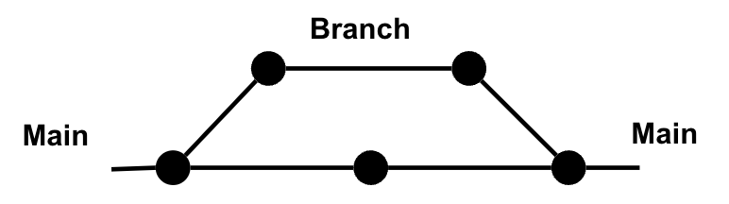
Example
Each point is a new version of your code. You can keep track of these on the central line.
You may want to experiment with changing some aspects of your code, so you branch off, and later “merge” with the main line.
Alternatively, you may share with a collaborator, who will make changes, and then merge.

Slide 56
Git
We don’t have time to help you install and learn git, but we have materials here.
It’s pretty easy to use, and to get started you need to learn less than 10 words:
init, status, add, commit –m, rm, rm --cached
(Live demonstration)

Slide 57
GitHub
GitHub is a website that allows you to:
Host repositories online
Perform Git actions through a graphical interface
GitHub Desktop is a pretty handy app to keep your local and remote repos synchronized.

Slide 58
.gitignore
VERY IMPORTANT
The .gitignore file tells Git which files to ignore. This is a very important file if you use GitHub or another public repository to avoid sharing secret information (for example API keys) online.
You can find .gitignore templates for your favorite programming language here.

Slide 59
General Principles
Collaboration
Version Control
Reproducibility

Slide 60
Intermezzo 3 – The Command Line

Slide 61
The command line interface
Text based interface to communicate with your operating system
Terminal
Console
Prompt
You will certainly need it for your projects, but don’t be afraid, you don’t need to learn everything about it.

Slide 62
Who’s afraid of the CLI?
You just saw me use the terminal for my Git commands.
Similarly, many tools will require you to run commands from the CLI, if anything just for installation.
Usually, these tools have clear instructions on how to use it and what to run.
You don’t need to learn everything now. Important steps:
Get comfortable with opening and closing it
Learn how to change directories

Slide 63
Integrated Development Environment

Slide 64
IDEs
Integrated Development Environments (IDEs) have many advantages besides editing scripts
Enhance productivity
Facilitate project management and Organization
Help with version control
Help with debugging

Slide 65
Examples
Visual Studio Code
Most versatile
Supports many languages
Supports many file formats
Takes a bit of extra time to get used to
Jupyter Lab
Ju-py-(te)r: supports Julia, Python, R
Others:
RStudio – For R. Best for R and de-facto.
Spyder – Like RStudio for Python
Pluto – Interactive like Jupyter, but nicer.

Slide 66
Choose your own adventure – but choose well!
If your language is proprietary (like MATLAB), you don’t have a choice.
If you are only working in R → RStudio
New-ish to python:
Spyder if using .py scripts, want to explore variables, variable structure, easily peak into class methods and properties, etc.
Jupyter if using .ipynb notebooks, are doing exploration, or are preparing educational materials.
More experienced, multi-language, and a bit of patience:
Visual Studio Code.
I’m a convert to VS Code. It is fast, helps you easily create auxiliary files of all types, supports many languages, etc.

Slide 67
Aside note on Jupyter notebooks
Jupyter notebooks are popular because of their pedagogical value: it is easy to present step by step procedures.
If you use them, use them for pedagogical reasons or for exploration and experimentation.
Make sure you add a folder akin to “exploration notebooks” to your directory tree!
But, you should aim to have full .py scripts as your final result.
Containment.
Consistency
Reproducibility.
Automation.

Slide 68
Environments

Slide 69
Environments
An environment is an isolated space, generally self-contained, containing dependencies necessary to run a project.
Dependencies include libraries, packages, and modules.
Environments contain specific versions of the project’s dependencies.
They avoid conflict among different dependencies and their versions.

Slide 70
Dependency hell
You can’t build everything from scratch. You will inevitably depend on libraries built by others.
These are built mostly independently, so they can conflict with each other.
When dependencies are in conflict with each other, your project may encounter unexpected errors and become impossible to run.
X package (v1)
Library 1
Your Project
X package (v2)
Library 2

Slide 71
The proprietary paradise
If you are a MATLAB user (or use another proprietary language) you may not be used to this concept, since most packages are designed by the company and kept consistent to avoid these conflicts.

Slide 72
Environments and package managers
Each language will have a tool to create environments, as well as to manage packages within an environment.
These packages are often downloaded from a repository.
Packages, repositories, and managers have varying degrees of security and security checks, so be careful when installing.

Slide 73
Environment cheat sheet*
Language | Terminology | Environment Creation Tool | Package Repository | Package Manager | Requirements Files
Python | Virtual environments Conda environments | venv conda | PyPI Conda | pip conda, mamba | requirements.txt environment.yaml
R | Project environments | renv (.RProj) | CRAN | renv install.packages() | renv.lock
JavaScript | node_modules | npm yarn | npm registry | npm yarn | node_modules .pnp.cjs
Julia | Project environments | Pkg | Julia general registry | Pkg | Project.toml Manifest.toml
Rust | Cargo projects | cargo | crates.io | cargo | Cargo.toml Cargo.lock
MATLAB | N/A | Path management Add-on manager | MATLAB central file exchange | Add-on Manager | N/A
* I’d love to improve on this cheat sheet, if you have suggestions let me know!

Slide 74
Example
Demonstration – setting up a conda environment
Demonstration – setting up an evironment with renv

Slide 75
General principles
Reproducibility
Consistency
Collaboration

Slide 76
Final Exercise

Slide 77
Chaos
Go to the Chaos folder, reorganize it and rename files based on the principles we learned today.
All files in this example folder pertain to the same project.
The mock files are empty, they are there just for practice.
If there are folders or files that you think must be added, feel free to do so!

Slide 78
Recap

Slide 79
Day 1- Overview

Slide 80
Questions?

Slide 81
Other resources
This cool post on file structure:
https://mitcommlab.mit.edu/broad/commkit/file-structure/
This workshop by our very own data management team:
Tobin_Magle_Data_Management_Slides
Related workshops by our data science team:
The command line
Conda environments
Git and GitHub

