Slide 1
Intro to scikit-learn
efrén cruz cortés, Ritika Giri, John Lee

Slide 2
Scikit-Learn Workshop Series
This workshop will
begin at 9:30 am
Materials for today:
To work on your own computer:
Go to https://github.com/nuitrcs/scikit-learn-workshop
Click on the green Code button, choose Download ZIP, unzip the folder, open your IDE of choice and navigate to the folder you downloaded.
To work on the cloud:
Go to https://github.com/nuitrcs/scikit-learn-workshop
On the instructions page, click on the link that says "Google Colab Notebook".

Slide 3
This workshop is brought to you by
Northwestern IT Research Computing and Data Services
Got a machine learning, data science, statistics, or visualization question about your research?
We’re here to help.
Go to bit.ly/rcdsconsult to request a FREE consultation.
Notes:
https://www.it.northwestern.edu/departments/it-services-support/research/data-science-statistics-visualization

Slide 4
Warning!
When using Google Colab, you're sending your data to Google's servers.
We recommend that you don't upload any information that you wouldn't publicly share (data, code, etc).
It is okay to use Google Colab for today's workshop.

Slide 5
Concept Intermezzos

Slide 6
What is linear regression?

Slide 7
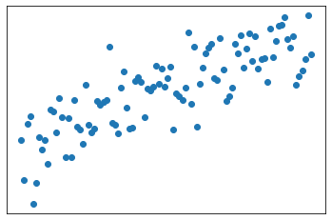
Learning a linear relationship
Imagine we observe the variation of one variable with respect to another.

Slide 8
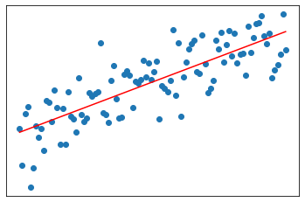
Learning a linear relationship
We presume the relationship is linear. Meaning, we expect some sort of line to explain the overall pattern:

Slide 9

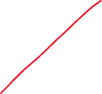

Learning a linear relationship
Fitting the model means finding the best straight lines among all possible candidates:
H1
H2
HN
H3
H4

Slide 10
Bias-variance trade-off Generalization Validation

Slide 11
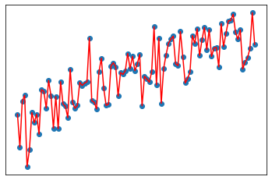
Should we perfectly fit our observations?
We run the risk of overfitting!!
While the line minimizes the error...
It is unlikely it will match any new observation.

Slide 12
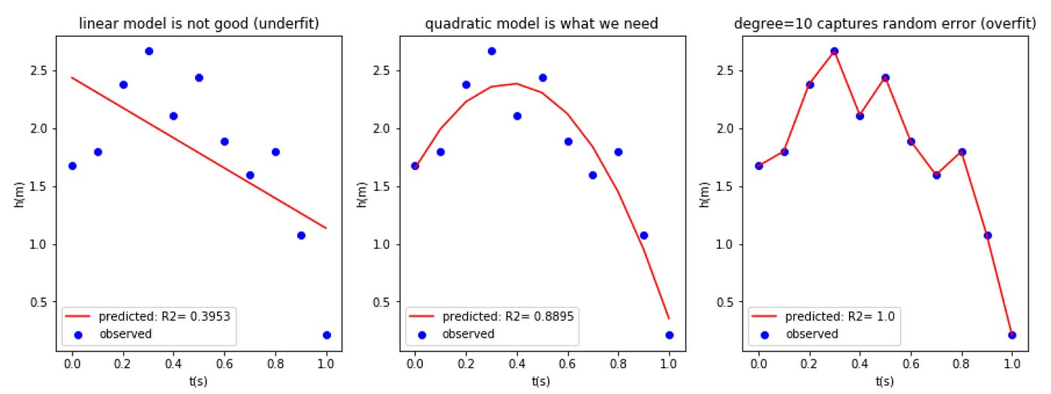
Example:
Say our data looks like the blue dots.
(1) A straight line is too simple of a hypothesis. Error is large.
(3) A complicated line relies too much on specific data, will fail with new data. Error is zero.
(2) A quadratic line is the perfect middle ground: gives space for new observations, keeps the error small.

Slide 13
Generalization
The problem of finding the middle ground between underfitting and overfitting is called the bias-variance trade-off.
A simple model will be biased towards a specific form, and it will vary little with observations (like a hard-headed person).
A complicated model will have low bias, but vary widely with observations (like someone who keeps modifying their theories just to be right).
A good balanced hypothesis will have the power of generalization: it will, with some small error, generalize to new observations.

Slide 14
Bias-Variance trade-off
Underfitting
Overfitting
Bias:​
Systematic prejudice in the model​
Simple model = High bias
Variance:​
Change in the model’s prediction, when the dataset is changed a little bit​
Complex model = High variance
High Bias
Low Variance
Low Bias
High Variance

Slide 15
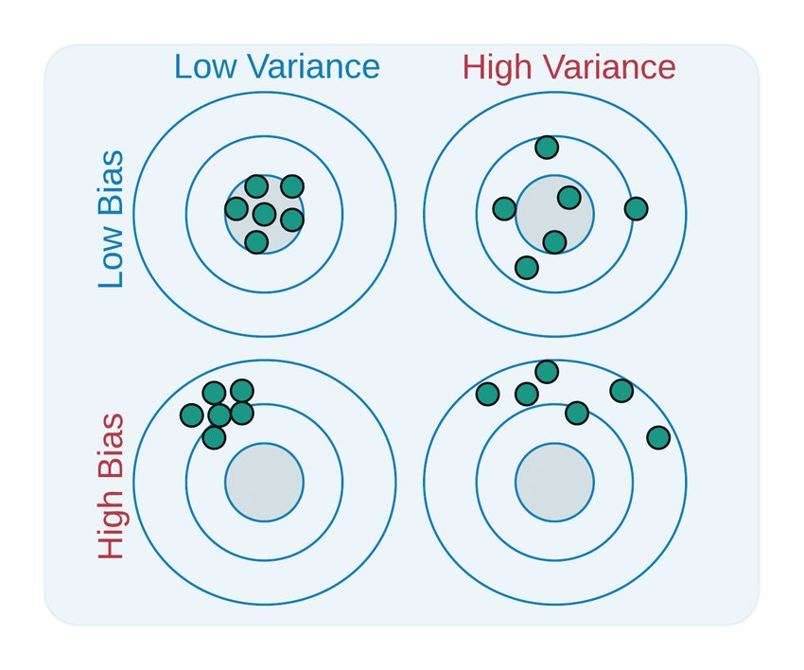
Bias-Variance trade-off
Imagine different research groups get different samples of the same phenomenon. Each green dot represents the found hypothesis H for different sets of observations.
The grey middle circle represents the optimal point.
High Bias, Low Var:
The Hs will be similar, but off from the optimal point.
High Variance, Low Bias:
Some Hs will be close to the optimal point, but it varies, widely.
Low Bias and Variance:
While ideal, many times impossible. Often there are fundamental limitations.

Slide 16
How to find a generalizable hypothesis?
Instead of minimizing the error on our observations:
Save a portion of the data and keep it secret, unobserved.
Formulate the model.
Test the model on the secret data.
This procedure helps us build models with good generalization properties.
Training data: observed data, used to formulate our model.
Test data: held out, secret data, used to test the model.

Slide 17
Machine learning tasks

Slide 18
What do we want to learn in ML?
We will take the task approach:
There is a task we want the machine to do.
To perform this task, the machine must learn an underlying concept.
We’ll try to learn this concept by searching over a space of hypotheses.
Task
Concept
Hypothesis Space

Slide 19
Task Example 1: learning a linear relationship
Imagine we observe the variation of one variable with respect to another. We presume the relationship is linear:
Response, target, dependent variable, etc...
Predictive Observation

Slide 20
Learning a linear relationship
Our hypothesis space is the set of all straight lines:
H1
H2
HN
H3
H4

Slide 21
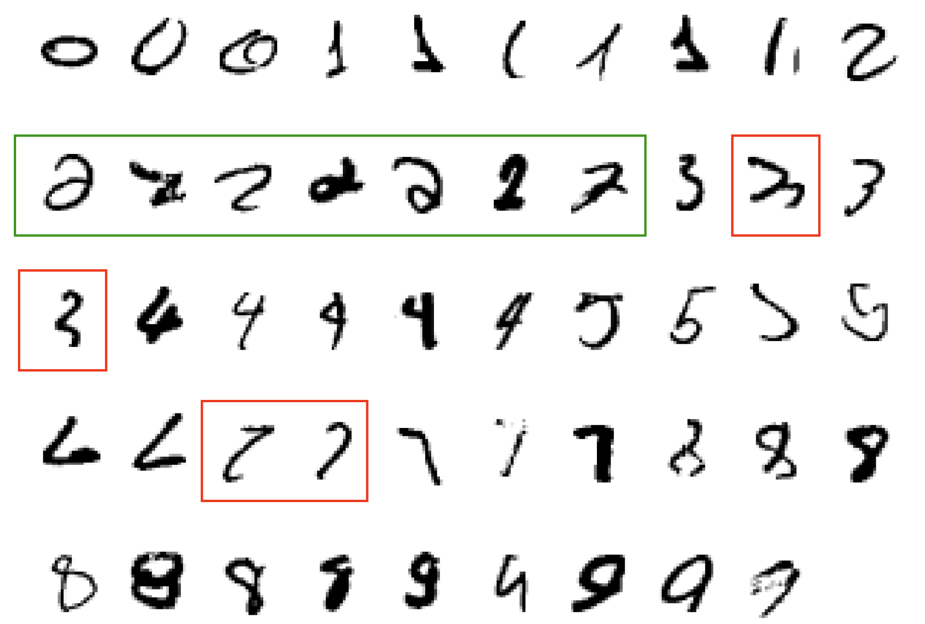
Task Example 2: classification
What makes a 2?

Slide 22
Task Example 2: classification
Yellow region → 0
Green region → 2
Red region → 4
Purple region → 1
...

Slide 23
Examples
Task | Concept | Hypothesis*
Recognize pedestrians | Pedestrian (image of) | Set of images representing pedestrians
Generate images from prompt | Entities in the prompt | Function from words to images
Identify a cancer | Cancer types | Subsets of genetic signatures
Allocate resources | Communities in need | Maps of (income, infrastructure) pairs to allocation amount.
* In practice take the form of functions: classifiers, regressors, generative models, etc.

Slide 24
When Do We Use Machine Learning?
ML is used when:
Human expertise does not exist (navigating on Mars)
Humans can’t explain their expertise (speech recognition)
Models must be customized (personalized medicine)
Models are based on huge amounts of data (genomics)
When you should not use ML:
There is no need to “learn” to calculate payroll.
When it is unethical!

Slide 25
More examples of ML tasks
Recognizing patterns:
Facial identities or facial expressions
Handwritten or spoken words
Medical images
Generating patterns:
Generating images or motion sequences
Recognizing anomalies:
Unusual credit card transactions
Unusual patterns of sensor readings in a nuclear power plant
Prediction:
Future stock prices or currency exchange rates

Slide 26
What is classification?

Slide 27
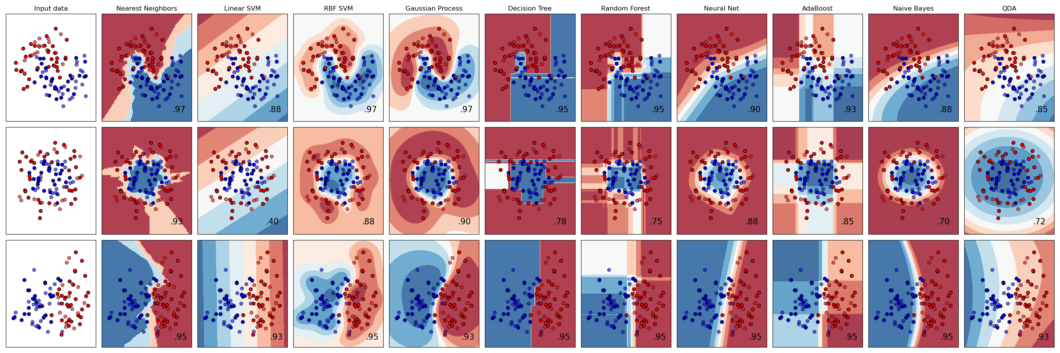
Labeled data
Assume we have a collection of data points, each of which belongs to a class.
In this case, the classes are blue and red.
Each data point is “labeled” according to its class.

Slide 28
Classification: find class regions
The main classification task is to create regions in the data space that will determine if a point is blue or red.

Slide 29
Example
*Images taken from scikit-learn website.

Slide 30
Example

Slide 31
Then what?
We can predict the class of any newly observed point!

