Slide 1


Slide 2

Research Computing and Data Services
We're here to help after the workshop!
quest-help@northwestern.edu
bit.ly/rcdsconsult
https://sites.northwestern.edu/researchcomputing/

Slide 3
Setup...
log onto Quest
ssh <netid>@quest.northwestern.edu # enter your netid password
move to our classroom folder
cd /projects/e32559
make your own subfolder if you weren’t here last week
mkdir <folder_name>

Slide 4
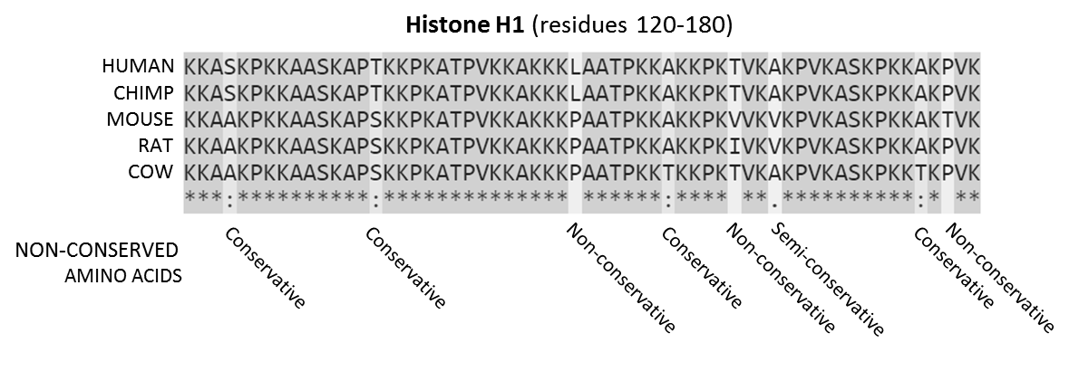
What is alignment?

Slide 5
What is alignment? - hypothesis of homolgy

Slide 6
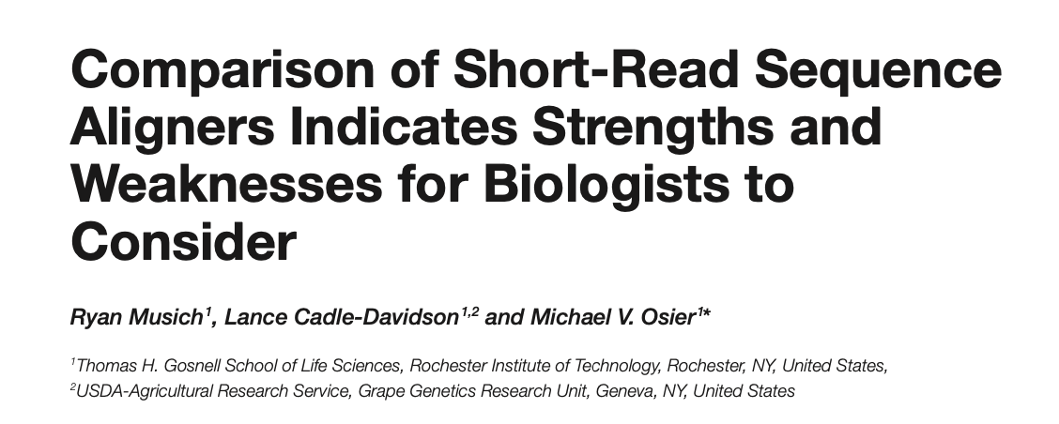
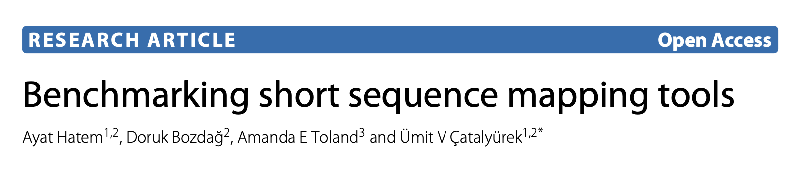
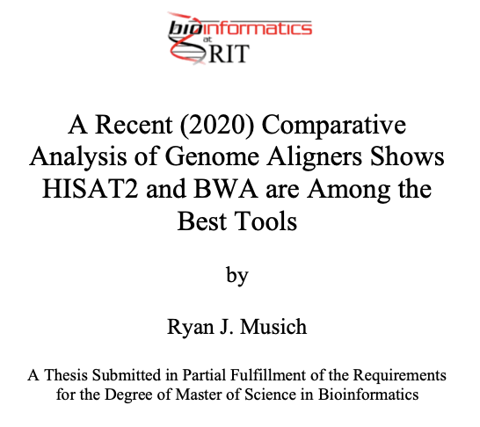
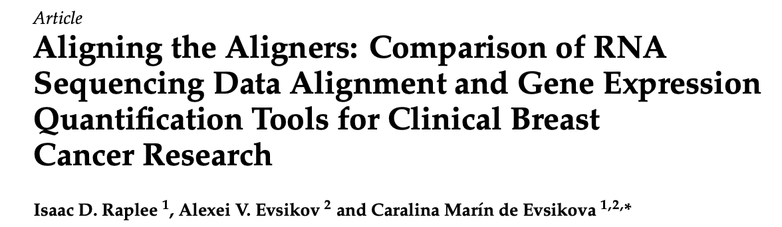
How to pick an aligner?
Type of data you have
aligning short read data (Illumina)
aligning long read data (PacBio, Nanopore)
aligning RNA-seq data - splice aware
Accuracy
percent of reads aligned
estimated gene coverage
Runtime

Slide 7
Aligners we will cover today
BWA - short read DNA sequences
bowtie2 - short read DNA sequences
minimap2 - long read sequences
HISAT2 - splice aware aligner for RNA-seq
STAR - splice aware aligner for RNA-seq

Slide 8
Indexing
Most tools require indexing your reference genome, and potentially also aligning reads too it
Creates standardized map to use across alignments
Generally, creates secondary files that need to be in the same folder as the genome, with the same name but difference file extension to be used properly

Slide 9
BWA: Burrows-Wheeler Aligner
Three algorithms: BWA-Backtrack, BWA-MEM, BWA-SW
BWA-Backtrack: designed for Illumina sequence reads up to 100bp
BWA-MEM and BWA-SW: for longer sequences ranged from 70bp to 1Mbp
BWA-MEM and BWA-SW share similar features such as long-read support and split alignment, but BWA-MEM, which is the latest, is generally recommended for high-quality queries as it is faster and more accurate. BWA-MEM also has better performance than BWA-backtrack for 70-100bp Illumina reads.
Resources:
https://bio-bwa.sourceforge.net/
https://github.com/lh3/bwa

Slide 10
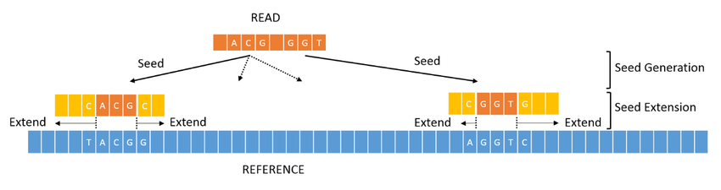
BWA: Burrows-Wheeler Aligner
module spider bwa
module load bwa/0.7.17
bwa
# latest version is 0.7.18
# remind me to update our modules if you need 0.7.18
cat bwa.sh

Slide 11
BWA EXERCISE
cp alignment_scripts/bwa.sh <your-folder>
cd <your-folder>
nano bwa.sh
# change it to output to your folder, and to use 1 hour of walltime
ctrl^o # to save
ctrl^x # to exit nano
sbatch bwa.sh # from within your folder

Slide 12
bowtie2
“an ultrafast and memory-efficient tool for aligning sequencing reads to long reference sequences. It is particularly good at aligning reads of about 50 up to 100s or 1,000s of characters, and particularly good at aligning to relatively long (e.g. mammalian) genomes. Bowtie 2 indexes the genome with an FM Index to keep its memory footprint small: for the human genome, its memory footprint is typically around 3.2 GB. Bowtie 2 supports gapped, local, and paired-end alignment modes.”
Resources:
https://bowtie-bio.sourceforge.net/bowtie2/index.shtml
https://github.com/BenLangmead/bowtie2

Slide 13
End-to-end alignment versus local alignment
By default, Bowtie 2 performs end-to-end read alignment. That is, it searches for alignments involving all of the read characters. This is also called an "untrimmed" or "unclipped" alignment.
When the --local option is specified, Bowtie 2 performs local read alignment. In this mode, Bowtie 2 might "trim" or "clip" some read characters from one or both ends of the alignment if doing so maximizes the alignment score.
End-to-end alignment example
Alignment:
Read: GACTGGGCGATCTCGACTTCG
| | | | | | | | | | | | | | | | | |
Reference: GACTG - - CGATCTCGACATCG
Local alignment example
Alignment:
Read: ACGGTTGCGTTAA -TCCGCCACG
| | | | | | | | | | | | | | |
Reference: TAACTTGCGTTAAATCCGCCTGG

Slide 14
bowtie2
module load bowtie2/2.5.4
bowtie2-build
# build genome reference index
# alternatively https://benlangmead.github.io/aws-indexes/bowtie
bowtie2
# align reads with bowtie2

Slide 15
bowtie2 Exercise: Create a bowtie2.sh script
nano bowtie2.sh # in your folder, could start by copying bwa.sh
#!/bin/bash
#SBATCH --account
#SBATCH --partition
#SBATCH --time
#SBATCH --nodes
#SBATCH --ntasks
#SBATCH --mem
Ask for appropriate resources form the scheduler.
Use our classroom account and the short partition.

Slide 16
bowtie2 Exercise: Create a bowtie2.sh script
bowtie2 \
--no-unal \ # optional argument to exclude unaligned reads
-p n \ # number of processors
-x index_name \ # reference genome index name
-1 reads_1.fastq \ # read 1 of pair
-2 reads_2.fastq \ # read 2 of pair
-S output.sam # output file
Don’t forget to load the module!

Slide 17
Check on jobs:
squeue -u <netid>
# shows all running and pending jobs
sacct -X
# shows all jobs from today
sacct -X -S 100124
# shows all jobs from this month

Slide 18
HISAT2 - Hierarchical Indexing for Spliced Alignment of Transcripts
splice-aware RNA-seq aligner
RNA sequences don’t include introns, so alignment to a reference genome that has both extron and intron sequences
Resources:
https://daehwankimlab.github.io/hisat2/
https://github.com/DaehwanKimLab/hisat2

Slide 19
HISAT2 - Hierarchical Indexing for Spliced Alignment of Transcripts
module load hisat2/2.1.0
# latest version is 2.2.1 or HISAT-3N (beta release for past 4 yrs)
# feel free to request module updates (but expect a bit of a wait)
hisat2-build
hisat2

Slide 20
STAR - Spliced Transcripts Alignment to a Reference
another splice aware aligner option
potentially better suited for draft or low quality genomes
uses more resources than hisat2
Resources:
https://www.ncbi.nlm.nih.gov/pmc/articles/PMC3530905/
https://github.com/alexdobin/STAR

Slide 21
minimap2
Typical use cases include:
mapping PacBio or Oxford Nanopore genomic reads to the human genome
finding overlaps between long reads with error rate up to ~15%
splice-aware alignment of PacBio Iso-Seq or Nanopore cDNA or Direct RNA reads against a reference genome
aligning Illumina single- or paired-end reads
assembly-to-assembly alignment
full-genome alignment between two closely related species with divergence below ~15%
Resources:
https://lh3.github.io/minimap2/minimap2.html
https://github.com/lh3/minimap2

Slide 22
minimap2
module load minimap2/2.24
# latest version is 2.28
Without any options, minimap2 takes a reference database and a query sequence file as input and produce approximate mapping, without base-level alignment (i.e. coordinates are only approximate and no CIGAR in output), in the PAF format:
minimap2 ref.fa query.fq > approx-mapping.paf
You can ask minimap2 to generate CIGAR at the cg tag of PAF with:
minimap2 -c ref.fa query.fq > alignment.paf
or to output alignments in the SAM format:
minimap2 -a ref.fa query.fq > alignment.sam

