Slide 1


Slide 2

Research Computing and Data Services
We're here to help after the workshop!
quest-help@northwestern.edu
bit.ly/rcdsconsult
https://sites.northwestern.edu/researchcomputing/

Slide 3
Setup...
log onto Quest
ssh <netid>@login.quest.northwestern.edu
# enter your netid password (it won't look like you're typing)
move to our classroom folder
cd /projects/e32680
make your own subfolder if you weren’t here last week
mkdir <folder_name>
move into your folder
cd <folder_name>
Class materials are at: github.com/nuitrcs/star_aligner_workshop

Slide 4

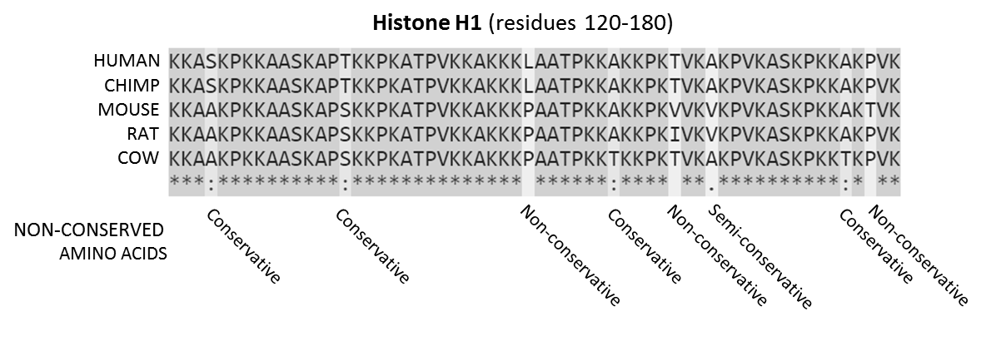



What is alignment? - hypothesis of homology

Slide 5


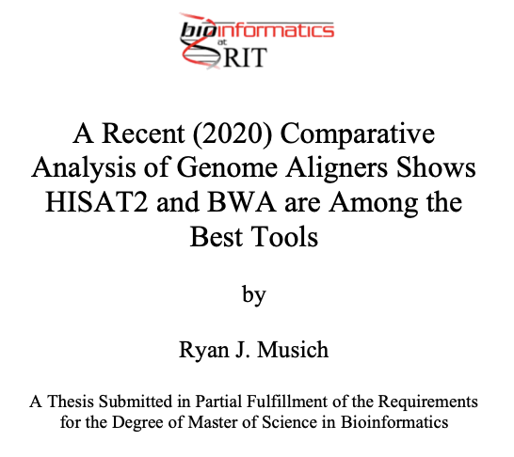
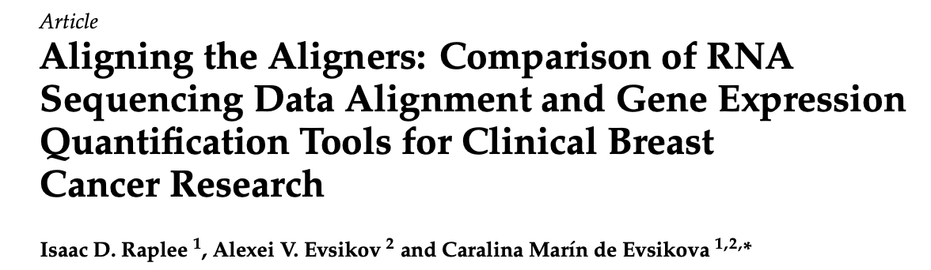
How to pick an aligner?
Type of data you have
aligning short read data (Illumina)
aligning long read data (PacBio, Nanopore)
aligning RNA-seq data - splice aware
Accuracy
percent of reads aligned
estimated gene coverage
Runtime

Slide 6
How to pick an aligner?
Type of data you have
aligning short read data (Illumina)
aligning long read data (PacBio, Nanopore)
aligning RNA-seq data - splice aware
Accuracy
percent of reads aligned
estimated gene coverage
Runtime

Slide 7
Why does it matter if you have DNA or RNA data?
often aligning to a reference genome
create a standard index to map to
most RNA-seq data is mature mRNA
typically no introns in the sequence of reads
but genomes have introns!
might introduce long gaps in the alignment, which are generally penalized against when determining the `best` mapping of a read
might show two or more partial matches for a read to different exons
spice-aware aligners
allows identification of novel splice junctions, regions of expression, structural variants...

Slide 8
STAR - Spliced Transcripts Alignment to a Reference
splice aware aligner
potentially better suited for draft or low-quality genomes than HISAT2 or other splice-aware options
uses more resources than HISAT2
default option of many pipelines, include nf-core’s RNA-seq
Resources:
https://www.ncbi.nlm.nih.gov/pmc/articles/PMC3530905/
https://github.com/alexdobin/STAR

Slide 9
How do we use it?
Generate genome index files
Map reads to the genome

Slide 10
Generate genome index files
if you are generating your own index you need:
fasta file of the genome sequence
gtf files of the genome annotation

Slide 11
Generate genome index files
STAR \
--runMode genomeGenerate \
--runThreadN 4 \
--genomeDir /path/to/genomeDir \
--genomeFastaFiles /path/to/genome.fa \
--sjdbGTFfile /path/to/genome.gtf \
--sjdbOverhang <ReadLength-1>

Slide 12
Generate genome index files
STAR \
--runMode genomeGenerate \
--runThreadN 4 \
--genomeDir /path/to/genomeDir \
--genomeFastaFiles /path/to/genome.fa \
--sjdbGTFfile /path/to/genome.gtf \
--sjdbOverhang <ReadLength-1>
# number of cores to parallelize over
# output location
# input location
# input location
# length of region around annotation to be used for constructing splice junctions database, default is 100, ReadLength-1 is recommendation

Slide 13
Running this on Quest...
Quest uses a scheduler to control access to compute resources.
We will wrap the STAR command in a ‘job script’ which will request compute resource through the scheduler and set up the software environment for STAR to run.
I have a template job script available to you! Please copy it into your folder with the following:
cd /projects/e32680 # you may already be here
cp 02_staralignment_reference/star1.sh <your_folder>
cd <your_folder>
ls # you should see star1.sh

Slide 14
Running this on Quest...
Open the script with nano:
Change the genomeDir to:
Save and exit nano with CTRL+O, ENTER, CTRL+X
Launch the job with:
nano star1.sh
/projects/e32680/<your_folder>/STARindex
sbatch star1.sh

Slide 15
Generate genome index files
We host pre-generated index files on Quest for many model systems:
/projects/genomicsshare/AWS_iGenomes/references/Mus_musculus/Ensembl/GRCm38/Sequence/STARIndex
/projects/genomicsshare/AWS_iGenomes/references/Homo_sapiens/Ensembl/GRCh37/Sequence/STARIndex

Slide 16
Map reads to genome
STAR \
--runThreadN 8 \
--genomeDir /path/to/genomeDir \
--readFilesIn /path/to/genome.fa
# number of cores to parallelize over
# input location
# input location, this can be multiple files fasta or fastq, both paired end read files need to be supplied
Those are the basic options but there are about a million more you can adjust...

Slide 17
Copy an alignment script to your folder....
cp /projects/e32680/02_staralignment_reference/star2.sh .

Slide 18
Copy an alignment script to your folder....
cp /projects/e32680/02_staralignment_reference/star2.sh .
What does this script contain?

Slide 19
star2.sh
STAR \
--runThreadN 4 \
--genomeDir /projects/e32680/02_staralignment_reference/STARindex \
--readFilesIn /projects/e32680/02_staralignment_reference/SRR7773980_1.fastq.gz,/projects/e32680/02_staralignment_reference/SRR7773980_2.fastq.gz \
--readFilesCommand gunzip -c \
--outFileNamePrefix ./STARoutputs

Slide 20
Launch the alignment job with:
sbatch star2.sh
From your folder! Not the 02_staralignment_reference one.

Slide 21

Outputs
Alignment file in SAM format
Log output that includes higher level summaries of mapping rates, number of splice sites, and runtime information
Log output that includes step by step detailed output
Log output that checks progress and reports summary every minute during runtime
Splice junction output in tab delimited format

Slide 22
Aligned.out.sam
alignment file in SAM (sequence alignment map) format
output format can be controlled with
--outSAMtype
for unsorted BAM (binary alignment map) format:
--outSAMtype BAM Unsorted
for sorted BAM format:
--outSAMtype BAM SortedByCoordinate
for both files:
--outSAMtype BAM Unsorted SortedByCoordinate
--outBAMsortingThreadN # controls number of threads for sorting, default is 6

Slide 23
SJ.out.tab
high confidence splice junctions in tab-delimited format
9 columns: chromosome, first base of intron, last base of intron, strand, intron motif, annotation, number of uniquely mapped reads crossing junction, number of multi-mapping reads crossing junction, maximum spliced alignment overhang
filtering can be controlled with
--outSJfilter*
for only uniquely mapping reads:
--outSJfilterReads Unique

Slide 24
”Pioneer factor GATA6 promotes colorectal cancer through 3D genome regulation” Lyu et al. 2025. Science Advances https://pmc.ncbi.nlm.nih.gov/articles/PMC11804904/#sec11
Materials and Methods
RNA-seq data processing
The trimmed FASTQ files of colon cancer cell lines are aligned against hg38 human reference genome using STAR (65)(v.2.7.10b) with parameters “--outSAMunmapped Within --outFilterType BySJout --outSAMattributes NH HI AS NM MD --outFilterMultimapNmax 20 --outFilterMismatchNmax 999 --outFilterMismatchNoverReadLmax 0.04 --alignIntronMin 20 --alignIntronMax 1000000 --alignMatesGapMax 1000000 --alignSJoverhangMin 8 --alignSJDBoverhangMin 1 --sjdbScore 1”. RSEM (66)(v1.3.3) facilitated the quantification and expression calculation for known genes with GENCODE v33. Genes with TPM value < 1 in all samples were excluded from downstream analyses.

Slide 25
Translate to job script to replicate on Quest:
aligned against hg38 human reference
STAR v.2.7.10b
--outSAMunmapped Within
--outFilterType BySJout
--outSAMattributes NH HI AS NM MD
--outFilterMultimapNmax 20
--outFilterMismatchNmax 999
--outFilterMismatchNoverReadLmax 0.04
--alignIntronMin 20
--alignIntronMax 1000000
--alignMatesGapMax 1000000
--alignSJoverhangMin 8
--alignSJDBoverhangMin 1
--sjdbScore 1
You can copy /projects/e32680/02_staraligner_reference/star3.sh as a starting place.

