Slide 1

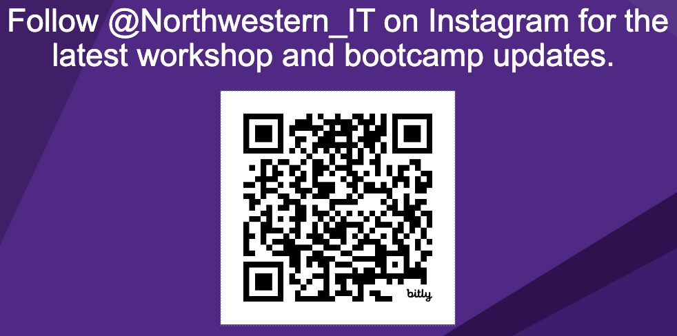
Workshop starts at 09:32
Materials for today:
https://github.com/nuitrcs/tidyverse_2_summer_2025

Slide 2
Intermediate Data Manipulation with Tidyverse
Emilio Lehoucq

Slide 3
This workshop is brought to you by:
Northwestern IT Research Computing and Data Services
Need help?
AI, Machine Learning, Data Science
Statistics
Visualization
Collecting web data (scraping, APIs), text analysis, extracting information from text
Cleaning, transforming, reformatting, and wrangling data
Automating repetitive research tasks
Research reproducibility and replicability
Programming, computing, data management, etc.
R, Python, SQL, MATLAB, Stata, SPSS, SAS, etc.
Request a FREE consultation at bit.ly/rcdsconsult.

Slide 4
Collaborative project support
If you're a faculty (or postdoc, research staff, or graduate student with faculty sponsorship), we can provide longer-term support in your project.
We can help from exploration (is this idea possible?) to concrete outcomes (e.g., data collection, cleaning, analysis or visualization for a publication).
Find more information at bit.ly/collaborative_project_support

Slide 5
Bring Your Own Data (BYOD)
Do you have research data waiting to be collected, cleaned, analyzed or visualized? Come to BYOD.
BYOD is a weekly working group that provides structure, guidance, and accountability to help you make progress on your research project in a supportive and stress-free environment.
Find more information at bit.ly/byod_groups

Slide 6
What’s next?
8/27: Statistics with R
8/28: Data Visualization and Tables with R
8/29: R Programming Basics

Slide 7
Joins

Slide 8
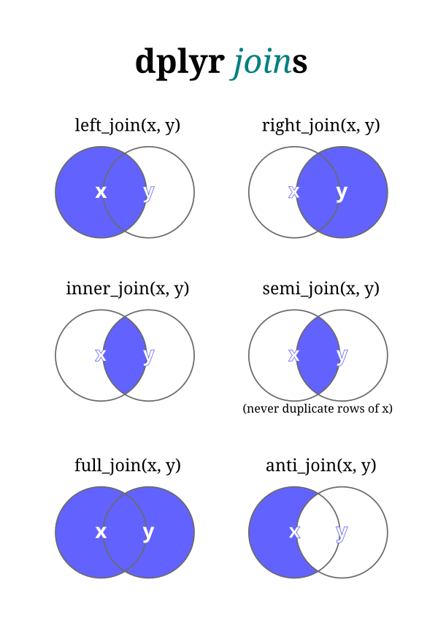

Slide 9
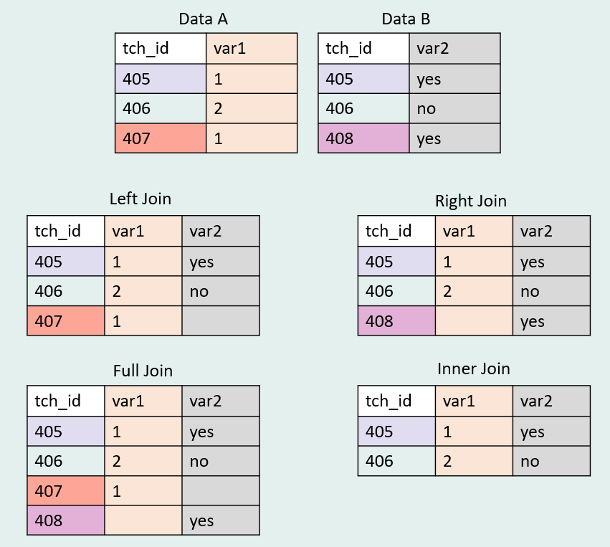

Slide 10
Pivoting with tidyr

Slide 11
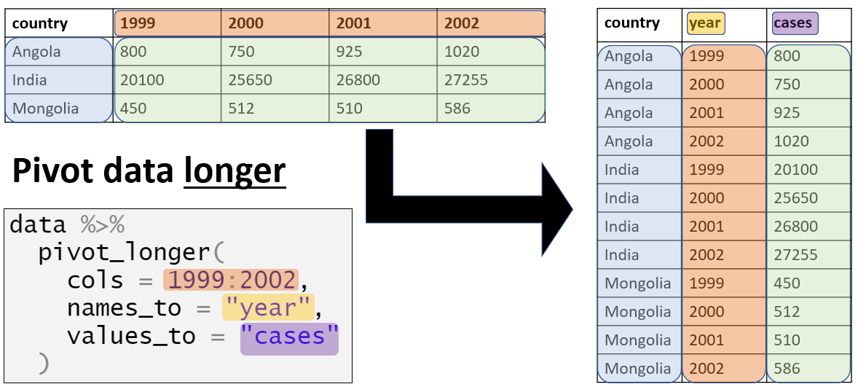

Slide 12
