Slide 1
Joins

Slide 2
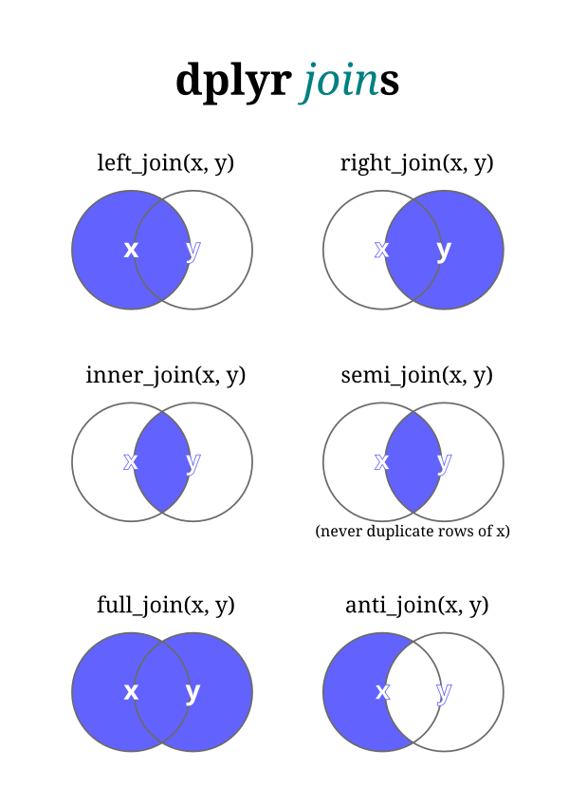

Slide 3
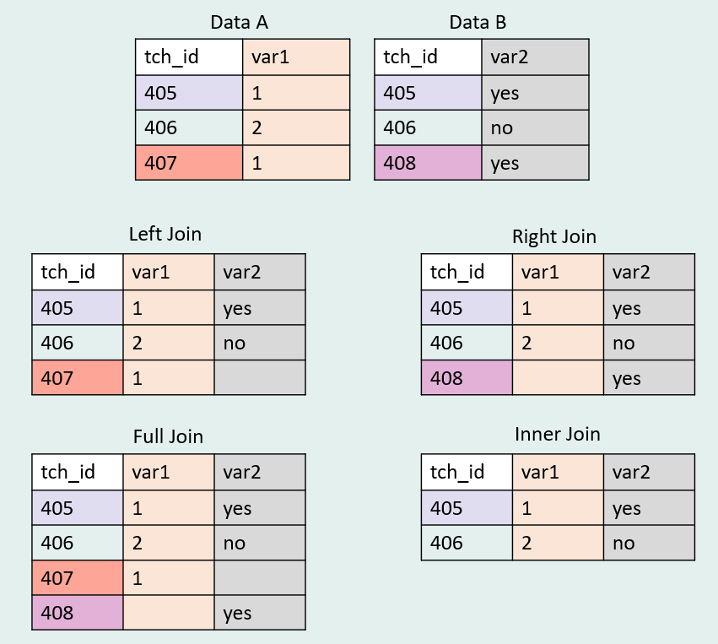

Slide 4
Pivoting with tidyr

Slide 5
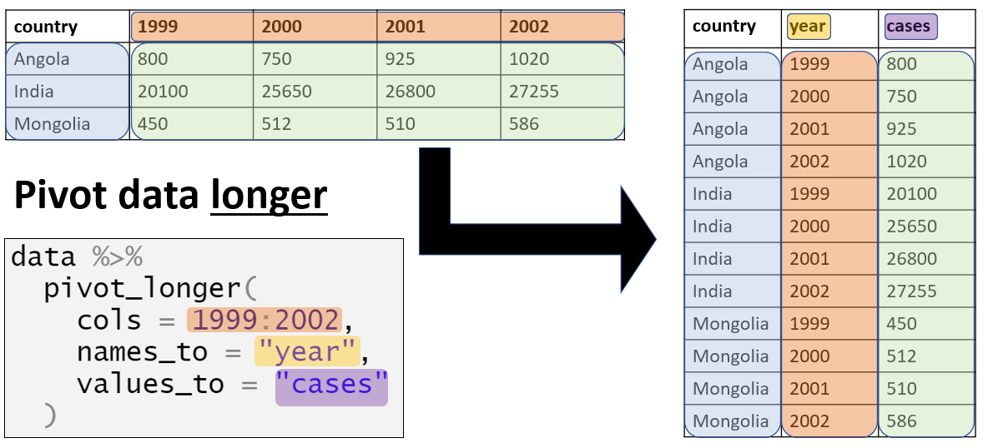

Slide 6
