Slide 1


Slide 2

Research Computing and Data Services
We're here to help after the workshop!
quest-help@northwestern.edu
bit.ly/rcdsconsult
https://sites.northwestern.edu/researchcomputing/

Slide 3
Virtual Environments
Create a sandboxed software environment that can be loaded and unloaded like a module
Doesn’t require admin permissions
Good for managing Python and R packages, but lots of other software can be installed via virtual environments too!

Slide 4

Virtual Environments
Basically separates software by folders...
~
.conda
envs
Full path to conda environment named “singlecell” would be ~/.conda/envs/singlecell

Slide 5
Conda vs Mamba vs Venv
The first version of this for Python used ‘venv’ which stands for virtual environment and pulls from PYPI (pip)
Conda was released after venv and is a very popular package management system originally distributed by Anaconda.
Mamba is a drop-in replacement for conda that is generally faster because it rewrites their dependency solver in C++

Slide 6
Loading mamba and initializing your shell
module purge
module load mamba/24.3.0
mamba init
source ~/.bashrc
*You only need to do this step once!

Slide 7
Creating a virtual environment
mamba create --name sc_env -c conda-forge python
# creates an environment named sc_env
# and installs python from conda-forge
* Check your home disk usage before you start building big environments!

Slide 8
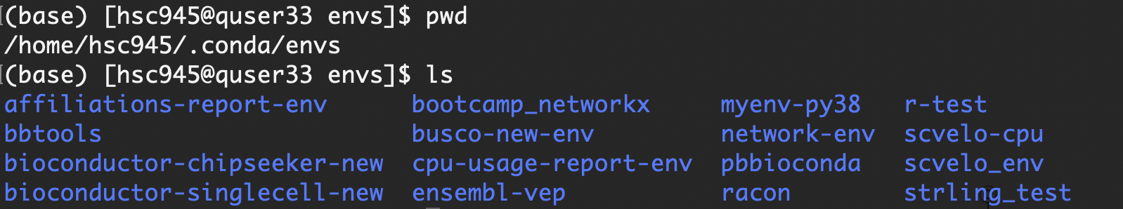
Creating a virtual environment
mamba create --name sc_env -c conda-forge python
# creates an environment named sc_env
# and installs python from conda-forge

Slide 9
Installing software into a virtual environment
which python
mamba activate sc_env
# moves you into the environment
which python
mamba list
# lists what’s installed in the environment

Slide 10
Installing software into a virtual environment
mamba install conda-forge::numpy
# install numpy and dependencies from conda-forge channel
# mamba install -c conda-forge numpy
# mamba install -c conda-forge numpy=1.26

Slide 11
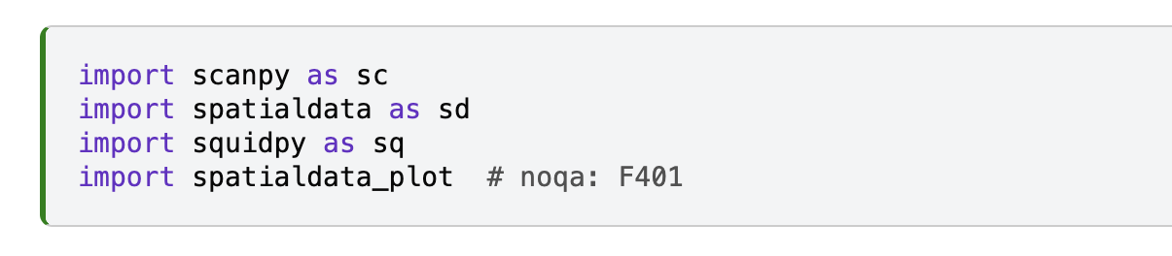
How do you know what you need?

Slide 12
What about pip?
# with the environment activated we did:
mamba install conda-forge::numpy
# but we could have installed with pip:
which pip
pip install numpy
I’ll demo this, you don’t have to change your environment if you don’t want to.

Slide 13
What about pip?
# with the environment activated:
conda list

Slide 14
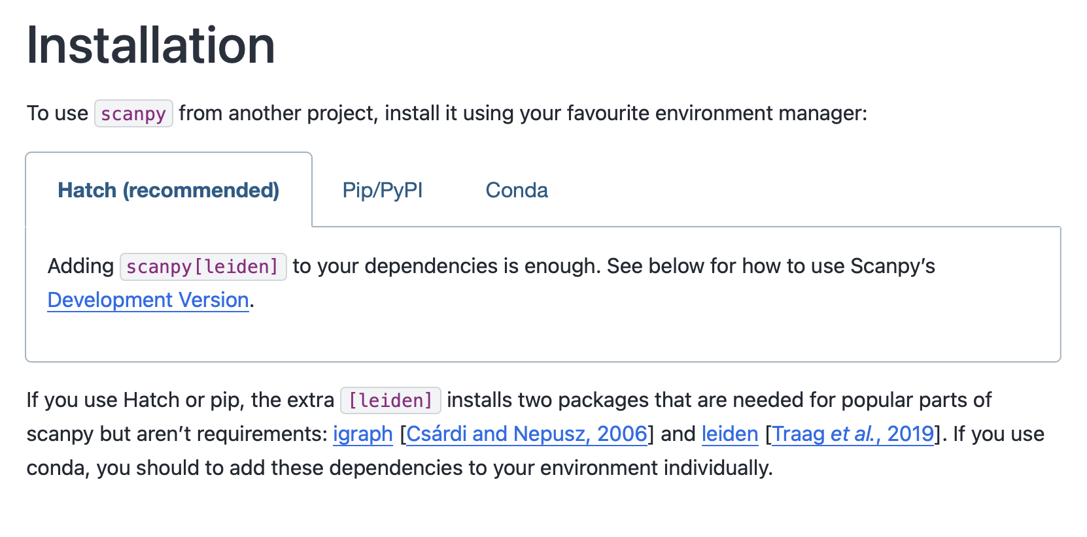
Sometimes it matters which you use…

Slide 15
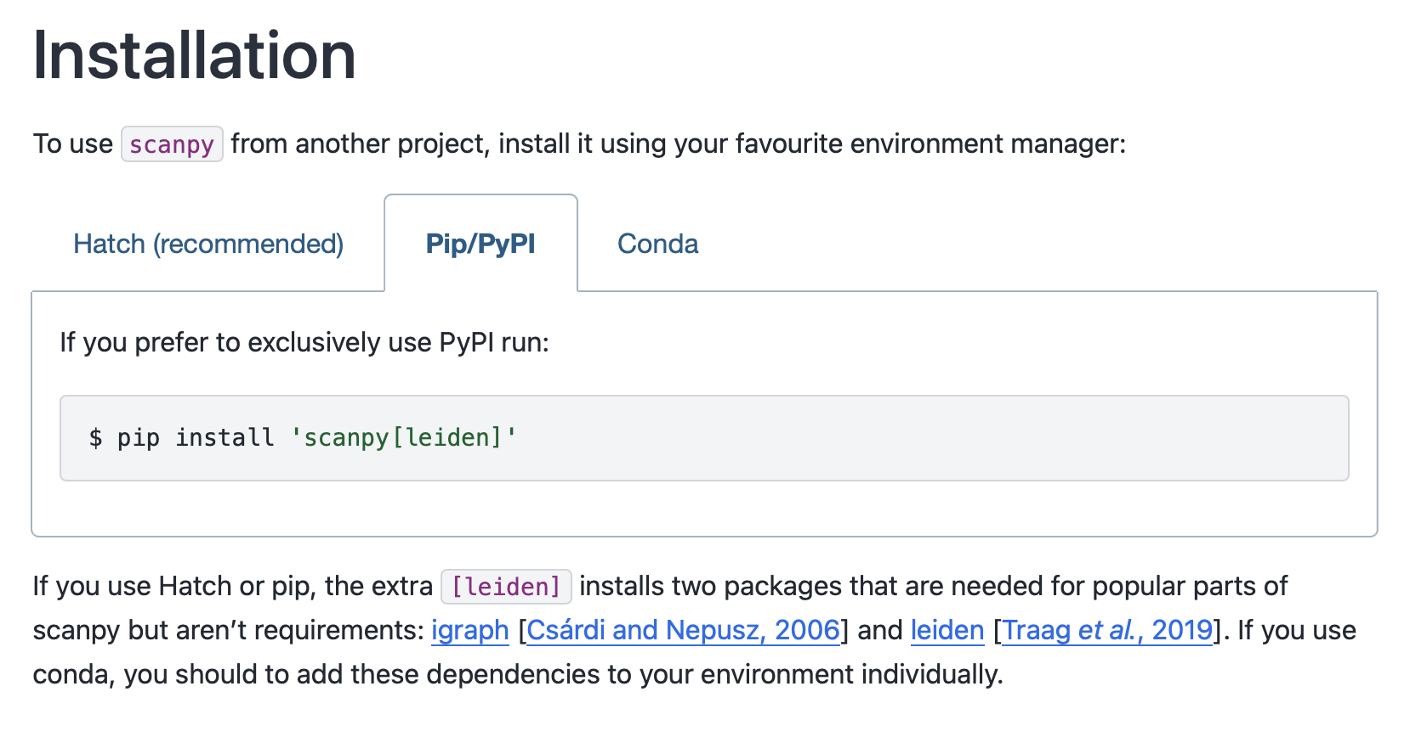
Sometimes it matters which you use…

Slide 16
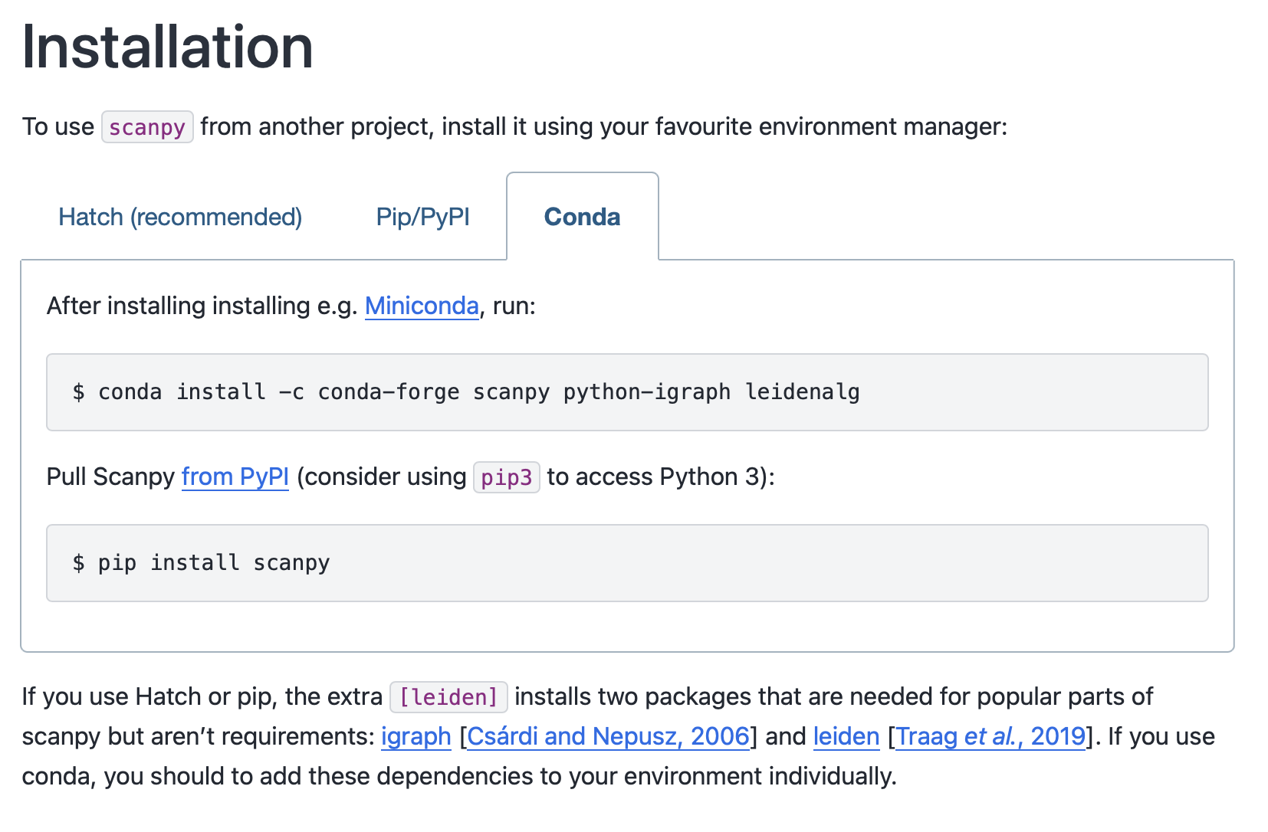
Sometimes it matters which you use…

Slide 17


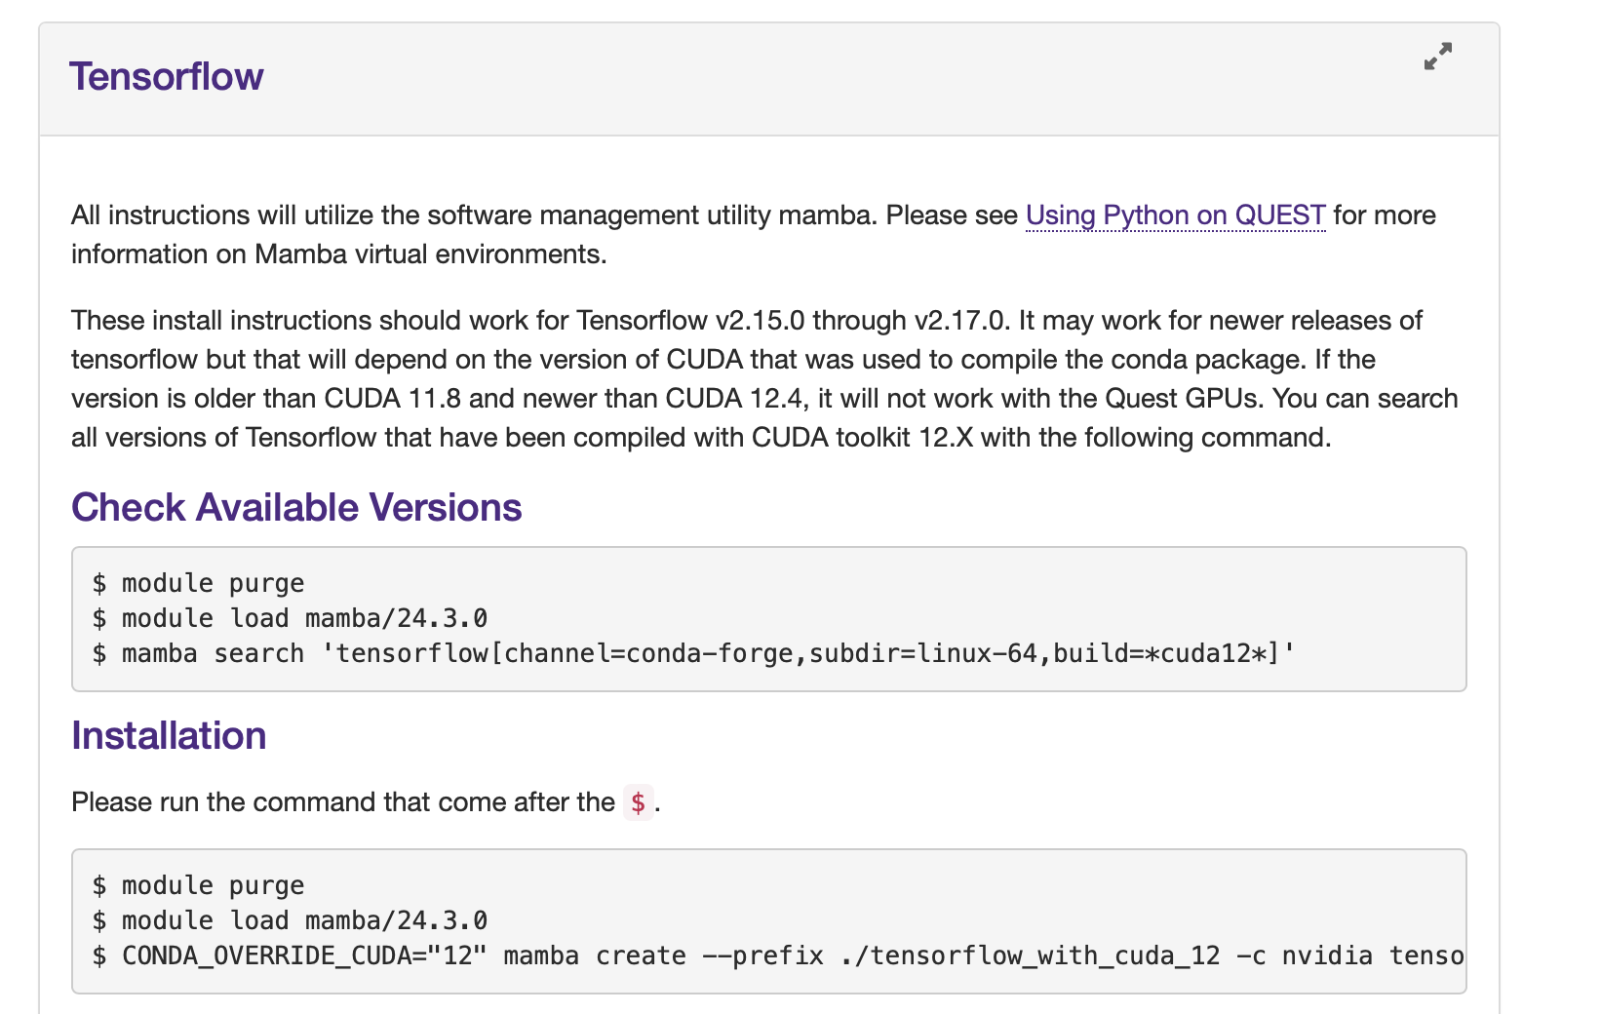
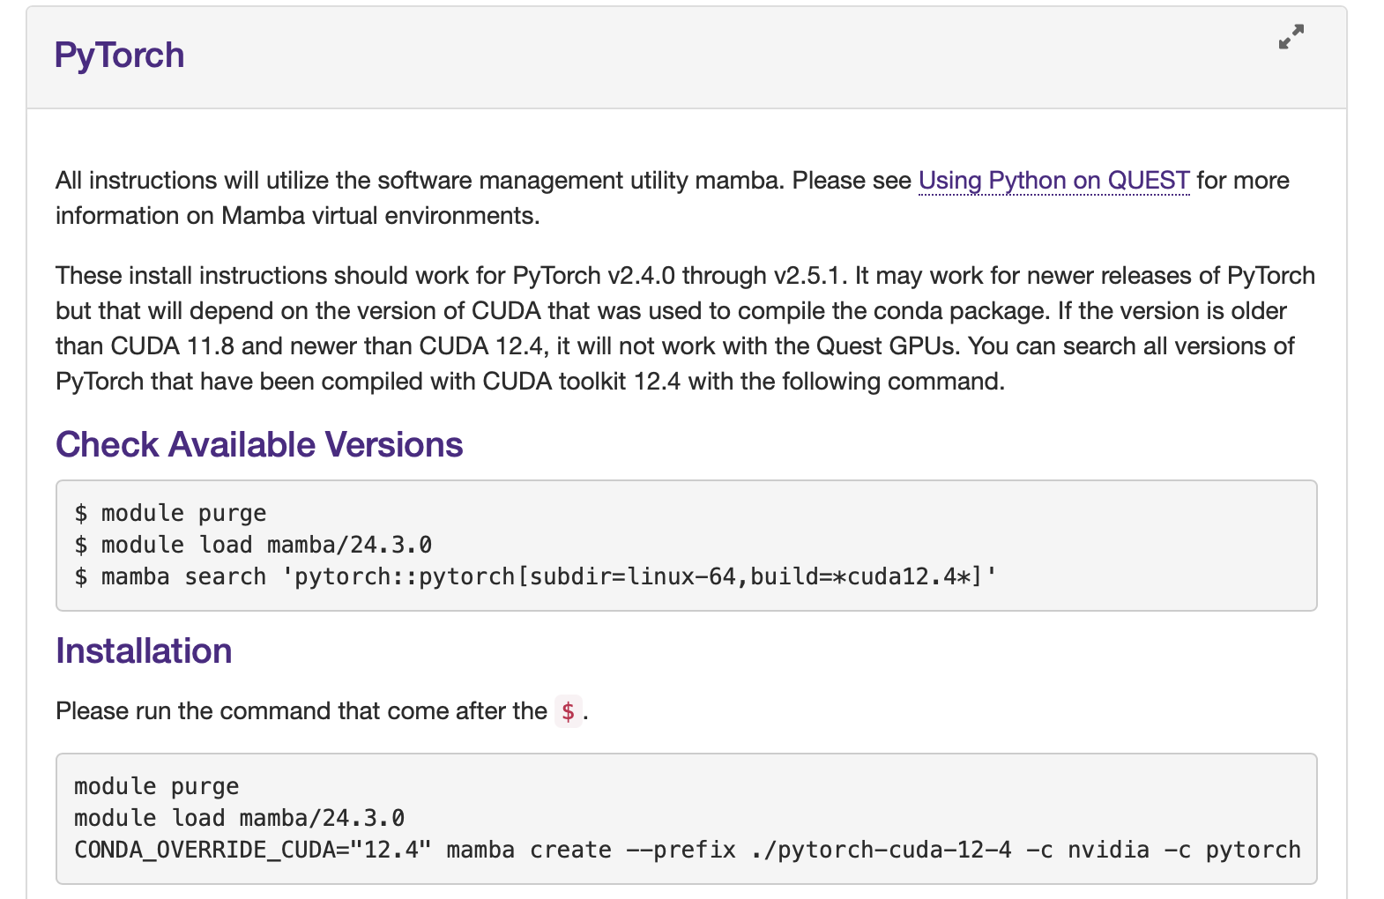
https://services.northwestern.edu/TDClient/30/Portal/KB/ArticleDet?ID=1112#what-gpu-software-is-on-Quest

Slide 18
We’ll add scanpy and others from pip for our single cell environment:
# with sc_env activated:
pip install 'scanpy[leiden]’ scvi-tools
# brings in jax, torch, pytorch, and many others

Slide 19
Installing Jupyter kernel into environment
mamba install ipykernel ipywidgets
# install ipykernel package into virtual environment
python -m ipykernel install --user --name sc_env --display-name “sc_env”
# create kernel to use this environment with Jupyter

Slide 20
What about these other packages?
Spatialdata: https://spatialdata.scverse.org/en/stable/installation.html
Squidpy:
https://docs.scvi-tools.org/en/1.3.0/installation.html

Slide 21
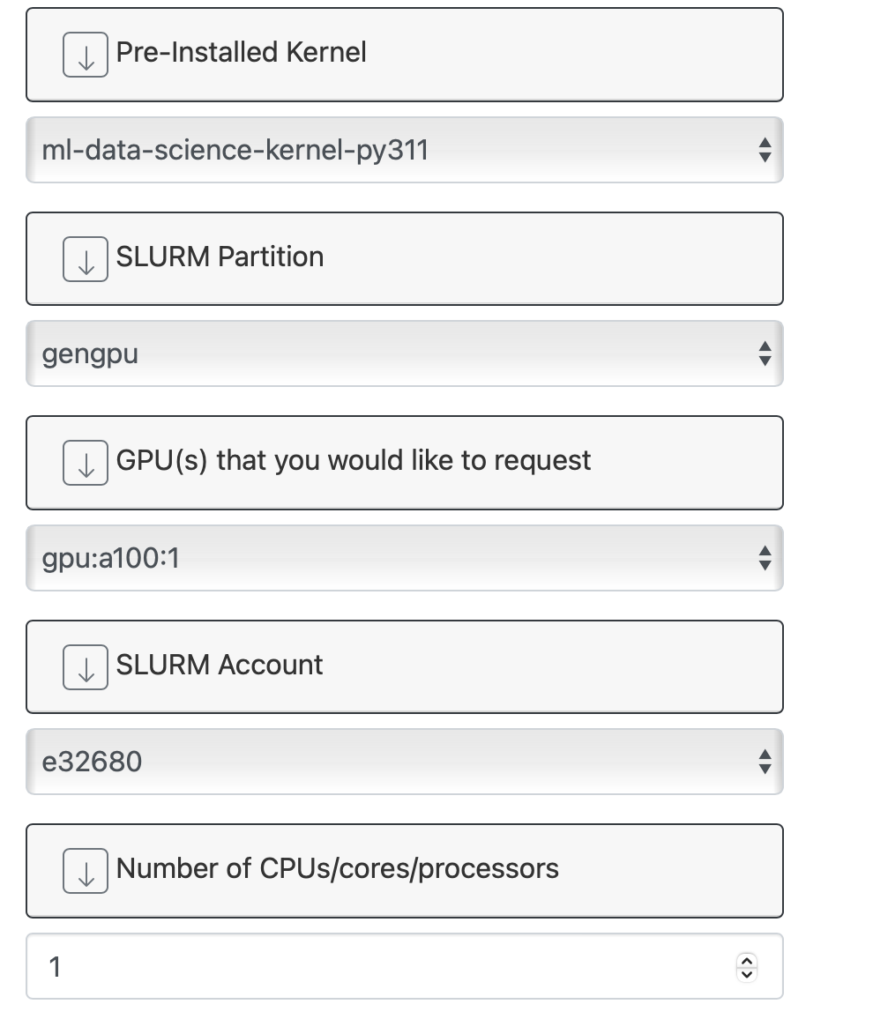
Let’s test it out!
# navigate to Quest OnDemand in a browser
ondemand.quest.northwestern.edu
# request a Jupyter Server session
# from the “Interactive Apps” dropdown

Slide 22
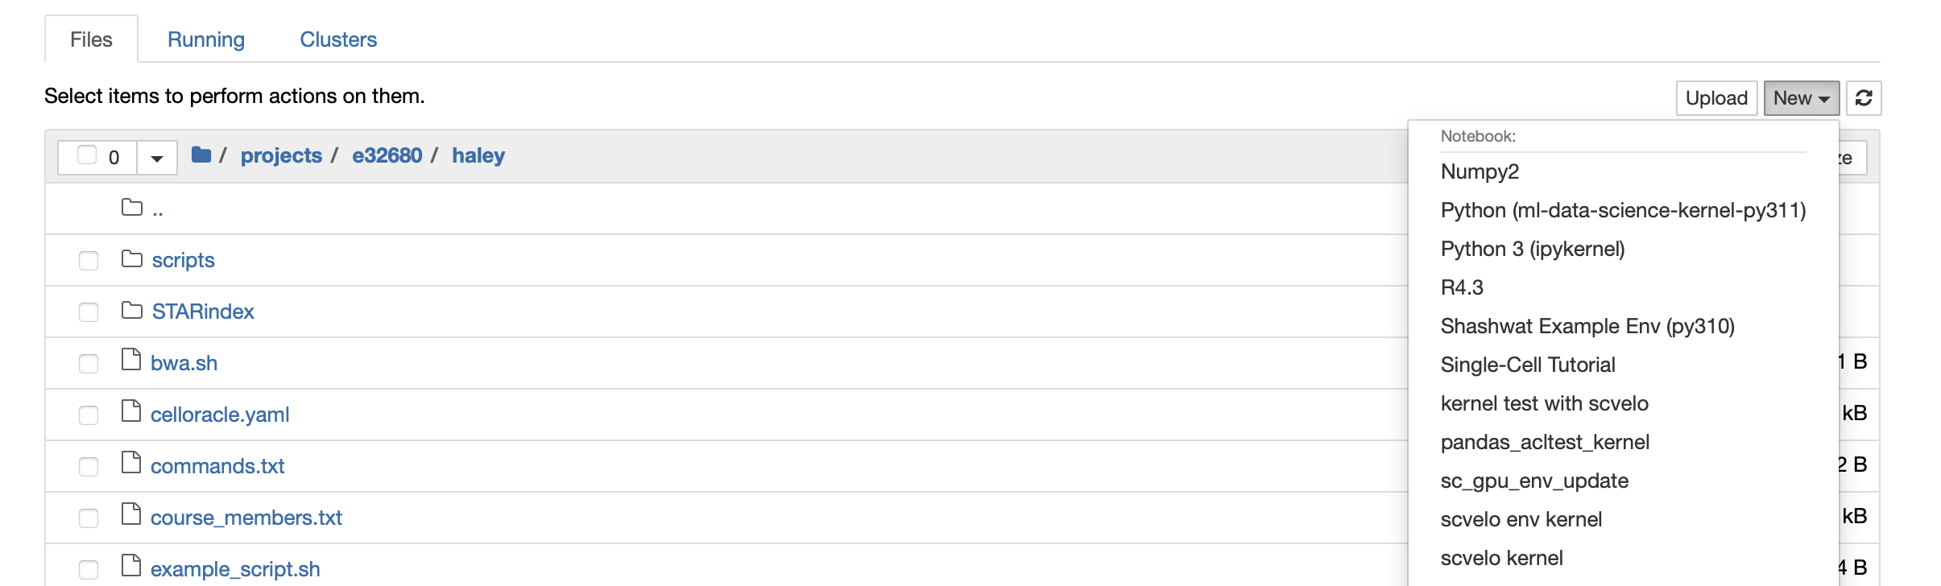
Navigate to your folder within /projects/e32680
From the “New” dropdown you should be able to select the kernel we just created!

Slide 23
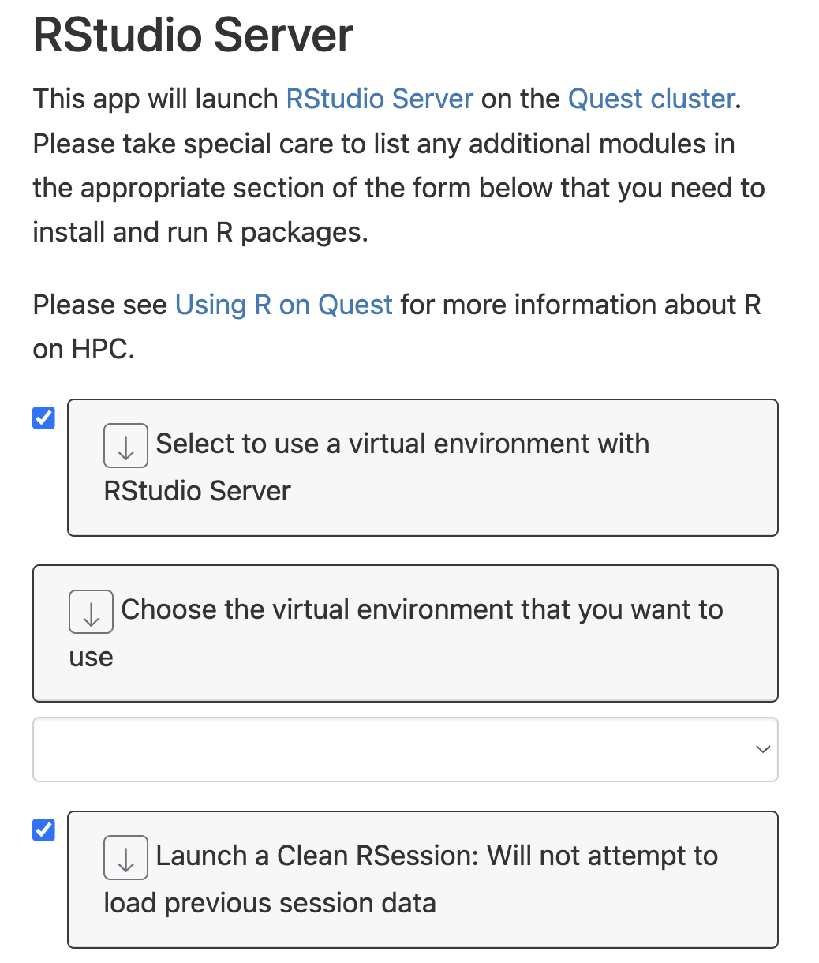
You can do the same for R
# put both R, and R packages in your environment
mamba install r-base r-igraph r-seruat r-seruat-data
# request a RStudio Server session
# Select to use a virtual environment (instead of modules)

