Slide 1
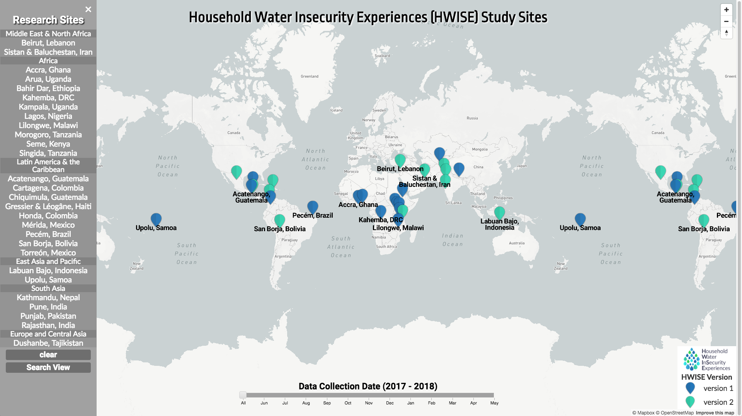
id: title_line
id: third_bar
id: Lister
class: sidenav
id: legend1
class: map-overlay

Slide 2
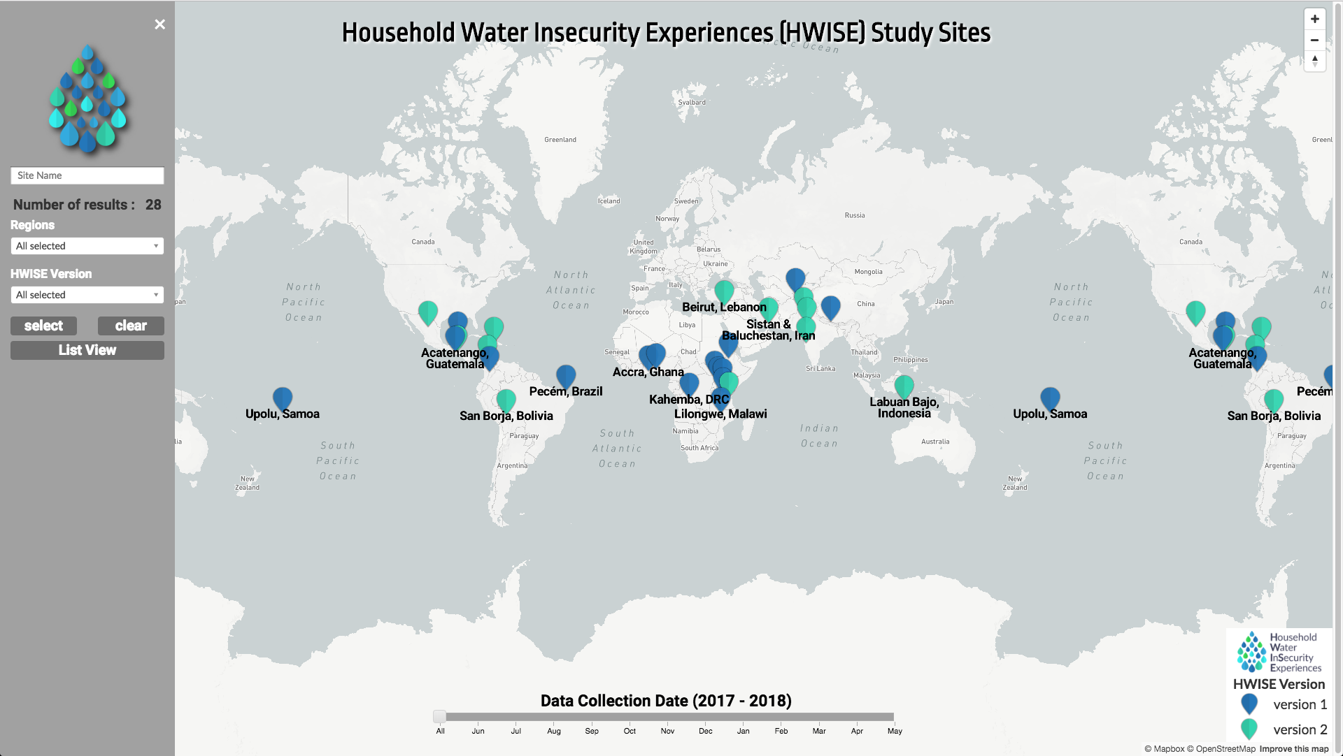
id: title_line2
id: Searcher
class: sidenav
class: d3-slider
d3-slider-horizontal

Slide 3
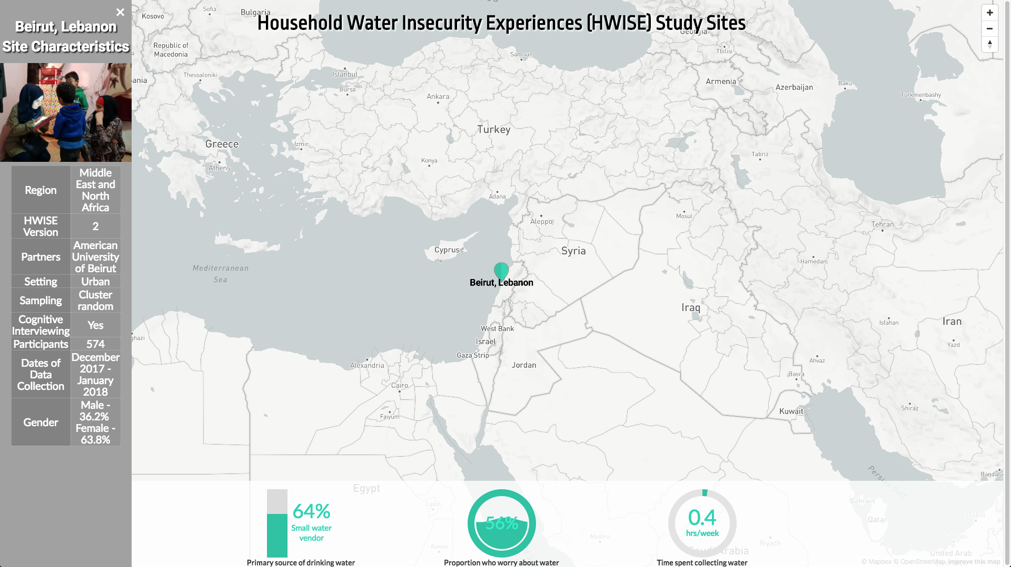
id: Desc
class: sidenav
id: bottom_bar
id: full_rect
id: fillgauge1
id: ciclemeter

Slide 4
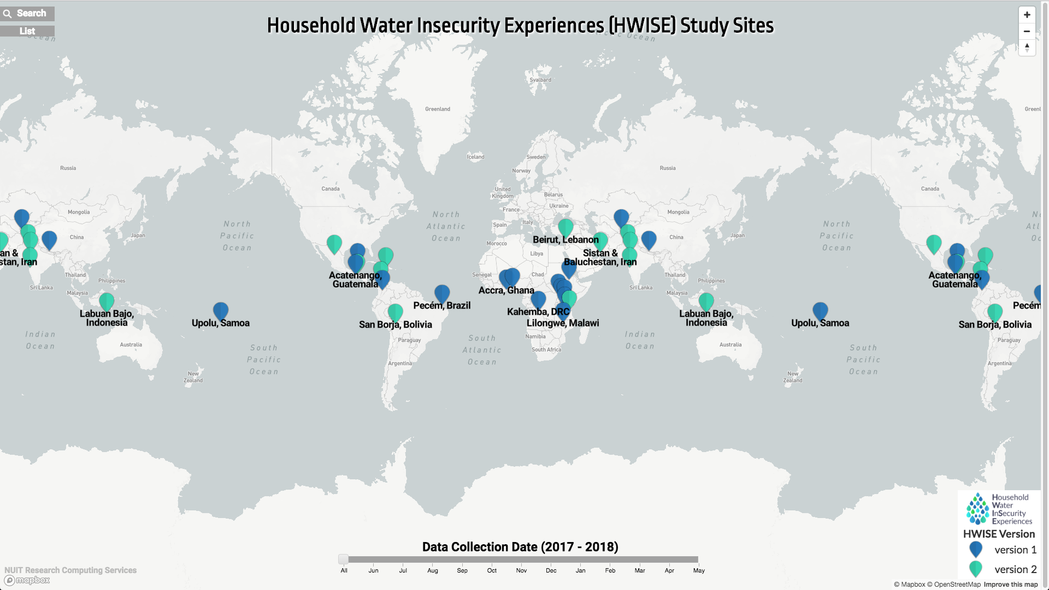
id: openner class: backsidenav
id: openner2 class: backsidenav
id: credit

