Slide 1
Microsoft excel
Present by: Sommith THOUMMALY
s.Thoummaly@nuol.edu.la
mithcom@yahoo.com

Slide 2
ບົດທີ 2 creating cell data
ໃນບົດນີ້ນັກສຶກສາຈະໄດ້ຮຽນຮູ້ການກ່າຍຂໍ້ມູນຈາການສໍາເນົາ ໂດຍນໍາໃຊ້ຄໍາສັ່ງ Paste Special, ການ Filling data series ແລະ ການສໍາເນົາຂໍ້ມູນໂດຍນໍາໃຊ້ Auto Fill. ນອກຈາກນັ້ນຍັງຈະໄດ້ຮຽນຮູ້ການສ້າງ ແລະ ການຈັດການຄໍາສັ່ງ Hyperlinks.

Slide 3
topic
Construct Cell Data
Apply Auto Fill
Apply and Manipulate Hyperlinks

Slide 4
1. Construct Cell Data
Pasting Structured Data
Inserting and Deleting Data

Slide 5
Pasting Structured Data
The cut, copy, and paste features are used by virtually everyone who uses Excel. However, Excel offers additional advanced techniques for pasting that a great many Excel users are unaware of or rarely use, even though they allow the user to do some very powerful data manipulation.
Using the Paste Special feature, you can perform mathematical operations when you paste data over existing data, you can transpose columns to rows and rows to columns, and you can be selective about what you want to paste from the source cells. You have the option to paste only values, formulas, formatting, data validation, comments, or column widths. You can choose to exclude borders when you paste. You can also link data that you’ve copied, so that if the source data changes, the copied data will also change. Strategy In

Slide 6
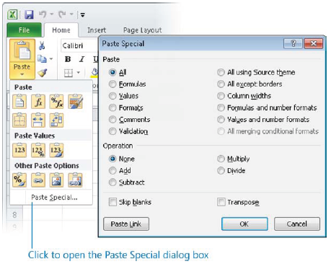
Pasting Structured Data

Slide 7
Inserting and Deleting Data
Inserting and deleting rows and columns is a natural part of worksheet development, and in Excel 2010, it couldn’t be easier. You can insert an entire row above the selected cell or an entire column to the left of it. If you want to insert a cell instead of a row or column, you are given the option of making room by moving cells down or to the right.
Similarly, you can delete a selected row or column, or you can delete only the selected cells, optionally specifying how the remaining cells should fill the space.
In addition to inserting empty rows, columns, or cells, you can insert cut or copied cell contents directly into an existing table or data range with one command. When you insert a range of cells rather than an entire row or column, Excel requests instructions for making room before inserting a similarly shaped range.

Slide 8
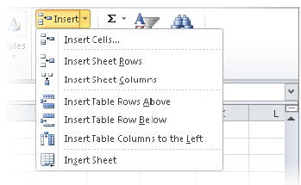
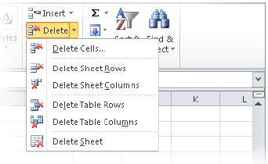
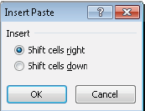
Step of Inserting and Deleting Data

Slide 9
2. Apply Auto Fill
Filling a Data Series
Copying Data

Slide 10
Filling a Data Series
You can quickly fill adjacent cells with data that continues a formula or a series of numbers, days, or dates, either manually from the Fill menu, or automatically by dragging the fill handle. When copying or filling data by using the Fill menu commands, you can set specific options for the pattern of the data sequence you want to create.

Slide 11
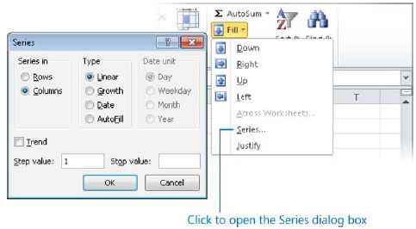
Step of Filling a Data Series

Slide 12
Step of Filling a Data Series
When creating a series based on one or more selected cells (called filling a series), you can select from the following series types:
● Linear Excel calculates the series values by adding the value you enter in the Step Value box to each cell in the series.
● Growth Excel calculates the series values by multiplying each cell in the series by the step value.
● Date Excel calculates the series values by incrementing each cell in the series of dates, designated by the Date Unit you select, by the step value.
● AutoFill This option creates a series that produces the same results as dragging the fill handle.

Slide 13
Step of Filling a Data Series
When you use the Auto Fill feature, either from the Fill menu or by dragging the fill handle, the Auto Fill Options button appears in the lower-right corner of the fill range. Clicking the button displays a menu of context-specific fill options.
You can use the Auto Fill feature to create sequences of numbers, days, and dates; to apply
formatting from one cell to adjacent cells; or, if you use Excel for more sophisticated
purposes, to create sequences of data generated by formulas, or custom sequences
based on information you specify.

Slide 14
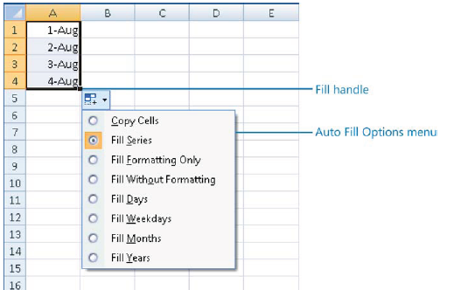
Step of Filling a Data Series

Slide 15
Step of Filling a Data Series
If you want to fill a series of information that does not match the available series type or unit, you can create a custom fill series consisting of a specific list of data you want your series to conform to. For example, this could be a list of names, regions, or industry-specific reference points.

Slide 16
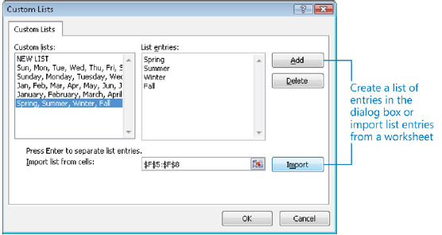
Step of Filling a Data Series

Slide 17
Copying Data
You can use the fill functionality to copy text data, numeric data, or cell formatting (such as text color, background color, and alignment) to adjacent cells.

Slide 18
3. Apply and Manipulate Hyperlinks
Creating Hyperlinks
Modifying Hyperlinks

Slide 19
Creating Hyperlinks
Excel worksheets can include hyperlinks that provide a quick way to connect to related information or to create a prefilled email message. You can create a hyperlink from any cell content to any of the hyperlink locations supported by the Office 2010 programs— to another location on the worksheet, in the workbook, in an external document, or on the web.
Within the worksheet, an active hyperlink appears underlined and in the color specified for hyperlinks by the applied theme. Pressing Ctrl and clicking the cell takes you to the link’s target. After you click the hyperlink, it appears in the theme color specified for followed hyperlinks.

Slide 20
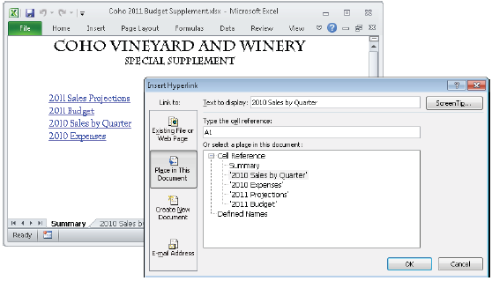
Step of Creating Hyperlinks

Slide 21
Modifying Hyperlinks
After creating a hyperlink of any type, you can change the type or target, or remove it without affecting the hyperlinked content

