Slide 1
Microsoft excel
Present by: Sommith THOUMMALY
s.Thoummaly@nuol.edu.la
mithcom@yahoo.com

Slide 2
ບົດທີ 3 Formatting Cells and Worksheets
This chapter guides you in studying ways of formatting cells and worksheets by using cell formats and styles; merging and splitting cells; and hiding, displaying, and printing row and column titles. You also study page setup options for worksheets.

Slide 3
Topic
Apply and Modify Cell Formats
Merge or Split Cells
Create Row and Column Title
Hide or Unhide Rows and Column
Manipulate Page Setup Options for Worksheets
Create and Apply Cell Style

Slide 4
3.21 Apply and Modify Cell Formats
Formatting Cell Content
Formatting Cell Fills and Borders
Setting Row Height and Column Width
Formatting Numbers

Slide 5
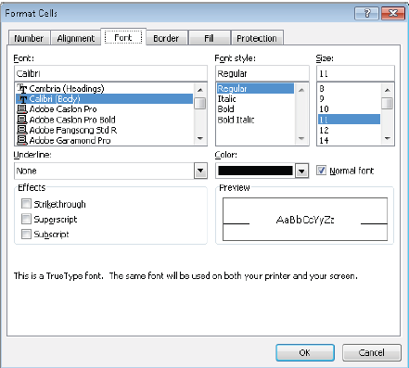
Formatting Cell Content
By default, the font used for entries in a new Excel worksheet is Calibri, but you can use the same techniques you would use in any Office 2010 program to change the font and the following font attributes: Size, Style, Color and Underline

Slide 6
Text wrapping
Excel does not wrap text in a cell. Instead, it allows the entry to overflow into the cell to the right if that cell is empty, or hides the part that won’t fit if the cell to the right contains its own entry. To make the entire entry visible, you can allow the cell entry to wrap to multiple lines, which increases the height of the row.

Slide 7
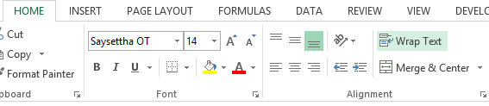
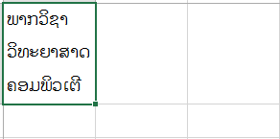
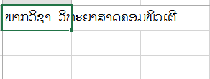
Step of Text wrapping
ເປັນການຈັດຂໍ້ຄວາມຍາວໃຫ້ຢູ່ໃນ Cell ດຽວ ເພື່ອຄວາມ ເໝາະສົມກັບໜ້າວຽກ
2. ເລືອກຄໍາສັ່ງ
3. ຜົນໄດ້ຮັບ
1. ພິມຂໍ້ຄວາມ

Slide 8
Orientation By
entries are horizontal and read from left to right. You can rotate entries for special effect or to allow you to display more information on the screen or a printed page. This capability is particularly useful when you have long column headers above columns of short entries.

Slide 9
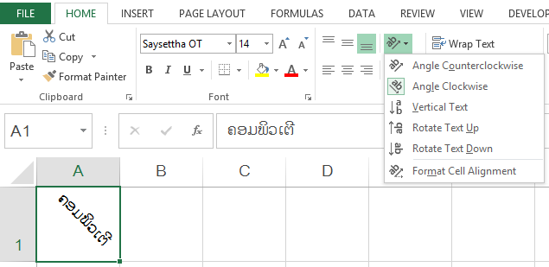
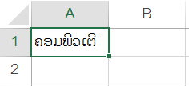
Step of Orientation
ເປັນການຈັດຂໍ້ຄວາມໃນ Cell ໃຫ້ໄປຕາມຄວາມຕ້ອງການຂອງຜູ້ໃຊ້ເຊັ່ນວ່າການປັບຄວາມງ່ຽງຂອງຂໍ້ຄວາມເປັນຕົ້ນ.
2. ກົດປຸ່ມ
2. ເລືອກຄໍາສັ່ງ
1. ພິມຂໍ້ຄວາມ
ສະແດງຜົນ

Slide 10
Formatting Cell Fills and Borders
You can format cells by using borders and shading to make them stand out. You can add predefined borders or custom borders of various styles, colors, and thicknesses to a single cell or to multiple cells. You can apply solid colors, gradients, and patterns to the background of one or more cells as creative ways of delineating structure and drawing attention to key information.

Slide 11
Setting Row Height and Column Width
By default, worksheet rows have a standard height of 15 points (1 point equals approximately 1/72 inch) and their height increases and decreases to accommodate the number of lines in their longest entry. You can manually change the height of a row, but it is best to leave it automatic unless you have a good reason to specify a particular height. For example, you might want to specify a narrow row to create a visual break between blocks of data. (You can restore dynamic height adjustment if you need to.)
By default, worksheet columns have a standard width of 8.43 characters. Column width does not always automatically adjust to fit the column contents. You are more likely to want to change column width than row height, usually to accommodate long cell entries. You can have Excel adjust a column to fit its longest entry, or you can adjust it manually. In conjunction with text wrapping, adjusting column widths is a key technique for making as much data as possible visible on the screen or page.

Slide 12
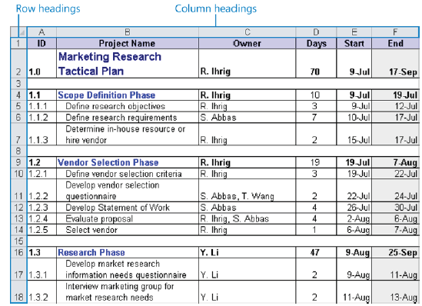
Setting Row Height and Column Width

Slide 13
Formatting Numbers
By default, all the cells in a new worksheet are assigned the General format. When setting up a worksheet, you assign to cells the format that is most appropriate for the type of information you expect them to contain. The format determines not only how the information looks but also how Excel can work with it.
You can assign the format before or after you type an entry in the cell. You can also just start typing and have Excel intuit the format from what you type. If you choose the format from the list or allow Excel to assign it for you, the format is applied with its default settings. For number and currency formats, you can change those settings in limited ways by clicking buttons on the Home tab. For all formats, you can change them in more precise ways in the Format Cells dialog box.

Slide 14
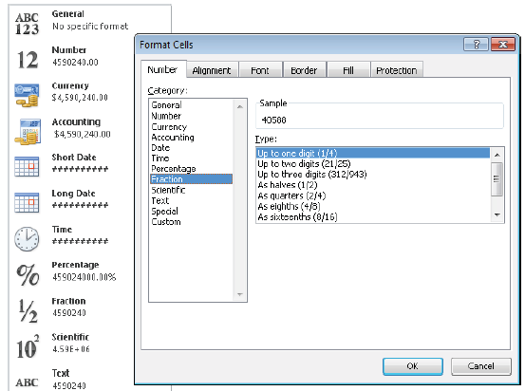
Formatting Numbers

Slide 15
3.2 Merge or Split Cells
ເປັນການເຊື່ອມ Cell ຕັ້ງແຕ່ 2 Cell ຂື້ນໄປ ຕາມຕ້ອງການ ໂດຍປະກອບມີ:
ຊື່ | ຄວາມໝາຍ
Merge & Center | ເຊື່ອມ Cell ແລະ ຈັດຂໍ້ຄວາມເຂົ້າກາງ
Merge Across | ເຊື່ອມ Cell ຕາມແຖວ
Merge Cells | ເຊື່ອມ Cell
Unmerge Cells | ຍົກເລີກການເຊື່ອມ Cell

Slide 16
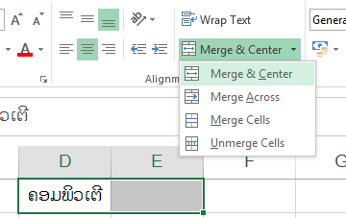
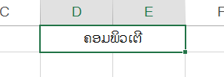
Merge & Center

Slide 17
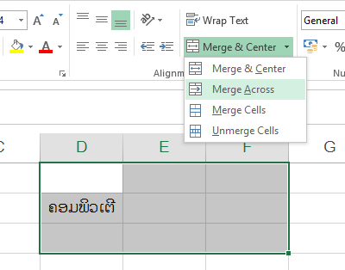
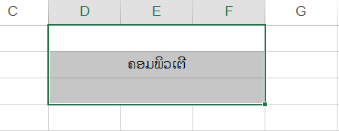
Merge Across

Slide 18
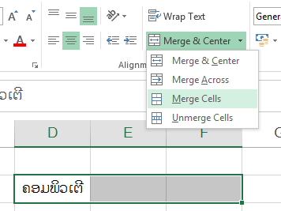
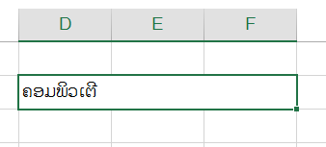
Merge Cells

Slide 19
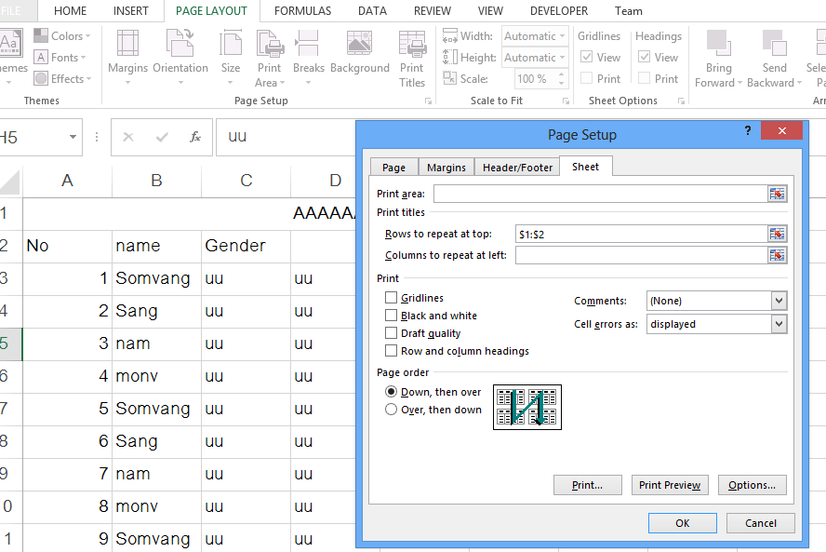
3.3 Create Row and Column Title
ໃນ Excel ປົກກະຕິ, ເວລາພິມເອກະສານອອກມາທາງເຄື່ອງພິມ, ຖ້າມີຫຼາຍໜ້າ ຫົວຂໍ້ຂອງເອກະສານດັ່ງກ່າວຈະບໍ່ໄດ້ພິມອອກມາທຸກໆໜ້າ, ຖ້າຕ້ອງການພິມໃຫ້ອອກມາທຸກໆໜ້າກໍສາມາດເຮັດໄດ້ດັ່ງຮູບລຸ່ມນີ້:
1. ເປີດໜ້າ Page setup
3. ກົດ Mouse ໃສ່ຫົວແຖວ
2. ກົດໃສ່ຊ່ອງ

Slide 20
3.4 Hide or Unhide Rows and Column
If parts of a worksheet contain information you don’t want to display, you can hide the rows or columns containing the data. Anyone who notices that column or row headings (column letters or row numbers) are missing can unhide the information unless you protect the workbook. If you don’t want to go to the trouble of enforcing protection, you can hide all the column and row headings in the worksheet to make the hidden information harder to detect.

Slide 21
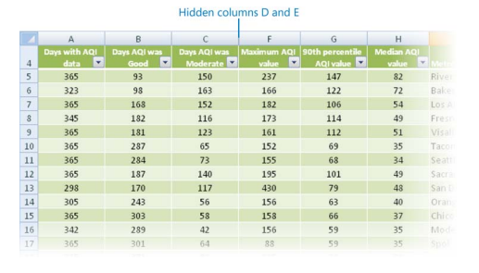
Hide or Unhide Rows and Column

Slide 22
3.5 Manipulate Page Setup Options for Worksheets
You can control the layout of printed worksheets not only by defining a print area and inserting page breaks but also by changing the page margins, the space allocated to the header and footer, the page orientation, and the paper size.

Slide 23
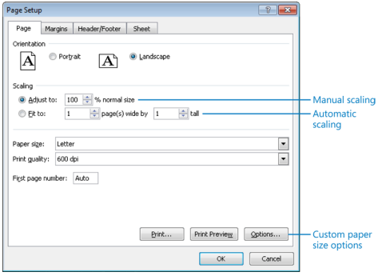
Manipulate Page Setup Options for Worksheets
You can scale a worksheet manually or allow Excel to scale it for you by specifying the number of pages you want the printed worksheet to be

Slide 24
3.6 Create and Apply Cell Style
You don’t have to apply cell formats one at a time. You can quickly apply several formats at once by clicking a style in the Cell Styles gallery. Some of the categories of styles in this gallery are static, whereas others are dynamic and change according to the theme applied to the worksheet.

Slide 25
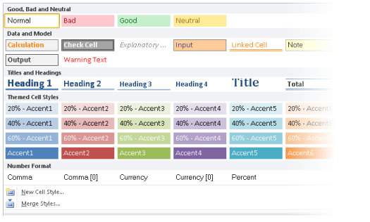
Create and Apply Cell Style

Slide 26
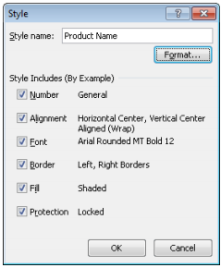
Create and Apply Cell Style
If you need a style that is not already defined, you can manually format a cell and then save the combination of formatting as a cell style that you can easily apply elsewhere.

