Slide 1
Microsoft excel 2013
Present by: Sommith THOUMMALY
s.Thoummaly@nuol.edu.la
mithcom@yahoo.com

Slide 2
ບົດທີ 4 Managing Worksheets and Workbooks
ໃນບົດນີ້ນັກສຶກສາຈະໄດ້ຮຽນຮູ້ການຈັດການ Worksheet ເຊັ່ນ: ການ ເຊື່ອງ, ການສໍາເນົາ ແລະ ອື່ນໆ ນອກຈາກນັ້ນຍັງໄດ້ຮຽນຮູ້ກ່ຽວກັບມູມມອງຂອງໜ້າ Worksheet ເຊັ່ນ: ການໃຊ້ຄໍາສັ່ງ Freeze panes, ການການເບິ່ງເອກະສານຫຼາຍເອກະສານພ້ອມກັນ. ພ້ອມກັນນັ້ນຍັງໄດ້ຮຽນຮູ້ການເຊື່ອມ ແລະ ຍົກເລີກໜ້າ ວິນໂດ, ການເອົາ ເສັ້ນຂັ້ນລະຫວ່າງ Cell ອອກ ຮູບແບບ Cell ເປັນຕົ້ນ.

Slide 3
Topic
Create and Format Worksheets
Manipulate Window Views
Manipulate Workbook Views

Slide 4
Create and Format Worksheets
Workbooks commonly include multiple worksheets for a single project or purpose. For example, the first worksheet might display a simple summary of more complex data presented on other, purpose-specific worksheets. You can move and copy worksheets within and between workbooks. You can hide worksheets you don’t need to use or don’t want other people to see. To work with multiple worksheets at one time—for example, to apply formatting to several worksheets at once—you can group the worksheets.

Slide 5
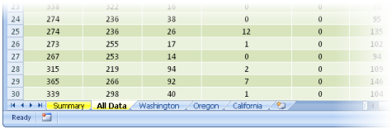
Create and Format Worksheets
When a workbook contains several sheets, it is helpful to change the names on the sheet tabs to reflect the worksheet contents. You can also assign different colors to the tabs to categorize them or to make them easily distinguishable.

Slide 6
To copy a worksheet within a workbook or to another workbook
1.Right-click the worksheet tab, and then click Move or Copy. 2. In the Move or Copy dialog box, if you want to copy the worksheet to another workbook, select that workbook in the To book list. 3. In the Before sheet list, click the worksheet you want to position the copy before. 4. Select the Create a copy check box, and then click OK.

Slide 7
To hide OR unhide a worksheet
HIDE:
Right-click the worksheet tab, and then click Hide
UNHIDE:
1. Right-click any worksheet tab, and then click Unhide. 2. In the Unhide dialog box, select the worksheet you want to display, and then click OK.

Slide 8
To assign a color to a worksheet tab
Right-click the tab, click Tab Color, and then in the color palette, click the color you want.

Slide 9
Manipulate Window Views. Freezing and Splitting Windows
It can be cumbersome to work in a worksheet that is too long or wide to display legibly in the program window because you have to scroll up and down or back and forth to view data. Similarly, it can be tedious to have to switch back and forth between multiple worksheets in the same workbook if you frequently need to access information in both of them. You can view multiple parts of a worksheet at one time by freezing rows or columns so that they stay in view while you scroll the rest of the worksheet. You can also split the window and then independently scroll and work in two views of the worksheet at one time.

Slide 10
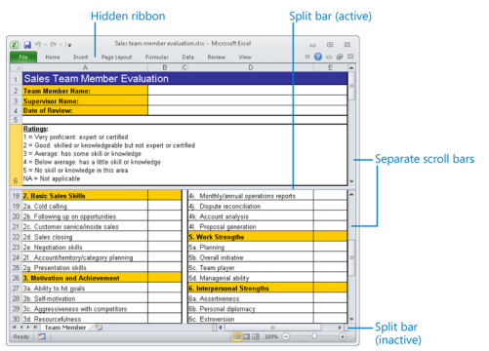
Manipulate Window Views

Slide 11
To freeze the first row or column of a worksheet
On the View tab, in the Window group, click the Freeze Panes button, and then click Freeze Top Row or Freeze First Column.

Slide 12
To freeze multiple rows or columns
1. Select the row below or column to the right of those you want to freeze, by clicking the row heading or column heading. 2. On the View tab, in the Window group, click the Freeze Panes button, and then click Freeze Panes.

Slide 13
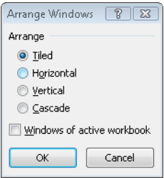
Displaying Multiple Windows
You can open multiple windows that all display the current spreadsheet and then arrange those windows in a variety of ways. You can also open and arrange multiple workbook windows.
click the New Window button on the View tab, in the Window group

Slide 14
Manipulate Workbook Views
From the View toolbar at the bottom of the program window, or from the View tab, you can switch among three views of a worksheet: ● Normal The worksheet is displayed in the window at 100 percent magnification or at whatever zoom level you select. Page breaks are indicated by black dashed lines. ● Page Layout Each worksheet page appears as it will when printed, with space between the individual pages. A ruler appears at the left edge of the window next to the optional row headings. The page header and footer are visible and you can select them for editing. ● Page Break Preview The entire worksheet is displayed in the window, with page breaks indicated by bold blue dashed lines and page numbers displayed in the center of each page. You can change the page breaks by dragging the blue lines.

