Slide 1
Microsoft excel 2013
Present by: Sommith THOUMMALY
s.Thoummaly@nuol.edu.la
mithcom@yahoo.com

Slide 2
ບົດທີ 5 Applying Formulas and Functions
This chapter guides you in studying ways of creating basic formulas, controlling the order in which Excel performs calculations within formulas, calculating data based on specific requirements, and referencing data within a formula.

Slide 3
topic
Create Formulas
Enforce Precedence
Apply Cell References in Formulas
Apply Conditional Logic in Formulas
Apply Named Ranges in Formulas
Apply Cell Ranges in Formulas

Slide 4
5.1 Create Formulas
Formulas in Excel can be made up of values that you enter, cell references, names, mathematical operators, and functions. A function can be thought of as a service provided by Excel to do a specific task. That task might be to perform a math operation, to make a decision based on information you give it, or to perform
an action on some text.

Slide 5
Create Formulas
A function is always indicated by the function name followed by a set of parentheses. For
most functions, arguments inside the parentheses either tell the function what to do or
indicate the values that the function is to work with. An argument can be a value that you
enter, a cell reference, a range reference, a name, or even another function. The number
and type of arguments vary depending on which function you’re using. It is important to
understand the syntax of common functions and be able to correctly enter the function
arguments. Fortunately, you don’t have to memorize anything; Excel 2010 does an excellent
job of walking you through the process of using a function within a formula. You can
type a function’s syntax yourself if you want, but it’s almost always easier to let Excel guide
you through the process.

Slide 6
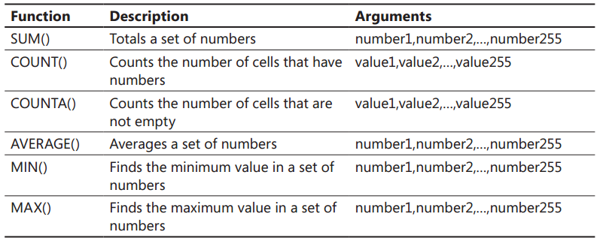
functions
The following table describes other functions that allow you to summarize information from sets of cells.
Each of these functions takes up to 255 arguments; each argument can be a range or named reference and can refer to thousands of values

Slide 7
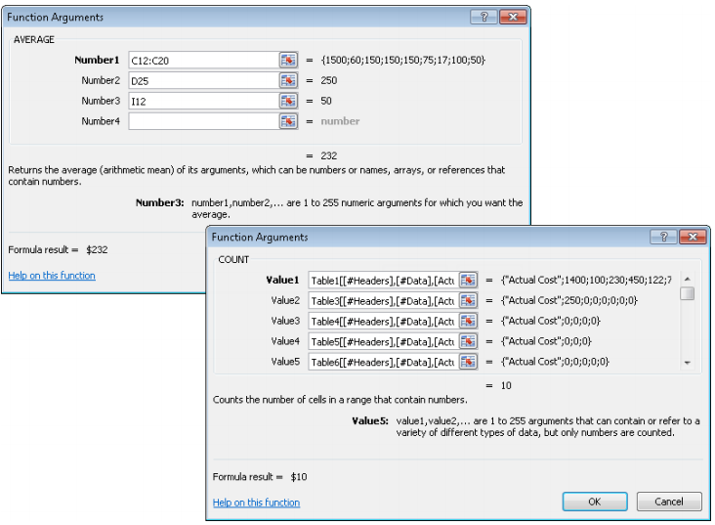
functions
Also in the table, any argument specified as a value can be any type of value. In the case of the COUNT() function, it will simply ignore any value that it can’t interpret as a number. In the case of COUNTA(), it will count every cell that isn’t empty.

Slide 8
5.2 Enforce Precedence
A formula can involve multiple types of calculations. Unless you specify another order of precedence, Excel evaluates formula content and processes calculations in this order: 1 . Reference operators The colon (:), space ( ), and comma (,) symbols 2 . Negation The negative (–) symbol in phrases such as –1 3 . Percentage The percent (%) symbol 4 . Exponentiation The raising to a power (^) symbol 5 . Multiplication and division The multiply (*) and divide (/) symbols 6 . Addition and subtraction The plus (+) and minus (-) symbols 7 . Concatenation The and (&) symbol connecting two strings of text 8 . Comparison The equal (=), less than (<), and greater than (>) symbols and any combination thereof

Slide 9
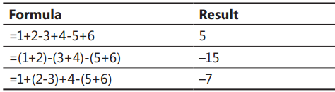
Enforce Precedence
If multiple calculations within a formula have the same precedence, Excel processes them in order from left to right. The following table illustrates the effect of changing precedence within a simple formula

Slide 10
5.3 Apply Cell References in Formulas
Formulas in an Excel worksheet most often involve functions performed on the values
contained in one or more other cells on the worksheet (or on another worksheet). A reference
that you make in a formula to the contents of a worksheet cell is either a relative
reference, an absolute reference, or a mixed reference. A relative reference changes in
relation to the cell in which the referring formula is originally entered; an absolute reference
doesn’t change. It is important to understand the difference and to know which to
use when creating a formula.

Slide 11
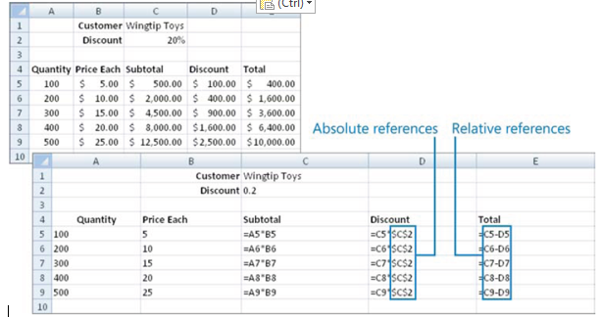
Apply Cell References in Formulas

Slide 12
5.4 Apply Conditional Logic in Formulas
Creating Conditional Formulas
Nesting Functions

Slide 13
Creating Conditional Formulas
You can use a formula to display specific results when certain conditions are met. To do so, you create a formula that uses the conditional logic provided by the IF() function or one of its variations. A basic formula that uses the IF() function performs a logical test and then returns one of two results based on whether the logical test evaluates as TRUE or FALSE.
The correct syntax for the IF() function is as follows:
=IF(logical_test,value_if_true,value_if_false)
The logical test and the result can include text strings or calculations. Enclose text strings
within the formula in quotation marks. Do not enclose numeric values or calculations in
quotation marks.

Slide 14
Creating Conditional Formulas
Excel 2010 includes the additional conditional logic functions shown in the following table.
AVERAGEIF() Returns the average of values in a range that meet one or more criteria
AVERAGEIFS()
COUNTIF() Returns the number of cells in a range that meet one or more criteria
COUNTIFS()
SUMIF() Returns the sum of values in a range that meet one or more criteria
SUMIFS()
IFERROR() Returns one value if a formula results in an error and another if it doesn’t

Slide 15
Creating Conditional Formulas
You can nest additional functions within an IF() function so that Excel evaluates multiple conditions before returning a result. You can use nested functions to do the following:
● Perform a calculation that results in an argument used by the IF() function, like this:
=IF(SUM(D1:D8)>=80,”Congratulations, you passed!”,”Sorry, you failed. Please try again.”)
● Combine multiple logical tests, like this:
=IF(AND(Year=2011,Month=”July”),B2*C4,”No”)

Slide 16
Creating Conditional Formulas
You can add logical tests to a conditional formula by using the following functions:
● AND() Returns a value of TRUE only if every logical test within it is TRUE.
● OR() Returns a value of TRUE if any logical test within it is TRUE.
● NOT() Reverses the logical outcome of a logical test, so if the test is TRUE, NOT
returns FALSE. For example, NOT(A1=3), returns TRUE as long as the value in cell A1 is not equal to 3. You use this function when you want to check whether a cell is not equal to a certain value.
You place the AND(), OR(), and NOT() functions before the associated arguments.

Slide 17
5.5 Apply Named Ranges in Formulas
To simplify the process of creating formulas that refer to a specific range of data, and to
make your formulas easier to create and read, you can refer to a cell or range of cells by
a name that you define. For example, you might name a cell containing an interest rate
Interest, or a range of cells containing nonwork days Holidays. In a formula, you can refer
to a named range by name. Thus a formula might look like this:
=WORKDAY(StartDate,WorkingDays,Holidays)
A formula that uses named ranges is easier to understand than one that uses standard
references, which might look like this:
=WORKDAY(B2,B$3,Data!B2:B16)

Slide 18
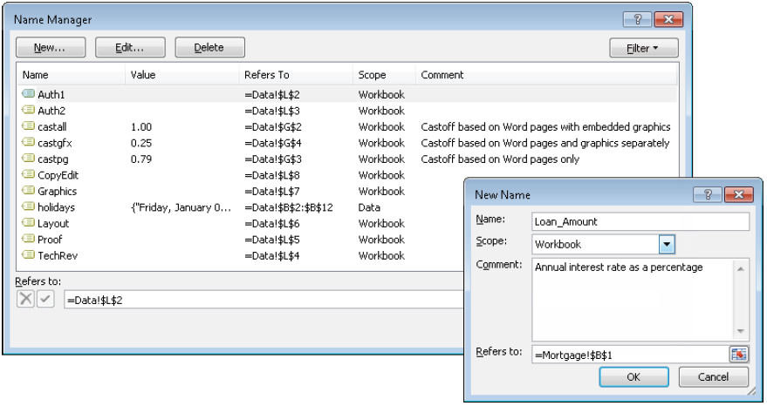
Name Manager

Slide 19
Name manager
After defining a named range, you can change the name or the cells included in the
named range. You can delete a named range definition from the Name Manager.
Note that deleting a cell from a worksheet does not delete any associated named
range. Invalid named ranges are indicated in the Name Manager by #REF! in the
Value column.

Slide 20
5.6 Apply Cell Ranges in Formulas
You can refer to the content of a range of adjacent cells. For example, you might use a formula to add the values of a range of cells, or to find the maximum value in all the cells in a row. When referencing a range of cells in a formula, the cell references can be relative, absolute, or mixed.

Slide 21
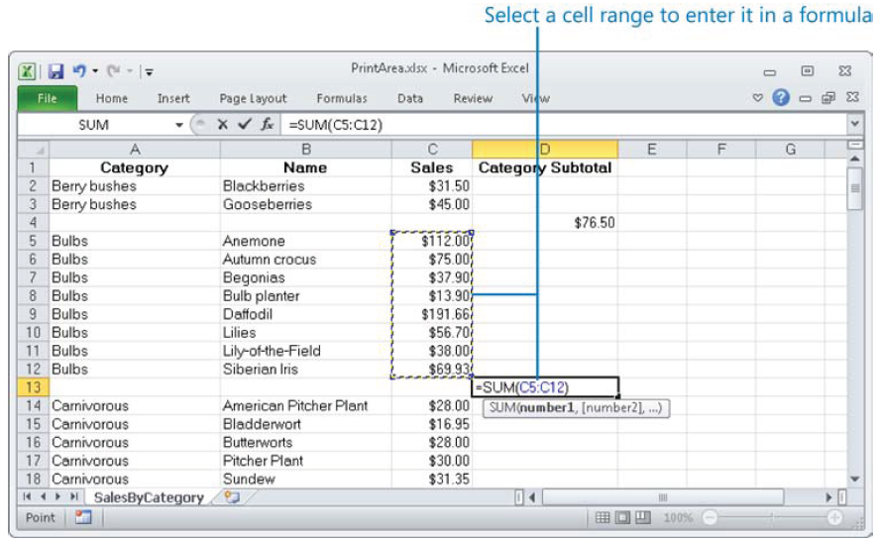
Apply Cell Ranges in Formulas

Slide 22
ການນໍາໃຊ້ຟັງຊັນພື້ນຖານຄົ້ນຫາຂໍ້ມູນ
ຟັງຊັນຄົ້ນຫາເປັນກຸ່ມຟັງຊັນທີ່ໃຊ້ເພື່ອຄົ້ນຫາຂໍ້ມູນຕາມເງື່ອນໄຂທີ່ຕ້ອງການ ທັງນີ້ກໍເພື່ອສະດວກໃນການຈັດການກັບຂໍ້ມູນໃຫ້ໄດ້ຕາມຄວາມຕ້ອງການຂອງຜູ້ໃຊ້. ໃນກຸ່ມຟັງຊັນຄົ້ນຫານີ້ປະກອບດ້ວຍຫຼາຍຟັງຊັນ, ແຕ່ໃນທີ່ນີ້ຈະນໍາສະເໜີບາງຟັງຊັນທີ່ເຫັນວ່າມີການນໍາໃຊ້ເຂົ້າໃນວຽກງານປະຈໍາວັນເປັນສ່ວນໃຫຍ່.

Slide 23
ຟັງຊັນ CHOOSE
ເປັນຟັງຊັນສົ່ງກັບຄ່າທີ່ເລືອກຈາກລາຍການໂດຍກຳ ນົດດັດສະນີທີ່ໃຊ້ໃນການເລືອກຄ່າ. ເຊິ່ງມີຮູບແບບດັ່ງນີ:
CHOOSE(index_num,value1,value2,…)
index_num ແມ່ນກຳນົດຄ່າທີ່ໃຊ້ໃນການບອກລຳ ດັບທີ, ຖ້າເທົ່າ 1 ຟັງຊັນຈະສົ່ງຄ່າ value1, ຖ້າເທົ່າ 2 ຟັງຊັນຈະສົ່ງ value2,….ແຕ່ຖ້າເປັນເລກເສດກໍຈະປັດເສດ ລົງໃຫ້ເປັນຈຳນວນເຕັມແລ້ວຈຶ່ງສົ່ງຄ່າ.
value1,value2,…ເປັນຄ່າທີ່ສາມາດກຳນົດໄດ້ສູງສຸດ 29 ຄ່າເຊິ່ງເປັນໄດ້ທັງຕົວເລກ ແລະ ຂໍ້ຄວາມ

Slide 24
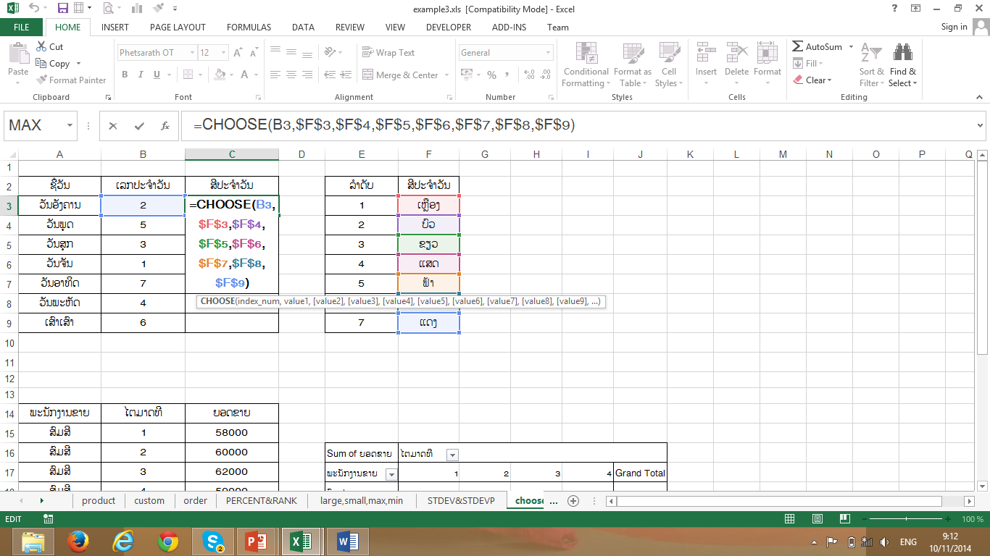
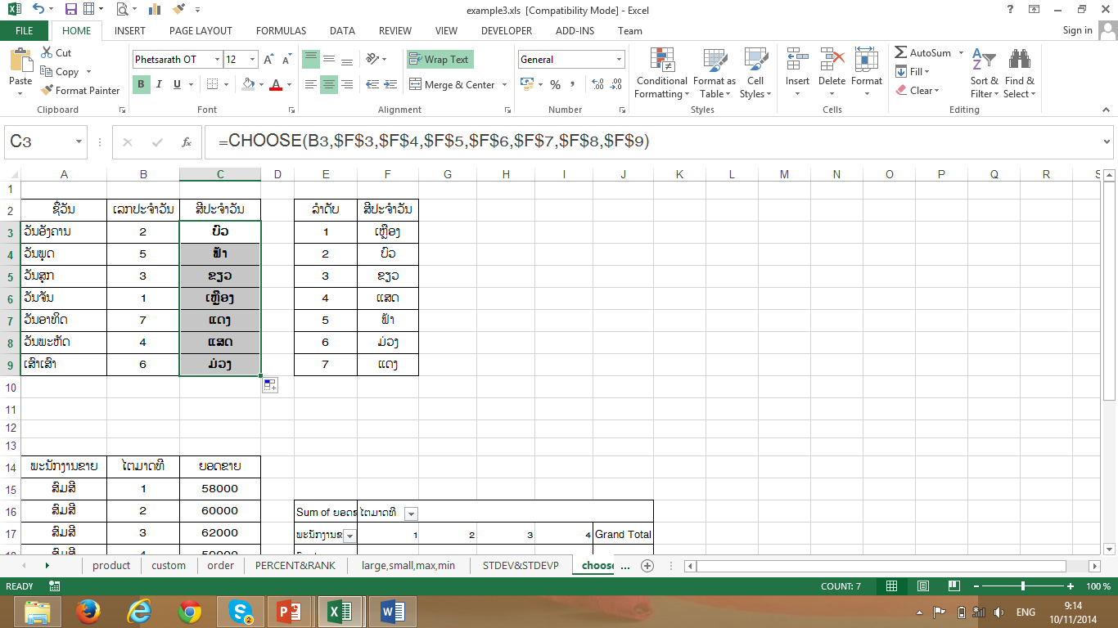
ຕົວຢ່າງການນໍາໃຊ້ຟັງຊັນ CHOOSE

Slide 25
ຟັງຊັນ LOOKUP
ເປັນຟັງຊັນສົ່ງກັບຄ່າທີ່ຕ້ອງການຈາກຊ່ວງຂໍ້ມູນ ຫຼື array ໂດຍການໃຊ້ວຽກຈະມີ 2 ແບບຄື:
ແບບເວັກເຕີ
ແບບ arry

Slide 26
ຟັງຊັນ LOOKUP ແບບເວັກເຕີ
LOOKUP(lookup_value,lookup_vector,result_vector).
lookup_value ແມ່ນຄ່າທີ່ຕ້ອງການນຳໄປຄົ້ນຫາໃນ lookup_vector, ຖ້າຟັງຊັນບໍ່ສາມາດຄົ້ນຫາຄ່າທີ່ກົງກັບ lookup_value ກໍຈະສົ່ງຄ່າທີ່ໃຫຍ່ທີ່ສຸດໃນ array ແຕ່ນ້ອຍກວ່າ lookup_value ແຕ່ຖ້າ lookup_value ມີຄ່ານ້ອຍກວ່າຄ່າ ນ້ອຍສຸດໃນແຖວຫຼືຖັນທຳອິດຈະສະແດງການຜິດພາດອອກມາ.
lookup_vector ແມ່ນຊ່ວງ cell ແບບ 1 ແຖວ ຫຼື 1 ຖັນທີ່ຕ້ອງການນຳມາຄົນຫາໃນ lookup_value.
result_vector ແມ່ນຊ່ວງ cell ແບບ 1 ແຖວ ຫຼື 1 ຖັນທີ່ຈະນຳມາຄົ້ນຫາລາຍການທີ່ຈັບຄູ່ກັບ lookup_value ໂດຍ result_vector ຈະຕ້ອງມີຂະໜາດດຽວກັບ lookup_vector

Slide 27
ຟັງຊັນ LOOKUP ແບບ arry
LOOKUP(lookup_value, array).
array ແມ່ນ cell ຂໍ້ມູນທີ່ເປັນໄດ້ທັງຕົວເລກ, ຂໍ້ຄວາມ ຫຼື ຄ່າຕັກກະສາດທີ່ນຳມາຄົ້ນຫາຂໍ້ມູນທີ່ກົງກັບ lookup_value.
ຖ້າ array ມີຈຳນວນຖັນຫຼາຍກວ່າຈຳນວນແຖວ, ຟັງຊັນຈະຫາຄ່າ lookup_value ຈາກແຖວທຳອິດ.
ຖ້າ array ມີຈຳນວນຖັນນ້ອຍກວ່າຫຼືເທົ່າກັບຈຳນວນແຖວ, ຟັງຊັນ ຈະຫາຄ່າ lookup_value ຈາກຖັນທຳອິດ.

Slide 28
ຟັງຊັນ HLOOKUP
ເປັນຟັງຊັນຄົ້ນຫາຄ່າຈາກແຖວທຳອິດຂອງຂໍ້ ມູນແລ້ວສົ່ງຄ່າທີ່ຢູ່ຖັນໃນແຖວນັ້ນກັບ. ເຊິ່ງມີຮູບແບບ ດັ່ງນີ້
HLOOKUP(lookup_value,table_array, row_index_num,range_lookup )

Slide 29
ຟັງຊັນ HLOOKUP (ຕໍ່)
lookup_value ແມ່ນຄ່າທີ່ຕ້ອງການຄົ້ນຫາຈາກ ແຖວຫຼືຖັນເທິງສຸດຂອງຕາຕະລາງເຊິ່ງເປັນໄດ້ ທັງຂໍ້ຄວາມ, ຕົວເລກ ຫຼື ການອ້າງອີງ.
table_array ການອ້າງອີງໄປຍັງຕາຕະລາງທີ່ຕ້ອງ ການນຳມາຄົ້ນຫາທີ່ກົງກັບ lookup_value,
ຖ້າ lookup_value ມີຄ່ານ້ອຍກວ່າຄ່າທີ່ນ້ອຍທີ່ສຸດໃນ ແຖວທຳອິດຂອງ table_array ຟັງຊັນຈະສະແດງ ຂໍ້ຜິດພາດອອກມາ.

Slide 30
ຟັງຊັນ HLOOKUP (ຕໍ່)
row_index_num ໝາຍເຖິງແຖວໃນ table_array ທີ່ຕ້ອງການໃຫ້ສົງຄ່າທີ່ກົງກັບ lookup_value ກັບ, ຖ້າ row_index_num ເທົ່າກັບ 1 ຟັງຊັນຈະສົ່ງກັບຄ່າໃນແຖວ ທຳອິດຂອງ table_array, ຖ້າ row_index_num ເທົ່າກັບ 2 ຟັງຊັນຈະສົ່ງກັບຄ່າໃນແຖວທີ່ສອງຂອງ table_array...
range_lookup ຄ່າຕັກກະສາດທີ່ກຳນົດໃຫ້ຟັງຊັນຄົ້ນ ຫາຄ່າທີ່ກົງກັນຢ່າງຖຶກຕອ້ງຫຼືໃກ້ຄຽງ. ຖ້າ range_lookup ເປັນ TRUE ຫຼືບໍ່ໃສ່ຄ່າຟັງຊັນຈະສົ່ງຄ່າຖືກຕ້ອງແຕ່ຖ້າບໍ່ພົບກໍຈະສົ່ງຄ່າ ທີ່ກົງກັນໂດຍປະມານເຊິ່ງເປັນຄ່າທີ່ຕຳແໜ່ງໃຫຍ່ທີ່ສຸດແຕ່ນ້ອຍກວ່າຕຳແໜ່ງ lookup_value ບໍ່ດັງນັ້ນຈະສົ່ງຄ່າຜິດພາດອອກມາ.

Slide 31
ຟັງຊັນ VLOOKUP
ເປັນຟັງຊັນຄົ້ນຫາຄ່າຈາກຖັນທຳອິດຂອງຂໍ້ມູນແລ້ວສົ່ງຄ່າທີ່ຢູ່ຖັນໃນແຖວນັ້ນກັບ. ເຊິ່ງມີຮູບແບບ ດັ່ງນີ້
VLOOKUP(lookup_value,table_array, col_index_num,range_lookup)

Slide 32
ຟັງຊັນ VLOOKUP (ຕໍ່)
lookup_value ແມ່ນຄ່າທີ່ຕ້ອງການຄົ້ນຫາຈາກ ແຖວ ຫຼືຖັນເທິງສຸດຂອງຕາຕະລາງເຊິ່ງເປັນໄດ້ ທັງຂໍ້ຄວາມ, ຕົວເລກ ຫຼື ການອ້າງອີງ.
table_array ການອ້າງອີງໄປຍັງຕາຕະລາງທີ່ຕ້ອງ ການນຳມາຄົ້ນຫາທີ່ກົງກັບ lookup_value.

Slide 33
ຟັງຊັນ VLOOKUP (ຕໍ່)
col_index_num ໝາຍເຖິງຖັນໃນ table_array ທີ່ຕ້ອງການໃຫ້ສົງຄ່າທີ່ກົງກັບ lookup_value ກັບ, ຖ້າ row_index_num ເທົ່າກັບ 1 ຟັງຊັນຈະສົ່ງກັບຄ່າໃນຖັນ ທຳອິດຂອງ table_array, ຖ້າ row_index_num ເທົ່າກັບ 2 ຟັງຊັນຈະສົ່ງກັບຄ່າໃນຖັນທີ່ສອງຂອງ table_array...
range_lookup ຄ່າຕັກກະສາດທີ່ກຳນົດໃຫ້ຟັງຊັນຄົ້ນ ຫາຄ່າທີ່ກົງກັນຢ່າງຖຶກຕອ້ງຫຼືໃກ້ຄຽງ. ຖ້າ range_lookup ເປັນ TRUE ຫຼື ບໍ່ໃສ່ຄ່າຟັງຊັນຈະສົ່ງຄ່າຖືກຕ້ອງແຕ່ຖ້າບໍ່ພົບກໍຈະສົ່ງຄ່າ ທີ່ກົງກັນໂດຍປະມານເຊິ່ງເປັນຄ່າທີ່ຕຳແໜ່ງໃຫຍ່ທີ່ສຸດແຕ່ນ້ອຍກວ່າຕຳແໜ່ງ lookup_value

