Slide 1
Microsoft excel 2013
Present by: Sommith THOUMMALY
s.Thoummaly@nuol.edu.la
mithcom@yahoo.com

Slide 2
ບົດທີ 6 Presenting Data Visually
You can insert many of the same graphic elements in an Excel workbook that you can insert in other Microsoft Office documents, including clip art, SmartArt diagrams, shapes, screenshots, and pictures. You can also express numeric data by creating charts, and summarize numeric data by using sparklines. This chapter guides you in studying ways of inserting and modifying charts, graphics images, and sparklines.

Slide 3
Topics
Create Charts Based on Worksheet Data
Apply and Manipulate Illustrations
Create and Modify Images
Apply Sparklines

Slide 4
6.1 Create Charts Based on Worksheet Data
Charts are an important tool for data analysis and are therefore a common component of certain types of worksheets. You can easily plot selected data as a chart to make it easy to identify trends and relationships that might not be obvious from the data itself

Slide 5
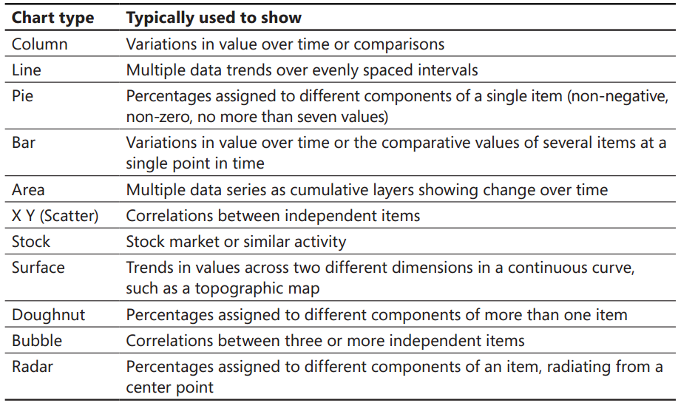
Plotting Charts
Different types of data are best suited for different types of charts. The following table shows the available chart types and the type of data they are particularly useful for plotting.

Slide 6
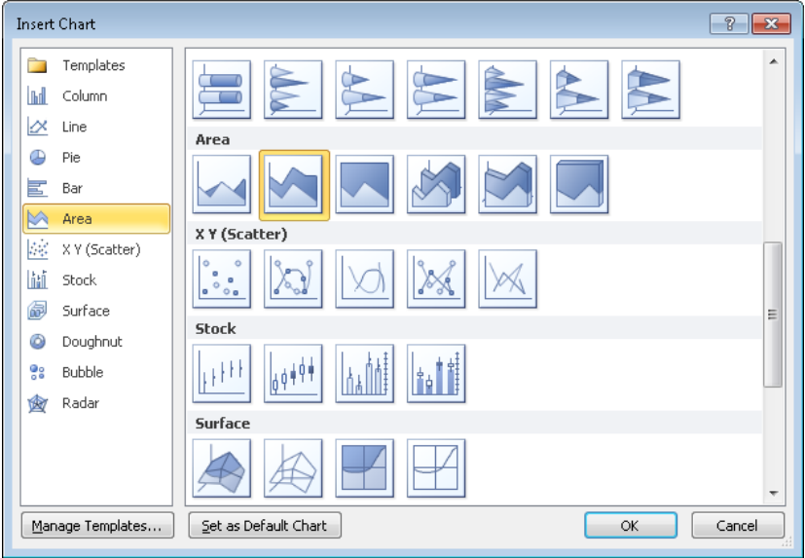
Plotting Charts

Slide 7
Plotting Charts
When you plot worksheet data, a row or column of values, which in the charting world are called data points, constitutes a set of data called a data series. Each data point in a data series is represented graphically in the chart by a data marker and in the chart legend by a unique color or pattern. The data is plotted against an x-axis (or category axis) and a y-axis (or value axis). Three-dimensional charts also have a z-axis (or series axis). Sometimes a chart does not produce the results you expect because the data series are plotted against the wrong axes; that is, Excel is plotting the data by row when it should be plotting by column, or vice versa. You can quickly switch the rows and columns to see whether that produces the desired effect. To see what Excel is doing behind the scenes, you can open the Select Data Source dialog box, which shows you exactly what is
plotted where.

Slide 8
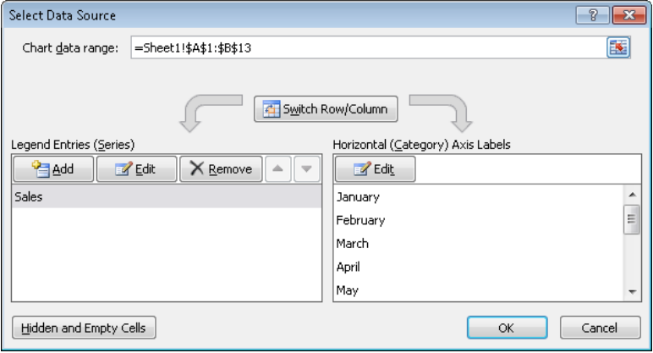
Plotting Charts

Slide 9
To plot selected data as a chart on the worksheet
Tip: Before plotting the data, ensure that it is correctly set up for the type of chart you want to create . For example, a pie chart can display only one data series .
On the Insert tab, in the Charts group, click the button of the chart type you want, and then click a sub-type

Slide 10
To change the type of a selected chart
1. On the Chart Tools Design contextual tab, in the Type group, click the Change Chart Type button. 2. In the Change Chart Type dialog box, click a new type and sub-type, and then click OK

Slide 11
To switch rows and columns in a selected chart
On the Design contextual tab, in the Data group, click the Switch Row/Column button.

Slide 12
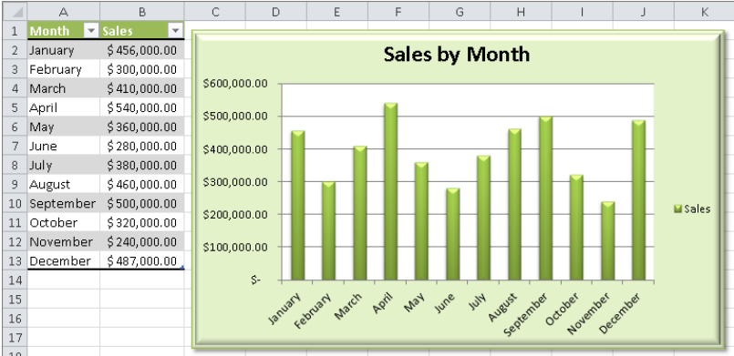
Applying Layouts and Styles
You can apply predefined combinations of layouts and styles to quickly format a chart. You can also apply a shape style to the chart area to set it off from the rest of the sheet.

Slide 13
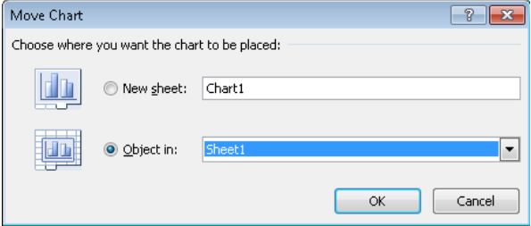
Moving and Sizing Charts
The charts you create often don’t appear where you want them on a worksheet, and they are often too big or too small to adequately show their data. You can move and size a chart by using simple dragging techniques.
If you prefer to display a chart on its own sheet instead of embedding it in the worksheet containing its data, you can easily move it. You can also move it to any other existing worksheet in the workbook.

Slide 14
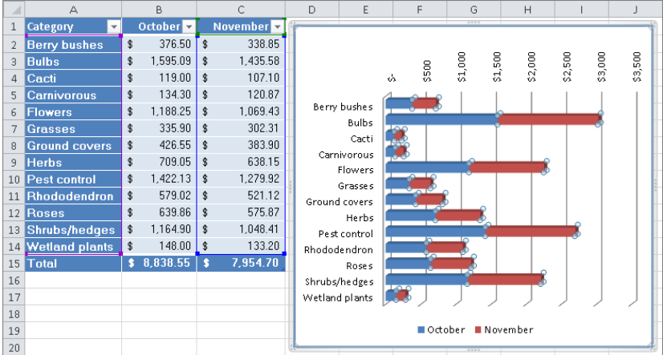
Editing Data
A chart is linked to its worksheet data, so any changes you make to the plotted data are immediately reflected in the chart. If you add or delete values in a data series or add or remove an entire series, you need to increase or decrease the range of the plotted data in the worksheet.

Slide 15
Configuring Chart Elements
To augment the usefulness or the attractiveness of a chart, you can add elements such as a title, axis labels, data labels, a data table, and gridlines. You can adjust each element, as well as the plot area (the area defined by the axes) and the chart area (the entire chart object), in appropriate ways.

Slide 16
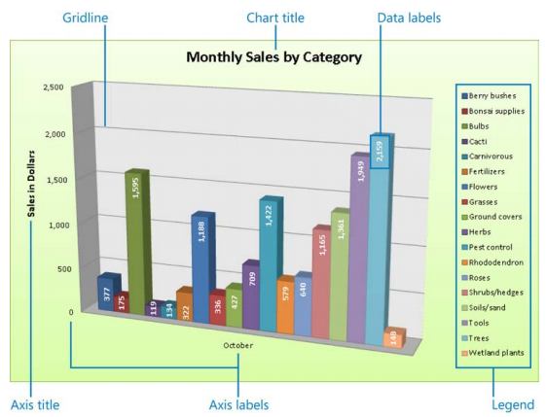
Configuring Chart Elements

Slide 17
6.2 Apply and Manipulate Illustrations
Inserting and Formatting Clip Art
Inserting and Modifying SmartArt Diagrams
Inserting and Formatting Shapes
Capturing Screenshots

Slide 18
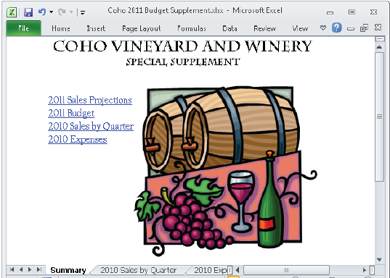
Inserting and Formatting Clip Art
You can use royalty-free clip art objects to add visual interest to worksheets.

Slide 19
Inserting and Modifying SmartArt Diagrams
When you create a worksheet that includes details of a process such as a project schedule, you might want to create an accompanying diagram to illustrate the process visually. You can create professional-looking business diagrams by using the SmartArt graphics feature. By using predefined sets of formatting, you can easily create the type of diagram best suited to the worksheet’s information. After selecting the type of diagram you want and inserting it into the document, you add text either directly in the diagram’s shapes or from its text pane. SmartArt diagrams can consist of only text, or of text and pictures.

Slide 20
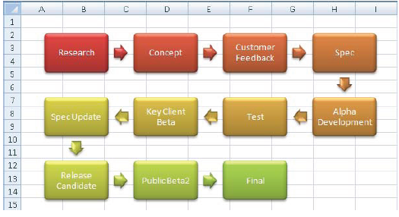
Inserting and Modifying SmartArt Diagrams Sample

Slide 21
Inserting and Formatting Shapes
To emphasize an important area of a worksheet, you can draw shapes (such as arrows) to which you can add text (such as assumptions or warnings). You can format a shape by changing its style, color, or outline. You can add text to shapes and format the text by using normal formatting techniques or WordArt styles; or by specifying the fill, outline, and effects to be applied to the text. You can format shapes by using built-in styles or by specifying the fill, outline, and effects to be applied to the shape.

Slide 22
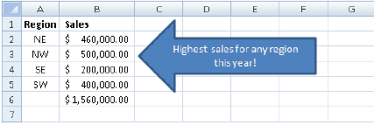
Inserting and Formatting Shapes
If you build a picture by drawing individual shapes, you can group them so that they act as one object. If you move or size a grouped object, the shapes retain their positions in relation to each other. To break the bond, you ungroup the object.

Slide 23
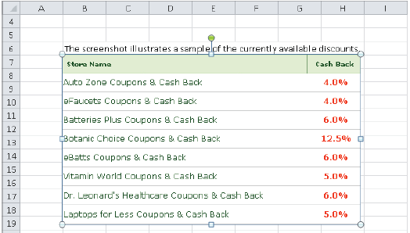
Capturing Screenshots
You can capture and insert images of content displayed on your computer screen directly from Excel. By using the built-in screen clipping tool, you can insert screen captures of entire windows or selected areas of on-screen content.

Slide 24
6.3 Create and Modify Images
You might want to add images created and saved in other programs or scanned photographs and illustrations to a worksheet such as a catalog of products or a list of employees. If a worksheet will be distributed to people outside your company, you might want to add a logo to the worksheet’s header or footer to establish content ownership and reinforce your business identity

Slide 25
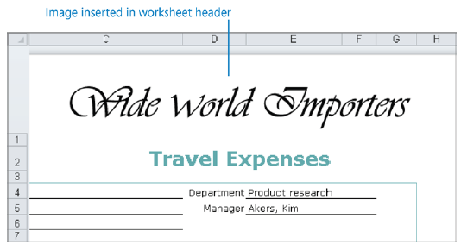
Create and Modify Images sample

Slide 26
Create and Modify Images
After you insert an image in a document, you can modify it in many ways. For example, you can crop or resize a picture, change its brightness and contrast, recolor it, apply artistic effects to it, and compress it to reduce the size of the document containing it. You can apply a wide range of preformatted styles to a picture to change its shape and orientation, as well as add borders and picture effects.

Slide 27
6.4 Apply Sparklines
Sparklines are miniature charts that summarize worksheet data in a single cell. Excel 2010 includes three types of sparklines: Line, Column, and Win/Loss. A Line or Column sparkline resembles a chart of the same type. A Win/Loss sparkline indicates whether each data point is positive, zero, or negative.
A sparkline consists of a series of markers. Depending on the sparkline type, you can choose to accentuate the following markers:
First point, Last point, High point, Low point and Negative points
You can apply styles and other formatting to sparklines in the same way that you do to other graphic elements.

Slide 28
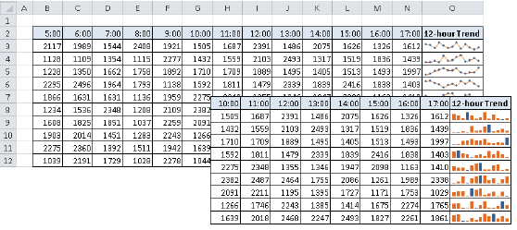
Apply Sparklines sample

Slide 29
Thank you
Q & A

