Slide 1
Microsoft excel 2013
Present by: Sommith THOUMMALY
s.Thoummaly@nuol.edu.la
mithcom@yahoo.com

Slide 2
ບົດທີ 7 Sharing Worksheet Data with Other Users
Many of the workbooks you create will contain content intended for reference by other people, or content that you collaborate on with other people. This chapter guides you in studying ways of saving workbooks in specific file formats for easy access by other people, sending workbooks to other people, and entering comments in workbooks.

Slide 3
Topic
Share Spreadsheets
Manage Comments

Slide 4
Share Spreadsheets
The 2007 Microsoft Office system introduced a new set of file formats based on XML, called Microsoft Office Open XML Formats. By default, Excel 2010 (and Excel 2007) workbooks are saved in the .xlsx format, which is an Excel-specific Open XML format. The .xlsx format provides the following benefits: ● File sizes are smaller than with previous file formats. ● It is simpler to recover damaged content because XML files can be opened in a variety of text editors. ● Security is greater because .xlsx files cannot contain macros, and personal data can easily be identified and removed from files.

Slide 5
Saving Workbooks in Specific Formats
In addition to saving a workbook for use with Excel 2010, you can save it in other formats, including the following: ● Excel Macro-Enabled Workbook To be able to store Microsoft Visual Basic for Applications (VBA) macro code or Excel 4.0 macro sheets, use the XML-based .xlsm format. ● Excel 97-2003 To share an Excel workbook with users of an earlier version of Excel, you can save it in the .xls file format. ● Excel Template To be able to use a workbook as the starting point for other workbooks, you can save the file as a template. ● Text (Tab delimited) or CSV (Comma delimited) If you don't know what program will be used to open the file, you can save it as a delimited text file that can be opened by many programs.

Slide 6
Saving Workbooks in Specific Formats
● Single File Web Page or Web Page You can convert a workbook into HTML so that it can be viewed in a web browser. Saving a workbook in the Single File Web Page format creates one .mht or .mhtml file that contains the content and supporting information, whereas saving a workbook in the Web Page format creates one .htm or .html file that sets up the display structure and a folder that contains separate content and supporting information files.

Slide 7
Saving Workbooks in Specific Formats
If you want to ensure that the appearance of the file content is the same no matter what computer or device it is displayed on, or if you want to ensure that other people can’t easily modify the file, you can save it in one of the following formats: Portable Document Format (PDF) A fixed-layout document format created by Adobe Systems. A PDF file includes the text, fonts, images, and vector graphics that compose the document. The Adobe Reader or Adobe Acrobat software is required to view a PDF document.
XML Paper Specification (XPS) document format A fixed-layout document format created by Microsoft. The XPS document format consists of structured XML markup that defines the layout of a document and the visual appearance of each page, along with rendering rules for distributing, archiving, rendering, processing, and printing the documents.

Slide 8
To save a workbook in a specific format
1.In the left pane of the Backstage view, click Save As. 2. In the Save As dialog box, browse to the folder in which you want to save the workbook. Enter a file name and select a file format, and then click Save.

Slide 9
To save a workbook as a PDF or XPS file
1. In the left pane of the Backstage view, click Save As. In the Save As dialog box, browse to the folder in which you want to save the workbook, and enter a file name. Then in the Save as type list, click PDF (* .pdf) or XPS Document (* .xps). Or In the left pane of the Export page of the Backstage view, click Create PDF/XPS Document. Then in the right pane, click the Create PDF/XPS button. In the Publish as PDF or XPS dialog box, browse to the folder in which you want to save the workbook, and enter a file name. 2. In the Optimize for area, click Standard to generate a larger, higher-quality file or Minimum size to generate a smaller, lower-quality file. Then click Options. 3. In the Options dialog box, select the workbook content you want to include in the file, and then click OK. 4. In the Save As dialog box, click Save. Or In the Publish as PDF or XPS dialog box, click Publish

Slide 10
Sending Workbooks
After you save a workbook to disk you can share it with other people by attaching it to an email message created in any program that supports attachments. Excel 2010 provides a simpler way of sharing workbooks, even without first saving them. From within Excel, you can send a workbook as an email attachment, or convert a workbook and send it as a PDF file or an XPS file.

Slide 11
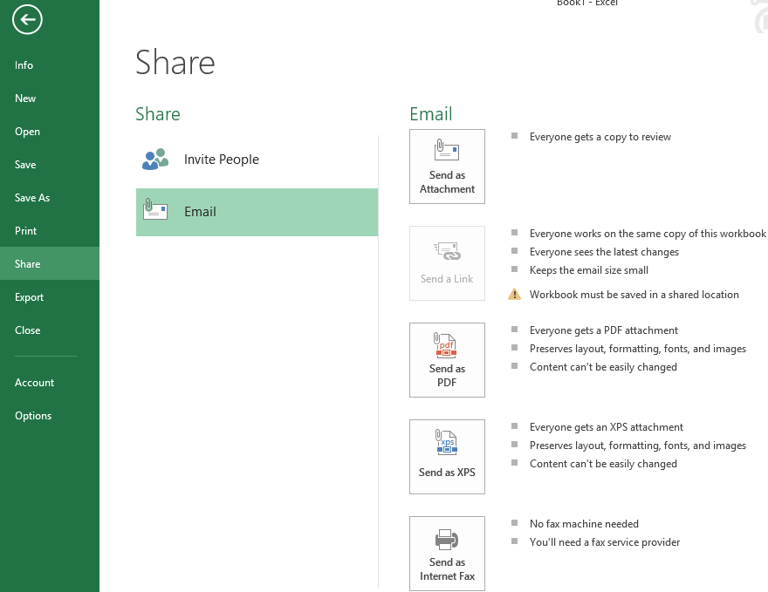
Sending Workbooks

Slide 12
Manage Comments
In addition to tracking the changes made to a worksheet, you can attach comments to cells without affecting the worksheet functionality. A cell with an attached comment is identified by a red triangle in its upper-right corner. The comment itself appears in a box attached to the red triangle by an arrow. The text of the comment is preceded by the name of the person who added it. By default, comment boxes are hidden.

Slide 13
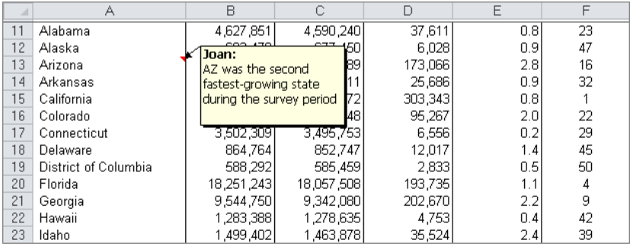
Manage Comments

Slide 14
Manage Comments
You can work with comments in the following ways:
● Display one comment or all comments. ● Move from comment to comment. ● Edit the content of a displayed comment. ● Resize or move a comment so that it does not obscure important information.

