Slide 1
Microsoft excel 2013
Present by: Sommith THOUMMALY
s.Thoummaly@nuol.edu.la
mithcom@yahoo.com

Slide 2
ບົດທີ 8 Analyzing and Organizing Data
A single Excel workbook can contain over one million rows and 16,000 columns of data. Although it’s unlikely that you’ll be working with that much data in Excel, you might frequently need to locate specific types of information within a data set or an Excel table. You can filter data to display only the records that meet specific criteria, and sort data to organize it in a logical manner. You can also format the cells within a data range to visually identify data that meets a range of conditions.

Slide 3
Objective
This chapter guides you in studying ways of filtering data to locate entries that match specific criteria, sorting data by one or more fields, and formatting data based on a set of conditions.

Slide 4
topics
Filter Data
Sort Data
Apply Conditional Formatting

Slide 5
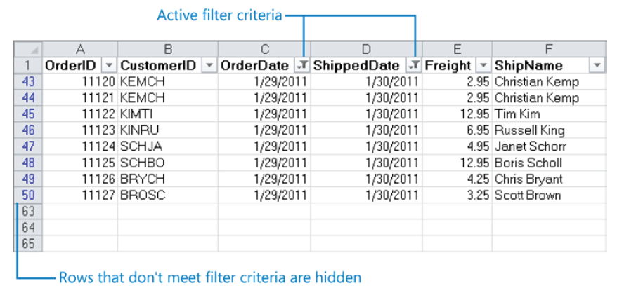
Filter Data
To locate a specific value, you can apply a filter. To filter by multiple criteria, you can apply additional filters to the results of the first one.

Slide 6
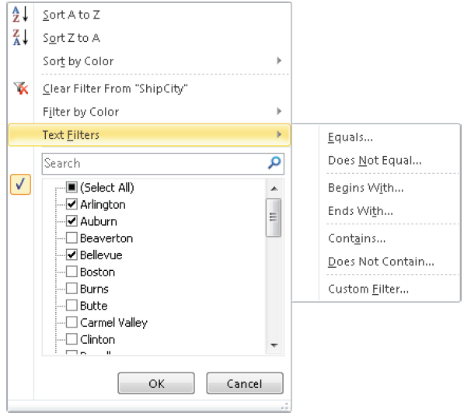
Filter Data
In addition to filtering on entire values, you can use ready-made filters to locate values that meet certain criteria. The criteria vary depending on the number format. If the worksheet or table is formatted, you can filter for the cell color, font color, or cell icon.

Slide 7
Filter Data
If none of the ready-made criteria meets your needs, you can create criteria from scratch.
The location of the selection determines which columns in the range are filtered. If you select a populated cell in a data range, filter buttons appear in the column headers for all columns in the range. If you select a row, filter buttons appear in that row, and you can filter only the cells below that row. If you select a column, a filter button appears in the first cell of only that column.

Slide 8
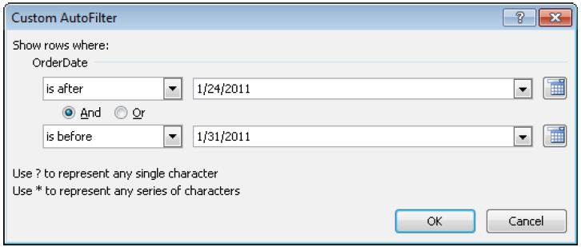
Filter Data

Slide 9
Sort Data
You can sort the values in one or more columns in a worksheet or table in either ascending or descending order. To sort on multiple columns, you specify in the Sort dialog box the order in which you want them to be sorted.
By default, Excel assumes that the first row in the worksheet contains column headers and does not include it in the sort. It also assumes that you want to sort on the cells’ values, but if the worksheet or table is formatted, you can specify that you want to sort on any of the following: Cell color, Font color and Cell icon

Slide 10
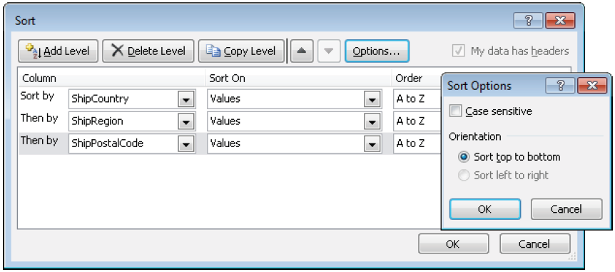
Sort Data
You can also specify whether entries starting with uppercase and lowercase letters
should be sorted separately and the orientation of the sort (whether you want to
sort columns or rows).

Slide 11
Apply Conditional Formatting
You can make worksheet data easier to interpret by using conditional formatting to format cells based on their values. If a value meets a particular condition, Excel applies the formatting; if it doesn’t, the formatting is not applied.
You set up conditional formatting by specifying the condition, which is called a rule. You can select from the following types of rules:

Slide 12
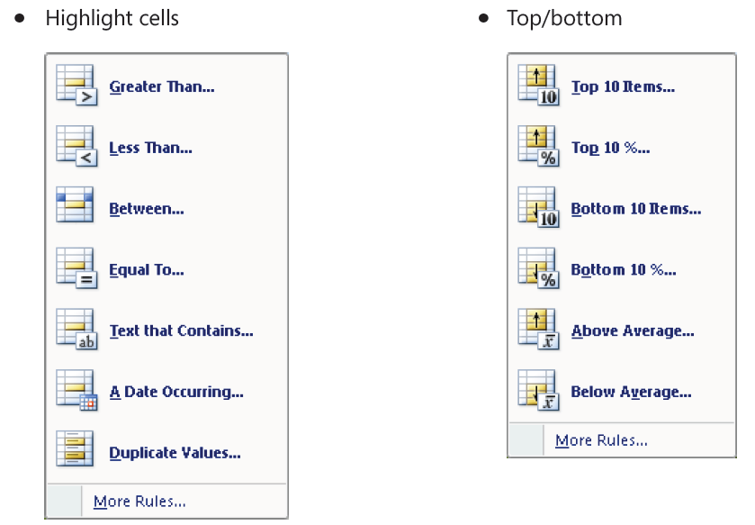
Apply Conditional Formatting

Slide 13
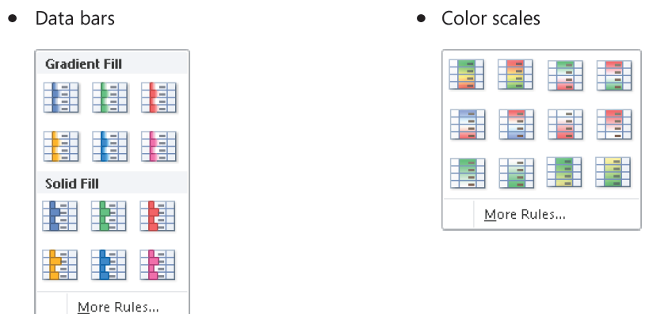
Apply Conditional Formatting

Slide 14
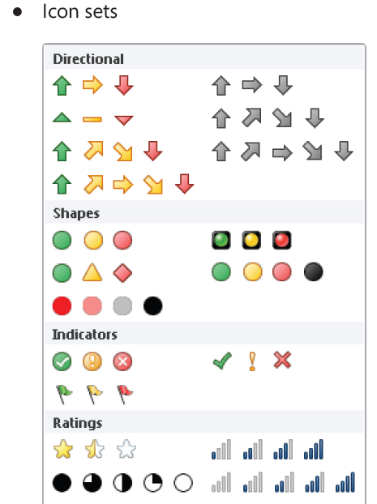
Apply Conditional Formatting

Slide 15
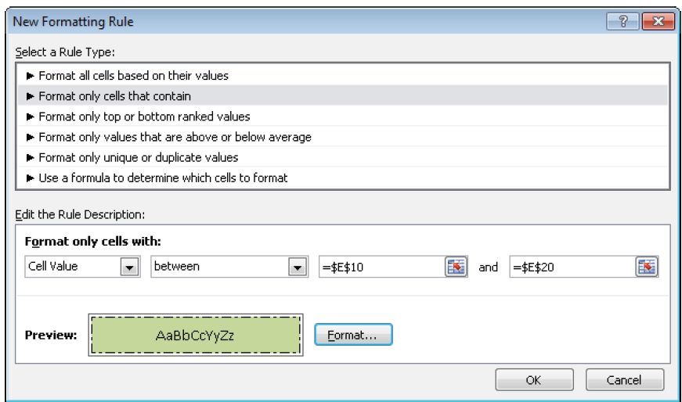
Apply Conditional Formatting
You can also define a rule from scratch in the New Formatting Rule dialog box.

Slide 16
Apply Conditional Formatting
The options available in the Edit The Rule Description area vary depending on the selection in the Select A Rule Type list. You can define multiple conditions for the same range of cells or table.
All the rules you create are listed in the Conditional Formatting Rules Manager, where
you can do the following:
● Create and delete rules.
● Edit a selected rule.
● Adjust the order in which Excel processes the selected rule.
● Specify whether Excel should stop processing rules after a cell has met the conditions
of the selected rule.

Slide 17
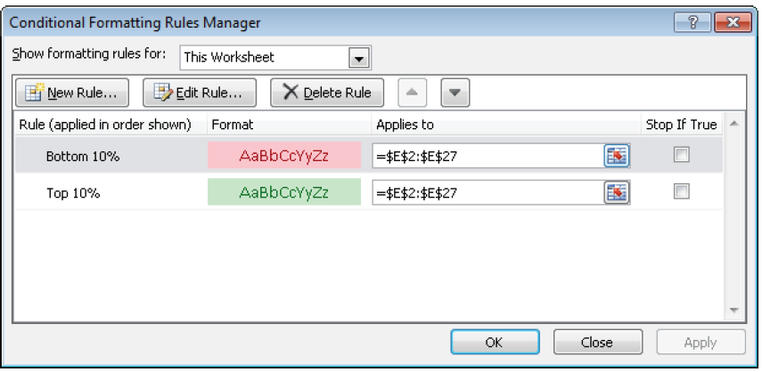
Apply Conditional Formatting

