Slide 1
WebGL - Drawing a Model ການແຕ້ມໂມເດວ
Dr. Lathsamy Chidtavong
Mobile: +8562077712077
Email: l.chidtavong@nuol.edu.la

Slide 2
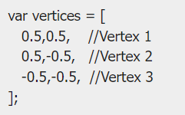
WebGL – Geometry ເລຂາຄະນິດ
ການກຳນົດເລຂາຄະນິດ Defining the Required Geometry
A 2D or 3D model drawn using vertices is called a mesh. Each facet in a mesh is called a polygon and a polygon is made of 3 or more vertices.
ເພື່ອທີ່ຈະແຕ້ມໂມເດວກຣາຟິກໃນ WebGL ເຮົາຈະຕ້ອງກຳນົດ vertices ແລະ indices ໂດຍນຳໃຊ້ arrays ຂອງ JavaScript.
ຕົວຢ່າງ ຖ້າເຮົາຕ້ອງການແຕ້ມຮູບສາມແຈເທິງແກນຕົວປະສານທີ່ມີບັນດາເມັດດັ່ງນີ້ {(5,5), (-5,5), (-5,-5)}, ເຮົາສາມາດສ້າງຕົວປ່ຽນ array ທີ່ມີຄ່າອົງປະກອບຕາມ vertices ດັ່ງນີ້:

Slide 3
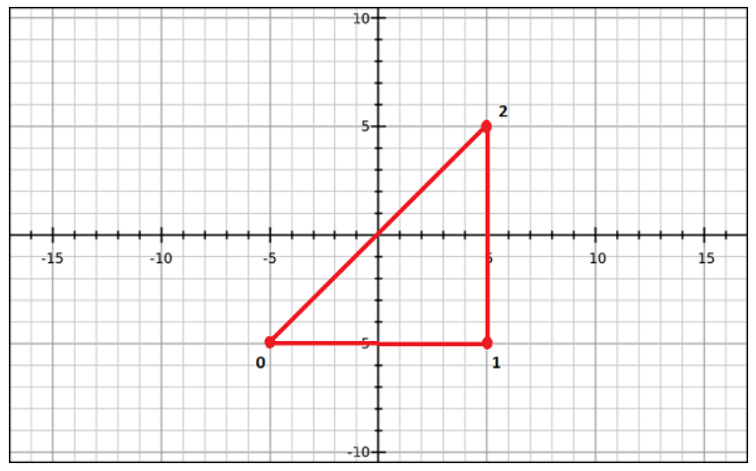
WebGL – Geometry ເລຂາຄະນິດ

Slide 4


WebGL – Geometry ເລຂາຄະນິດ
Defining the Required Geometry
Similarly, you can create an array for the indices. Indices for the above triangle indices will be [0, 1, 2] and can be defined as:
For a better understanding of indices, consider more complex models like square. We can represent a square as a set of two triangles. If (0,3,1) and (3,1,2) are the two triangles using which we intend to draw a square, then the indices will be defined as:

Slide 5
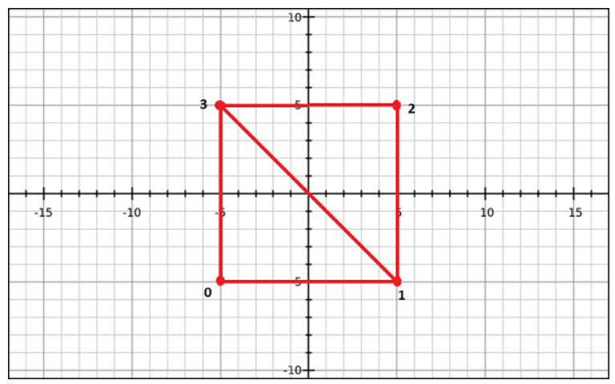
WebGL – Geometry ເລຂາຄະນິດ

Slide 6
WebGL – Geometry ເລຂາຄະນິດ
ສຳລັບການແຕ້ມຮູບຊົງເລຂາຄະນິດພື້ນຖານ WebGL ສະໜອງ 2 methods ດັ່ງນີ້:
drawArrays() − While using this method, we pass the vertices of the primitive using JavaScript arrays.
drawElements() − While using this method, we pass both vertices and indices of the primitive using JavaScript array.

Slide 7

WebGL - Drawing a Model ການແຕ້ມໂມເດວ
drawArrays() is the method which is used to draw models using vertices. ມີ syntax (ໄວຍາກອນ) ດັ່ງນີ້:
mode − ໃນ WebGL ໂມເດວຕ່າງໆຖືກແຕ້ມໂດຍໃຊ້ ຮູບຊົງເລຂາຄະນິດພື້ນຖານປະເພດຕ່າງໆໂດຍການກຳນົດ mode, ນັກຂຽນໂປຣແກຣມຈະຕ້ອງກຳນົດໜຶ່ງປະເພດຂອງຮູບເລຂາຄະນິດພື້ນຖານເພື່ອຈະແຕ້ມ. Mode ຕ່າງໆສຳລັບແຕ້ມປະກອບມີ: gl.POINTS, gl.LINE_STRIP, gl.LINE_LOOP, gl.LINES, gl.TRIANGLE_STRIP, gl.TRIANGLE_FAN, ແລະ gl.TRIANGLES.
first − ແມ່ນອົງປະກອບທຳອິດຂອງອາເຣ, ບໍ່ສາມາດເປັນຄ່າລົບໄດ້.
count − ຈຳນວນອົງປະກອບຂອງອາເຣທີ່ຈະຖືກ Render

Slide 8
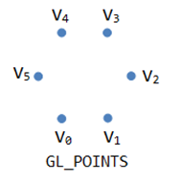
WebGL - Drawing a Model ການແຕ້ມໂມເດວ
Mode ຕ່າງໆສຳລັບແຕ້ມໂມເດວ:
GL_POINTS ແມ່ນ mode ສຳລັບແຕ້ມເມັດ

Slide 9
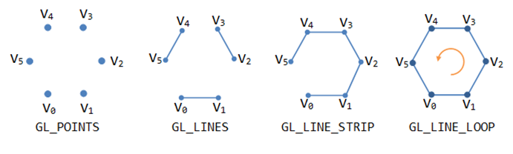
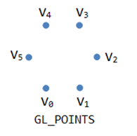
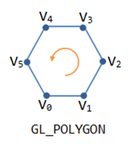
WebGL - Drawing a Model ການແຕ້ມໂມເດວ
GL_LINES, GL_LINE_STRIP, GL_LINE_LOOP ແມ່ນ mode ສຳລັບແຕ້ມເສັ້ນຊື່
GL_POLYGON ແມ່ນ mode ສຳລັບແຕ້ມຮູບຫຼາຍໜ້າ

Slide 10
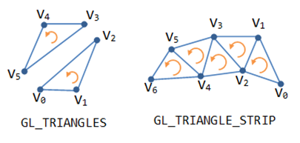
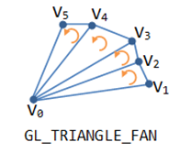
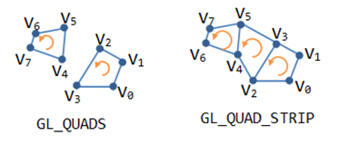
WebGL - Drawing a Model ການແຕ້ມໂມເດວ
GL_TRIANGLES, GL_TRIANGLE_STRIP, GL_TRIANGLE_FAN ແມ່ນ mode ສຳລັບແຕ້ມຮູບສາມແຈ
GL_QUADS, GL_QUAD_STRIP ແມ່ນ mode ສຳລັບແຕ້ມຮູບສີ່ແຈ

Slide 11
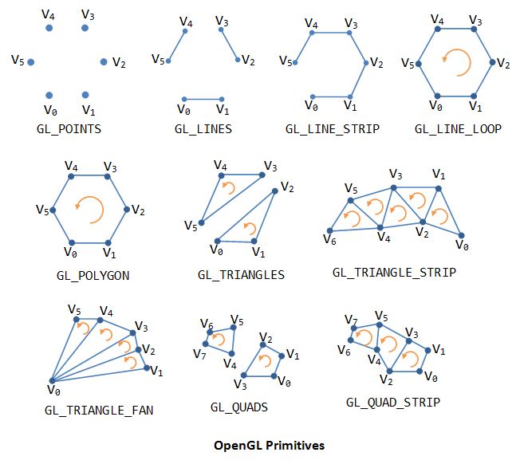
WebGL - Primitive Types

Slide 12


WebGL - Drawing a Model ການແຕ້ມໂມເດວ
Example: If you want to draw a single triangle using drawArray()

Slide 13


WebGL - Drawing a Model ການແຕ້ມໂມເດວ
Suppose you want to draw contiguous triangles, then you have to pass the next three vertices in order in the vertex buffer and mention the number of elements to be rendered as 6.

Slide 14
WebGL - Drawing a Model ການແຕ້ມໂມເດວ
drawElements() is the method that is used to draw models using vertices and indices. ມີ syntax (ໄວຍາກອນ) ດັ່ງນີ້:
mode − ໃນ WebGL ໂມເດວຕ່າງໆຖືກແຕ້ມໂດຍໃຊ້ ຮູບຊົງເລຂາຄະນິດພື້ນຖານປະເພດຕ່າງໆໂດຍການກຳນົດ mode, ນັກຂຽນໂປຣແກຣມຈະຕ້ອງກຳນົດໜຶ່ງປະເພດຂອງຮູບເລຂາຄະນິດພື້ນຖານເພື່ອຈະແຕ້ມ. Mode ຕ່າງໆສຳລັບແຕ້ມປະກອບມີ: gl.POINTS, gl.LINE_STRIP, gl.LINE_LOOP, gl.LINES, gl.TRIANGLE_STRIP, gl.TRIANGLE_FAN, ແລະ gl.TRIANGLES.
count − ຈຳນວນອົງປະກອບຂອງອາເຣທີ່ຈະຖືກ Render

Slide 15
WebGL - Drawing a Model ການແຕ້ມໂມເດວ
drawElements() is the method that is used to draw models using vertices and indices. ມີ syntax (ໄວຍາກອນ) ດັ່ງນີ້:
type − This option specifies the data type of the indices which must be UNSIGNED_BYTE or UNSIGNED_SHORT.
offset − This option specifies the starting point for rendering. It is usually the first element (0).
If you draw a model using drawElements() method, then index buffer object should also be created along with the vertex buffer object. If you use this method, the vertex data will be processed once and used as many times as mentioned in the indices.

Slide 16
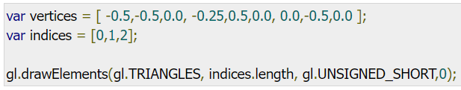
WebGL - Drawing a Model ການແຕ້ມໂມເດວ
Example: If you want to draw a single triangle using indices, you need to pass the indices along with vertices and call the drawElements():

Slide 17
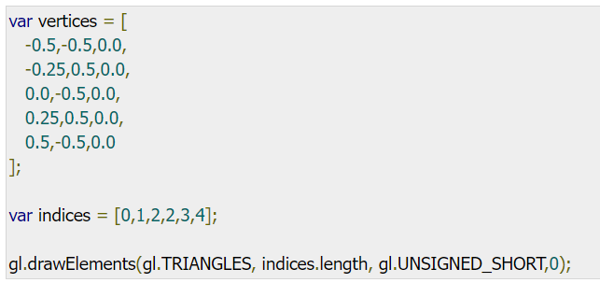
WebGL - Drawing a Model ການແຕ້ມໂມເດວ
If you want to draw contagious triangles using drawElements() method, simply add the other vertices and mention the indices for the remaining vertices.

Slide 18

Required Operations ການດຳເນີນງານທີ່ຈຳເປັນ
Clear the Canvas
First of all, you should clear the canvas, using clearColor() method. You can pass the RGBA values of a desired color as parameter to this method.
Then WebGL clears the canvas and fills it with the specified color. Therefore, you can use this method for setting the background color.
Example: Here we are passing the RGBA value of gray color.

Slide 19

Required Operations ການດຳເນີນງານທີ່ຈຳເປັນ
Enable Depth Test
Enable the depth test using the enable() method, as shown below.

Slide 20

Required Operations ການດຳເນີນງານທີ່ຈຳເປັນ
Clear the Color Buffer Bit
Clear the color as well as the depth buffer by using the clear() method, as shown below.

Slide 21

Required Operations ການດຳເນີນງານທີ່ຈຳເປັນ
Set the View Port
The view port represents a rectangular viewable area that contains the rendering results of the drawing buffer.
You can set the dimensions of the view port using viewport() method. In the following code, the view port dimensions are set to the canvas dimensions.

