Slide 1
Mini project :: Android programming with Kotlin
Post Report for
Rock-Paper-Scissor / Muk-Ji-bba
고 재영 Jaeyoung Ko
(jyko1101@gmail.com)
2022.07.23

Slide 2
Contents
App
Explanation
2. Possible
Improvements

Slide 3
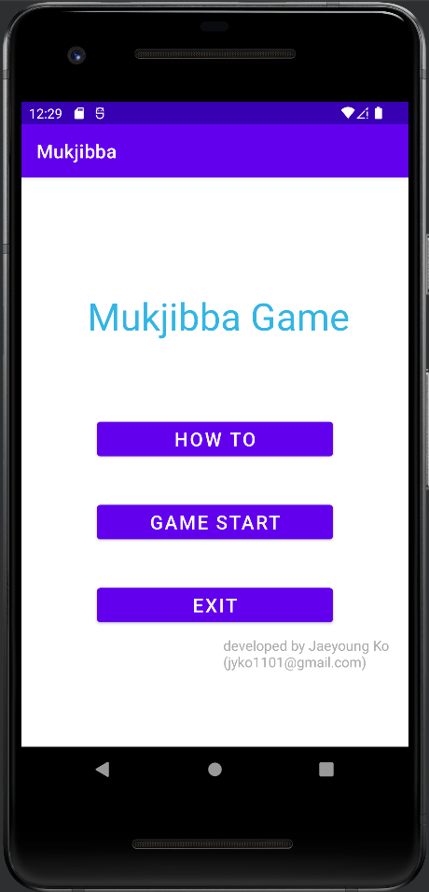
App Explanation
Main Screen
Game Title
3 buttons
How to
Game start
exit

Slide 4
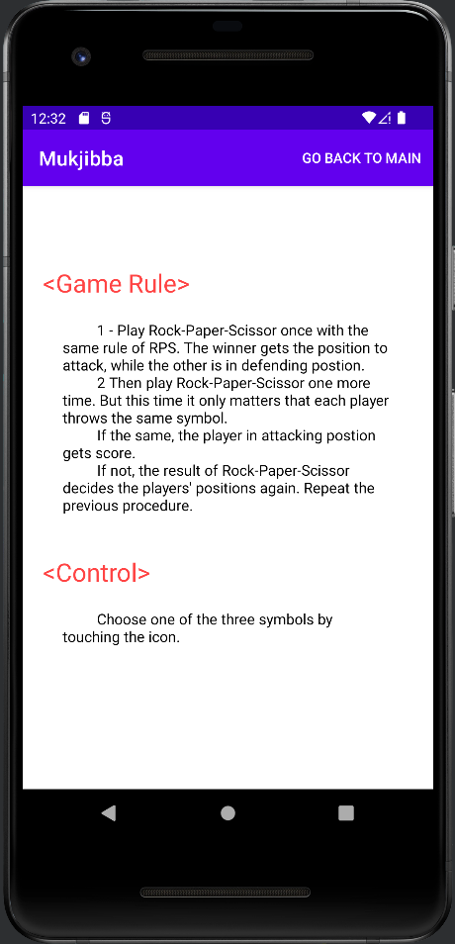
App Explanation (cont.)
Main Screen > [How To]
Simple explanations for game
- Game Rules
- Control
Return to main screen using menu button

Slide 5
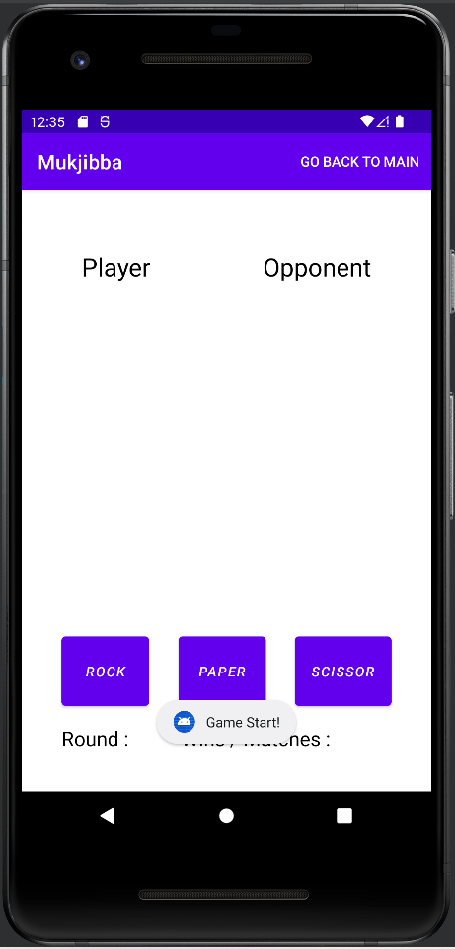
App Explanation (cont.)
Main Screen > [Game Start]
Initial Screen
3 buttons : choose rock / paper / scissor
Game information : current round no. , accumulated wins and matches
Menu button : return to main screen

Slide 6
App Explanation (cont.)
Main Screen > [Game Start]
Initial Screen
- Toast message : the game starts
3 buttons : choose rock / paper / scissor
Game information : current round no. , accumulated wins and matches
Menu button : return to main screen

Slide 7
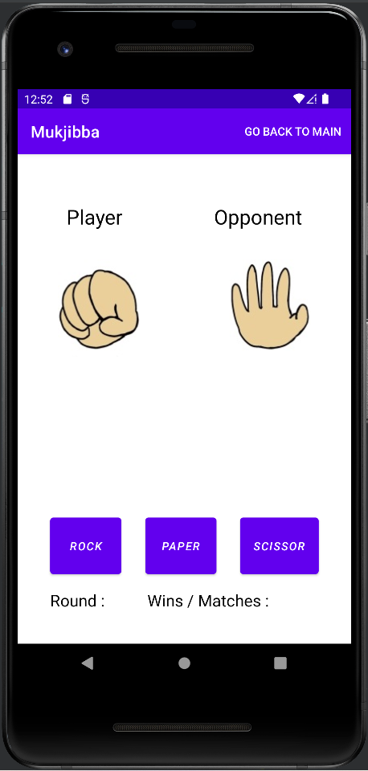
App Explanation (cont.)
Main Screen > [Game Start]
Main Logic
Event-driven : by clicking one of three buttons
Select player’s symbol
Then opponent randomly selects
Initial Screen
- Toast message : the game starts
3 buttons : choose rock / paper / scissor
Game information : current round no. , accumulated wins and matches
Menu button : return to main screen
Press ‘ROCK’ button once

Slide 8
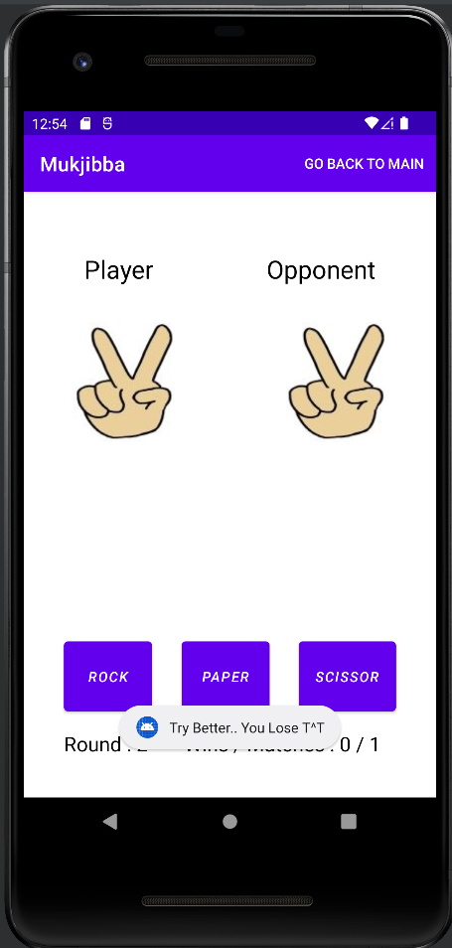
App Explanation (cont.)
Main Screen > [Game Start]
Main Logic
Event-driven : by clicking one of three buttons
Select player’s symbol
Then opponent randomly selects
If winner decided,
Toast message
Update current round number and player’s total number of wins and matches
Initial Screen
- Toast message : the game starts
3 buttons : choose rock / paper / scissor
Game information : current round no. , accumulated wins and matches
Menu button : return to main screen
Then press
‘scissor’ button
Pressed ‘ROCK’ button once

Slide 9
App Explanation (cont.)
Main Screen > [Game Start]
Main Logic
Event-driven : by clicking one of three buttons
Select player’s symbol
Then opponent randomly selects
If winner decided,
Toast message
Update current round number and player’s total number of wins and matches
Initial Screen
- Toast message : the game starts
3 buttons : choose rock / paper / scissor
Game information : current round no. , accumulated wins and matches
Menu button : return to main screen
Then press
‘scissor’ button
Pressed ‘ROCK’ button once

Slide 10
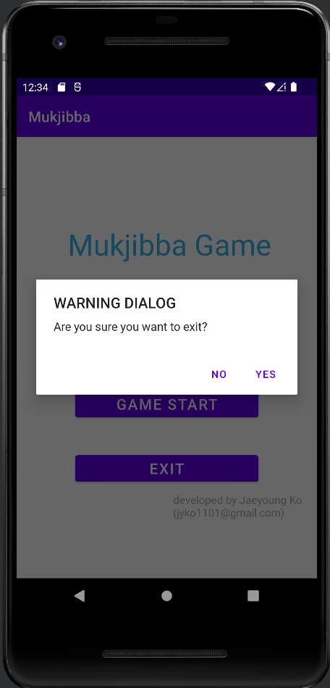
App Explanation (cont.)
Main Screen > [Exit]
Alert Dialog
Check one more time if user want to exit

Slide 11
Possible Improvements
Using Timer event
:: for smooth animation
Add sound resources
:: for user convenience
File system / Storing states
:: for recording match ranks

