Slide 1
Single-Cycle ARM Processor Design
1st Term Project
Kyung Min Kim
E-mail: kyoungmin2@naver.com
SoC & Microprocessor Research Laboratory

Slide 2
Flow
Instruction Analysis
Control Signal Analysis
Module Implementation
1st Term Project
2nd Term Project

Slide 3
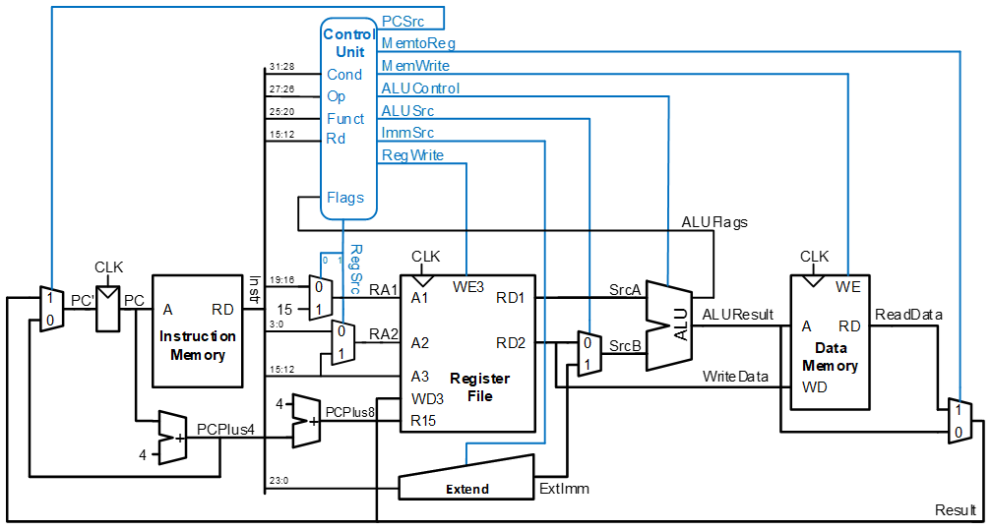
Single-Cycle ARM Processor

Slide 4
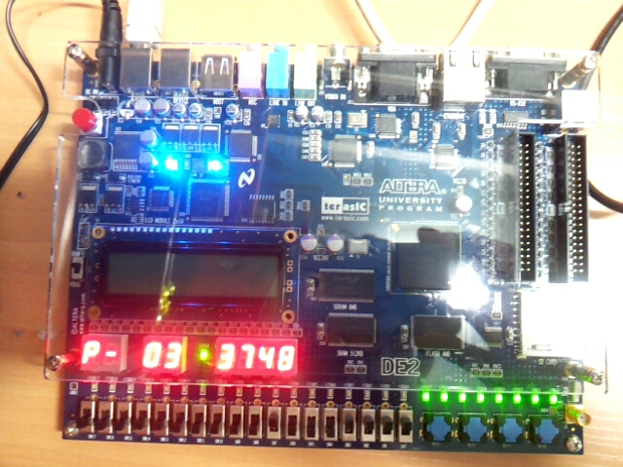
Altera DE2 FPGA Board

Slide 5
1st Term Project
Given processor is able to run following instructions
Branch : B, BL
Arithmetic : ADD, SUB, CMP, MOV
Load/Store : LDR, STR
Given processor is able to run following suffixes
Logical : EQ, NE
Addressing Modes
Addressing Mode 1 : 1 (immediate), 2 (register)
Addressing Mode 2 : 1 (immediate offset), 2 (register offset)

Slide 6
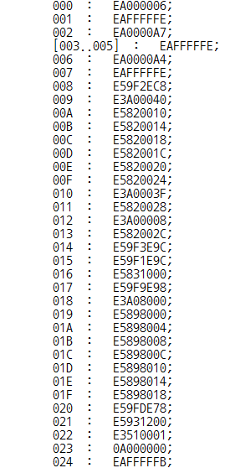
inst_data.mif
address
(HEX)
EA000006
instruction
(HEX)

Slide 7
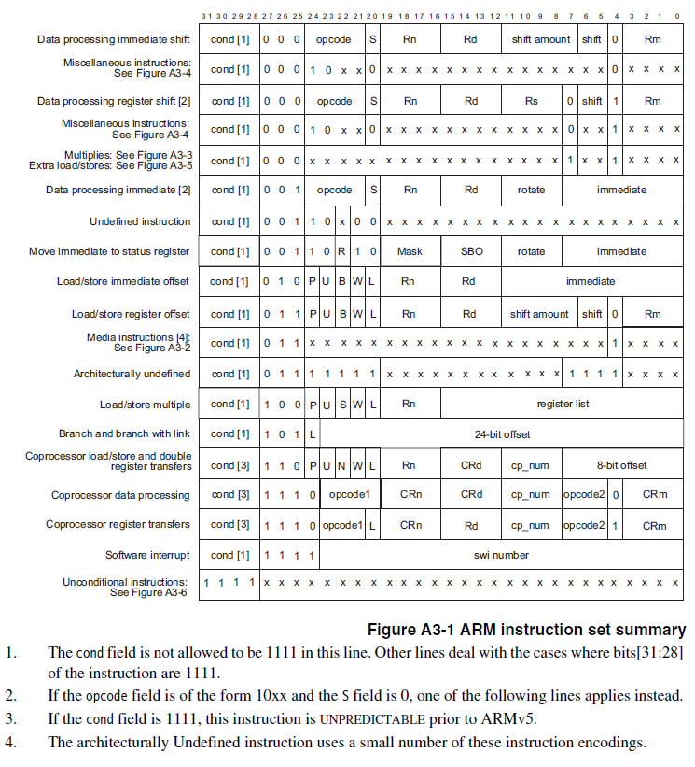
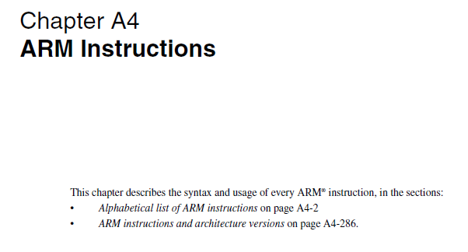
arm_architecture_reference_manual.pdf
Read ‘Chapter A3 The ARM Instruction Set’ (pp. 109) and ‘Chapter A4 ARM Instructions’ (pp. 151)

Slide 8
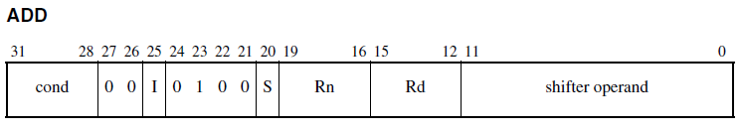
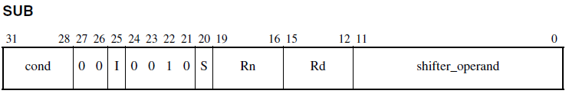
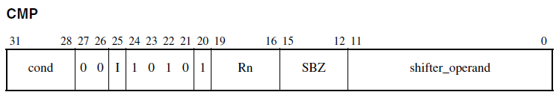
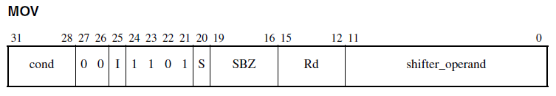
Program Status Registers
Condition code flags
N = Negative result from ALU
Z = Zero result from ALU
C = ALU operation Carried out
V = ALU operation oVerflowed
If S bit is 1, update NZCV flags according to result from ALU

Slide 9

Condition code flags
ARM Example
CMP r0, #5 // cond = 1110, (r0 == #5) ? Z = 1 : Z = 0
BEQ Bypass // cond = 0001
ADD r1, r1, r0
SUB r1, r1, r2
Bypass …
Cond | Mnemonic | Meaning | Condition flag state
0000 | EQ | Equal | Z = 1 (Zero is set)
0001 | NE | Not Equal | Z = 0 (Zero is clear)
1110 | AL | Always
MIPS Example
beq $s3, $s4, True // Branch if $S3 == $4
sub $s0, $s1, $s2
j Exit
True: …
Exit: …

Slide 10
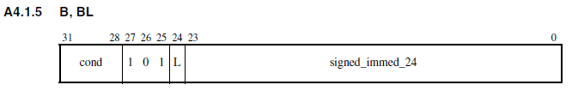
Example
EA000006
Convert hexadecimal to binary
1110 1010 0000 0000 0000 0000 0000 0110 ₍₂₎
Describe which instruction is through ‘arm_architecture_reference_manual.pdf’
B #6;
Describe what instruction means
Move to PC + 8 + 6x4 address (note that this is +4 for MIPS)
Go to address 008
The next instruction becomes ‘E59F2EC8’ at address 008

Slide 11
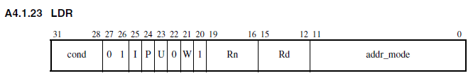
Example
E59FDE78
Convert hexadecimal to binary
1110 0101 1001 1111 1101 1110 0111 1000 ₍₂₎
Describe which instruction is through ‘arm_architecture_reference_manual.pdf’
LDR $13, [$15, #0xE78];
Since the 25th bit I bit is 0, it is indicated by #
Describe what instruction means
Read the value from the memory of the address added by the value of register 15 and the value of # 0xE78 and store it in register 13

Slide 12
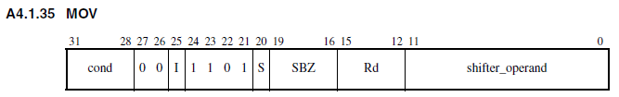
Example
E1A0F00E
Convert hexadecimal to binary
1110 0001 1010 0000 1111 0000 0000 1110 ₍₂₎
Describe which instruction is through ‘arm_architecture_reference_manual.pdf’
MOV $15, $14;
Describe what instruction means
Store the value of register 14 in register 15

Slide 13
1st Term Project
5 points (2nd term project is 25 points)
What to submit
Analyze instructions from 000 to 024 in order of operation
Convert hexadecimal to binary (0.5 points)
Describe which instruction is through ‘arm_architecture_reference_manual.pdf’
(0.5 points)
Describe what instruction means (4 points)
How to submit
Send a report file to kyoungmin2@naver.com
Due date: 10/31 23:59
Both Korean and English are available
Please fill in the fille name as ‘StudentNumber_Name_1stTermProject’
Ex) 2018010594_김경민_1stTermProject.docx

Slide 14
Q&A

