Slide 1
Building Advanced BlackBerry WebWorks JavaScript Extension APIs
Chris DelCol, Nukul Bhasin, Jeffrey Heifetz
DEV 51
Wednesday October 19, 2011 11:30
Notes:
Intro:
Question: HTML5? WW? Found something that it can’t do?
My name is…. Joined by Jeff Heifetz and Nukul Bhasin
1. Prove that WW can be extended by you
2. Remove barriers to addoption
3. Allow you to leverage the power of WebWorks

Slide 2
Session Survey
** This slide will be removed once you have submitted your presentation **
The BlackBerry DevCon team will insert a slide regarding session surveys that will be displayed at the beginning of your presentation
It is important that you remind your attendees to complete the survey for your session
The production team will give you the necessary information regarding survey locations and details to be conveyed to the audience closer to the conference

Slide 3
Key objectives
HTML5 Platform and BlackBerry WebWorks Framework
Expandability of BlackBerry WebWorks
Build an extension
Tips and tricks
Not:
How to build a BlackBerry WebWorks application
How to code using “native” APIs
Notes:
Expandability
Anything that the “native” api can do
HTML5 platform with WW framework for extensibility
Cross dev platform, plus extensions
Build an extension (2 platforms)
Tips & Tricks on BB
Build and deploy to devices
Not:
How to build a WW application
Java/ActionScript implementation

Slide 4

platform
Extended by the BlackBerry WebWorks framework

Slide 5
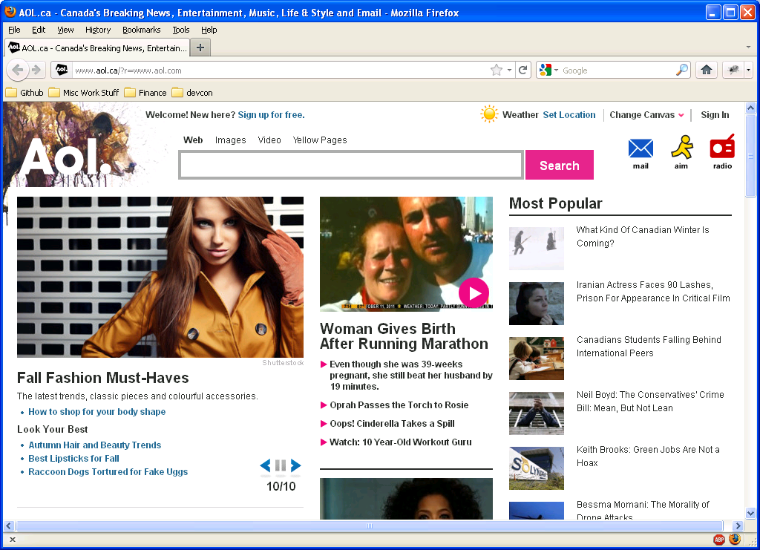
HTML 4.0 A look back
All about content!
Separation of structure and presentation
.css
FRAME/IFRAME
SCRIPT additions
Additional events
External script files
beginning of “functionality”

Slide 6
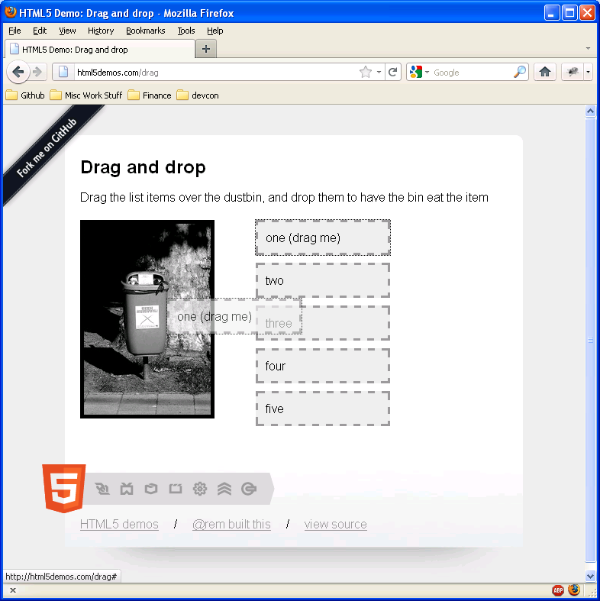
HTML5 An application platform
All about functionality!
Database
Audio/video
Canvas/WebGL
Worker (threading model)
Device motion
Evolving specification
Form field types
Email
Password
etc

Slide 7
BlackBerry WebWorks Fills in the gaps
HTML5 platform
“native” extensions
BlackBerry WebWorks
framework
Standard
PIM
Push
BBM
Hardware events
Etc
Custom
Anything supported in the “native” api

Slide 8
Getting from a “native” api to JavaScript
The SOA Architecture Explained

Slide 9
SOA Architecture
Inject blackberry.system namespace
Web UI &
JavaScript Engine
http://localhost:8472/blackberry/system/get
HTTP json response
“native” uri handler
“native” api implementation
“native” platform

Slide 10
“old” Scriptable Object
Placholder. Create and put at end of deck just in case.

Slide 11
Writing the JavaScript Client
The SOA Architecture Explained

Slide 12
Writing the Native Server
The SOA Architecture Explained

Slide 13
Code Sample Subtitle, 20pt Arial
public class HelloWorldExtension implements IJSExtension {
public String[] getFeatureList() {
return new String[] {“blackberry.helloworld" }; }
public void loadFeature( String feature, String version,
Document document, ScriptEngine scriptEngine,
SimpleSortingVector jsInjectionPaths ) {
JSUtilities.loadJS( scriptEngine, "HelloWorld.js",
jsInjectionPaths ); }
public void invoke( JSExtensionRequest request,
JSExtensionResponse response) throws WidgetException {}

Slide 14
Building an Extension for BlackBerry
What API are we building?
From JavaScript I should be able to call
blackberry.helloworld.sayHello(String name)
Namespace is blackberry.helloworld
Has to be in blackberry for it to work.
Will return “Hello <name> from <System Version>”

Slide 15
How are we going to build this extension?
Create JavaScript client
Create native server.
Notes:
Now that you have designed your JavaScript function you are ready do some work.

Slide 16
Create JavaScript Client
Show makeCall JavaScript method

Slide 17
Add extension to packager
Copy the extension to the packager.
Notes:
BlackBerry-
Copy the Extension into the Packager
Playbook-
Extension already copied into Packager

Slide 18
App that uses this extension

Slide 19
Build and Deploy
Build and Deploy using Ripple
Notes:
Launch Ripple
Load Application
BlackBerrry-
Hit Build
Hit Deploy to device
Playbook-
Hit Build
Hit Deploy to device

Slide 20
Best practices
Stay in JavaScript when you can like constants.
Always use JavaScript namespaces starting with blackberry. Must not be top level.

Slide 21
THANK YOU
Chris DelCol, Nukul Bhasin, Jeffrey Heifetz
DEV 51
October 18 - 20, 2011

Slide 22
Demo Title: 36pt Arial
Demo Description – Objective

Slide 23
Slide Title, 28pt Arial Subtitle, 20pt Arial
Level One bullet point; 24pt Arial
Level Two bullet
20pt Arial
Level three: 18pt
Level four: 18pt
Level five: 18pt
Minimum size of text is 16pt

Slide 24
Dual-Column Slide Subtitle, 20pt Arial
Level One bullet point
24pt Arial
Level Two bullet
20pt Arial
Level three: 18pt
Minimum size of text is 16pt
Level One bullet point
24pt Arial
Level Two bullet
20pt Arial
Level three: 18pt
Minimum size of text is 16pt

Slide 25
Code Sample Subtitle, 20pt Arial
Code Samples: Courier New Bold 18pt
Recommended font and size for short blocks of code.
{
apply orange to code you want to discuss or highlight
}
{
Other Notes for Code
If you have room, feel free to enlarge the type for additional readability
}

Slide 26
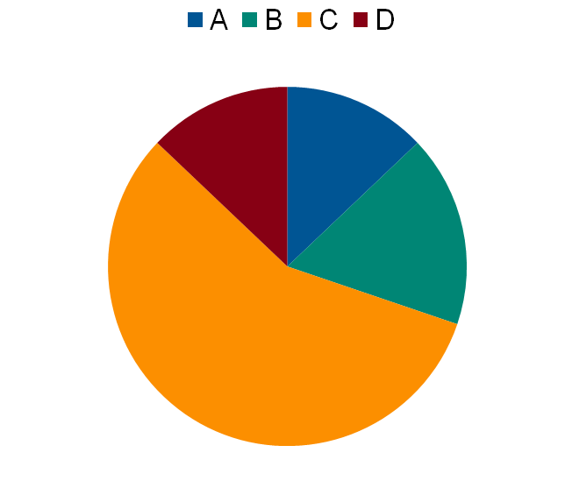
Sample Charts Subtitle, 20pt Arial

Slide 27
For More Information…
List of other resources:
Cross-references to other sessions
BOFs
URLs
Related books, etc.

