Slide 1
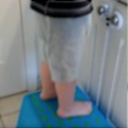
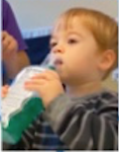
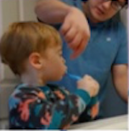
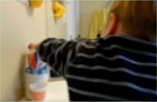
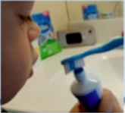
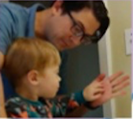
Factor-Based View—6 Big Factors
Scale of Environment
Toothbrush
Ergonomics
Checking/
Feedback
Access
Portioning
Rewards
ENVIRONMENT
ERGONOMICS
EMOTION

Slide 2

This work is licensed under the Creative Commons Attribution-NonCommercial 4.0 International License. To view a copy of this license, visit http://creativecommons.org/licenses/by-nc/4.0/
or send a letter to Creative Commons, PO Box 1866, Mountain View, CA 94042, USA.

