Slide 1

Ethics
moral philosophy

Slide 2
Ethics
Ēthos Greek (moral character – root word)
Ēthikos Greek (pertaining to character)
Ethica Latin
Etique Old French (ethics, moral philosophy)
https://www.etymonline.com/word/ethic
Dr. Laura Pigozzi & Dr. Clara Mitchell
Notes:
etymology

Slide 3
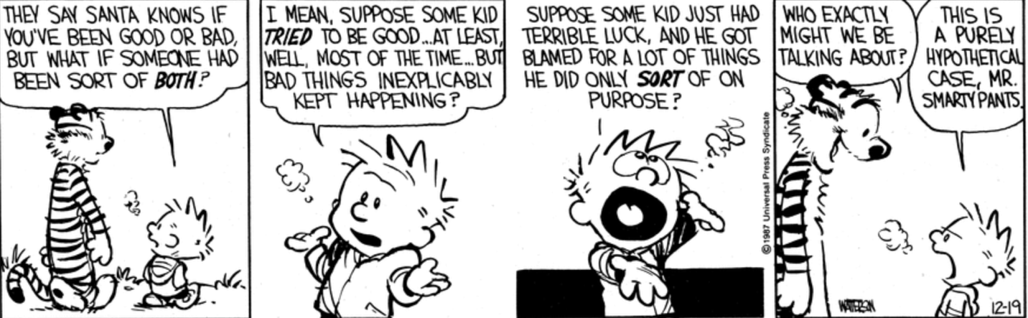
Notes:
Are there ethics issues here?

Slide 4
What are ethics?
Where do ethics come from?
What are morals?
Notes:
Ask the students the questions one at a time

Slide 5
Definitions
Ethics
Standards of right and wrong that prescribe
what humans ought to do, often in terms of
rights, obligations, benefits to society, fairness,
or specific virtues.
https://www.scu.edu/ethics/ethics-resources/ethical-decision-making/what-is-ethics/
Right
Wrong
Notes:
Standards that impose reasonable obligations
Ethics operate on several levels:
Acting ethically as individuals
Creating ethical organizations and governments
Making our society as a whole ethical in the way it treats everyone
(https://www.scu.edu/ethics/ethics-resources/ethical-decision-making/a-framework-for-ethical-decision-making/)

Slide 6
Definitions
Morals
Guiding principles with the goal of doing
the right thing.
Right
Wrong
Notes:
Morals are guiding principles with the goal being doing the right thing.
there are two uses or senses of “morality”—a descriptive sense and a normative sense—
1. descriptively to refer to certain codes of conduct put forward by a society or a group (such as a religion), or accepted by an individual for her own behavior, or
2. normatively to refer to a code of conduct that, given specified conditions, would be put forward by all rational people.
(https://plato.stanford.edu/entries/morality-definition/)
Morality – traditions of belief and right and wrong conduct.
Morality is a social institution
Morality has a history, code of learnable rules and conventions.
The terms ethics and morality are often used interchangeably

Slide 7
Normative ethics
Which general moral norms for the guidance and
evaluation of conduct should we accept and why?
Beauchamp & Childress, 2013
Notes:
Normative ethics, or moral theory, is the study of what makes actions right and wrong and suggests how one “ought” to behave.
Moral theories provide a framework for processing moral problems.
This may involve articulating the good habits that we should acquire, the duties that we should follow, or the consequences of our behavior on others. (https://libguides.francis.edu/c.php?g=182116&p=1199480#s-lg-box-4096159)
There are several moral theories, for example consequentialist theories, deontological theories, and virtue-based theories
Philosophers have…noted the difference between saying that this is the way things are (these are the facts) and this is what we should do (http://humancond.org/analysis/philosophy/is_ought)
This is sometimes referred as the difference of “is” versus “ought” Metaethics is about facts – the “is” –Normative ethics are about the ”should” or “ought”

Slide 8
Metaethics
Analysis of the language, concepts, and methods of reasoning in normative ethics
Study of the origin and meaning of ethical concepts
Notes:
Metaethics involves analysis of the language, concepts, and methods of reasoning in normative ethics. (Beauchamp & Childress, 2013)
Where do our ethical principles come from and what do they mean?
Metaethics looks at the meanings of notions such as right, obligation, virtue, justification, morality, and responsibility (Beauchamp & Childress, 2013)
We may define metaethics as the study of the origin and meaning of ethical concepts. (https://iep.utm.edu/ethics/)
Philosophers have…noted the difference between saying that this is the way things are (these are the facts) and this is what we should do (http://humancond.org/analysis/philosophy/is_ought)
This is sometimes referred as the difference of “is” versus “ought” Metaethics is about facts – the “is” –Normative ethics are about the ”should” or “ought”

Slide 9
Applied ethics
The moral permissibility of real world actions
and practices

Slide 10
Professional Ethics
A set of standards defined by the
professional community which provides a guide for behavior that is expected from the professional.
Notes:
Medicine and law
Business ethics

Slide 11
Why practice professional ethics?
Violating the professional standard of
behavior can have financial and legal
consequences.

Slide 12
Engineering Ethics
1. The study of moral issues and decisions
confronting individuals and organizations involved in engineering.
2. The study of related questions about moral conduct, character, ideals and relationships of peoples and organizations involved in technological development.
Martin & Schinzinger

Slide 13
National Society of Professional
Engineers Code of Ethics
Notes:
The NSPE Code of Ethics for Engineers is designed to provide positive stimulus for ethical conduct as well as helpful guidance and advice concerning the primary and basic obligations of engineers. The Code also establishes the ethical guideposts for the NSPE Board of Ethical Review in interpreting ethical dilemmas submitted by engineers, public officials, and members of the public.
(https://www.nspe.org/resources/ethics/ethics-resources/faq)
Mechanical Engineering
Bioengineering
Electrical Engineering
Civil Engineering
etc

Slide 14
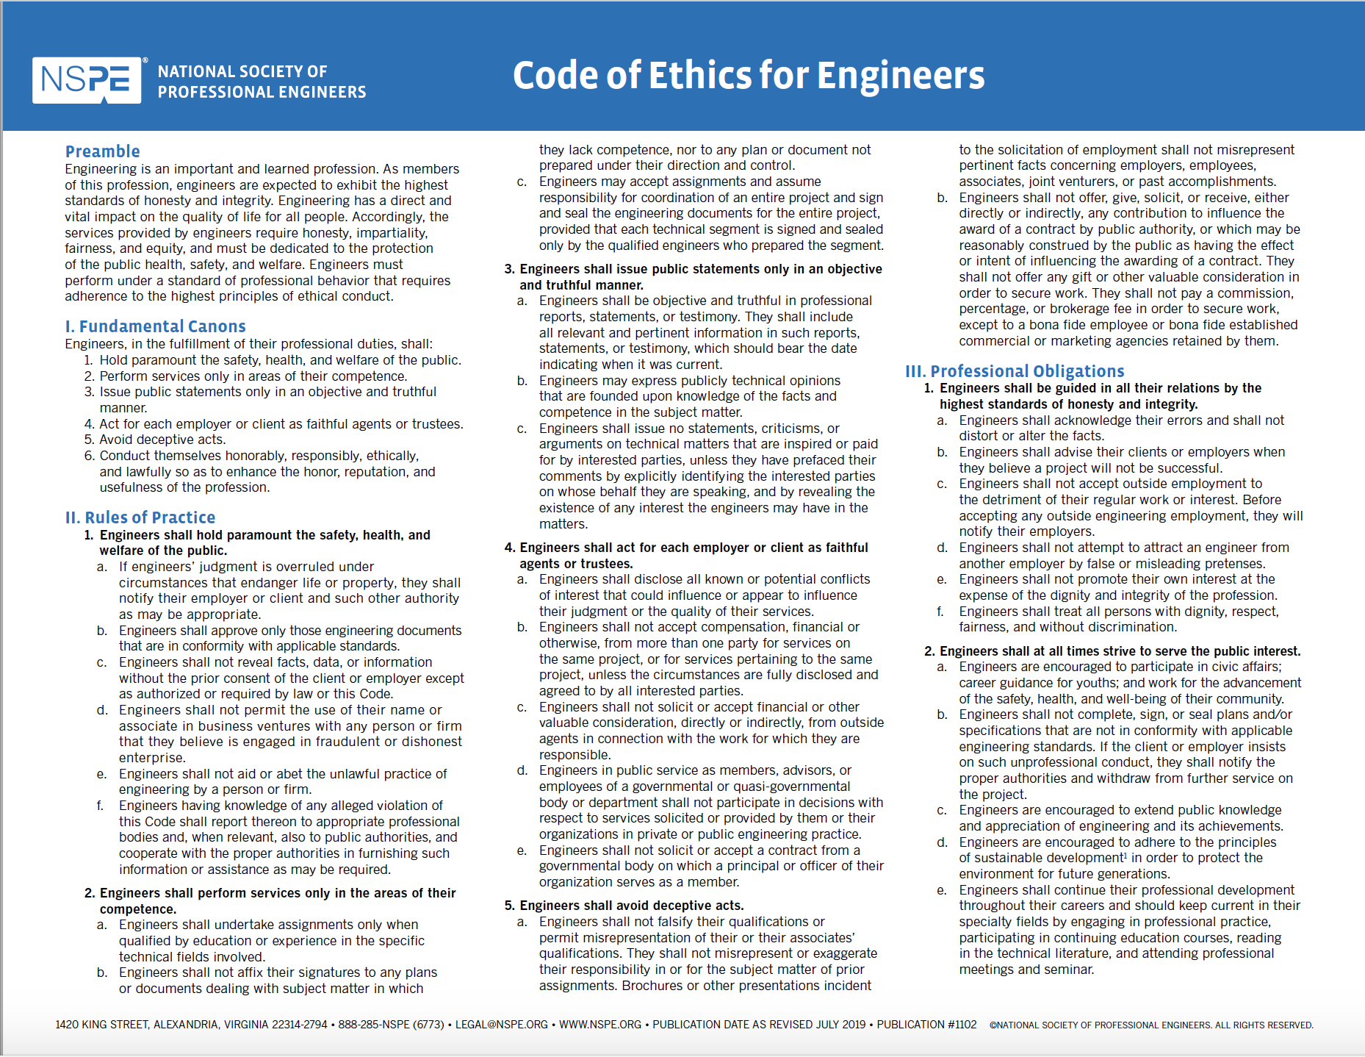
1. Hold paramount the safety, health, and welfare of the
public.
2. Perform services only in areas of their competence.
3. Issue public statements only in an objective and
truthful manner.

Slide 15
4. Act for each employer or client as faithful agents or
trustees.
5. Avoid deceptive acts.
6. Conduct themselves honorably, responsibly, ethically,
and lawfully so as to enhance the honor, reputation,
and usefulness of the profession.

Slide 16
Ethical Dilemma vs Ethical Issue
Ethical Dilemma
Facing competing moral requirements with no
right option
Ethical Issue
Choice among several actions that can be
evaluated as right or wrong (ethical or
unethical)

Slide 17
Directions for how to approach the
case studies

Slide 18
Think carefully about the issues
Identify the key moral concepts and principles
What are the relevant facts?
Who has a stake in the outcome?
What are the options?
Evaluate the options
support conclusions with reasons
7. Consider alternative views

Slide 19

This work is licensed under the Creative Commons Attribution-NonCommercial 4.0 International License. To view a copy of this license, visit http://creativecommons.org/licenses/by-nc/4.0/
or send a letter to Creative Commons, PO Box 1866, Mountain View, CA 94042, USA.

