Slide 1
Cat Herding 301 — Taming the Alma Analytics API
Kate Deibel, Web Applications Specialist
University of Washington Libraries
deibel@uw.edu / @metageeky

Slide 2

Cat Herding?
The Analytics API is a bit of a beast to deal with.
Fortunately, I have some experience with cat rustling…

Slide 3
In all seriousness…
In August 2014, I was asked to develop a means for UW to provide our print holdings data to HathiTrust.
This entailed being able to:
Define a search/set for the relevant items
Export the necessary information for those items
Do this in a way that would not take months
At the time, the Analytics API was in beta but available for use.
I pushed on the system and ultimately developed a Python toolkit for working with the API,

Slide 4
In this talk, I will model the learning steps I took to master the Analytic API, such as:
Figuring out input nuances
Interpreting returned data
Identifying system limitations
Challenging those limitations

Slide 5
Keep in mind that not all APIs require as much work to understand and use.
Nuances,, bugs, and “features” will arise and require hands-on work to figure out.
That being said, the Analytics API is a tad beastly compared to many APIs.

Slide 6
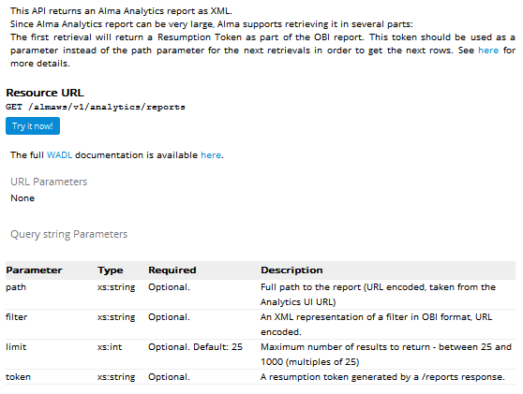
Why is the Analytics API “beastly”?
As Al said, the API is less mature than the others:
The API console descriptions are minimal

Slide 7
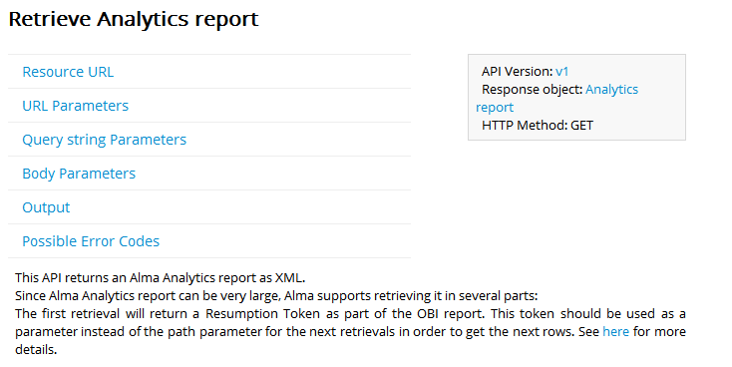
Why is the Analytics API “beastly”?
As Al said, the API is less mature than the others:
The API console descriptions are minimal
Most details are found in a blog post that you might miss the link for: https://developers.exlibrisgroup.com/blog/Working-with-Analytics-REST-APIs

Slide 8
Why is the Analytics API “beastly”?
As Al said, the API is less mature than the others:
The API console descriptions are minimal
Most details are found in a blog post that you might miss the link for: https://developers.exlibrisgroup.com/blog/Working-with-Analytics-REST-APIs
Further details are buried in various forum posts (and support cases)
Most importantly:
This API is fundamentally different!

Slide 9
How the Other Alma APIs Work
You
Alma
API
Alma
Data

Slide 10
How the Analytics API works
You
Alma
API
Alma
Data
OBIEE
API
OBIEE

Slide 11
The Analytics API works with the OBIEE via a separate API provided by Oracle.
Ex Libris is thus limited in:
What functionality they can provide
Addressing issues inherent to the OBIEE
That being said, the Analytic API is/can be powerful:
Any data pushed into the OBIEE can be searched, filtered, manipulated using tool more refined than what Alma alone offers
One just needs the data to be there and the right analytic to get at it

Slide 12
How do you design a good analytic?
This talk isn’t about that.
Attend the session later on Analytics Fundamentals 101 (led by Mark Galvin of UO).
Instead, let’s assume we have an analytic already constructed…

Slide 13
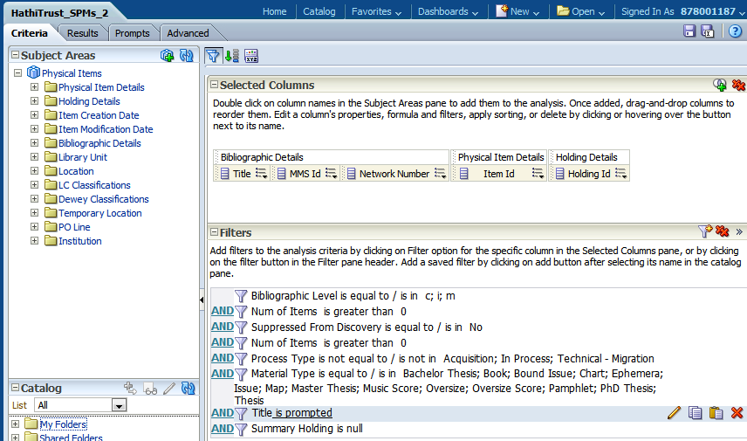
Analytic: HathiTrust_SPMs
Physical Items that are single-part monographs:
3,762,309 individual items
Let’s download them all!!

Slide 14
Making an Analytic REST Request:
The Parameters

Slide 15
Analytic REST Request: The Parameters
The REST request involves up to 5 parameters:
apikey
path
limit
token
filter

Slide 16
Analytic REST Request: The Parameters
The REST request involves up to 5 parameters:
apikey
Required. Used for authentication just as with other Alma API requests.
path
limit
token
filter

Slide 17
Analytic REST Request: The Parameters
The REST request involves up to 5 parameters:
apikey
The file path within OBIEE to the analytic that you want to grab data from.
There are two ways to find this path.
path
limit
token
filter

Slide 18

Determining the path parameter value (1 of 2)
Option 1:
In the OBIEE, do a Save As on the analytic.
The path provided in the file dialogue box is almost what you need:
Replace ‘Shared Folders’ with ‘shared’ at the start
Append the name of the analytic at the end

Slide 19
Determining the path parameter value (2 of 2)
Option 2: (as described in the analytic blog post)
In the OBIEE, open the analytic and copy the url.
In the URL, copy the text between &path= and #
Convert this from URL encoding (percent-encoding) to regular text using tools like Chrome’s Advanced REST Client or any one of many online tools.
https://analytics‑na01.alma.exlibrisgroup.com/analytics/saw.dll?Answers&path=%2Fshared%2FUniversity%20of%20Washington%2FReports%2FITS%2Fdeibel_HathiTrust%2FHathiTrust_SPMs#criteriaTab14e6504b579

Slide 20
About URL Encoding
URL Encoding, or percent-encoding, is required when using certain characters in data values in an HTTP request
Examples:
%2F ⬄ /
%26 ⬄ &
%20 ⬄ (space)
Without these, a server can become confused when interpreting a URL

Slide 21
For our purposes
All Alma API parameters must be URL encoded
The API console on the Developers Network does this for you automatically
If you write your own code, you will need to make sure that the parameters get properly encoded

Slide 22
Analytic REST Request: The Parameters
The REST request involves up to 5 parameters:
apikey
Limit and token work together.
Limit is the number of results (multiple of 25 between 25 and 1000)
Token is a value that allows you to connect multiple requests together.
The key concept here is that you do not grab the analytic data all at once with a single request. You instead make sequential requests until all the data is received.
path
limit
token
filter

Slide 23
How Sequential Requests and Tokens Work
Make first request: limit=1000, no token
Receive items 1 – 1000 (I call this a page)
Receive resumption token <value>
Make second request: limit=1000, token=<value>
Receive items 1001 – 2000
NOTE: the token <value> is NOT resent
Make third request: limit=1000, token=<value>
Receive items 2001 – 3000
…
Keep requesting pages until all items are received

Slide 24
Analytic REST Request: The Parameters
The REST request involves up to 5 parameters:
apikey
Filters are complex little monsters that we will get to later.
Generally, you probably don’t need to use them.
path
limit
token
filter

Slide 25
Making an Analytic REST Request:
Interpreting the Results

Slide 26
Your First Response
We made a request and excitedly receive the following XML response:
<?xml version="1.0" encoding="UTF-8" standalone="yes"?> <report>
<QueryResult>
<ResumptionToken>33D9…F247</ResumptionToken>
<IsFinished>false</IsFinished>
<ResultXml/>
</QueryResult>
</report>

Slide 27
Your First Response: <ResumptionToken>
The <ResumptionToken> tag contains a 128-character sequence that is your token
You should grab this value for use in subsequent request calls.
<?xml version="1.0" encoding="UTF-8" standalone="yes"?> <report>
<QueryResult>
<ResumptionToken>33D9…F247</ResumptionToken>
<IsFinished>false</IsFinished>
<ResultXml/>
</QueryResult>
</report>

Slide 28
Your First Response: <IsFinished>
The <IsFinished> tag is a Boolean indicating if there is any more data that can be downloaded.
<?xml version="1.0" encoding="UTF-8" standalone="yes"?> <report>
<QueryResult>
<ResumptionToken>33D9…F247</ResumptionToken>
<IsFinished>false</IsFinished>
<ResultXml/>
</QueryResult>
</report>

Slide 29
Your First Response: <ResultXml>
The <ResultXml> is where the analytic data should be found…
WHERE’S OUR DATA!?!?
<?xml version="1.0" encoding="UTF-8" standalone="yes"?> <report>
<QueryResult>
<ResumptionToken>33D9…F247</ResumptionToken>
<IsFinished>false</IsFinished>
<ResultXml/>
</QueryResult>
</report>

Slide 30
“Still Loading”
I call this the “Still Loading” response as it appears the OBIEE is still pulling up the analytic results.
<?xml version="1.0" encoding="UTF-8" standalone="yes"?> <report>
<QueryResult>
<ResumptionToken>33D9…F247</ResumptionToken>
<IsFinished>false</IsFinished>
<ResultXml/>
</QueryResult>
</report>

Slide 31
What do I do with a “Still Loading” response?
Wait a few seconds and resend your request.
Should I use the Resumption Token?
I generally do, but it’s okay to just send a new request. The only hard and fast rule is that when you finally get data, you need to grab that token. Tokens do expire, so I’m leaning towards only grabbing the token on the first page of data.

Slide 32
Response: With Actual Data!
After repeated tries, you finally get some data:
<?xml version="1.0" encoding="UTF-8" standalone="yes"?> <report>
<QueryResult>
<ResumptionToken>33D9…F247</ResumptionToken>
<IsFinished>false</IsFinished>
<ResultXml>
<rowset:rowset …>
<xsd:schema …> </xsd:schema>
<Row>
<Column0>0</Column0>
<Column1>39031025815804</Column1>
…
<Column4/>
</Row>
<Row>
...
</Row>
WHAT DOES IT ALL MEAN??!?

Slide 33
Understanding the Analytic Response XML
Take a deep breath. Here’s what you need to know:
The XML is from Oracle and is not user friendly
The data is in the <ResultXml> tag
This tag also has a namespace that is set within the <xsd:schema> tag. The namespace is: {urn:schemas-microsoft-com:xml-analysis:rowset}
Each row in the analytic is a <Row> in the XML
The column ordering in the Analytic is UNRELATED to the column ordering in the XML
<Column0> is always empty

Slide 34
Mapping Analytic Fields to XML Columns
The XML column ordering is by alphabetical order of the dimension table and field name
At least this appears to work 99% of the time.
dimension tables
field names

Slide 35
Mapping Analytic Fields to XML Columns
Dimension Table | Field Name | XML Tag
Bibliographic Details | MMS Id | Column1
Bibliographic Details | Network Number | Column2
Bibliographic Details | Title | Column3
Holding Details | Holding Id | Column4
Physical Item Details | Item Id | Column5

Slide 36
So that’s it, right?
That the input parameters and how to interpret the response XML?
There’s nothing else to worry about… right?
Right?
Oh no… what now?

Slide 37
Making an Analytic REST Request:
The 65001 Limit (and Beyond)

Slide 38
You’re merrily requesting page after page of data:
Page 1: Items 1 – 1000
Page 2: Items 1001 – 2000
Page 3: Items 2001 – 3000
…
And then something weird happens…
Page 64: Items 63001 – 64000
Page 65: Items 64001 – 65000
Page 66: Item 65001 (IsFinished == true)

Slide 39
The 65001 Limit
Analytics are limited to only 65001 rows of data!
True whether exporting within the OBIEE or using the REST API
Legacy from early versions of Excel and Oracle that could only approximately 65000 rows (2¹⁶)
Can be configured in the OBIEE to be larger (but we don’t have that access and can only go so high)
Is this a hard limit?
Not if you’re clever.

Slide 40
Remember the Filter Parameter?
The filter parameter allows you to refine what rows of the analytic your request returns.
By default, analytic data is sorted by the first field (A-Z order by item Title in this case)
Using a filter, we could do any of the following:
Request results with titles greater than ‘M’
Request results that only begin with ‘Q’
Request results between ‘D’ and ‘G’ inclusive
etc.

Slide 41
Breaking the 65001 Barrier: Basic Idea
Call a collection of 65001 items a report
Request the first report (first 65001 items/ 66 pages from the analytic)
After receiving the 65001st item, grab its title.
Requery the analytic but this time add a filter:
Request only titles ≥ last item’s title
Repeat steps 2 & 3 until you receive a report with less than 65001 items
The basic idea is to start each new query where the last report stopped.

Slide 42
Working Example
First report (no filter)
Item 1: Aardvarks
Item 2: Aardwolves
…
Item 65001: Coraline
Second report (filter: title ≥ Coraline)
Item 1: Coraline
Item 2: Corals of the South Sea
…
Item 65001: David Copperfield

Slide 43
Working Example (cont.)
Third report (filter: title ≥ David Copperfield)
Item 1: David Copperfield
Item 2: David Copperfield (different edition)
Item 3: David Copperfield’s Greatest Magic Tricks
…
Item 65001: Emma
Fourth report (filter: title ≥ Emma)
Item 1: Emma
…

Slide 44
The trick is simply to use a filter to start the next query exactly where we were previously stopped!

Slide 45
Wait… aren’t you getting duplicate rows because the filter is ‘greater than or equal’?
Yes, but this is necessary because multiple items may have the same title.
We can filter out duplicates by keeping track of unique IDs for each item (the item ID in our example single-part monograph analytic)
Why not just sort by the unique IDs in the first place?
I find that the OBIEE has issues sorting by fields like the MMS ID.
Also, sorting by titles makes it easier to parallelize the requests into smaller subtasks.

Slide 46
So what does the filter parameter look like?
The filter parameter requires specialized XML from Oracle called sawx:
The blog post on the Analytic API on the Developer Network describes how to create a filter… sort of.
<sawx:expr xsi:type="sawx:comparison" op="greaterOrEqual" xmlns:saw="com.siebel.analytics.web/report/v1.1" xmlns:sawx="com.siebel.analytics.web/expression/v1.1" xmlns:xsi="http://www.w3.org/2001/XMLSchema-instance" xmlns:xsd="http://www.w3.org/2001/XMLSchema">
<sawx:exprxsi:type="sawx:sqlExpression">"#FIELD#"</sawx:expr>
<sawx:expr xsi:type="xsd:#TYPE#">#TAG#</sawx:expr>
</sawx:expr>

Slide 47
Issues with the filter parameter
The filter parameter is clearly not user friendly:
The sawx XML is complex and long
In an actual request, it has to be URL encoded
There are also poorly documented problems:
The filtered field needs to be ‘prompted’ (explained in the blog post)
SQL hates apostrophes and the API fails if the filter values includes one. All apostrophes must be XML encoded.
Orpaned &s (surrounded by whitespace) also need to be XML encoded for the same reasons
I only discovered these last two issues by pure chance of a problematic title being the 65001st item

Slide 48
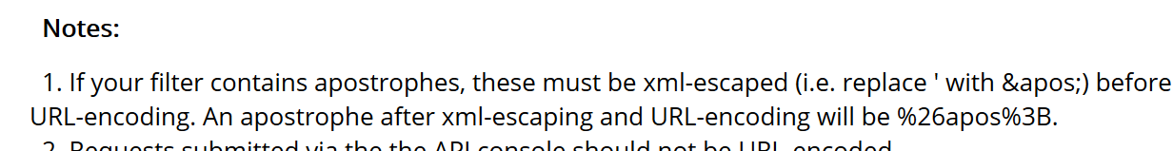
You can thank me for this footnote on the blog…
This footnote was only added to the blog post after I filed a support case on problems with apostrophes in filters:
Note that it doesn’t mention orphaned ampersands. I still need to report that issue to Ex Libris.

Slide 49
Don’t Panic:
My Python Analytic Library

Slide 50
Feeling overwhelmed?
As the Hitchhiker’s Guide to the Galaxy says:
DON’T PANIC!
The fruits of my wrestling with the Analytic API is the code library I’ve written for easier requesting:
https://bitbucket.org/uwlib/uwlib-alma-analytic-tools

Slide 51
UW Alma Analytic Tools
Written in Python (Python 2 but works in 3)
Free to use and develop under the MIT license
Features include:
Support classes for managing requests
Command line scripts for downloading pages, reports, or all contents of an analytic
Human-readable configuration files
Explanatory wiki
Extensible classes for controlling print output
Ability to run multiple requests in parallel
HathiTrust print holdings download tools

Slide 52
Configuration File
# url is your institution's resource url for alma
url https://api-na.hosted.exlibrisgroup.com/almaws/v1/analytics/reports
# path is where to find the analytic
# you can include multiple paths for when running parallel threads
path /shared/University/Reports/testing/Hathi/Monographs_1
path /shared/University/Reports/testing/Hathi/Monographs_2
# apikey is the authentication required by alma
# as with multiple paths, multiple apikeys can be included for parallelism
apikey l7xxdfed8d...2ef8ec0792ce
apikey l7xx3e...c459
apikey l7x...fbc935cadd371
# names to columns: preferred name (xml element rules) and then column in
# the analytic xml (named as Column#)
# output will be in the order the names are given here
Begin NamesToColumns
Title Column3
MMS_ID Column1
Holding_ID Column4
Item_ID Column5
OCLC Column2
End NamesToColumns

Slide 53
Default Output
If you provide a mapping for the columns, the default outputted XML is far more human-readable:
<Analytic encoding="UTF-8">
<Description>
<Path>/shared/University of Wash…</Path>
<Apikey>l7xx0a39084226d5459ba2725c6cd986a494</Apikey>
<Started>13:59:27 PDT 2015-07-07</Started>
<Completed>14:06:53 PDT 2015-07-07</Completed>
<RecordCount>65001</RecordCount>
</Description>
<Record>
<Title>A formulary for plasma physics</Title>
<MMS_ID>99155225090001452</MMS_ID>
<Holding_ID>22537844340001452</Holding_ID>
<Item_ID>23480021830001452</Item_ID>
<OCLC>(OCoLC)24583856</OCLC>
</Record>
</Analytic>

Slide 54
Configuration File (cont.)
# should be one of the preferred names
uniqueID holding_id
# should be a preferred name
sortedBy title
# the data type used in the OBIEE: string, decimal (date, datetime to be
# implemented later)
sortedByType string
# the name of the field used within OBIEE. Is of the form Field.Subfield
sortedByOBIEE Bibliographic Details.Title
# job_bounds (optional)
# a comma-separated list of the same type as sortedBy in which each
# consecutive pair (x,y) will form a job that only gathers entries of
# the form x <= sortedBy < y
# negative and positive infinity can be achieved by placing commas at
# beginning and the end of the list: ,a,m,z,
jobBounds ,A,B,C,D,E,F,G,H,I,J,K,L,M,N,O,P,Q,R,S,T, U,V,W,X,Y,Z,

Slide 55
Parallel Requests
Breaking a large request in smaller tasks has multiple advantages:
Can run in parallel for shorter total download time
Partial work is saved in case API server or code experiences a failure
Using 6-8 parallel requesters, the 3.7 million single-part monographs can be downloaded in <2 hours

Slide 56
Caveats about running in parallel
Use multiple API keys
Make copies of the analytic in the OBIEE
Requests that are longer than 3 reports (>195,003 items) are more likely to have server errors
Ex Libris or the OBIEE (or both) appear to blacklist [temporarily] some analytics/apikeys if overused
I call this a ‘Zero Result Problem’ in that you get an empty, IsFinished result regardless of data actually being present
Issue tends to reset after 24 hours
Might be a caching issue

Slide 57
Anything Else?

Slide 58
As I said, the Analytic API is beastly but has tremendous power for accessing Alma data.
I welcome you to use, ask questions about, or fork and expand the library I developed.
And for the sake of it, here’s another cute kitty pic…

Slide 59

I can eat ALL the data!!

