Slide 1
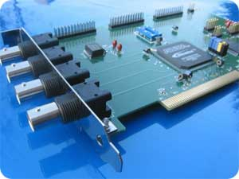
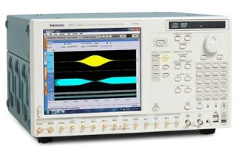
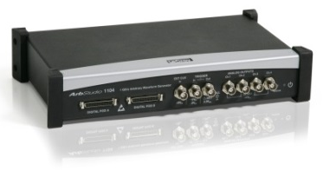
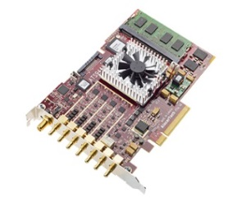
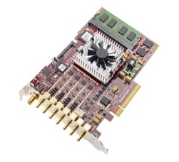

Physical setup
Layout architecture
Triggering instrument
Pulse sequence
Layout
AWG
Interface
Interface
Interface
Acquisition
instrument
Triggering
AWG
Acquisition

