Slide 1
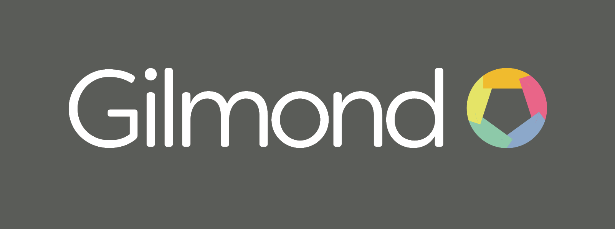
Generics
Daniel Gray

Slide 2
Ah, the prologue
What are generics?
Why are they useful?
Writing your own generic types and methods
Notes:
2

Slide 3
What are generics
Templates for types & methods that rely on other types, but don’t specify what type.
Callers specify the type involved.
Classic example is List<T> - where a T denotes ANY type. Allows you to construct a list that can only contain a particular type.
Essentially they are a compile time replacement of T with a referenced type.
  Actually it’s JITed but the net result is the same.
Notes:
3

Slide 4
Why are generics useful
Massive increase in type safety.
Before generics you had types like ArrayList which contained objects – any object of any type – when consuming the ArrayList you HAD to know what types were in there.
Generics remove this uncertainly – replacing runtime errors with compile time errors.
Notes:
4

Slide 5
Writing your own generic types
Generic types declare their “type parameters” as part of the class declaration:
  public class Lazy<TValue>
  Tvalue can then be used in the place of a type anywhere in the rest of the type – as a parameter, field, variable or return value
  When constructing a new instance of Lazy<TValue> you MUST fill in TValue:
    var lazyInteger = new Lazy<int>();
TValue can then be referred to anywhere in the type.
Notes:
4

Slide 6
Writing your own generic methods
Generic methods declare their “type parameters” as part of the method declaration:
  public void RegisterMapping<TInterface, TConcrete>()
  When invoking a generic method you must provide all the required generic parameters
TInterface and TConcrete can ONLY be used in the scope of the declaring method.
Notes:
4

Slide 7
Funcs & Actions
Daniel Gray

Slide 8
Ah, the prologue
What is a Func?
What is an Action?
How do you use them?
Why do you use them?
Notes:
8

Slide 9
What is a Func?
In C parlance a Func is a “functor” – a pointer to a function
They represent an abstraction around a piece of code where you don’t care what the code is – just that it conforms to a given signature
  You can pass a Func around like any other type.
A Func always returns a value – and may take parameters – the types are declared using generics.
  Last type is the return type
  So Func<string> takes no parameters and returns a string
  Func<int, string> takes an int and returns a string
Notes:
8

Slide 10
What is a Action?
Very similar to a Func – with one big difference.
An Action never returns a value. They act upon their parameters – not that they must have parameters.
Declared in a similar way to Func:
  Action – takes no parameters
  Action<string> takes a single string as a parameter
Notes:
8

Slide 11
How do you use them?
Use lambda syntax to declare anonymous functions:
  Func<string> helloFunc = () => { return “Hello”; }
    var message = helloFunc();
  Func<int, string> formatFunc = (i) => { return i.ToString(); }
    var message = formatFunc(1000);
  Action<StringBuilder> builderAction = (b) => { b.AppendLine(“Hello”); }
    var builder = new StringBuilder();
    builderAction(builder);
Notes:
8

Slide 12
How do you use them?
Point them at an existing function
  public static void Print(string) {…}
  Action<string> printAction = Print;
    printAction(“Hello”);
Notes:
8

Slide 13
Why do you use them?
Allows you to “inject” functionality without knowing what it is.
Generic nature means you can even have funcs where you don’t know what the types are.
Notes:
8

