Slide 1

CS5488 · PROFESSOR KA CHUN WONG
One Core to Many
Parallel data-computing solutions to the 2023 NYC yellow-taxi trips
WANG Shen
LIU Wanyang
WANG Yuwei
YU Xiyan
60216681
60915652
60875477
61076721
01 / 11
Notes:
LIU Wanyang, about 20 seconds.
I'm LIU Wanyang. There are four of us, and we have five minutes.
I'll set the background. WANG Shen will state the cleaning rules.
WANG Yuwei answers how the trips are arranged, and whether they form groups.
YU Xiyan answers whether another worker still helps. That third question is the one we measured.

Slide 2
NEW YORK YELLOW TAXIS
One row in the file is one trip
The TLC publishes every yellow-taxi trip. We use January to December 2023.
Twelve Parquet files, one calendar month each: 38,310,226 rows.
A row keeps the two times, the two zones, distance, fare, and payment type.
The release has no passenger name and no driver name.
Zone names come from the TLC lookup. Zone locations come from the TLC shapefile.
LIU Wanyang
02 / 11
Notes:
LIU Wanyang, about 30 seconds.
These are yellow taxis in New York, published by the Taxi and Limousine Commission.
One file is one month. 2023 is twelve files and 38,310,226 trips.
Each row is one trip: when it started and ended, the pickup zone and the dropoff zone, the distance, the fare, and how it was paid.
There is no passenger name and no driver name.
The borough names come from the TLC zone lookup, and the locations come from the zone shapefile.

Slide 3
THREE QUESTIONS
One process takes 52.1 seconds on four cores
1
How is 2023 demand arranged in time and across boroughs?
WANG Yuwei
2
With zone and time, what does k = 4 give, against the silhouette maximum?
WANG Yuwei
3
How does ETL time change with processes, threads, and chunk size?
YU Xiyan
How does k-means scale from one worker to four?
Eight workers means eight processes on the same four cores. It is not an eight-core server.
LIU Wanyang
03 / 11
Notes:
LIU Wanyang, about 30 seconds.
These are the three questions in the report, in shorter words.
First: how is yellow-taxi demand in 2023 arranged in time and across boroughs? Yuwei answers that.
Second: on features that include zone location and time of day, what groups does k equals 4 produce, and how does that cut compare with the silhouette maximum? Yuwei answers that too.
Third: on this four-core host, how does the ETL wall time change with the number of processes, with a thread pool, and with the chunk size? And how does k-means scale from one worker to four? Xiyan answers that.
Eight workers on four cores is oversubscription. We report that point. We do not treat the machine as an eight-core server.

Slide 4
CLEANING
Each month is cleaned, then counted
01
02
03
Read one month
Apply seven rules
Return the counts
One Parquet file is one task.
The first rule that fails removes the row.
Zone, hour, and weekday. Not the trips.
38,310,226
34,893,980
8.92%
raw rows, twelve files
rows kept
removed, first rule only
WANG Shen
04 / 11
Notes:
WANG Shen, about 30 seconds.
Each worker reads one month, applies seven rules, and returns counts by zone, hour, and weekday.
It does not send the trips back.
The rules run in order. The first rule that fails removes the row, so a row is counted once.
We start with 38,310,226 rows and keep 34,893,980. That is 8.92 percent removed.

Slide 5
THE SEVEN RULES
A row is charged to the first rule that rejects it
Rule
Field
Rejected when
Share of raw
R1
Duration
outside 1 minute to 3 hours
1.24%
R2
Distance
not positive
1.24%
R3
Zone id
missing from the TLC lookup, or Unknown
1.04%
R4
Fare
outside $2.50 to $500
0.84%
R5
Speed
missing, or at least 70 mph
0.01%
R6
Duplicate
same key inside a 1,000,000-row batch
2 rows
R7
Code
passenger, rate, or payment code out of range
4.54%
WANG Shen
05 / 11
Notes:
WANG Shen, about 40 seconds. Point at the row, do not rush the decimals.
Duration must sit between one minute and three hours: 1.24 percent.
Distance must be positive: another 1.24.
The zone must be in the TLC lookup, and not Unknown: 1.04.
Fare must sit between 2 dollars 50 and 500 dollars: 0.84.
Speed must be under 70 miles an hour: 0.01.
Duplicates inside a one-million-row batch: 2 rows in the whole year.
The large cut is a code. Passenger count, rate code, or payment type outside the legal range: 4.54 percent, 1.74 million rows.

Slide 6
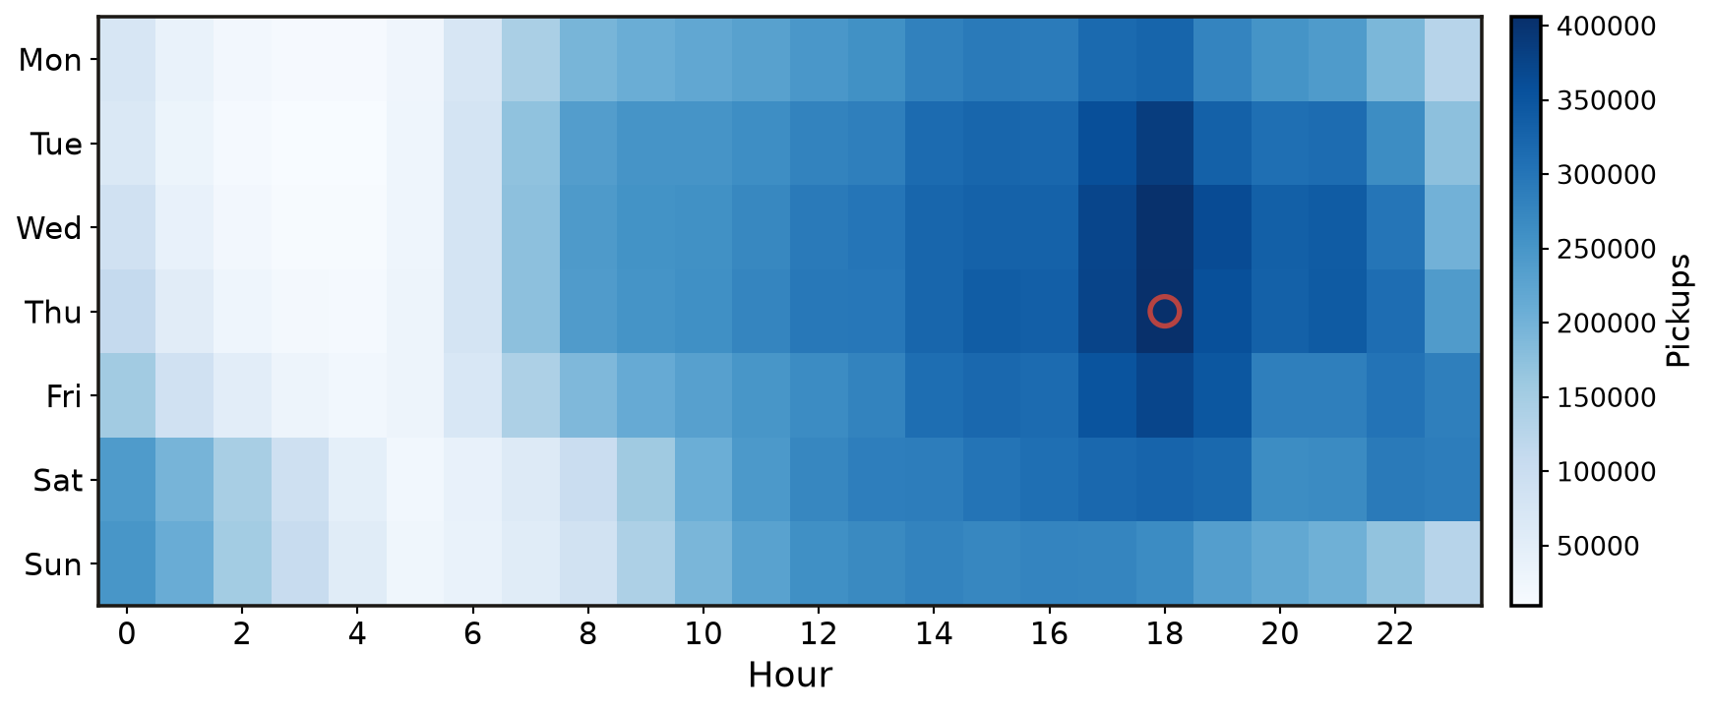
ANSWER 1
A weekday evening peak, mostly in Manhattan
89.8%
start in Manhattan
9.79%
start in Queens
72.9%
fall on a weekday
405,828
Thursday at 18:00
WANG Yuwei
06 / 11
Notes:
WANG Yuwei, about 35 seconds. This closes question 1.
Of the pickups dated in 2023, 89.8 percent start in Manhattan.
Queens is next, at 9.79 percent.
Weekdays hold 72.9 percent.
The ringed cell is Thursday at 18:00, 405,828 trips. Wednesday at the same hour is almost as high.
The year has a weekday evening peak. It is not a flat day.

Slide 7
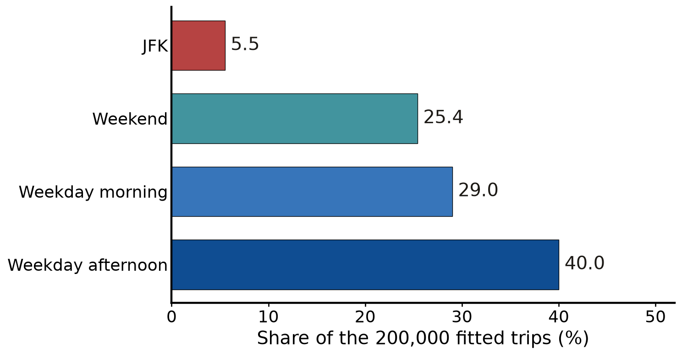
ANSWER 2
k = 4 has names. 16.1 miles is a trip length.
Silhouette peaks at k = 2 (0.550): JFK against the city. We report k = 4, silhouette 0.312.
16.1 miles
Mean distance of the JFK group.
Other groups: 2.68 to 2.84 miles.
JFK fare $63.69, and 42.0 min.
Zone 132 is 98.3% of this group.
Not the whole of Queens.
LaGuardia is not in this group.
Weekend is an input.
The hour splits the day.
WANG Yuwei
07 / 11
Notes:
WANG Yuwei, about 40 seconds. This closes question 2. Say what 16.1 miles is, and that the group is JFK, not Queens.
Silhouette is highest at k equals 2, score 0.550. That cut is JFK against the city, and the clock does not split.
We report k equals 4, score 0.312, because the four groups have names.
Weekday morning is 29.0 percent, weekday afternoon 40.0, weekend 25.4, and JFK 5.5.
16.1 miles is the mean trip distance of the JFK group. The fare is 63 dollars 69, and the duration is 42.0 minutes.
Zone 132, JFK Airport, is 10,903 of the 11,092 rows, 98.3 percent.
The other three groups average between 2.68 and 2.84 miles.
Queens as a borough is still 9.79 percent of pickups, on the previous slide. LaGuardia is not in this group.
Weekend is an input feature. Morning and afternoon come from the hour.

Slide 8
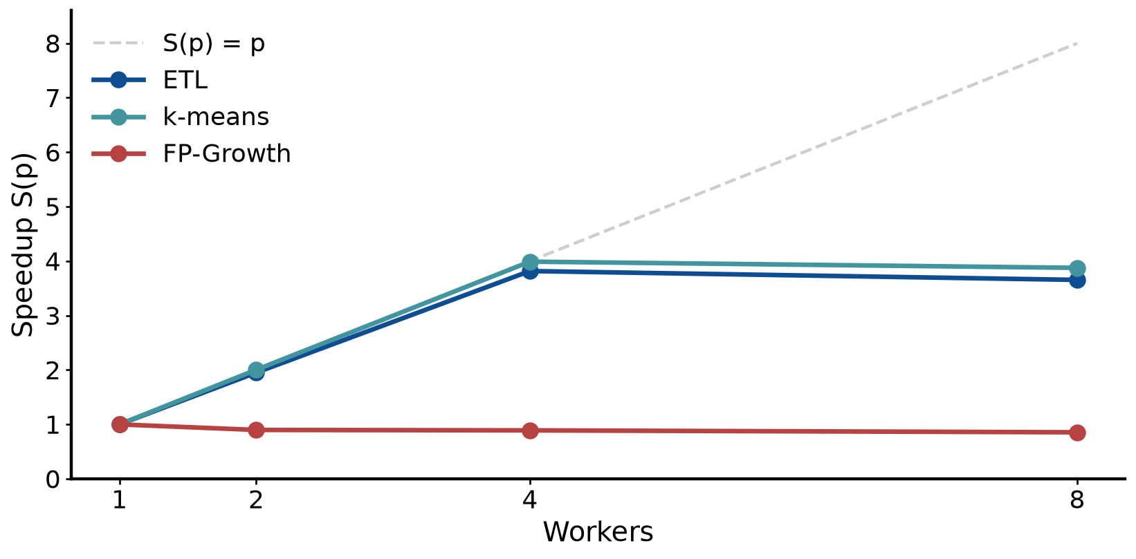
ANSWER 3 · ETL WALL TIME
Process-pool ETL, one file per worker
1 worker
2 workers
4 workers
8 workers
52.135 s
26.717 s
13.658 s
14.266 s
S = 1.00 · E = 1.000
S = 1.95 · E = 0.976
S = 3.82 · E = 0.954
S = 3.65 · E = 0.457
E(p) = S(p) / p. Efficiency stays above 0.95 through four cores, then falls to 0.457.
YU Xiyan
08 / 11
Notes:
YU Xiyan, about 30 seconds. The dashed line is ideal speedup. Blue is the ETL, teal is k-means, and red is FP-Growth. The red line stays near 1. I give it one sentence on the last results page.
One worker, 52.135 seconds. Two workers, 26.717, speedup 1.95, efficiency 0.976.
Four workers, 13.658 seconds, speedup 3.82, efficiency 0.954.
Eight workers, 14.266 seconds, speedup 3.65, efficiency 0.457.
Efficiency is speedup divided by the number of workers. It stays above 0.95 while each worker has a core. At eight workers, two processes share each core.
The teal line is k-means. I will come to it after the time breakdown.

Slide 9
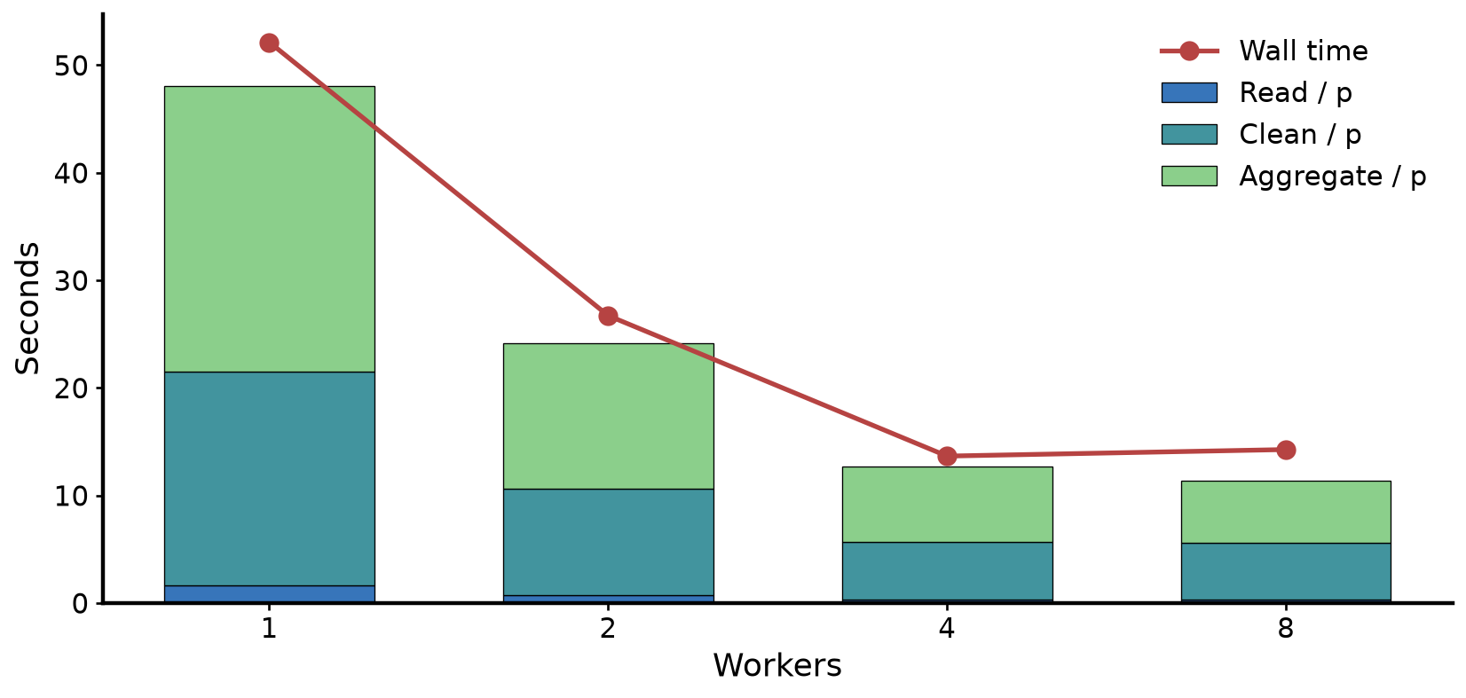
ANSWER 3 · WHERE THE ETL TIME GOES
Clean and aggregate dominate. Read does not.
One worker: read 1.600 s, clean 19.916 s, aggregate 26.527 s. Wall time 52.135 s.
4 threads
4 processes
Chunk of 4 files
Chunk of 12 files
27.423 s
13.658 s
17.038 s
49.668 s
CPU 42.3% · S = 1.90
CPU 100% · S = 3.82
CPU 76.2%
CPU 25.3%
YU Xiyan
09 / 11
Notes:
YU Xiyan, about 30 seconds. This is where the ETL second goes.
At one worker, read is 1.600 seconds, clean is 19.916, aggregate is 26.527. The wall is 52.135.
Clean and aggregate are the work. Read is a small slice once the cache is warm.
The same four workers as threads take 27.423 seconds, CPU 42.3 percent, speedup 1.90.
Four processes take 13.658 seconds and use 100 percent of the CPU.
Threads still beat one process, because some numeric work releases the GIL. The cleaning rules keep the rest on one interpreter, so processes win.
A chunk of 4 files takes 17.038 seconds, CPU 76.2 percent. A chunk of all 12 takes 49.668 seconds, CPU 25.3 percent, because one worker holds the year.

Slide 10
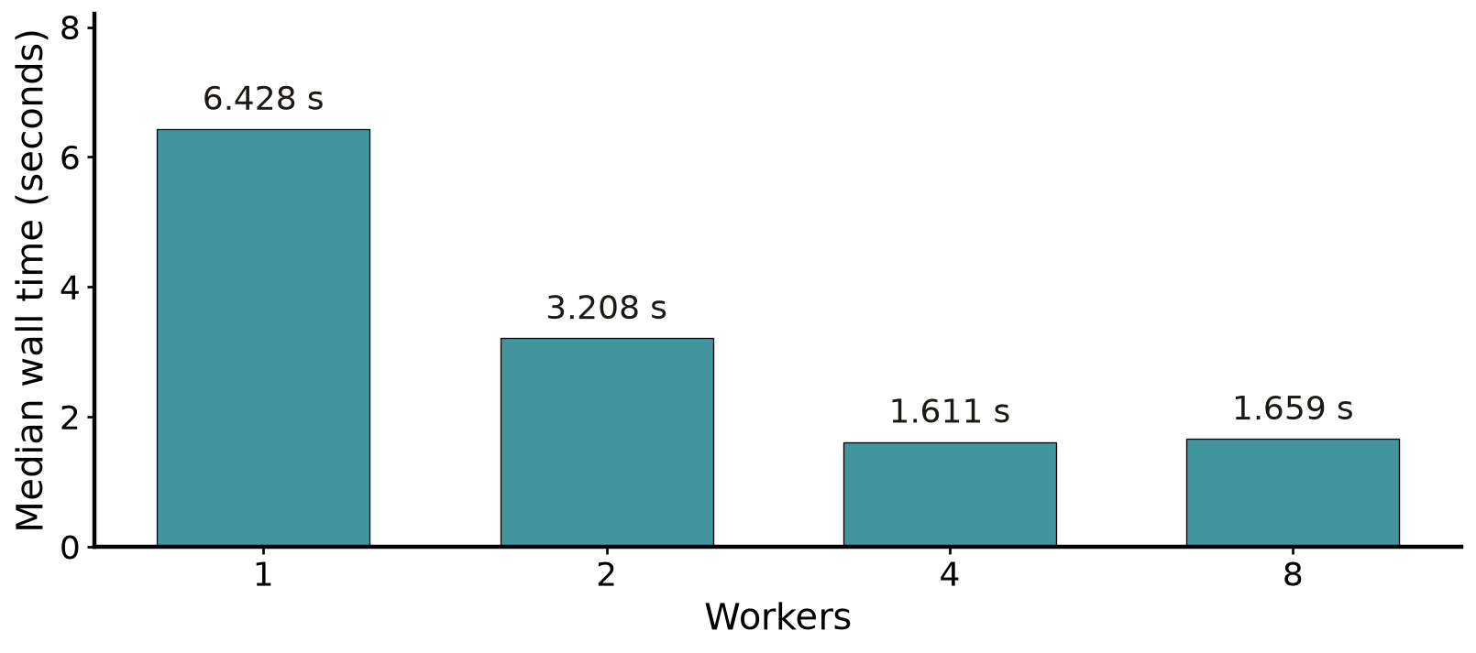
ANSWER 3 · K-MEANS
k-means scales from one worker to four
1 worker
2 workers
4 workers
8 workers
6.428 s
3.208 s
1.611 s
1.659 s
S = 1.00 · E = 1.000
S = 2.00 · E = 1.002
S = 3.99 · E = 0.997
S = 3.88 · E = 0.484
2,600,000 points, k = 24, 30 iterations. This is not the k = 4 profile.
FP-Growth does not speed up: 1.497 s to 1.681 s, S(4) = 0.89. The tree is built before the pool starts.
YU Xiyan
10 / 11
Notes:
YU Xiyan, about 25 seconds. k-means, 2,600,000 points, k equals 24, 30 iterations. This is a compute load, not the k equals 4 profile.
One worker, 6.428 seconds. Two, 3.208, speedup 2.00, efficiency 1.002.
Four, 1.611 seconds, speedup 3.99, efficiency 0.997.
Eight, 1.659 seconds, speedup 3.88, efficiency 0.484. Same limit: no fifth core.
FP-Growth, in one sentence: it goes from 1.497 seconds to 1.681, speedup 0.89, because the tree is built before the pool starts. We do not use the itemsets.

Slide 11
ACKNOWLEDGEMENTS
Thank you
The New York City TLC, for the 2023 yellow-taxi trips.
WANG Shen
LIU Wanyang
WANG Yuwei
YU Xiyan
11 / 11
Notes:
YU Xiyan, about 10 seconds.
We thank the New York City TLC for the public 2023 yellow-taxi trips.
That is our five minutes.

