Slide 1

Bundles of Love Leadership Meeting Saturday, April 1, 2016 11 am – 3:30 pm Assisi Heights (Walter’s conference room) Rochester
Notes:
Welcome & Thank you for attending - Mary Jo
Housekeeping:
Restrooms
Beverages & Lunch
Name tags
Handouts
Board members
President – Mary Jo Prinsen
Vice President – Claudia Brau
Treasurer – Sandy Hamlin
Secretary – Laura Nees (not attending?)
Director – Beth Kopitzke - Procurement and currently Technology /website
Director of Organizational Effectiveness - Amy Hutsell (led strategic planning)
Director – Julie Nagorski (Initially expect to focus on Grants )
Director of Development and Fundraising - strategic focus– Michele Thacker
Not here today – Sam Snell. Sam had a prior commitment in one his PT jobs as a DJ and couldn’t be with us today. He has been leading the Fundraising Committee and will continue to do ???? Michele is looking forward to working with the Fundraising Committee. ???
Introduction of attendees by work group (Rochester, Spring Valley, Chatfield/Winona/St. Charles, Plymouth, Northern Anoka County, New Brighton, Woodbury, Burnsville)

Slide 2
Agenda/Schedule
11:00 am Introductions & Housekeeping
11:15 am 2016 Recap
11:30 pm 2016 Work Group Successes, Stories
12:00 pm Lunch
12:45 pm 2017 Strategic Planning Process
1:00 pm Work Group Involvement – 1:45 Breakout Session#1
2:00 pm Break
2:15 pm Work Group Involvement – 2:45 Breakout Session #2
3:25 pm Closing Comments
3:30 pm Adjournment
Notes:
Agenda / Schedule
Copy of slides to take notes
General schedule – adjust if needed
Ask questions / Interactive – also available:
During the day, if you need a ‘change of pace’ or a filler….remember these topics?
Sue – Amish
Sleep Sack discussion

Slide 3
2016 Recap
In-Kind donations – 76,327 items + 17,055 lbs. supplies
Valued at $281,000
Increase of 15%
Volunteer Hours 127,000
Equivalent to at least 66 full time employees
596 volunteer activities
(increase of 16%)
3761 bundles delivered
(increase of 0.4%)
1,283,000 items delivered since 2001
Notes:
2016 Recap 11:15 a.m.
Several slides about our 2016 activities.
These will be in your packets for reference, but I will be going through them fairly quickly to leave more time for other discussions we will like to have today.

Slide 4
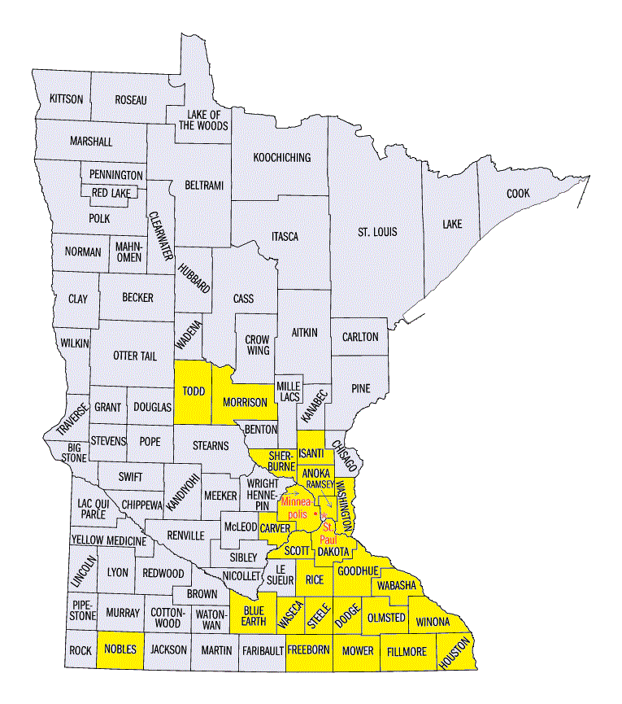
2016 Recap
Bundles delivered in 25 Minnesota counties
Notes:
Bundles in 25 counties
Todd (New Brighton)
Nobles (Rochester)
Morrison (Rochester)
Future: Requests in Duluth area – Everyday Miracles – (St. Louis county)
Detroit Lakes (Becker county)

Slide 5

2016 Recap
Notes:
As you would expect, the largest counties as far as population have received the most bundles, but we also have a good presence in
Olmsted, Dakota, Anoka, and Fillmore counties

Slide 6
Perspective
3,761 Bundles delivered in 2016
313 average bundles delivered per month
72 average bundles delivered per week
10 average bundles delivered per day
1 bundle delivered every 140 minutes
(2 hours 20 minutes) on average

Slide 7
2016 Financials
Under review / preliminary
Expenses higher than Income
Lower income (2 large donations in 2015; $16k,$15k) not repeated
Timing of purchase of 2 laptops for financial team and software with prior year funds
Notes:
Had switched to a new financial software in 2016, and still finalizing 2016 results.
We do know that expenses look higher than income for a couple of reasons
1) 2 large donations in 2015 that were not repeated / replaced
2) Timing of purchase of 2 laptops and software for financial team with 2015 extra funds that was not completed until 2016

Slide 8
Work Group Sharing
Share your successes from 2016
Notes:
Share your successes with other groups; including any challenging situations and how you overcame them. Start at 11:30/11:40 ALL - until lunch time (noon)

Slide 9
Lunch Break
Notes:
12 Noon

Slide 10
2017 Strategic Planning
SWOT Analysis
Process
Strengths, Weaknesses, Opportunities, Threats
Define:
Vision
Mission
Core Values
Brainstorming in 6 Focus Areas
Setting Goals for 2017
Notes:
12:45 Amy Hutsell, new Director of Organizational Effectiveness – led this effort

Slide 11
Vision
A world where every newborn has access to the basics.
Mission
We are a volunteer driven non-profit that partners with community organizations to assist Minnesota families in need by providing handmade items for their newborns.
Notes:
Quick review – we hope you will memorize this , share it, and be able to speak to it when talking about Bundles of Love with potential donors, community members and others.

Slide 12
Core Values
COMPASSION
APPRECIATION
COLLABORATION
CREATIVITY
RESPECT
Notes:
This is a shorter list of values than previously shared.
This does not mean the other values are not important, but we determined that these are the top 5 we believe in and want to reflect in our organization.
We would like all leaders and volunteers to understand and demonstrate these values and share this information with volunteers.
DEFINITIONs – are included in handout

Slide 13
Core Values
COMPASSION - We are motivated by compassion for those whom we serve. Our compassion is expressed through kind and caring actions, specifically by delivering clothing and necessities for babies. We do not place judgment on the circumstances or the character of our recipients.
APPRECIATION – We are grateful and freely express our thankfulness to each other as we work together to meet the needs of our community. We value each other's thoughts and feelings.

Slide 14
Core Values
COLLABORATION - We cooperate in a coordinated effort, acting together as a team in the interests of a common cause. Our collaboration results in more impact than any of us can achieve alone.
CREATIVITY - We are artisans who take pride in producing high quality handmade gifts. We use our resources and creativity to create items that are attractive as well as useful.
RESPECT- We acknowledge and listen to each other, are truthful with each other, and accept each other's individuality and idiosyncrasies.

Slide 15
Strategic Plan: Areas of Focus
Stabilize financial resources.
Enhance internal organizational operations.
Build stronger relationships with our agencies and corporate sponsors to grow financial support and name recognition.
Grow a more diverse volunteer base and implement programs that enhance leadership skills and recognize volunteers more formally.
Widen Bundles of Love Charity name recognition.
Increase coverage in current areas and across Minnesota and grow the number of work groups to serve more babies.
Notes:
These were the top 6 areas of focus determined by the board and the basis for our strategic planning and goal setting for this year and the next 3 years, and we selected a subset of these for 2017.

Slide 16
Goals Including Work Group Involvement
Stabilize financial resources.
Enhance internal organizational operations.
Build stronger relationships with our agencies and corporate sponsors to grow financial support and name recognition.
Grow a more diverse volunteer base and implement programs that enhance leadership skills and recognize volunteers more formally.
Widen Bundles of Love Charity name recognition.
Increased coverage in current areas and across Minnesota and grow the number of work groups to serve more babies.
Notes:
1:00 - Mary Jo
There are several areas where we need support from all of you as leaders in the organization, as shown by the starred items above.

Slide 17
Stabilize Financial Resources
Encourage Baby Shower or Group Collection of in-kind donations of baby wash, diapers, wipes, fabric
Help increase monetary donations
Encourage more Thrivent Action Teams
Encourage participation in corporate giving campaigns, company match, Dollars for Doers and other corporate support
Encourage participation in fundraisers – craft sale, Scrips, t-shirts, special events, auction
Notes:
Baby Shower:
Sandy Hamlin recently conducted a baby shower at Federal Reserve….I know it was a large donation. Sandy – you want to share any details?
Bundles of Love recently applied to be a participant in Jet.com non-profit program which has now become our source of diapers. Beth Kopitzke is the contact for this supplier. Beth, Can you explain how the program works?
This is a good way to ask for support to get diapers – have donors contribute to Jet.com and we can have diapers shipped where and when needed.
Consider shifting to collections of baby wash and baby wipe.
Continue with fabric donations – at this time, we may need to contact quilters to get more quilting fabric.

Slide 18
Strengthen Relationships
Use Agency Reconnect Questionnaire to update contact information for our community partners
Invite agency contacts to future fundraising events
Hold open house events for agencies to see BOLC operation and invite their support
Notes:
1:30 Mary Jo
A high priority relationship for Bundles of Love is our agencies. We have experience an ongoing challenge with ‘being in the loop’ when there is a staff change at any particular agency we partner with. In an effort to reconnect with our partners, we will be embarking on an initiative to make contact with the agency, reiterate expectations of bundle handling (they stay intact) and be able to ask questions of them. The Questionnaire will be sent out with a defined process / talking points. We realize for some groups this will need to be done in stages. We also want all this information stored in our central database.
Remember to invite our partners to our fundraising events. Some of you have been invited to support our community partners at their fundraising events, and we would like to do the same – to both strengthen our relationship and not miss a potential source for monetary donatons.
We are asking each group to hosting an open house event for agencies or service organizations in the community (Veterans, Churches) to share more information about what we do. For this first group brainstorm, the topic is
1:45 Brainstorm – Ideas for hosting an open house event - Who to invite, should there be prizes, what kind of demonstrations should be in place? In the middle of the table is a paper entitled Open House Events. Please identify a scribe and that person will take the notes. We will want to hear 1 hear from each group and will plan to collect the notes pages so we can recap all the ideas.
2:00 Afternoon break

Slide 19
Grow Volunteer Base
Better use of existing volunteer posting opportunities
Hold more skills boot camps to teach volunteers of all ages sewing skills.
Recognize volunteers
Reinstate volunteer spotlight
Public recognition / nomination of volunteers
Notes:
2:15 Mary Jo
As an organization, we know we need to increase volunteers.
Word of mouth has been a primary method for recruiting volunteers.
We want to more actively pursue volunteers using other methods.
Certainly FB and our web site include volunteer opportunities and we also post volunteer opportunities on web sites such as Volunteer Match, Hands on Twin Cities. There are more community organizations developing a web page and collecting their own Volunteer Opportunities. We need to find them.
This includes more sewing support:
Burnsville leader, Ruth Volk and her assistant leaders , came up with the idea of holding a Bundles boot camp to teach volunteers how to sew our infant garments. Can you share about that experience Ruth?
It is very important to recognize the efforts of our volunteers. The recognition of our volunteers will be taking on a old and new approach.
Reinstate Volunteer Spotlight (formerly newsletter, now other methods, website, Facebook, etc.
Research public awards for nominating volunteers from Bundles of Love (WCCO Good Neighbor, KTIS, 11 Kare, KTTC) . We have an award winner in the room with us today …. Mary Rossman received the 10 Who Make a Difference Award in May 2016 from KTTC and UW of Olmsted County . Congratulations again Mary and thank you for your volunteer work with Bundles of Love.
2:30-2:45 Brain Storming Where are some secret hiding places from where we can grow our volunteer base. Again, in the middle of the table is page for Growing Volunteer Base. Please assign scribe (someone different this time) and have them record ideas. We will try to share ideas.

Slide 20
Widen Name Recognition
More consistent Facebook posts from all areas
Solicit volunteers to be followers of our Facebook page
Solicit more real life stories to inspire those we have helped
Increase the use of baby pictures and the families that are helped (must have permission for use)
Participate in events as a group, wearing Bundles of Love t-shirts
Notes:
3:00 Mary Jo
We need everyone’s help with this. Please continue to take photos and share activities in your area. This does not

Slide 21
Additional Board Activities
Building Grant writing expertise
Coordinated fundraising across groups
Building on relationships with corporations and donors
Technology - Website upgrade, Seeking PCs
Bundles of Love e-mail addresses for leaders
Improving Internal Communications
Standardizing and Documenting Operations
Volunteer Recruitment and Leadership development
Recruit Marketing Board Member to handle Branding / Social Media Presence
Notes:
3:10 Mary Jo
There is a long list of efforts the Board of Directors will be working on in order to focus on these same strategic initiatives, including 2017 goals.
Too many to list here, but including some examples

Slide 22
Final Comments
Anyone who hasn’t received a prize today, please pick from the basket
Work Group Leaders
Volunteer Appreciation Packet
Honoring / Remembering Fundraiser
Share Vision, Mission, Core Values
Brainstorm Scribes
Hand in notes pages
Notes:
3:20 Final Comments
Communicate Mission, Vision, Values with your groups
Work towards Strategic goals
Questions after you go home:
E-mail: info@bundlesoflove.org

Slide 23
THANK YOU!
Notes:
Communicate Mission, Vision, Values with your groups
Work towards Strategic goals
Questions after you go home:
E-mail: info@bundlesoflove.org

