Slide 1
MQTT over WebSockets
Distributed Embedded Systems
Max Mizutani and Fenja Freitag

Slide 2



Our Task
Demonstrate WebSockets using MQTT as overlayed tunnel, e.g. with seminar‘s sensor I/O task
Run, describe/analyze with Wireshark

Slide 3
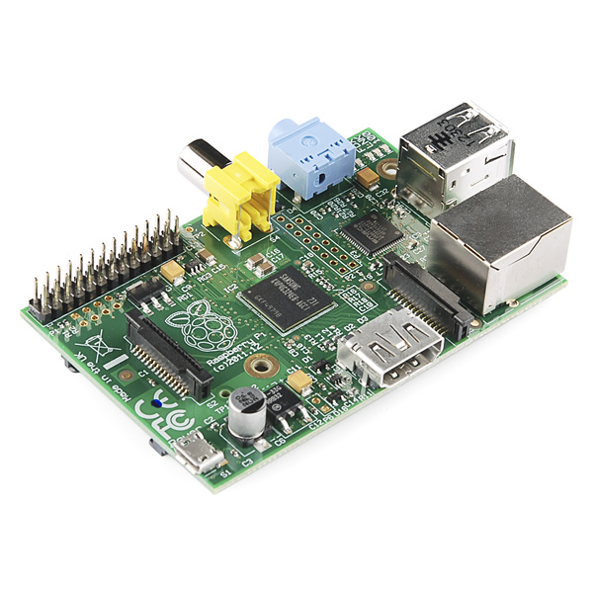





Setup
Publisher / Subscriber
(VESbox)
Broker

Slide 4
Setting up the broker
First, install mosquitto (and optionally mosquitto-clients)
sudo apt install mosquitto
then, change the configuration of mosquitto in /etc/mosquitto/mosquitto.conf or create a new configuration file for mosquitto e.g. with nano
sudo nano /etc/mosquitto/conf.d/mosquitto.conf
add the following lines:
listener 1883
listener 8080
protocol websockets
allow_anonymous true
connection_messages true
log_timestamp true

Slide 5
Setting up the broker
Now WebSocket packets will be received on port 8080. Run Mosquitto with these settings using the -c flag
mosquitto -c /etc/mosquitto/conf.d/mosquitto.conf
Or restart the service with
sudo systemctl restart mosquitto

Slide 6
Publisher Client
MQTT Explorer
https://github.com/thomasnordquist/MQTT-Explorer
Supports WebSocket connections
Gives sufficient overview of available topics of the broker
Easy and intuitive UI

Slide 7
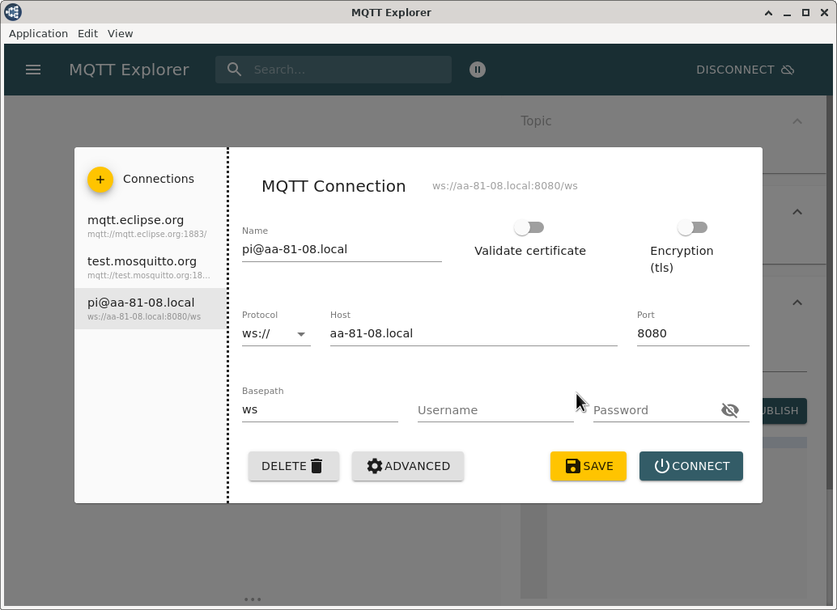
Setting up the connection
Connect the Pi with PC in PRTlab
After choosing Pi-Direct-Connection-to-Pi in the network settings of the VM, give the credentials for the connection to the broker (Pi).
Choose WebSockets

Slide 8
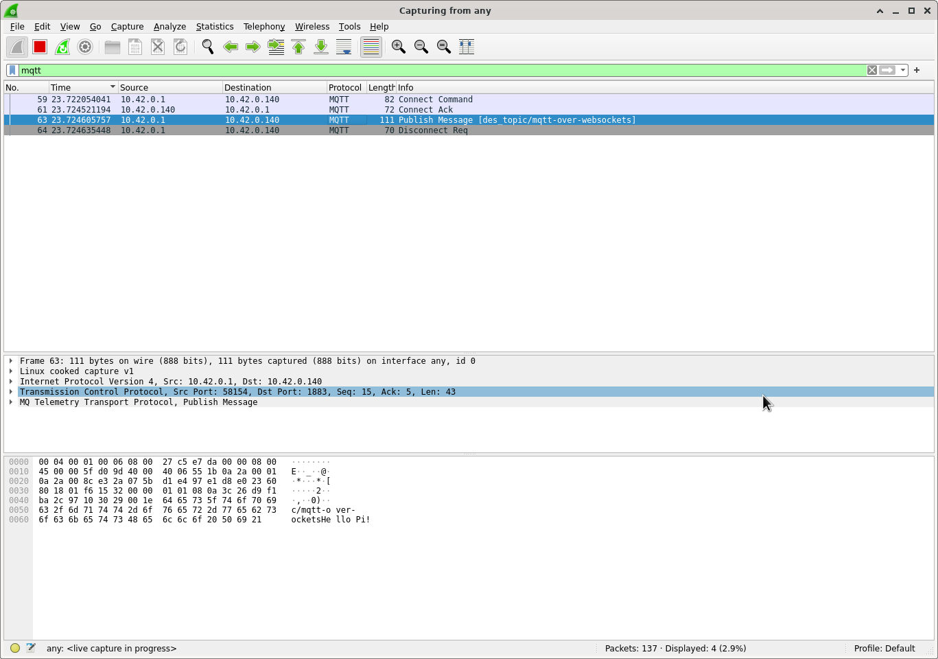
Ordinary MQTT connection sequence
QoS-0 connection flow requires 4 packets
QoS-1 requires 5 packets
QoS-2 requires 7 packets
for ordinary MQTT (without WebSockets)

Slide 9
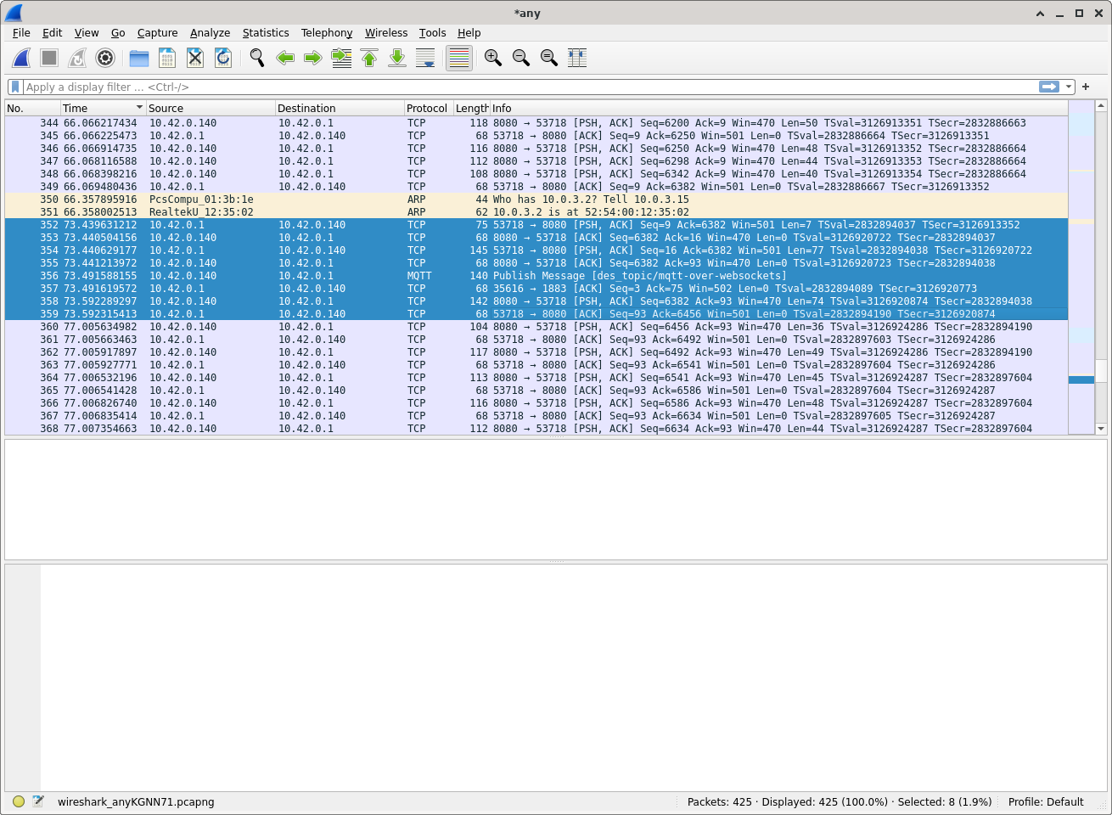
MQTT over WebSockets
Publishing MQTT messages over WebSockets with MQTT Explorer
required 6 packets at least for a QoS-0 message
displayed TCP connections instead of WebSocket connections (probably because WebSockets are also based on TCP)

Slide 10
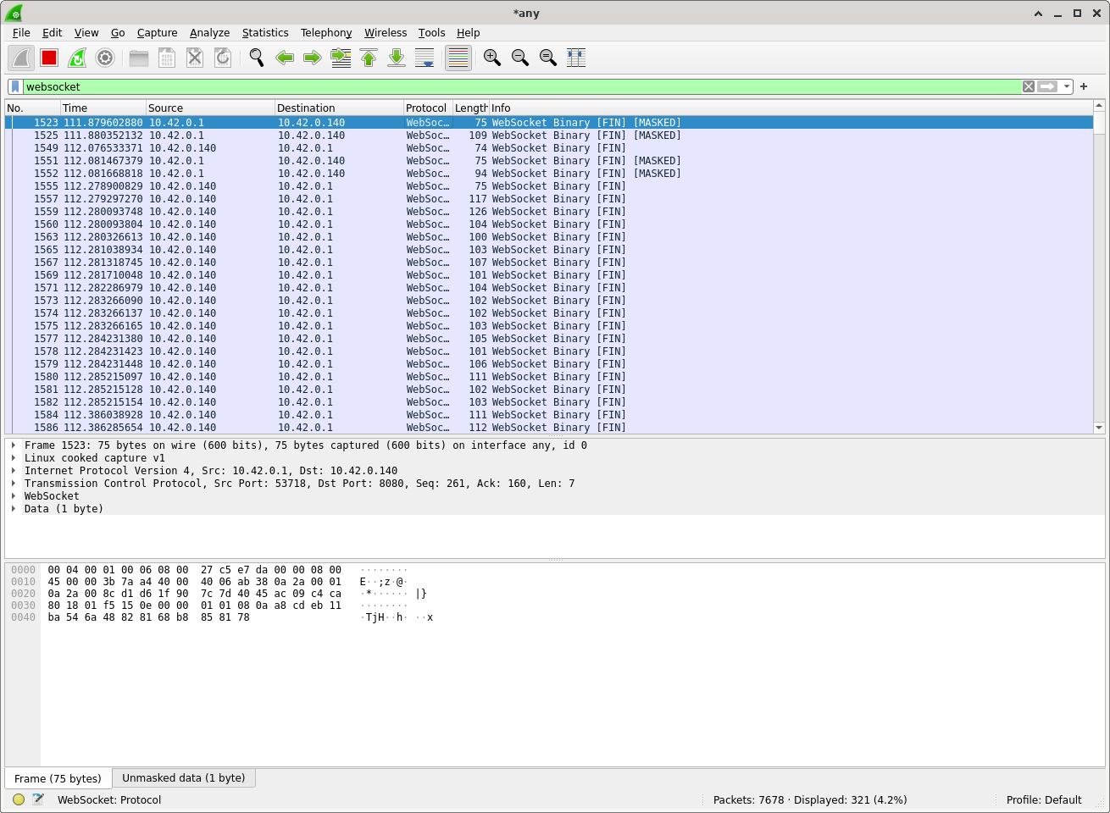
MQTT over WebSockets
This is interesting, because
querying the MQTT broker for its topics shows ordinary WebSocket frames on Wireshark
Since the MQTT Explorer connects with the broker over WebSockets without any issues, we assume the TCP connection to be a WebSocket connection

Slide 11
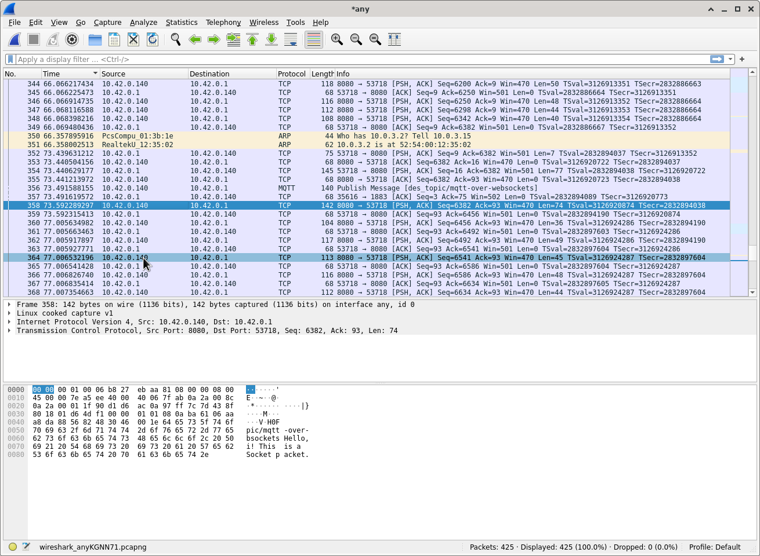
MQTT over WebSockets
The payload can be seen in the frame hex
“MQTT over WebSockets allows you to receive MQTT data directly into a web browser. This is important as the web browser may become the DE-facto interface for displaying MQTT data.” ^{[1]}
[1] http://www.steves-internet-guide.com/mqtt-websockets

Slide 12
MQTT over WebSockets
A detailed analysis of the throughput differences of ordinary MQTT and MQTT over WebSockets is given in [2]
[2] https://www.hivemq.com/article/understanding-the-differences-between-mqtt-and-websockets-for-iot/
No. of messages | Payload Size (bytes) | MQTT QoS | MQTT over TCP (msgs / sec) | MQTT over WebSockets (msgs / sec)
10k | 256 | 0 | 6631 | 5708
10k | 256 | 1 | 1591 | 1306
10k | 256 | 2 | 1344 | 1095
10k | 100k | 0 | 1119 | 705
10k | 100k | 1 | 1060 | 676
10k | 100k | 2 | 1042 | 660

Slide 13
Playing around

