Slide 1
Surveying Current Methods for Question Generation using Transformers
PS-1 at Jio Platforms Ltd. on
Sarvaswa Mohata, 2020B1AA2358H
Rohan Srinivasan, 2020A7PS0081P
Sai Prasanna Panda, 2020A7PS0080H

Slide 2
Contents
Flow of Script
Context and Reference
Common Libraries and Modules across all three models
Running inference on T5
Running inference on BERT
Running inference on T5 QG with BERT QE

Slide 3
Flow of Script
We generated questions using three models(namely T5, BERT, and T5 GG with BERT QE), their codes are stored in their respective Colab notebooks present in this repository. Each notebook can be used independently to generate questions using its model and their flow is linear. Here is a generalized flow for all 3 models:
Install modules
Fetch pre-trained transformer model
Fetch context and reference files
Parse context file
Generate questions using transformer
Store questions in output file
Calculate BLEU and METEOR scores

Slide 4
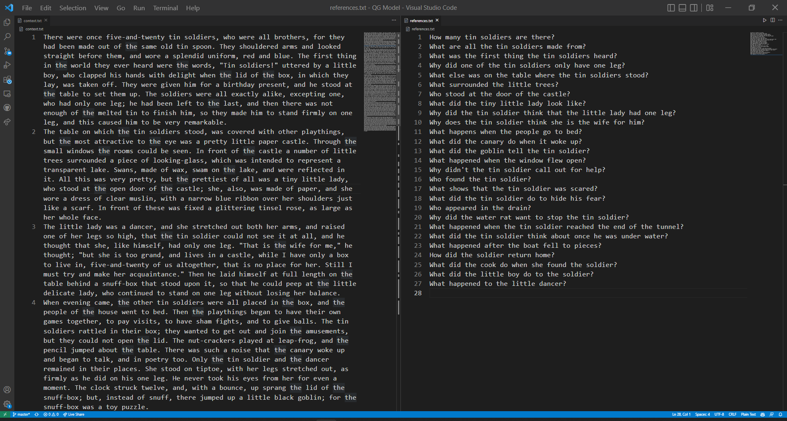
Context and Reference
We used FairytaleQA Dataset (https://arxiv.org/abs/2203.13947) as context for our models and reference for generating BLEU and METEOR scores. Google drive links to the exact files used are present in the Colab notebooks.
Different files can be used if required, instructions to replace the files are present in the Colab notebooks as well.
Xu, Ying, et al. "Fantastic Questions and Where to Find Them: FairytaleQA--An Authentic Dataset for Narrative Comprehension."

Slide 5
Models and Libraries
T5, bert2BERt, T5 G with bert qe

Slide 6
Common Libraries and Modules across all three models
LIBRARIES:
🤗 Transformers: The Hugging Face transformers package is an immensely popular Python library providing pretrained models that are extraordinarily useful for a variety of natural language processing (NLP) tasks. We use some of the APIs provided by the package to easily download our models and use them to generate questions.
Documentation: https://huggingface.co/docs/transformers/index
Natural Language Toolkit(NTLK): The Natural Language Toolkit, or more commonly NLTK, is a suite of libraries and programs for symbolic and statistical natural language processing for English written in the Python programming language. We use NLTK to generate BLEU and METEOR scores for all our models.
Documentation: https://www.nltk.org/

Slide 7
Common Libraries and Modules across all three models
MODULES:
os: The OS module in Python provides functions for interacting with the operating system. OS comes under Python's standard utility modules. We used it to interact with the file systems (to read context, reference and to write the generated questions to an output file).
Documentation: https://docs.python.org/3/library/os.html
gdown: gdown is a Python package that allows us to download a large file from Google Drive. We use it to fetch our context and reference files.
Documentation: https://pypi.org/project/gdown/

Slide 8
Running inference on T5
Github repository with pre-trained model: https://github.com/patil-suraj/question_generation
It uses T5 model trained on SQuAD v1 dataset. We used the t5-small version of the model which can be found here: https://huggingface.co/valhalla/t5-small-qa-qg-hl
Here are the relevant papers used to train this model:
https://arxiv.org/abs/1906.05416
https://www.aclweb.org/anthology/D19-5821/
https://arxiv.org/abs/2005.01107v1

Slide 9
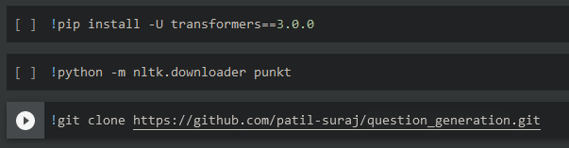
Running inference on T5
First, we install 🤗 transformer library and ntlk, then we clone the github repository:

Slide 10
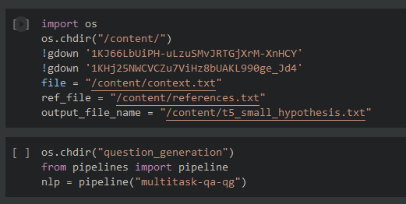
Running inference on T5
Next, we fetch the context and reference files, set the output file name and create an instance of the multitask-qa-qg pipeline (more information in the github repo on the previous slide)

Slide 11
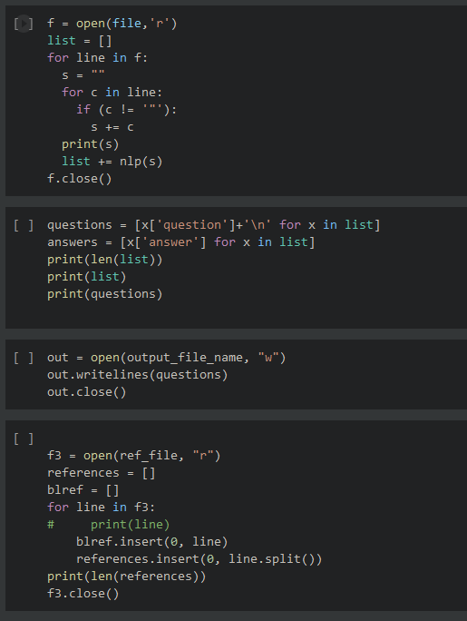
Running inference on T5
Here, we are generating questions from the context file using the instance of the pipeline and writing them to the output file

Slide 12
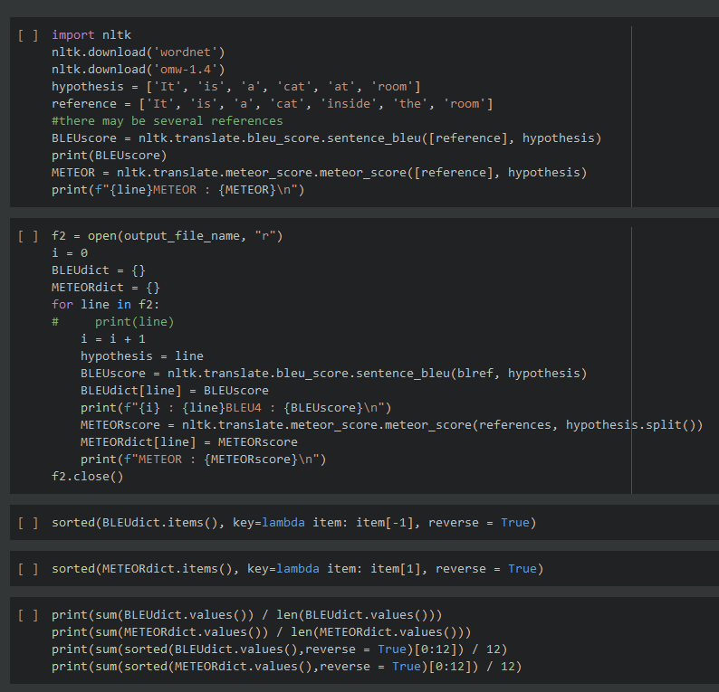
Running inference on T5
Finally, we are generating BLUE and METEOR scores for each question and calculating the averages

Slide 13
Running inference on BERT2BERT
Our BERT2BERT model code is similar to that of our T5 model code. The major difference is we fetched our model from Hugging Face directly instead of a Github repository.
Here is the link to the pre-trained BERT2BERT model that we used: https://huggingface.co/mrm8488/bert2bert-medium_shared-question-generation
We have added descriptions of the code blocks above them in the notebook.

Slide 14
Running inference on T5 QG with BERT QE
Github repository with pre-trained model: https://github.com/amontgomerie/question_generator/
The question generator uses t5-base model trained on SQuAD, RACE, CoQA, and MSMARCO datasets. Phrases are extracted from the input text using spaCy.
The question answer evaluator uses bert-base-cased model with a classification head. The pretrained model was finetuned on the same data as the question generator model.
The code for this model is similar to the T5 model as well. Additionally, we have used sacremoses and sentencepiece packages for tokenizing and detokenizing the text.

