Slide 1
Open Data Reuse and Attribution

Slide 2
Overview
Introduction to key ideas in data management and curation
Who, What, Why?

Slide 3
What is Data Management?
Involves acquiring, validating, storing, protecting, and processing required data to ensure the accessibility, reliability, and timeliness of the data for its users
Principles can be applied to any size dataset in any environment
Once collected, data must be effectively managed to be useful

Slide 4
What are Considered Data?
Almost anything of value to the users
Numeric or tabular data (Probably what most of us think about when we use the term data is numeric or tabular data, what researchers might refer to as ‘quantitative data’
other types
Samples such as DNA or blood samples, physical collections, including plant specimens, software programs and code, databases, algorithms, etc.
Questionnaire, reports, articles, books, etc.
Question: Can you think of other examples?

Slide 5
Who Needs Data Management?
Every organization produces data
Academia – research data
Businesses – operations data, user data
Government and non-government agencies – about anything the government oversees (e.g., see data.gov)
Every person produces their own data, too

Slide 6
Key Concepts
Big Data
Data Repositories
Metadata
data about data
Structured information that describes, explains, locates, or otherwise represents something(e.g., research data)
Metadata makes it easier to retrieve, use or manage an information source
One cannot search for, identify, or interpret data without robust metadata. For each dataset, we need to know at minimum, who created the data, when the data were created or published, and a title or descriptive name used to refer to the dataset.
At a minimum, one needs to know who created the data, when the data were created or published, and a title or descriptive name used to refer to the dataset. Digital data should also have a unique and persistent identifier. Two metadata standards commonly used to describe research data are Dublin Core and the Data Documentation Initiative.

Slide 7
Key Concepts
Unique Identifiers
We can locate data, even if the data a moved to a different location on the web.

Slide 8
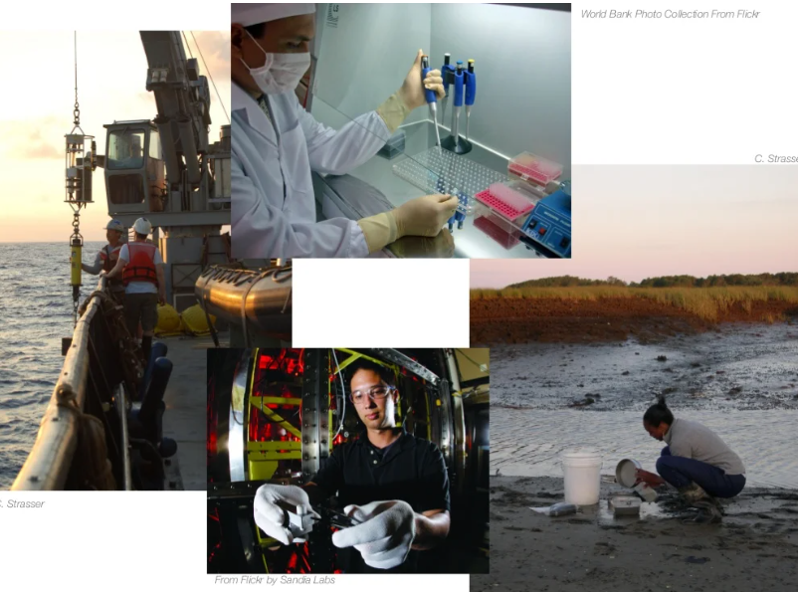
Data reuse
Once data are shared, their use should be acknowledged
Ways of acknowledging reuse of data

Slide 9
What is Data Reuse?
Once data have been shared, they may be used by the originating authors or others for similar or new purposes
Others may use the data in full or in part
Open data may be modified or added to (depending on usage license)
Data that are reused should be acknowledged
What are the options?
How is this best done?

Slide 10
Authorship & Acknowledgment
Concept of authorship or authority can apply to any intellectual work: article, book, database, computer program, techniques or methods
Authors traditionally receive recognition or credit for their contributions
Awards
Citations
Formal acknowledgments

Slide 11
Why is Formal Author Recognition Important?
Data & software authors may be evaluated on their contributions to scholarship or their organizations
Recognizing the reuse of authors’ works provides an indication of their value to the community they serve
More citations Greater impact
Provides authors an incentive to continue sharing their products, which benefits everyone

Slide 12
Code Reuse Attribution
Depending on license, if code is reused & repurposed, the reuser can become another author while recognizing existing authors
Original developer & source should be acknowledged
Like citing copied text, when is it necessary to acknowledge sources?
What if (software) code is translated to a new programming language … who gets credit?

Slide 13
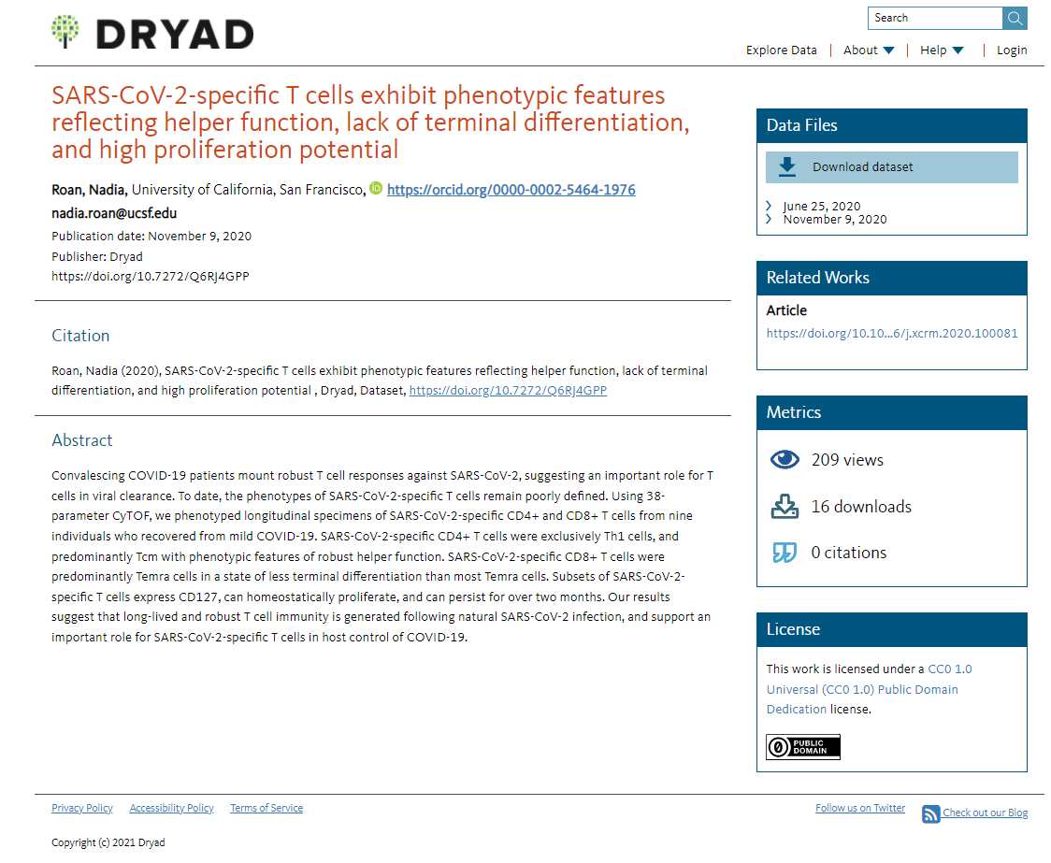
How is Reuse Measured?
Direct and indirect measures may be used
https://datadryad.org/stash/dataset/doi:10.7272%2FQ6RJ4GPP
Indirect
Downloads – may indicate popularity, but not evidence of direct use
Altmetrics – e.g., social media mentions; also, a measure of popularity
Direct
Citations – data may be formally cited like any other document
Integration into other sources – e.g., software or scripts that are integrated into larger programs

Slide 14
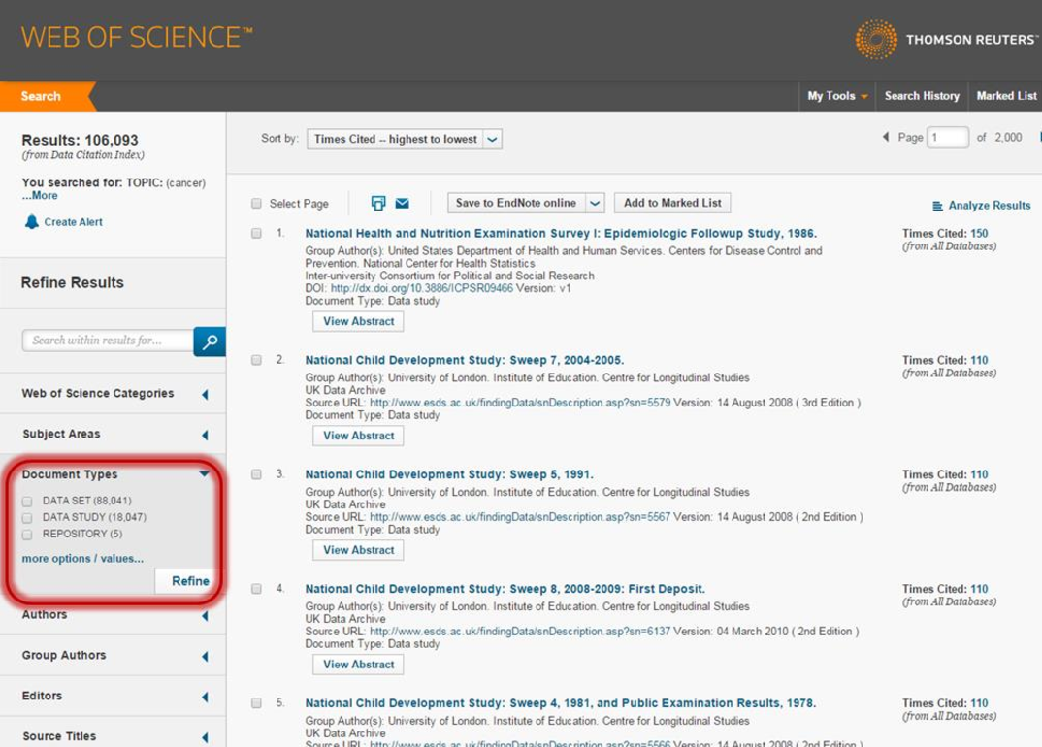
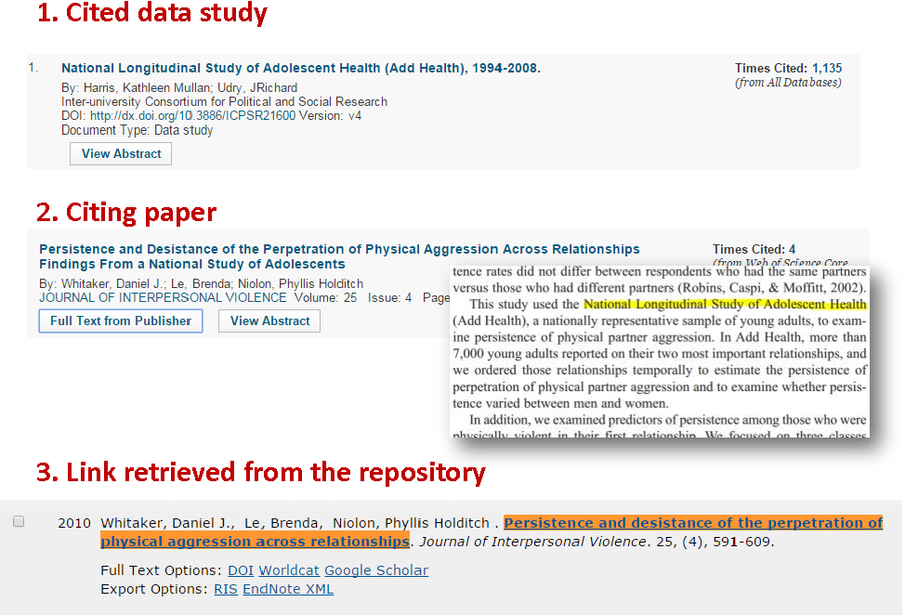
Tracking Data Citations
A few indexes track data citations
Clarivate Analytics’ Data Citation Index
Began in 2012
Similar to its other citation databases (Web of Science)
Indexes hundreds of data repositories
DataCite.org (https://datacite.org/)

Slide 15
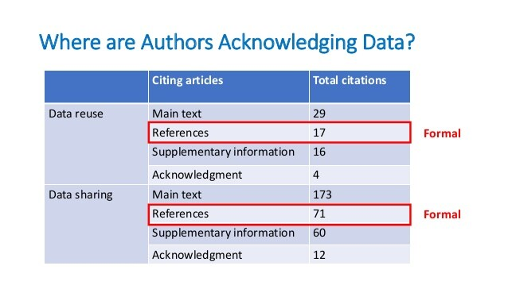
Current State of Citation Tracking
Can be hit or miss
Citation database sources only capture citations from the repositories they index
Citations usually only captured if formally cited in references or other areas of papers
Informal citations buried in a paper are not captured, so data authors do not receive due credit
Currently, there isn’t a strong tradition for data reusers to cite data sources in the same way bibliographic sources are cited.
Source from: (Park, & Wolfram, 2018) https://asistdl.onlinelibrary.wiley.com/doi/pdf/10.1002/asi.24049

Slide 16
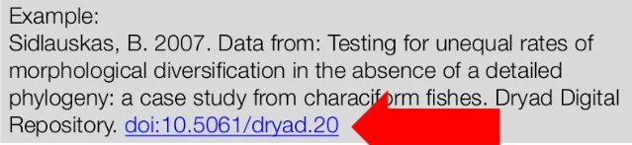
Examples of Data Citation
Kumar, Sujai (2012): 20 Nematode Proteomes. figshare. https://doi.org/10.6084/m9.figshare.96035.v2 (Accessed 2016-09-06).
Morran LT, Parrish II RC, Gelarden IA, Lively CM (2012) Data from: Temporal dynamics of outcrossing and host mortality rates in host-pathogen experimental coevolution. Dryad Digital Repository. https://doi.org/10.5061/dryad.c3gh6
Donna Strahan. "08-B-1 from Jordan/Petra Great Temple/Upper Temenos/Trench 94/Locus 41". (2009) In Petra Great Temple Excavations. Martha Sharp Joukowsky (Ed.) Releases: 2009-10-26. Open Context. https://opencontext.org/subjects/30C3F340-5D14-497A-B9D0-7A0DA2C019F1 ARK (Archive): http://n2t.net/ark:/28722/k2125xk7p
OECD (2008), Social Expenditures aggregates, OECD Social Expenditure Statistics (database). https://doi.org/10.1787/000530172303 (Accessed on 2008-12-02).
Denhard, Michael (2009): dphase_mpeps: MicroPEPS LAF-Ensemble run by DWD for the MAP D-PHASE project. World Data Center for Climate. https://doi.org/10.1594/WDCC/dphase_mpeps
Manoug, J L (1882): Useful data on the rise of the Nile. Alexandria : Printing-Office V Penasson. http://n2t.net/ark:/13960/t44q88124
<Source: The Regents of the University of California>

Slide 17
A Role for Information Professionals
As developers of shared data
Provide a formal citation format for your data
Ensure it is appropriately indexed for discovery by others
As data managers/librarians
Ensure developers of data sources are aware of acknowledgement practices within the community and by data publishing sources (repositories, journals)
Encourage formal citation to provide data authors due credit

Slide 18
Types of Open Data Resources
Open Education Resources (OER) includes digital learning materials such as
Open textbooks, full courses, syllabi, lectures, homework assignments, quizzes, lab activities
e.g.) MIT’s open courseware https://ocw.mit.edu/courses/most-visited-courses/
Government Data
Research Data

Slide 19
Characteristic of Open Data
Used
Reused
Distributed
Easy to find
Easy to understand
Easy to access
Safe to use

