Slide 1



Team Name: CODEZILLA
Overnight Hackathon
Team details
1) SHEIKH HAMZAH
2) PRANSHU MISHRA
3) NIKHIL SHARMA
4) PRANAV V

Slide 2
Problem Statement
The Problem:
Modern web applications are subjected to a relentless volume of HTTP traffic, making it humanly impossible for security analysts to manually inspect server logs for malicious activity. Cybercriminals increasingly utilize sophisticated Application Layer (Layer 7) attacks—such as SQL Injection (SQLi), Cross-Site Scripting (XSS), and Command Injection—which are often buried within legitimate traffic or obfuscated to evade standard firewall.
Current log analysis methods often suffer from two major issues:
Data Overload: The sheer velocity of generated logs (Big Data) overwhelms manual auditing, leading to "alert fatigue."
Pattern Obscurity: without advanced parsing, it is difficult to distinguish between harmless errors, automated bot scanners, and successful targeted intrusions.
The Consequence: Failure to rapidly identify and classify these patterns results in an increased Mean Time to Detect (MTTD), leaving organizations vulnerable to data exfiltration and system compromise for extended periods.

Slide 3
Proposed Solution
Automated HTTP Threat Forensics Engine
We propose the development of an automated, centralized analysis platform designed to ingest raw HTTP traffic logs and csv files, applying heuristic and behavioral analysis to detect, classify, and visualize web-based threats.

Slide 4
Key Features
Automated Detection: The system utilizes cognitive reasoning of Large Language Models (LLMs) to instantly scan HTTP logs for complex threats like SQL Injection, XSS, and Path Traversal.
"Attempt vs. Success" Verification: Unlike standard parsers, this tool smartly correlates malicious payloads with HTTP status codes (e.g., 200 vs 403) to distinguish between harmless blocked attempts and critical successful breaches.
Session-Based Forensics: The backend goes beyond simple log viewing by grouping individual requests into user sessions (via Cookies or IP/User-Agent), allowing analysts to track an attacker's complete journey.
Interactive SPA Dashboard: Features a modern, dark-mode Single Page Application (SPA) interface that supports drag-and-drop uploads, real-time searching, and dynamic filtering by severity or attack type

Slide 5
Key Features
Resilient Data Ingestion: Built with a robust CSV parser that automatically detects varying column names (like url, request_url, or path), making it compatible with logs from Nginx, Apache, and IIS without manual reformatting.

Slide 6
System Architecture
Layer 1: Presentation (Frontend)
Tech: Built using standard HTML5, CSS3, and JavaScript (ES6).
Input: Features a drag-and-drop zone for easy CSV log uploading.
Display: A single-page application (SPA) that dynamically renders attack statistics, data tables, and filters without reloading.
Layer 2: Application (API Gateway)
Tech: Powered by Python Flask to handle server requests.
Function: Acts as the bridge between the UI and the logic; handles file ingestion and validation.
Output: Processes raw streams and serializes results into JSON for the frontend.
Layer 3: Intelligence (Analysis Engine)
Detection: Uses Regex pattern matching to identify specific threats like SQLi and XSS.
Logic: Classifies traffic into "Normal" or "Attack" categories.
Verification: Smartly correlates malicious payloads with HTTP Status Codes to distinguish between failed attempts (e.g., 403) and successful breaches (e.g., 200).

Slide 7
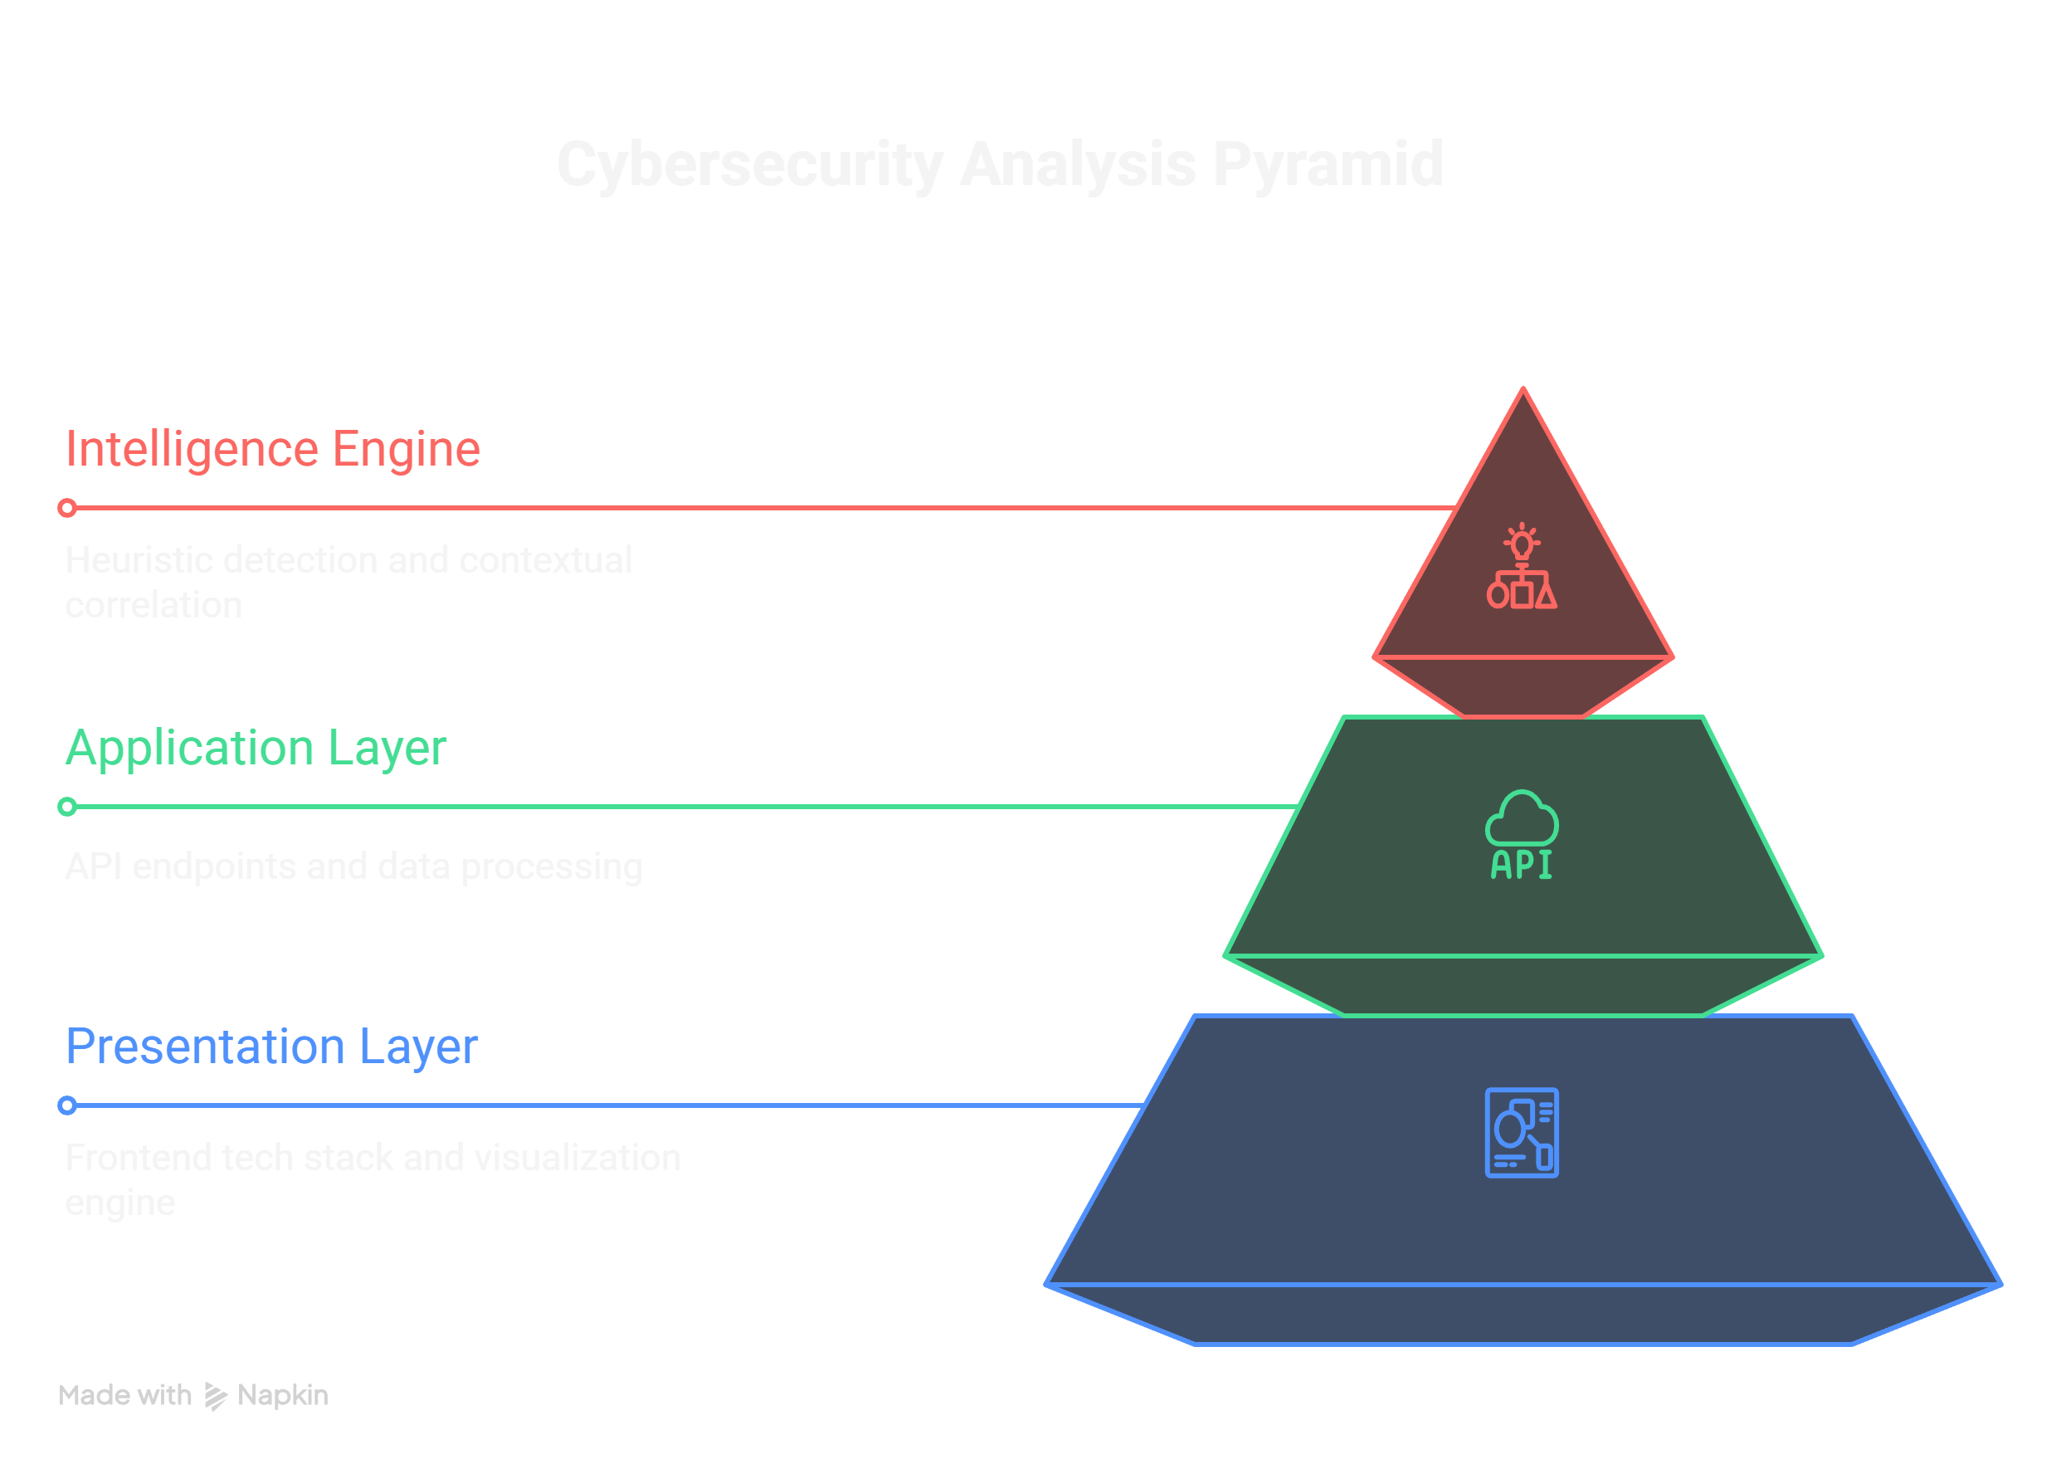

Slide 8
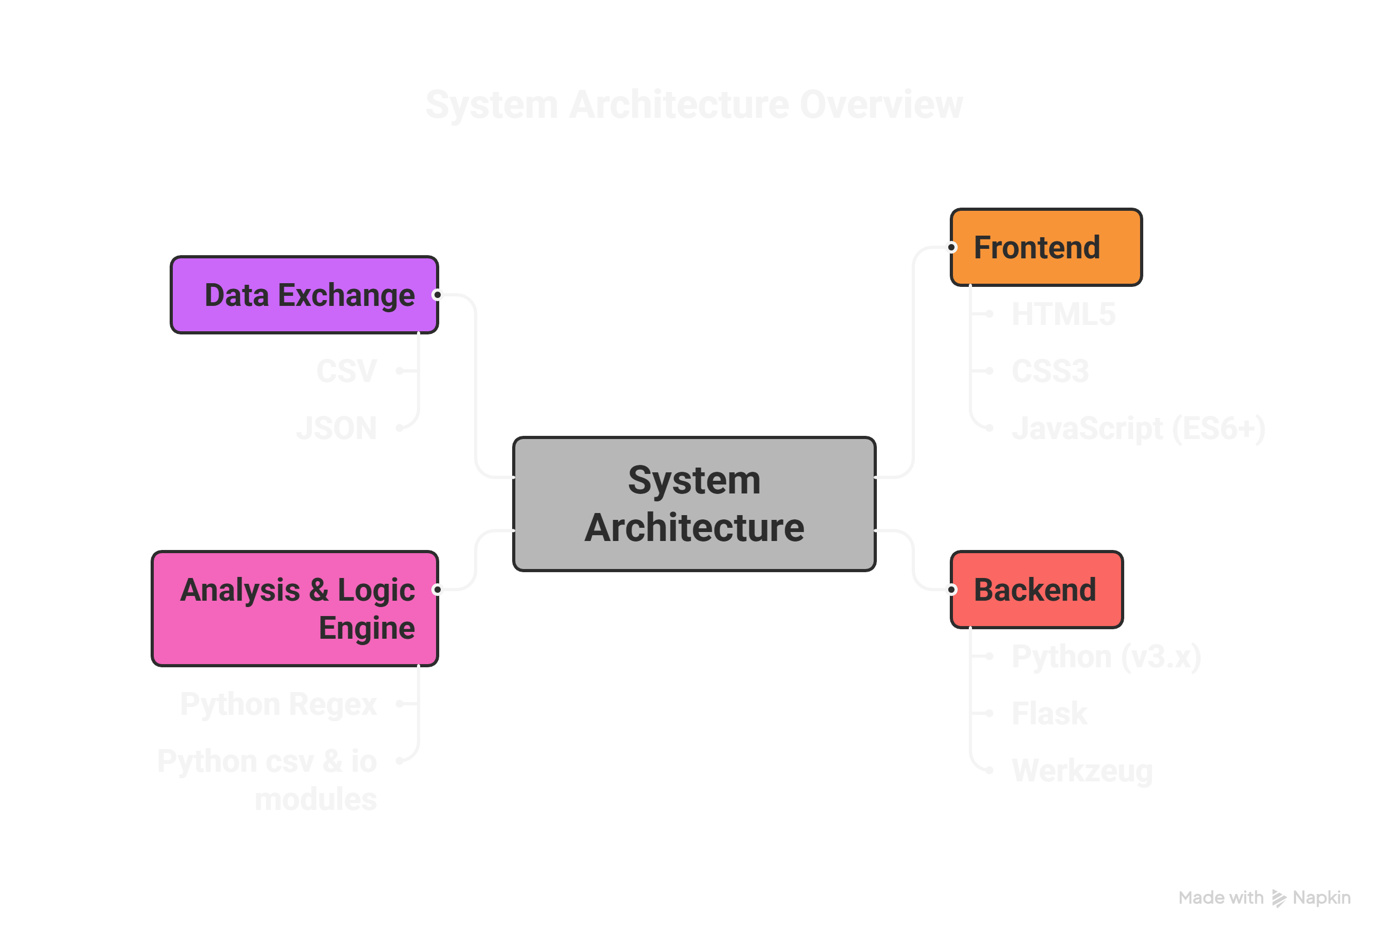
Tech Stack
LLM MODEL

Slide 9
Challenges Faced
1.Massive Data Volume
Security teams are overwhelmed by millions of HTTP log lines generated daily.
Manual inspection of traffic logs (IPDR/Web Logs) is humanly impossible at this scale.
2.Distinguishing "Attempt" vs. "Success"
The Core Problem: Most tools flag every malicious signature.
The Challenge: It is difficult to differentiate between a failed attack (blocked by firewall) and a successful breach (payload executed), leading to critical incidents being missed in the noise.
3.Complex Attack Obfuscation
Attackers hide payloads using sophisticated encoding (Base64, Hex, URL-encoding) to bypass standard keyword filters.
Identifying "Low and Slow" attacks that mimic legitimate traffic is difficult without heuristic analysis.
4. Slow Incident Response
Without centralized search and filtering, forensic analysis takes hours or days.
Lack of actionable visibility (e.g., "Show me all SQLi from this IP") delays mitigation.

Slide 10
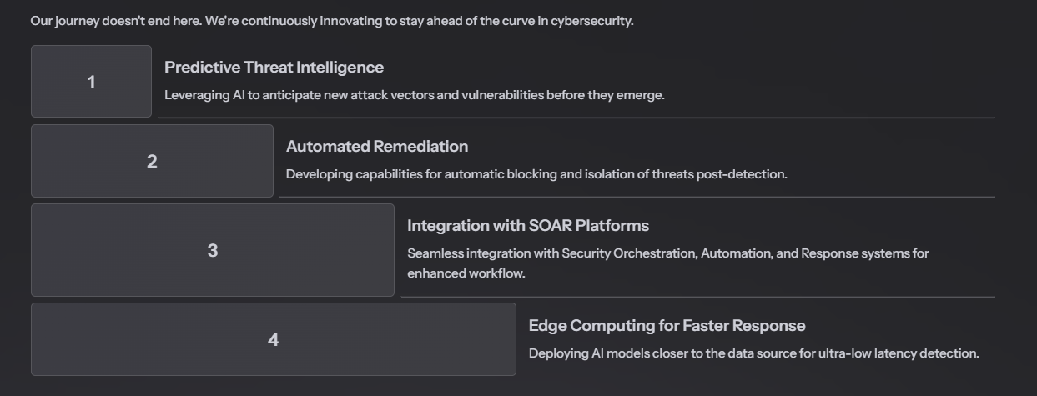
Future Scope

Slide 11
Thank You

