Slide 1
Solving the 0-1 Knapsack Problem using a Genetic Algorithm
ADITYA ACHARYA 2019A4PS0672H

Slide 2
0-1 Knapsack Problem
Given a list of N items, each with a value pi and a volume vi, and a bag of capacity V.
Put items in the bag such that the profit is maximized and the capacity of the bag is not exceeded.
When there is only one of each item available, it is called a 0-1 knapsack problem.
Example of an NP-complete problem. There is no known efficient polynomial time algorithm to solve it.

Slide 3
The Genetic algorithm:
Let the population size be K, let the number of items be N.
Encoding: binary encoding is used. There are N bits in a chromosome Bit i is 1 if that item is included in the knapsack, and 0 otherwise.
Initialization: an array called pop_array is created with K chromosomes, in which the 0’s and 1’s are randomly initialized.
Fitness function: the fitness of the chromosome is the total profit in the knapsack. If the total volume of the knapsack is greater than its capacity, then elements are removed from it at random until it is not.
Selection: 2 selection functions are used, called roulette wheel selection, and group selection respectively. They are used to choose the 2 best chromosomes.
Crossover: single point crossover is used.
Mutation: in each chromosome, each bit with some small probality (0.01 % ) will be flipped.
Termination: The algorithm terminates when 90% of the population have the same fitness OR if the number of generations exceeds the specified amount.

Slide 4
The Selection Functions:
Roulette select:
  The fitness values of the population are summed up (= fitness_sum) , and a number is chosen at random from 0 to fitness_sum
  The population is iterated over and the fitnesses are added up until it exceeds the chosen number. The chromosome which it stopped at when it exceeded the chosen number is selected.
  Called roulette select because the fitness_sum is like a dart board, or a pizza, and each chromosome represents a slice whose area is proportional to the fitness. Choosing the random number is like throwing a dart at random. The chromosomes with larger area have a greater chance of being hit.
Group select: The chromosomes are sorted according to their fitness, and divided into quartiles:
  Quartile-1 indices [0, K/4]
  Quartile-2 indices [K/4, K/2]
  Quartile-3 indices [K/2, 3K/4]
  Quartile-4 indices [3K/4, K]
  A quartile is chosen with the following probabilites: 50% from Q1, 30% from Q2, 15% from Q3, and 5% from Q4.
  A chromosome is chosen at random from the selected quartile.

Slide 5
Input Files
The program takes 3 input files: one for the profits, one for the volumes, and one for the capacity of the knapsack.
These values were taken from an online dataset:
https://people.sc.fsu.edu/~jburkardt/datasets/knapsack_multiple/knapsack_multiple.html

Slide 6
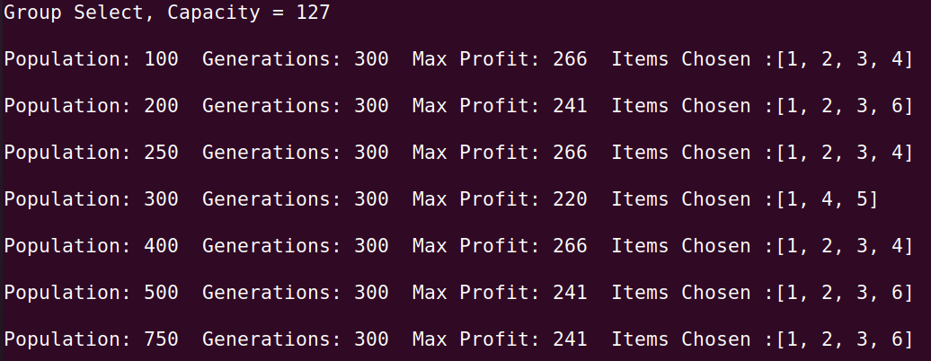
Output Format
One output file is generated, containing the following results for each population size : number of generations, maximum profit, and array containing items chosen. This is done twice, one for roulette select and one for group select.

Slide 7
Analysis of the algorithm
The number of chromosomes in each generation and the number of generations are fixed, therefore the time complexity of the program depends only on the number of items. Let N be the number of items, K be the size of the population, and G for the number of possible generations.
The function that initializes the array chromosomes has a complexity of O(N). The fitness, crossover and mutation functions also have complexities of O(N).
The complexities of the two selection functions and the function that checks for the terminating condition depend only on population size (K), therefore they have constant times of running O(1).
The fitness, crossover and mutation functions are performed in in the main loop. The number of times the code in the loop is executed depends only on G, which is set as a constant. Hence, the total time complexity of the algorithm is O(N).

Slide 8
References:
http://www.sc.ehu.es/ccwbayes/docencia/kzmm/files/AG-knapsack.pdf
https://people.sc.fsu.edu/~jburkardt/datasets/knapsack_multiple/knapsack_multiple.html

