Slide 1


Search Project
COURSE: Z534 Search
INSTRUCTOR: Xiaozhong Liu
GROUP: Abhishek Bane, Rohit Rokde, Vidit Mohaniya

Slide 2
Project Tasks
Task 1:
Comparing different Collaborative Filtering methods for recommendation.
Task 2:
Classifying a review's rating from its text alone

Slide 3

EDA
&
Data Preprocessing

Slide 4
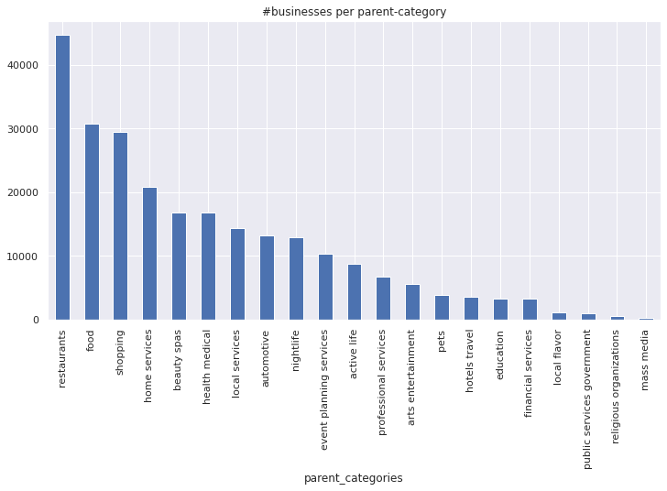
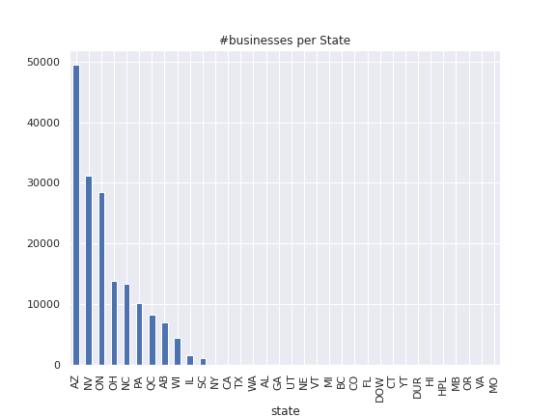
Business
Arizona has the highest number of businesses in the data. Most common business category is Restaurants and Food

Slide 5
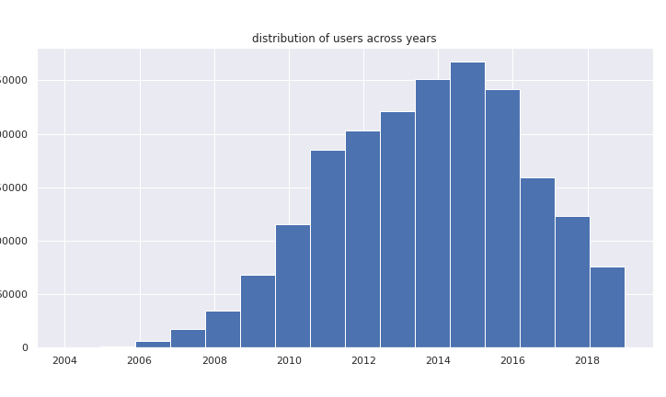
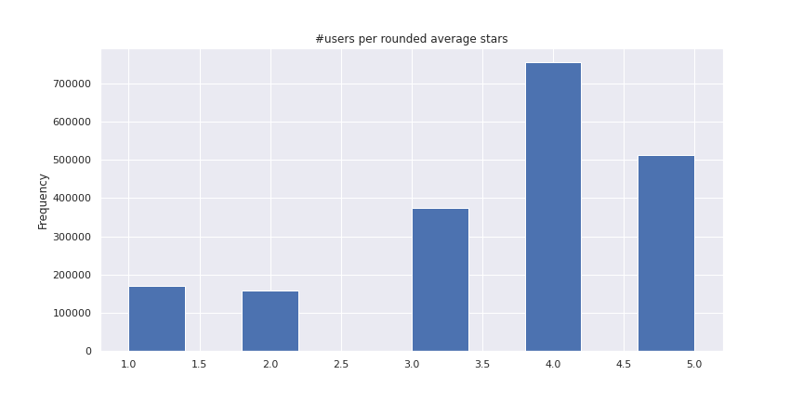
Users
The data has very few users before 2010 and most of the users prefer to give a rating of 3 or more to the business

Slide 6

Data Preprocessing
Users
Businesses
Year >= 2010
Only Open
Arizona State
Top 2 Parent Categories
Reviews
Reviews of above users and businesses
Most recent review of a user on a business
Users who rated at least 50
businesses

Slide 7

Task 1

Slide 8
Task 1
Memory Based CF Approaches
User-Based
Item-Based
Model Based CF Approaches
Singular Value Decomposition
Alternating Least Squares

Slide 9
Memory Based CF Approaches
For both User-Based & Item-Based:
Without and With considering mean ratings of User
Similarity Matrix using:
MSD
Cosine
Pearson

Slide 10
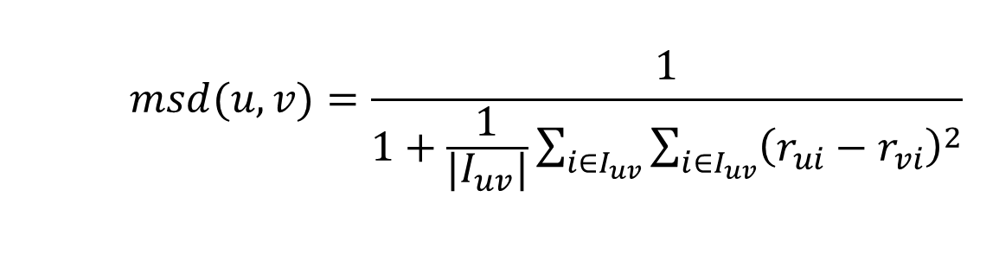
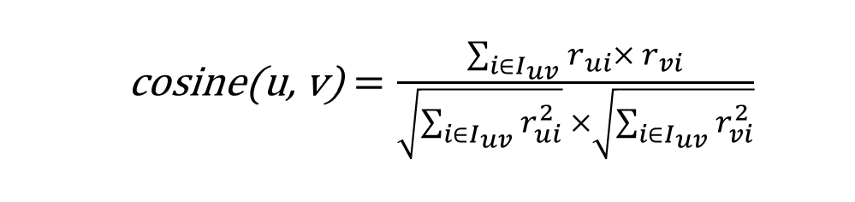
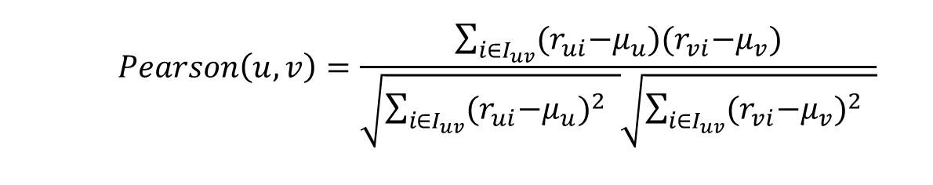
User-Based Similarity Matrices

Slide 11
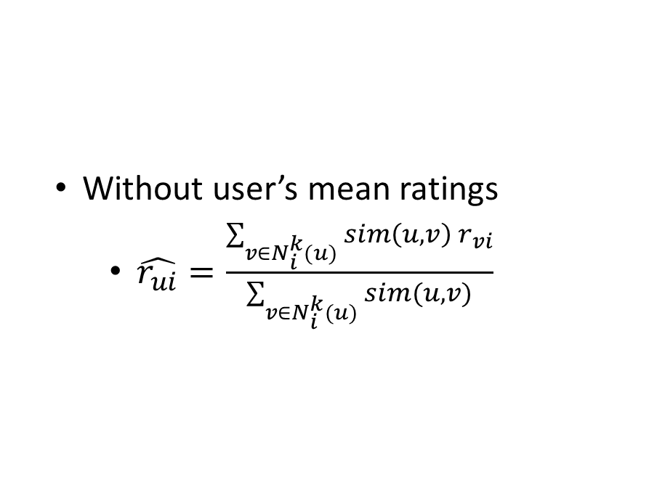
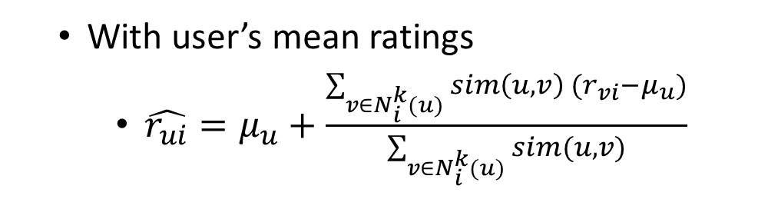
Used-Based CF

Slide 12
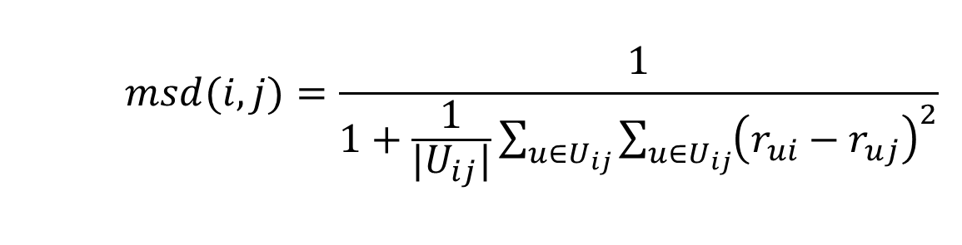
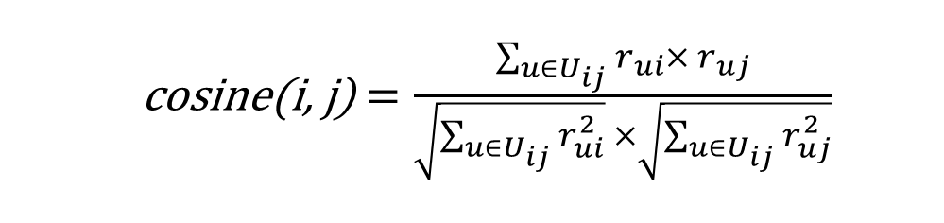
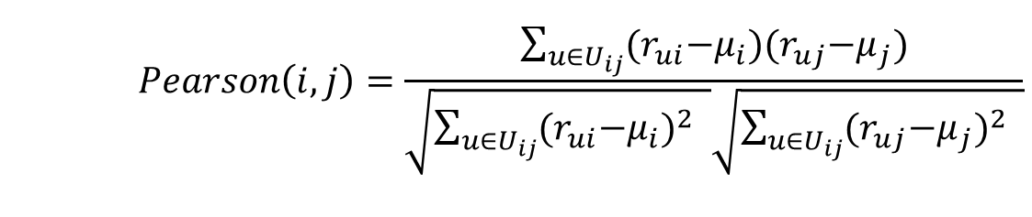
Item-Based Similarity Matrices

Slide 13
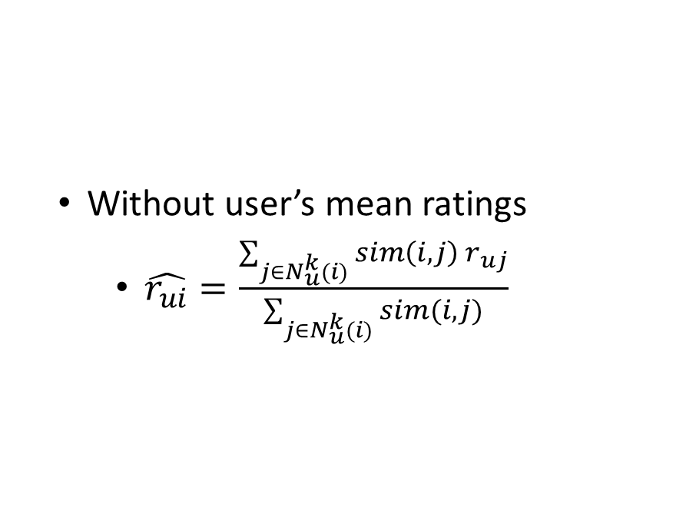
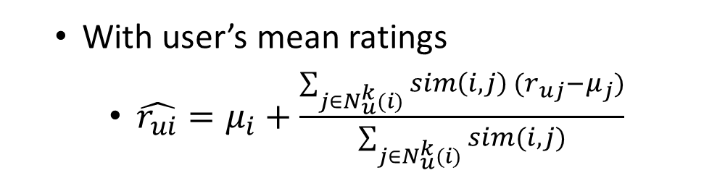
Item-Based CF

Slide 14
Model Based CF
Matrix Factorization
SVD with Gradient Descent
Alternating Least Squares
Social Context

Slide 15
Matrix Factorization
Business
Estimate a matrix Rpred such that matrix Rpred=PQ is close to the User-Business matrix R
Cost Function: Square difference between Actual and Predicted ratings
Business latent
factors
=
(Q)
Users
User-Business Sparse Matrix
User latent
factors
(R)
(P)
R is a n x m matrix where
n = Number of Users
m =Number of Businesses
P is a n x k matrix
Q is a k x m matrix
k = Number of latent factors (small)

Slide 16

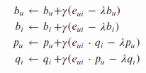
Singular Value Decomposition
Cost Function =
Minimization: Performed by Stochastic Gradient Descent
Biases
Regularization
Square of (Actual - Predicted)
eui is the difference between actual and predicted
λ is the regularization parameter
𝛾 is the learning rate

Slide 17

Alternating Least Squares
Cost Function =
Algorithm:
Initialize user vector P (can be random)
For each restaurant, compute where ri is the vector of ratings for a
restaurant
For each user, compute where ru is the vector of ratings of a
user
Repeat for N iterations
Square of (Actual - Predicted)
Regularization

Slide 18

Improving recommendations with Social context (friends)
Not everyone who visits a restaurant rates it
The users who have friends on yelp most likely have similar restaurant preferences. If a restaurant was positively rated by a lot of friends, then the user might most likely rate it positively as well.
Friend 1
The number of positive ratings (>=3 stars) from a user’s friends for a business are used as proxy interactions between the user and that business
We estimate this user-restaurant matrix with proxy interactions as product of user and business matrices with latent factors using ALS
Friend 2
user A
Friend 3

Slide 19
Evaluating recommendation systems
Test dataset was made by masking a few percentage of restaurant ratings for every user. For example, if a user rates 10 restaurants, 2 ratings will be used for test and 8 for training (for 20% test)
Metrics
Mean Precision@K
From the top K recommendations, how many were positively rated by the user
Mean precision for all users
Mean Reciprocal Rank (MRR)
Mean position of the first positively rated restaurant
Root Mean Squared Error (RMSE)

Slide 20
Evaluating recommendation systems
Test dataset was made by masking a few percentage of restaurant ratings for every user. For example, if a user rates 10 restaurants, 2 ratings will be used for test and 8 for training (for 20% test)
Metrics
Mean Precision@K
From the top K recommendations, how many were positively rated by the user
Mean precision for all users
Normalized Discounted Cumulative Gain (NDCG@K)
Positively rated restaurant must be recommended first
Binary version of NDCG
Mean Reciprocal Rank (MRR)
Mean position of the first positively rated restaurant
Root Mean Squared Error (RMSE)

Slide 21
Comparing Collaborative filtering methods
 | User-Based CF | Item-Based CF | SVD | ALS | ALS with social context
Mean Precision@5 | 0.91 | 0.90 | 0.91 | 0.87 | 0.88
MRR@5 | 0.95 | 0.95 | 0.97 | 0.94 | 0.95
RMSE | 1.0469 | 1.12 | 1.02 | - | -
Both User-Based & Item-Based CF considers user’s average rating, uses cosine similarity and 5-NN.

Slide 22

Task 2

Slide 23
Task 2
Classify a review's rating from its text alone

Slide 24
Pipeline
Parsing
Data Cleaning
Feature Engineering
Model Selection
Evaluation
Feature Engineering
Feature Engineering
TF-IDF
Single word
Ngram
Character
Word Embedding
300 dimensional vector (Wikipedia 2017, UMBC webbase corpus)

Slide 25
Converting text features into numerical features
TF-IDF Vectorizer
For a given term “t”, the TF-IDF is calculated as
TF-IDF(t, d) = tf(t, d) * idf(t)
where
tf(t, d) = term / total terms in the document
idf(t) = log [ n / df(t) ] + 1
n = total number of documents in the document set
df(t) is the document frequency of t
Vector length = 5000
Word embedding
Map the 300 dimensional vector to a smaller - 70 dimensional vector for each document
Vector length = 70

Slide 26
Model Selection
Evaluation
Traditional Machine Learning
Naive Bayes
Logistic Regression
Support Vector Classifier
Random Forest Classifier
XG boost
Deep Learning
Convolutional Neural Network
Long-Short Term Memory
Gated Recurrent Unit
Combination of above layers
Evaluation metrics
Accuracy
Precision
Recall
F1-score

Slide 27
Accuracies obtained using Traditional Machine Learning approaches
 | Multinomial Naive Bayes | Logistic Regression | XGBoost
Token counts (CountVectorizer) | 54.47% | 60.88% | 59.67%
TF-IDF (Word level) | 54.84% | 62.30% | 59.79%
TF_IDF N-gram) | 55.49% | 60.48% | -
TF-IDF (Character level) | 53.54% | 60.80% | -

Slide 28
Accuracies obtained using Deep Learning approaches
 | Convolutional Neural Network | Long Short-Term Memory | Gated Recurrent Units | Gated Recurrent Units (Bidirectional) | Gated Recurrent Units (Bidirectional) + CNN | Long Short-Term Memory ((Bidirectional)) x 2 [Deep LSTM]
Word Embeddings | 62.27% | 65.28% | 64.65% | 65.11% | 62.17% | 65.53%

Slide 29
Classification report using Deep LSTM
 | Precision | Recall | F1-score | Support
1 | 0.74 | 0.78 | 0.76 | 104516
2 | 0.57 | 0.59 | 0.58 | 104670
3 | 0.61 | 0.54 | 0.57 | 105104
4 | 0.61 | 0.59 | 0.60 | 105439
5 | 0.75 | 0.79 | 0.77 | 104908
Macro avg | 0.65 | 0.66 | 0.66 | 524637
Weighted avg | 0.65 | 0.66 | 0.66 | 524637
Note: High Precision and recall for the prediction of rating-classes 1 and 5.

Slide 30
Future scope
Task 1
Combining Model based and Memory based approaches
Exploring more variables for implicit interactions
Task 2
Improvements in word embeddings: Glove, fast-ai, and many others to choose from.
Combining TF-IDF features with word embeddings.

Slide 31

Project Tasks
&
Members Role

Slide 32
Members Role
Abhishek Bane
Collaborative filtering with SVD and ALS
Social context with Collaborative filtering
Model Evaluation
Rohit Rokde
Task 2: Feature Engineering
Model selection
Compilation of results
Vidit Mohaniya
Exploratory Data Analysis
Data Preprocessing
Task 1: Memory-Based Collaborative Filtering Approaches and their evaluation
Task 2: Models Development

Slide 33
Thank You

