Slide 1
Amazon Referral Network
- Rohit Hiwale
- Sanjeev Chandra Vadde
- Satish Chandra
Mentor - Joydeep Chandra

Slide 2
Problem Statement
Collect data for books from www.amazon.com
  For each book, data includes :
    Title
    Authors
    Ratings
    List of books bought together
Analyze the properties of network of books derived from data
  Network has
    Nodes : Books
    Edges : Relations such as
      same author
      bought together

Slide 3

Questions to be answered
  Will a book likely to be popular if any one of its author is popular?
  Books co-authored by popular authors are likely to be more popular than books written by a single popular author?
  For co-author network and co-customer network, discuss:
      Degree Distribution
      Clustering Co-efficient
      Assortativity

Slide 4
Network Topology
Each book recommends 7 other books bought by the same customers.
Each other books recommend a set of 7 books themselves. The process repeats.
Multiple instances of the same book being encountered.
Book already exists – Discard
Book doesn’t exist in the graph - Add

Slide 5

Network Topology(contd..)
  Edges between books with a common feature.
  In this case, feature refers to
      a same author (or)
      a recommendation of one book on another's page.
  An example looks like,

Slide 6
I
G
B
J
K
C
L
M
A
D
N
O
E
P
H
F
Q

Slide 7
Will a book likely to be popular if any one of its author is popular?
r = #(popular books with popular authors) / #(popular books)
Rating Threshold for popularity (out of 5) | Ratio (r)
3.5 | 0.992
4.0 | 0.948
4.5 | 0.870
4.7 | 0.784
4.8 | 0.768
From the above data, it can be concluded that as there are many books which are highly popular and yet do not have an already popular author.

Slide 8

Books co-authored by popular authors are likely to be more popular than books written by a single popular author?
r1 = #(popular books by multiple popular authors) /#(books by multiple popular authors)
r2 = #(popular books by single popular author) /#(books by single popular author)
Rating Threshold for popularity | Multiple Popular Authors (r1) | Single Popular Author (r2) | Difference |(r1-r2)|
4.0 | 0.968 | 0.881 | 0.087
4.5 | 0.935 | 0.801 | 0.134
4.7 | 0.957 | 0.893 | 0.064
4.8 | 0.902 | 0.920 | 0.018

Slide 9

  An interesting observation
    The difference between the two ratios rises a bit and falls.
    From the observation it can be concluded that
      Books with less ratings need multiple authors to get popular.
      Books with very high ratings have no such constraint.
      Hence, for books of high ratings, it doesn’t matter that they have a single author or multiple authors.

Slide 10
Analysis of the book popularity given a single popular author vs. many less-popular authors
  r1 = #(popular books by single popular author) / #(books by single popular author)
  r2 = #(popular books by multiple less-popular author) / #(books by multiple less-popular author)

Slide 11
Rating Threshold for popularity | Single Popular Author (r1) | Multiple Less-Popular Authors (r2)
4.0 | 0.881 | 0.062
4.5 | 0.801 | 0.025
4.7 | 0.893 | 0.041
4.8 | 0.920 | 0.029
  From the data, it is evident that,
    Single popular author makes a book more popular than many less-popular co-authors.

Slide 12
Degree Distribution
  Co-customer network :
    Amazon gives 7 “also recommended books” for each book entry.
    Thus, a degree of 7 for more than 99% of the nodes.
    Interesting fact :
      Amazon prevents the existence of a 3-edged loop spanning over 3 layers in this graph.
    This may be a part of Amazon's strategy for some suitable content discovery.
    Thus, contributing to the growing network, but hiding the underlying actual network.

Slide 14
Degree Distribution
Co-author network :
  Different from the co-customer network.
  The degree falls gradually from a large value and goes into oblivion.
  Inference:
    Number of books with less co-authored books is hugely more than the number of books with more co-authored books.

Slide 16
Clustering Co-efficient:
Co-author network :
  Observed to be around 0.779.
  Many nodes have individual CC values of 1.
  Inference:
    It can be inferred that the graph is a set of cliques connected by edges.
    The nodes with less value of CC are the nodes which form connections between two cliques.

Slide 17
Clustering Co-efficient (Contd.)
Co-customer network :
    Neighborhood of each node is almost same due to typical topology of the graph.
    CC for each node is approx 0.714
    Hence, CC for whole graph is also approx 0.714

Slide 18
Assortativity
Co-author network :
  Observed assortativity = 0.785394
  Inference:
    any book co-authored with a high degree book is likely to have high degree too.
    similarly, any book co-authored with low degree books is likely to have a low degree.

Slide 19
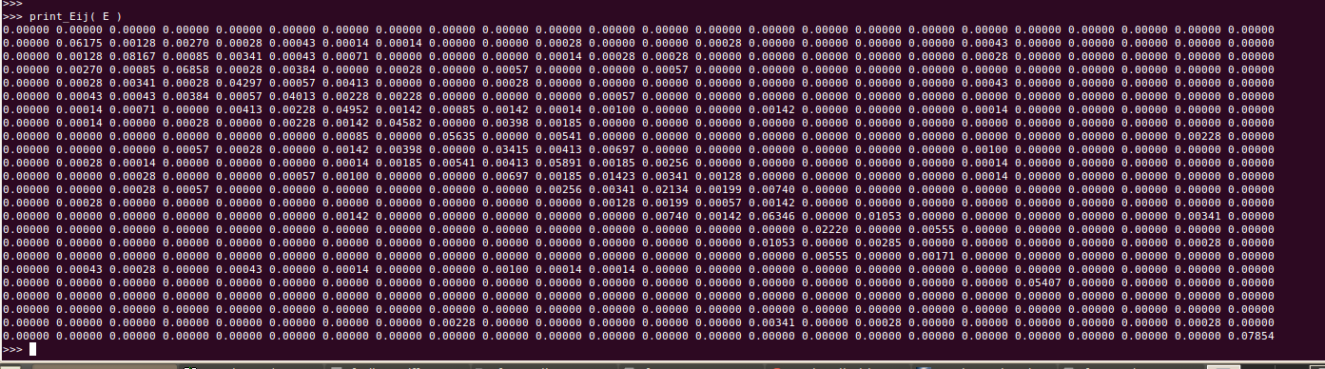
E[i][j] : fraction of edges between nodes of degree i and j

Slide 20
Assortativity (Contd..)
Co-customer network :
  Observed assortativity is approximately equal to 0.
  The graph is a well connected graph with almost all nodes having the same neighborhood connectivity pattern.
  Inference:
    any book recommended by the users of a popular book need not be popular.

Slide 21
Tools Used
  Data Collection
    Python module mechanize to ignore robot.txt
    Python module BeatifulSoup and pyparsing to parse html content
  sqlite3 database to store crawled data and as data structure for network.

Slide 22
Problems Faced
  Amazon discourages crawling by
    malforming html tags
    introducing unrecognized Unicode characters
  Unstable internet
  Hence slow data collection.

Slide 23
Thank You.
Any Questions??

