Slide 1

Blazor work cross platform
DC4/Program3
Nhat Le

Slide 2
agenda
What is Blazor?
Blazor Server Project
Blazor in MAUI project
Blazor in Window Forms project
Blazor in WPF project
Blazor in Web MVC

Slide 3
WHAT IS BLAZOR?

Slide 4
WHAT IS BLAZOR?
Web UI Framework
HTML, CSS, C#
Javascript is optional
Binding & eventing

Slide 5
WHAT IS BLAZOR?
Blazor WebAssembly
Blazor server
Notes:
Traditional web apps
Server side web UI framework: produce WebUI on the server. WebUI is an user interface that is built using web technologies such as HTML, CSS, JAVASCRIPT. Why don’t create webUi by html, css, javascript that need a Frame work. Because the framework can create a dynamic web

Slide 6
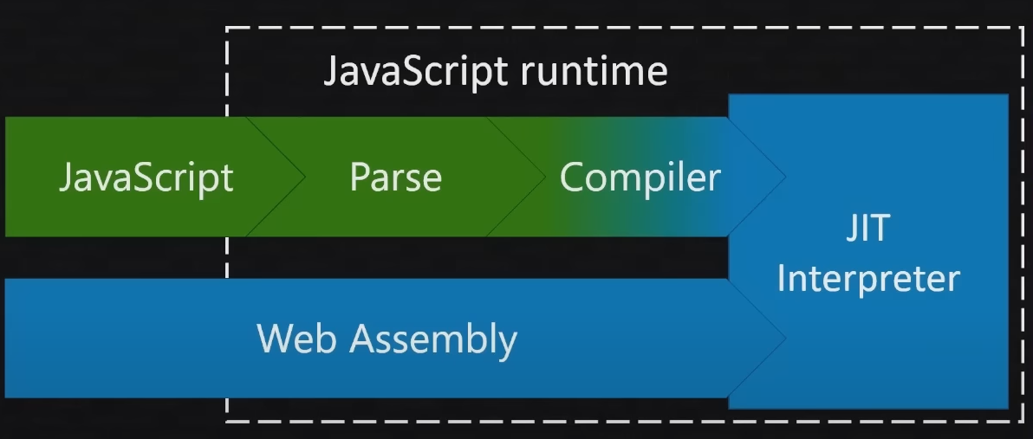
How does blazor webassembly work?
Notes:
Javascript will work a little bit here. It will compile and JIT will run code.
Also, web assembly do those steps. It seems like to be a kind of by pass

Slide 7
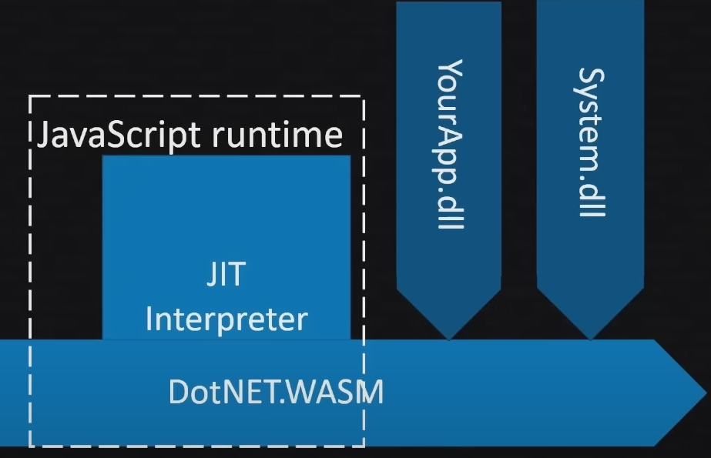
How does blazor webassembly work?
Notes:
We’re thinking that dotnet.WASM is running with whole our DLLs inside browser. That is a cool thinking, if it is, we’ll have an amount large file. That is probably wrong a bit.
Another explain way, at go ahead time is compilation we can remove all DLLs and put everything, compile everything to webassembly

Slide 8
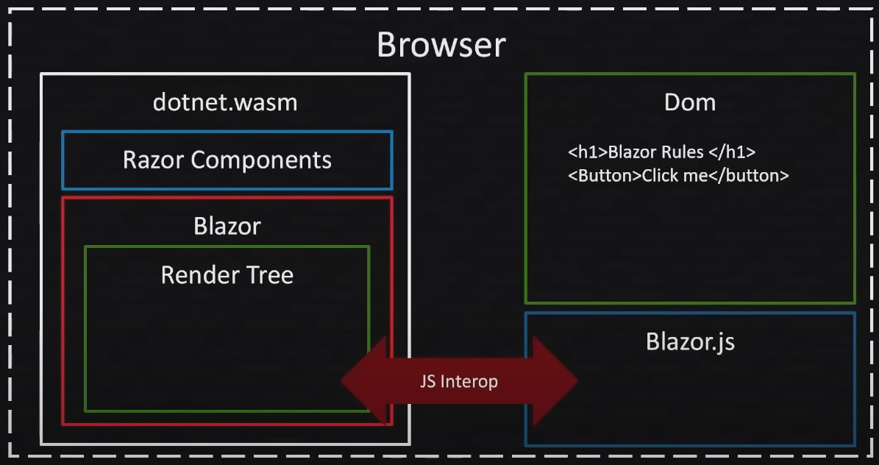
How does blazor webassembly work?
Notes:
As webserver, it only change hosting. Now all things is inside browser. WebAssembly also don’t work directly with DOM that it access to DOM via JS Interop instead of SignalR

Slide 9
What WASM?
Not a Language
Not a Compiler
Virtual machine
Target for compilers, just like an OS
Code compiled to WASM binary
Near native speed
Notes:
Did people hear about http3 protocol, this is protocol which support for wasm. It helps to increase performance for web. WASM outside work on the browser. It also desirable to be able to execute well in other environments (IoT devices, mobile/desktop apps, or embedded with larger programs)

Slide 10
Benefit of Blazor WASM
Faster UI Code
Offline Support
Server Not Required
Any .NET standard 2 C#
Notes:
Did people hear about http3 protocol, this is protocol which support for wasm. It helps to increase performance for web. WASM outside work on the browser. It also desirable to be able to execute well in other environments (IoT devices, mobile/desktop apps, or embedded with larger programs)

Slide 11
How secure is WASM?
More secure than Javascript
No direct DOM access
Send message to JS Handler
JS interacts with DOM
Notes:
Did people hear about http3 protocol, this is protocol which support for wasm. It helps to increase performance for web. WASM outside work on the browser. It also desirable to be able to execute well in other environments (IoT devices, mobile/desktop apps, or embedded with larger programs)

Slide 12
BLAZOR SERVER

Slide 13
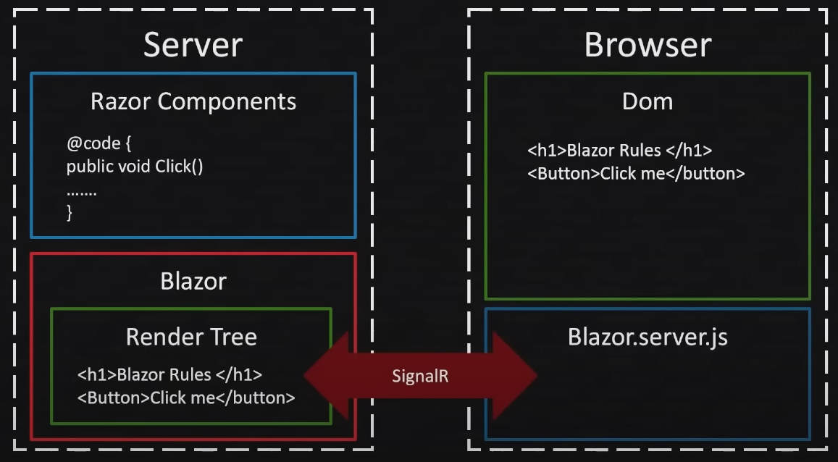
Blazor server
BLAZOR SERVER

Slide 14
Blazor Server Demo
Install packages:
System.ServiceModel.Syndication (to read feed data)
Create 2 files: BlogPost.cs and BlogDataManager.cs to read feed data.
Update Index.razor file to display the feed data

Slide 15
Window MAUI BLAZOR HYBRID

Slide 16
Window maui blazor hybrid
Install packages:
System.ServiceModel.Syndication (to read feed data)
Copy 2 files: BlogPost.cs and BlogDataManager.cs from the blazor server project.
Update Home.razor file to display the feed data

Slide 17
Window Forms Project

Slide 18
Window forms project
Install packages:
System.ServiceModel.Syndication (to read feed data)
Microsoft.AspNetCore.Components.WebView.WindowsForms
Copy 2 files: BlogPost.cs and BlogDataManager.cs from the blazor server project.

Slide 19
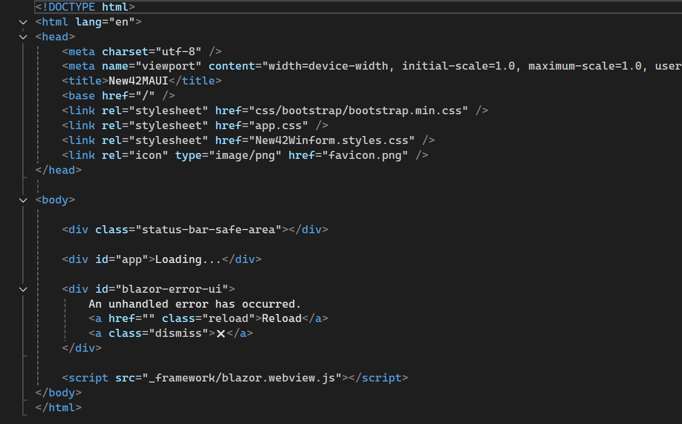
Window forms project
Create wwwroot folder and index.html as below

Slide 20
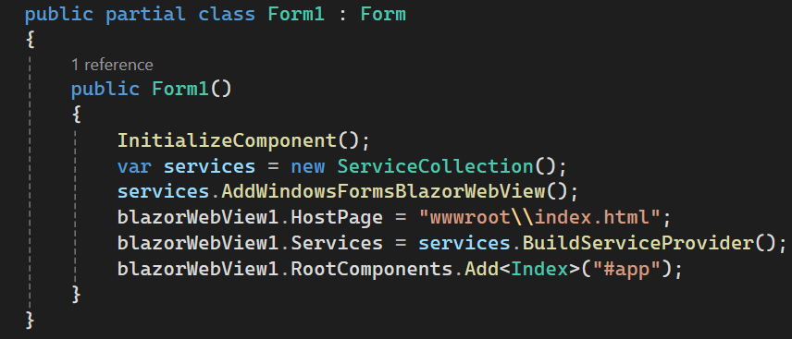
Window forms project
Update Form1.cs

Slide 21
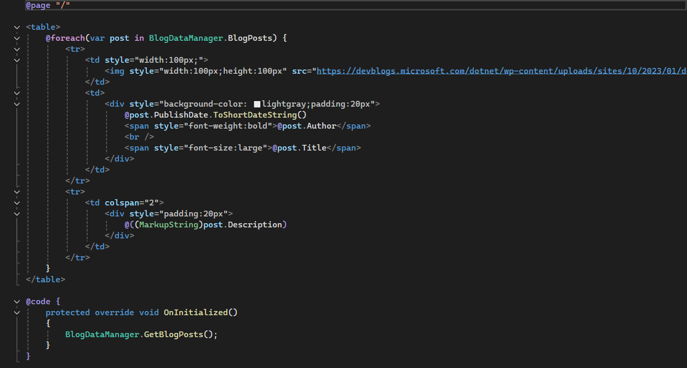
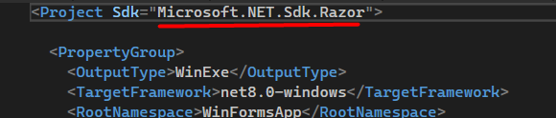
Window forms project
Create Index.razor at project folder
Don’t forget update project file

Slide 22
WPF Project

Slide 23
WPF Project
Install packages:
System.ServiceModel.Syndication (to read feed data)
Microsoft.AspNetCore.Components.WebView.Wpf
Copy 2 files: BlogPost.cs and BlogDataManager.cs from the blazor server project.

Slide 24
WPF project
Create wwwroot folder and index.html as below

Slide 25
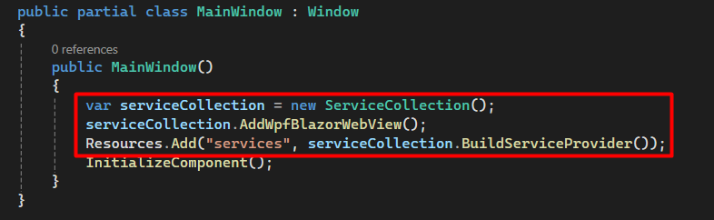
WPF project
Update MainWindow.xaml.cs

Slide 26
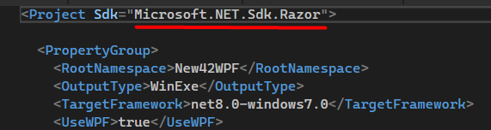
WPF project
Create Index.razor in the project folder as the Window Forms project
Don’t forget update project file

Slide 27
Blazor with MVC

Slide 28
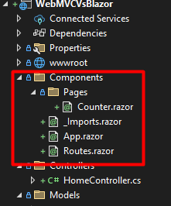
Blazor with mvc
Create folder tree as side image
_imports.razor, App.razor, Routes.razor
Component: Counter.razor

Slide 29
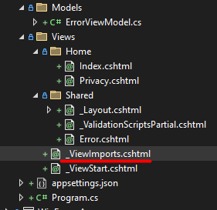
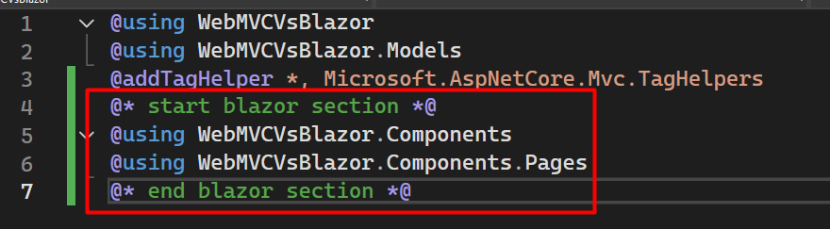
Blazor with mvc
Config the _ViewImports.cshtml

Slide 30
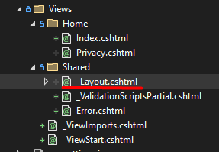
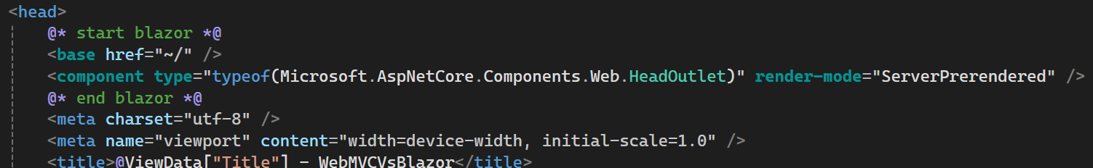
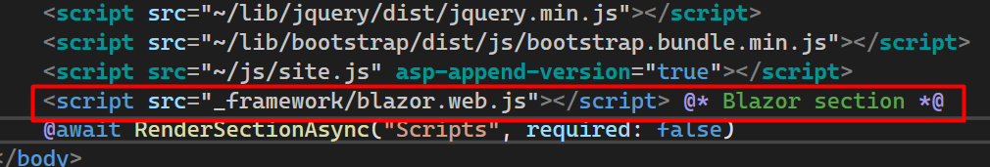
Blazor with mvc
Setting the _Layout.cshtml as following

Slide 31
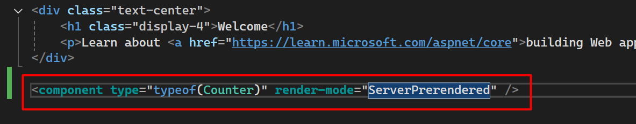
Blazor with mvc
Insert Counter component into index.cshtml

Slide 32
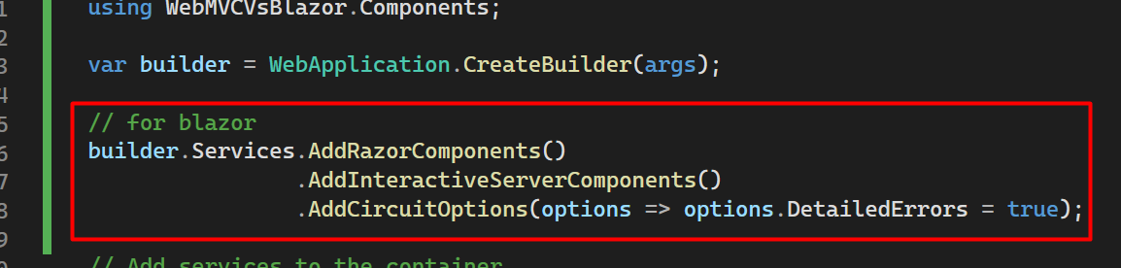
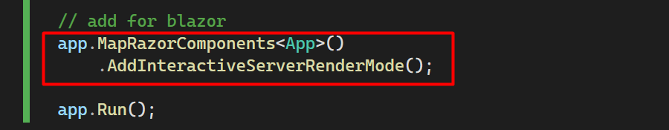
Blazor with mvc
Setting for program.cs

Slide 33
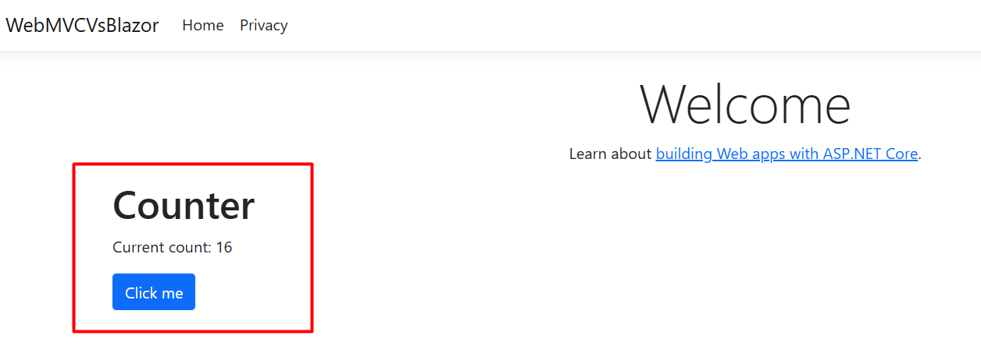
Blazor with mvc
Run applicaton and the result as below

Slide 34
Blazor cross platform
Q&A

Slide 35
Reference
https://learn.microsoft.com/en-us/aspnet/core/blazor/?view=aspnetcore-7.0&WT.mc_id=dotnet-35129-website
https://www.youtube.com/watch?v=rfPQytn7tfk
https://www.youtube.com/watch?v=dsoGW59Vtpk

