Slide 1

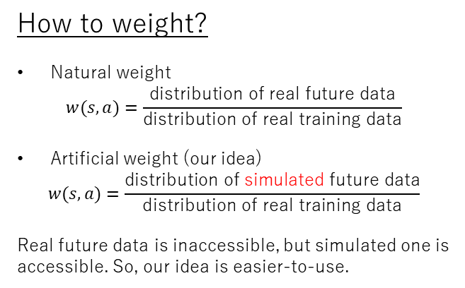
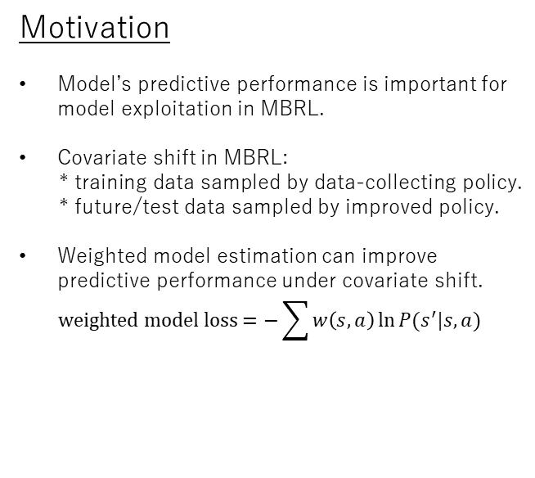
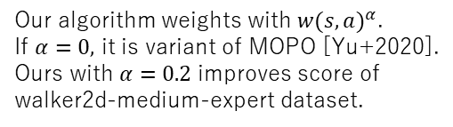
Weighted model estimation for offline model-based reinforcement learning
Toru Hishinuma, Kei Senda
Motivation
Model’s predictive performance is important for model exploitation in MBRL.
Covariate shift in MBRL:
* training data sampled by data-collecting policy.
* future/test data sampled by improved policy.
Weighted model estimation can improve predictive performance under covariate shift.
$$weighted model loss=−\sum{w\left(s,a\right)\ln{P(s^{′}|s,a)}}$$
How to weight?
Natural weight
$$w(s,a)=\frac{\text{distribution} \text{of} \text{real} \text{future} \text{data}}{\text{distribution} \text{of} \text{real} \text{training} \text{data}}$$
Artificial weight (our idea)
$$w(s,a)=\frac{\text{distribution} \text{of} \text{simulated} \text{future} \text{data}}{\text{distribution} \text{of} \text{real} \text{training} \text{data}}$$
Real future data is inaccessible, but simulated one is accessible. So, our idea is easier-to-use.
Summary of our algorithm
EM-style optimization:
* E-step: weighted model estimation.
* M-step: policy optimization in simulation.
Our idea of weighting is justified as evaluating upper bound of policy evaluation error.
Experiments
Future issues
Extension to Bayesian MBRL, by defining posterior distribution based on log-likelihood weighted with artificial weight.
Combining with loss function in decision-aware model learning approaches.
Model selection based on loss function weighted with artificial weight.
Addressing far extrapolation.
Pendulum swing-up prediction using small NNs
D4RL MuJoCo benchmark
Color markers show training data and its weight.
Black markers show simulated future data.
Unweighted model estimation (left fig) cannot capture swing-up. Weighted model estimation (right fig) can do.
Our algorithm weights with ${w(s,a)}^{α}$.
If $α=0,$ it is variant of MOPO [Yu+2020].
Ours with $α=0.2$ improves score of walker2d-medium-expert dataset.

