Slide 1
Weighted model estimation for offline model-based reinforcement learning
Toru Hishinuma and Kei Senda
Kyoto University

Slide 2
Background
Offline model-based reinforcement learning.
(RL using environment model and previously collected offline data)
Typical approach:
1. Estimating model by standard supervised learning.
2. Planning policy using estimated model.
Issue:
Model estimation without considering covariate shift.
* Training data (offline data) is sampled using data-collecting policy.
* Test data (real future data) is sampled using newly planned policy.

Slide 3
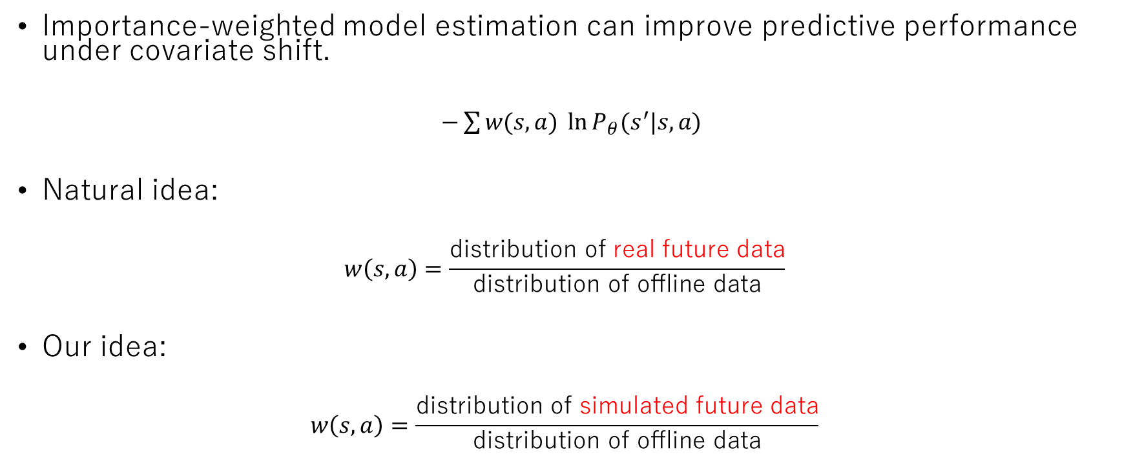
Key idea
Importance-weighted model estimation can improve predictive performance under covariate shift.
$−\sum{w(s,a) \ln{P_{θ}(s^{′}|s,a)}}$
Natural idea:
$$w\left(s,a\right)=\frac{\text{distribution} \text{of} \text{real} \text{future} \text{data}}{\text{distribution} \text{of} \text{offline} \text{data}}$$
Our idea:
$$w\left(s,a\right)=\frac{\text{distribution} \text{of} \text{simulated} \text{future} \text{data}}{\text{distribution} \text{of} \text{offline} \text{data}}$$

Slide 4
Key idea
Importance-weighted model estimation can improve predictive performance under covariate shift.
$−\sum{w(s,a) \ln{P_{θ}(s^{′}|s,a)}}$
Natural idea:
$$w\left(s,a\right)=\frac{\text{distribution} \text{of} \text{real} \text{future} \text{data}}{\text{distribution} \text{of} \text{offline} \text{data}}$$
Our idea:
$$w\left(s,a\right)=\frac{\text{distribution} \text{of} \text{simulated} \text{future} \text{data}}{\text{distribution} \text{of} \text{offline} \text{data}}$$
We cannot access real future data. Estimating this weight is one of challenges in off-policy evaluation in RL. This weight is not easy-to-use.

Slide 5
Key idea
Importance-weighted model estimation can improve predictive performance under covariate shift.
$−\sum{w(s,a) \ln{P_{θ}(s^{′}|s,a)}}$
Natural idea:
$$w\left(s,a\right)=\frac{\text{distribution} \text{of} \text{real} \text{future} \text{data}}{\text{distribution} \text{of} \text{offline} \text{data}}$$
Our idea:
$$w\left(s,a\right)=\frac{\text{distribution} \text{of} \text{simulated} \text{future} \text{data}}{\text{distribution} \text{of} \text{offline} \text{data}}$$
We can generate simulated future data in simulation. Estimating this weight is ratio estimation in supervised learning. This weight is easier-to-use.

Slide 6
Question
Our idea may not seem natural from viewpoint of covariate shift. Is it valid?

Slide 7

Justification
Our idea can be seen evaluating upper bound of policy evaluation error.
$$\left|η\left(P_{θ},π\right)−η\left(P_{∗},π\right)\right| ≤ B\sqrt{E\left[−w\left(s,a\right)\ln{P_{θ}\left(s^{′} | s,a\right)}\right]−const}$$

Slide 8
Justification: derivation
Policy evaluation error
Telescoping Lemma
[Luo+2019]
Holder inequality
Pinsker inequality
+ Jensen inequality
Definition of minimum self-entropy
≒
Importance-weighted loss function

Slide 9
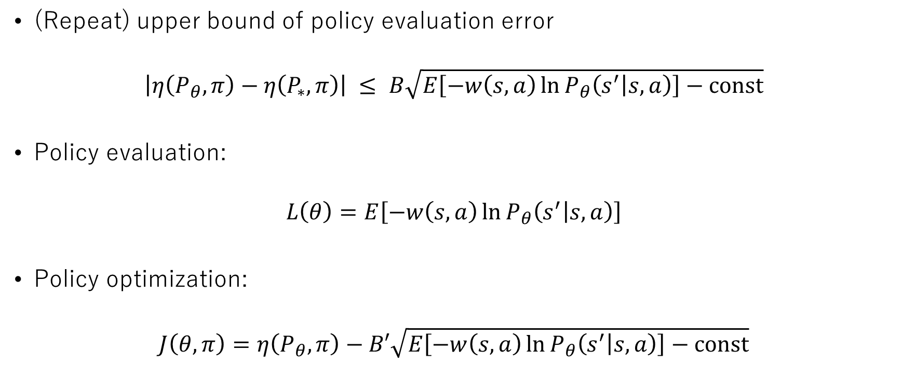
Loss functions
(Repeat) upper bound of policy evaluation error
$$\left|η\left(P_{θ},π\right)−η\left(P_{∗},π\right)\right| ≤ B\sqrt{E\left[−w\left(s,a\right)\ln{P_{θ}\left(s^{′} | s,a\right)}\right]−const}$$
Policy evaluation:
$$L\left(θ\right)=E\left[−w\left(s,a\right)\ln{P_{θ}\left(s^{′} | s,a\right)}\right]$$
Policy optimization:
$$J\left(θ,π\right)=η\left(P_{θ},π\right)−B′\sqrt{E\left[−w\left(s,a\right)\ln{P_{θ}\left(s^{′} | s,a\right)}\right]−const}$$

Slide 10

Algorithm: policy evaluation (full version)
Loss function:
$$L\left(θ\right)=E\left[−w_{θ}^{π}\left(s,a\right)\ln{P_{θ}\left(s^{′} | s,a\right)}\right]≈−\sum{w_{θ}^{π}\left(s,a\right)\ln{P_{θ}\left(s^{′} | s,a\right)}}$$
Gradient-based optimization:
$$∇L\left(θ\right)≈−\sum{w_{θ}^{π}\left(s,a\right)\left\{∇\ln{P_{θ}\left(s^{′} | s,a\right)}+\ln{P_{θ}\left(s^{′} | s,a\right)}∇\ln{d(s)}\right\}}$$
Ratio estimation for supervised learning
Extension of LSDG [Morimura+2010]

Slide 11
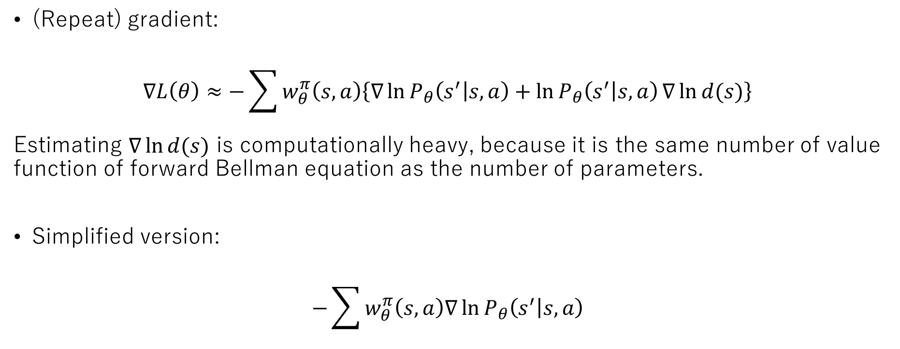
Algorithm: policy evaluation (simplified version)
(Repeat) gradient:
$$∇L\left(θ\right)≈−\sum{w_{θ}^{π}\left(s,a\right)\left\{∇\ln{P_{θ}\left(s^{′} | s,a\right)}+\ln{P_{θ}\left(s^{′} | s,a\right)}∇\ln{d(s)}\right\}}$$
Estimating $∇\ln{d(s)}$ is computationally heavy, because it is the same number of value function of forward Bellman equation as the number of parameters.
Simplified version:
$$−\sum{w_{θ}^{π}\left(s,a\right)∇\ln{P_{θ}\left(s^{′} | s,a\right)}}$$

Slide 12
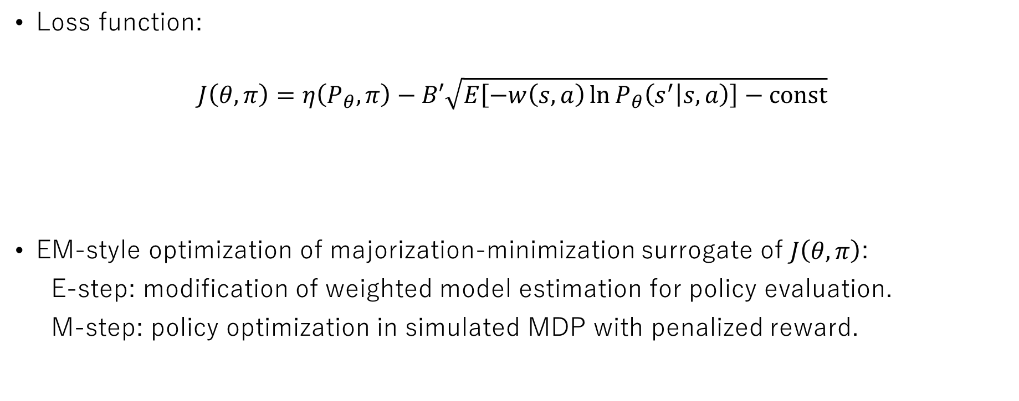
Algorithm: policy optimization
Loss function:
$$J\left(θ,π\right)=η\left(P_{θ},π\right)−B′\sqrt{E\left[−w\left(s,a\right)\ln{P_{θ}\left(s^{′} | s,a\right)}\right]−const}$$
EM-style optimization of majorization-minimization surrogate of $J\left(θ,π\right)$:
E-step: modification of weighted model estimation for policy evaluation.
M-step: policy optimization in simulated MDP with penalized reward.
Model expected return
Penalty for policy evaluation error

Slide 13
Pendulum swing-up prediction using small NNs
Fig (a)
Fig (b)
Fig (c)
Fig (a) shows real future data obtained using optimal policy.
The goal is to predict swing-up.
Fig (b) shows result of standard supervised learning.
Fig (c) shows result of weighted model estimation.
Black markers are simulated future data.
Colored markers are offline data, where coloring indicates importance weighting.
Fig (b) cannot capture swing-up, because small NNs cannot generalize globally.
Fig (c) can capture swing-up, because small NNs can generalize locally around swing-up behavior, based on importance weighting.
×
〇

Slide 14
D4RL MuJoCo benchmark
Our EM-style algorithm
Our EM-style algorithm improves performance for walker2d-medium-expert dataset.

Slide 15
Limitation
Full version of our algorithm is derived from theory, but it cannot be applied to large-scale problems due to large amount of computation.
Simplified version of our algorithm is practical, but it has no convergence with respect to loss function.

Slide 16
Conclusion
We discuss model estimation considering covariate shift in offline MBRL.
Our idea is importance-weighting with distribution ratio of offline data and simulated future data.
Question: our idea may not seem natural. Is it valid?
Our idea is justified as evaluating upper bound of policy evaluation error.
We propose EM-style algorithm based on our idea. It improves performance in numerical experiments.

Slide 17
Future issues
Extension to Bayesian MBRL.
Combining with loss functions in decision-aware model learning approaches.
Model selection based on importance-weighted loss function.
Addressing extrapolation.

Slide 18
References
Levine et al. Offline reinforcement learning: Tutorial, review, and perspectives on open problems. 2020.
Luo et al. Algorithmic framework for model-based deep reinforcement learning with theoretical guarantees. 2019.
Morimura et al. Derivatives of logarithmic stationary distributions for policy gradient reinforcement learning. 2010.
Yu et al. MOPO: Model-based offline policy optimization. 2020.

